Slide 1

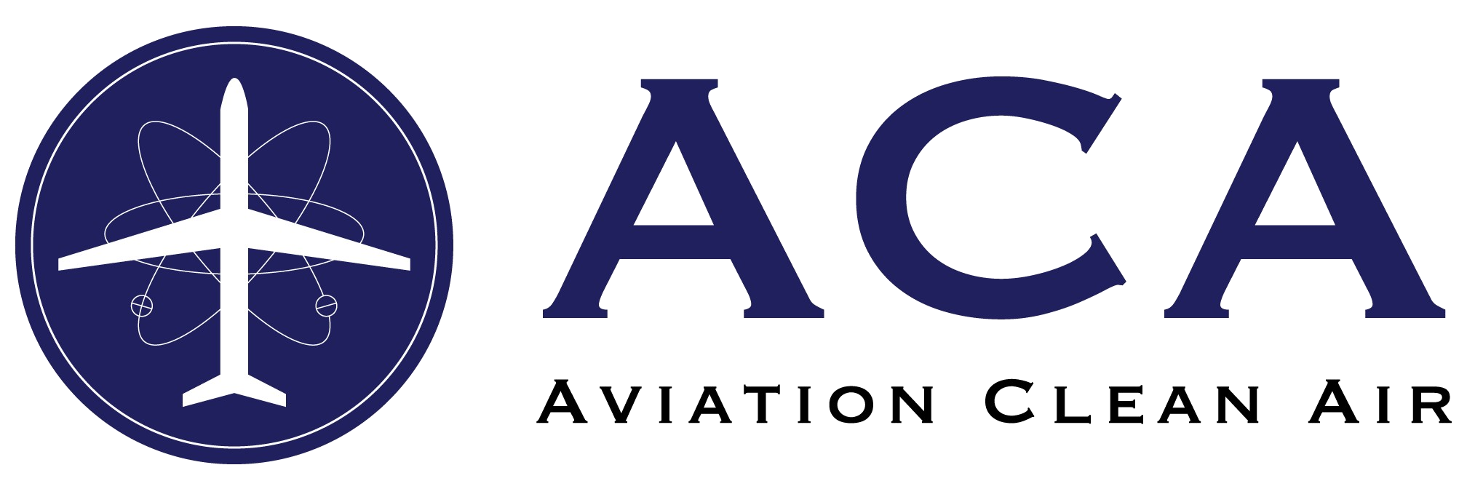

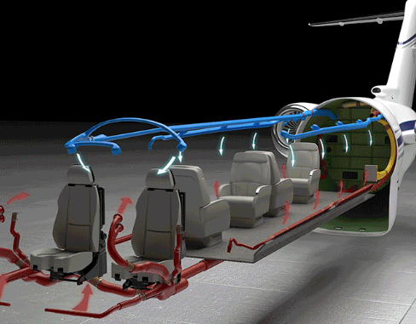

CLEANING THE AIR WE BREATHE IN FLIGHT
Give Your VVIP Passengers and Crew Every Possible Protection
Peregrine Avionics has obtained an Approved Model List Supplemental Type Certificate (AML STC) for the installation of the ACA Needle Point Bipolar Ionization (NPBI™) system in Gulfstream G-IV, Challenger 600 Series and Dassault Falcon 50 and 900 aircraft models. The ACA system ionizes cabin air to combat a broad range of contaminants including mold, bacteria and viruses, including COVID-19. The ACA website provides additional detail, technical information and laboratory testing data; see: www.aviationcleanair.com
The ACA system integrates with the aircraft environmental control system and provides continuous ion generation treating both incoming and any recirculated air. The system adds peace of mind for your passengers and crew as part of a layered protection system.
STC licenses and installation kits can be obtained from Peregrine Avionics with hardware delivered by Lee Aerospace. For more information, please contact us through our website, peregrine.aero or contact us directly at +1 (303) 325-3873
NPBI treated air
peregrine.aero +1 (303) 325-3873 .
Aircraft Systems Engineering & Certification

