Slide 1

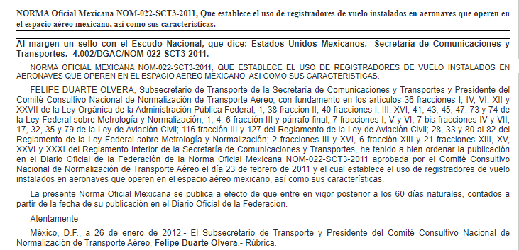

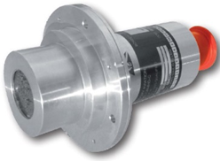
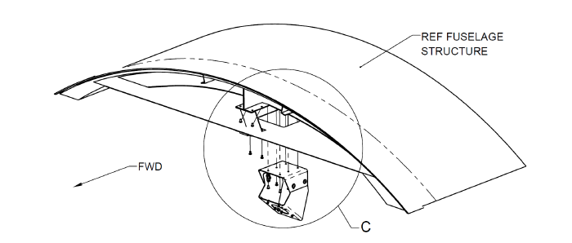
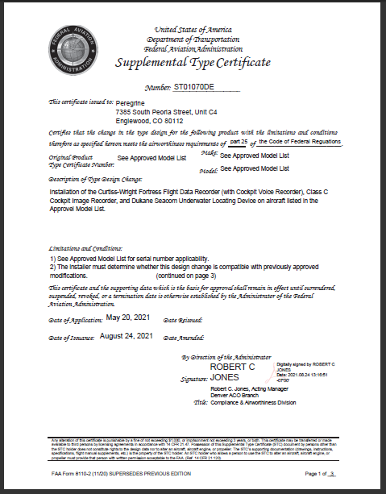
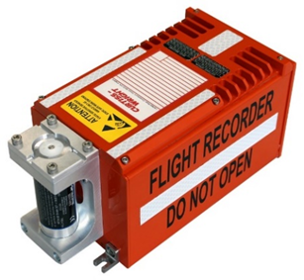
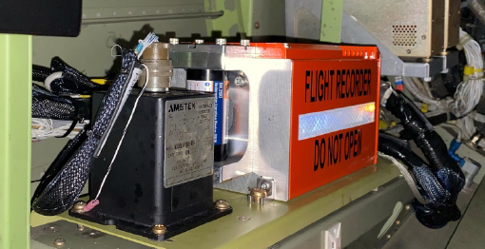
Installation of the Curtiss-Wright Fortress Flight Data Recorder (with Cockpit Voice Recorder), Class C Cockpit Image Recorder, and Dukane Seacom Underwater Locating
Regulation
NOM‑022‑SCT3 2011
Cockpit Image Recorder Camera
Flight Data Recorder with Cockpit Voice and Cabin Airborne Image Recording functions
Curtiss-Wright, SoCal Jets, Inc. and Peregrine Avionics have developed a solution to meet the requirements for recorders as outlined by the Federal Civil Aviation of Mexico, AFAC, for the operation of Part 25 aircraft in Mexico Airspace.
Solution
Approved Model List:
BAe.125 Series 800A, 800B, 1000A, 1000B
Hawker 750, 800, 800XP, 850XP, 900XP, 1000
Learjet 31, 31, 35, 35A (C-21A), 36, 36, 36A, 45
Cessna 750
Under certain regulatory bodies, Class C recorders are allowed as a means for recording flight data where it is not practical or prohibitively expensive to record on an FDR, or where an FDR is not required. This AML STC offers an economical means of complying with the new AFAC and ICAO requirements.

