Slide 1
AviaGlobal recommends a restructuring of the website to merge STC/Product and Project pages, with new material developed around projects in progress, to reinforce the core business message
  Focus should be on enhancing content related to project achievements and blog entries
  Enhance depth of new Peregrine scope content including current in-progress project presentations; focus website on attracting new project clients
  Website could be personalized with addition of a Peregrine Management blog, in addition to the current news feed

Slide 2
STCs and Projects
Peregrine STCs: your engineering leverage
- Experts
- Timely
- Free up your resources
26 STCS, Transport (Part 25), Rotorcraft (part 27 & 29) and Normal (Part 23)
21 different equipment models
100 Makes
2200 Aircraft Models
4 different Air Agencies (FAA, ANAC, AFAC, Transport Canada)
New project focus:
Ajax avionics contracted with Peregrine for an AML STC for a 666-01-01
Seat heater for arctic operations…
Recent projects:
COVID disinfections, ADS-B, TCAS II
STCs

Slide 3
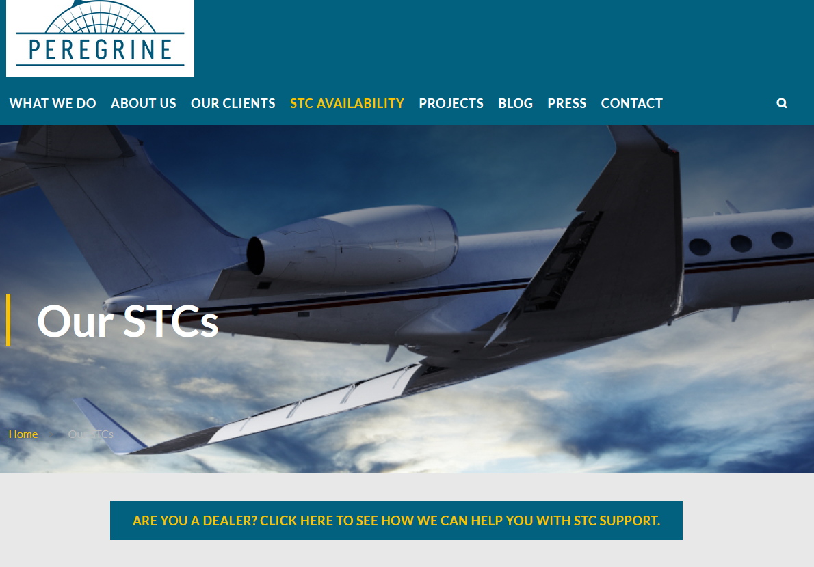
And Projects
Peregrine’s expertise and experience can bring your certification and engineering projects to market with cost-effective speed and efficiency, allowing your company resources to focus on your core business
Explore our STC portfolio
Explore our projects

Slide 4
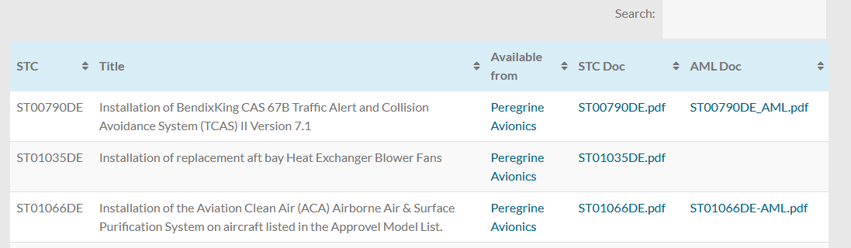
Explore our STC portfolio
26 STCS, Transport (Part 25), Rotorcraft (part 27 & 29) and Normal (Part 23)
21 different equipment models
100 Makes
2200 Aircraft Models
4 different Air Agencies (FAA, ANAC, AFAC, Transport Canada)
Transport Category STCs
Rotorcraft Category STCs
Normal Category STCs

Slide 5
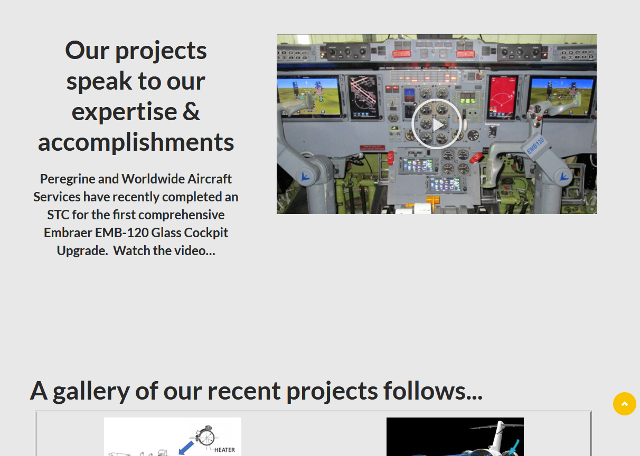
Explore our Projects

