Slide 1
And Projects
Peregrine’s expertise and experience can bring your certification and engineering projects to market with cost-effective speed and efficiency, allowing your company resources to focus on your core business
Explore our STC portfolio
Explore our projects
On the Horizon

Slide 2
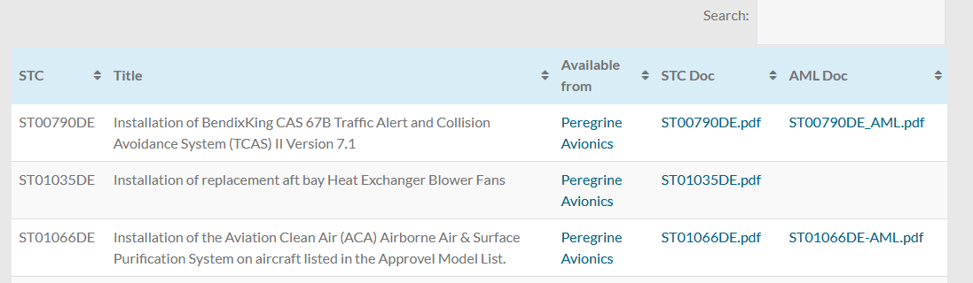
Explore our STC portfolio
26 STCS, Transport (Part 25), Rotorcraft (part 27 & 29) and Normal (Part 23)
21 different equipment models
100 Makes
2200 Aircraft Models
Air agencies around the world: FAA, ANAC, AFAC, Transport Canada, Columbia, India, Venezuala
Transport Category STCs
Rotorcraft Category STCs
Normal Category STCs

Slide 3
Explore our Projects

Slide 4
Explore our Projects

Slide 5
On the Horizon
Peregrine is currently engaged with a number of customers to certify and create STCs for a variety of projects;
… we just can’t talk about them
We would like to talk to you about how you can take advantage of Peregrine expertise to give your products a market edge
Part 23 and Part 25 Avionics
Sensors
Comm and nav AML STC
Flight control systems
Part 25 and Part 23 Advanced Technology power systems
Batteries
Emergency power supplies
Part 25 and Part 23 Displays and Part 25 Recorder System
Engine displays
Modernized indicators
CVR and FDR applications

Slide 6
BUY NOW:
BUY NOW:
ST00790DE Installation of BendixKing CAS 67B Traffic Alert and Collision Avoidance System (TCAS) II Version 7.1
ST01035DE Installation of replacement aft bay Heat Exchanger Blower Fans
ST01066DE Installation of the Aviation Clean Air (ACA) Airborne Air & Surface Purification System on aircraft listed in the Approvel Model List.
ST01075DE Installation of Supplemental Flap/Slat Actuator Heater System
SR00828DE Installation of Automatic Dependent Surveillance – Broadcast (ADS-B) Out functionality using the Garmin G330ES or G33H ES Transponder and qualified position sensor
SR00851DE Installation of Automatic Dependent Surveillance – Broadcast (ADS-B) Out functionality using the Garmin GTX 330ES transponder and a qualified position sensor
BUY NOW

