Slide 1
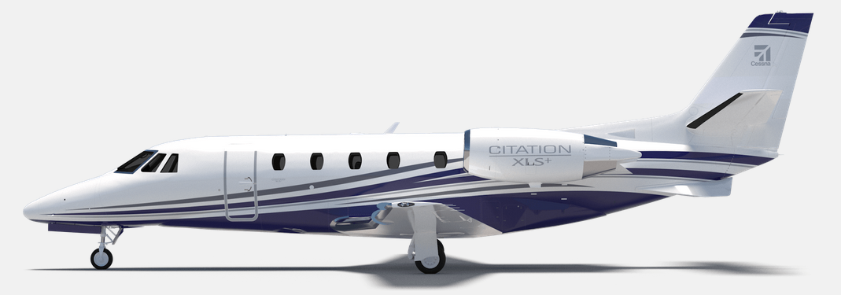
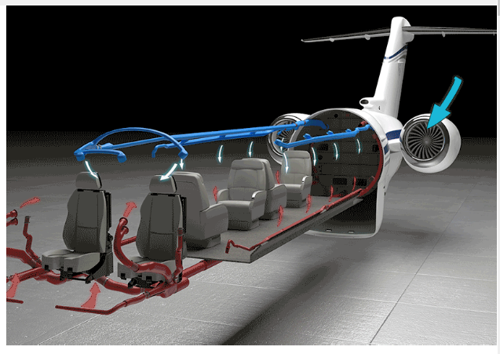
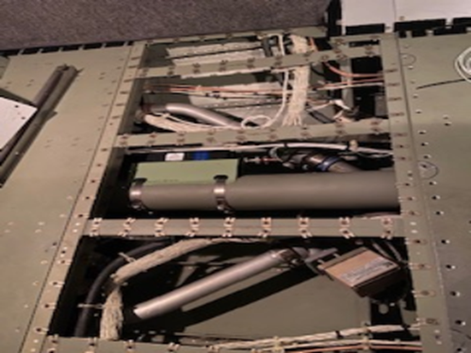
ACA System

Slide 2
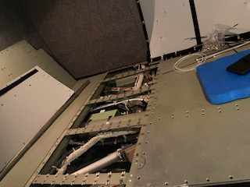
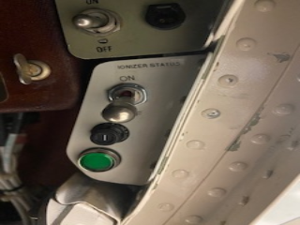
Example installation in Cessna 650XL baggage compartment
Power switch, status light and breaker
Underfloor installation

Slide 3
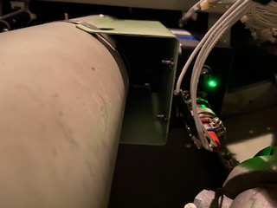
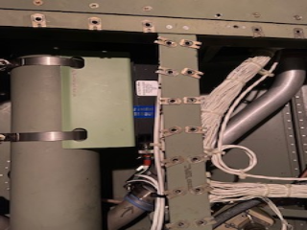
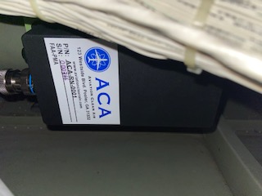
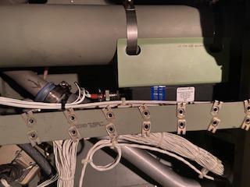
ACA needle point bipolar ionization system (NPBI™ ) system installed in fresh air duct feeding the cockpit and cabin of the aircraft
In other aircraft, one unit would be installed per ECS pack or source of fresh air feeding the cabin and cockpit.
The ACA units are a proactive air and surface purification technology installed in the aircraft environmental control system ductwork giving crew and passengers immediate clean, safe and healthy interior air. In addition to removing odors and allergens, its patented ionization technology kills pathogens throughout the cockpit and cabin including, but not limited to COVID 19, Bird Flu Virus (H5N1), Swine Flu Virus (H1N1), SARS Bacteria, Staph Bacteria, Mold Spores, MRSA, E.coli, T.B., C.diff, Pneumonia and more. Testing for SARS-CoV-2 (COVID-19) effectiveness validation performed by an independent laboratory demonstrates over 99% effectivity.

