Slide 1
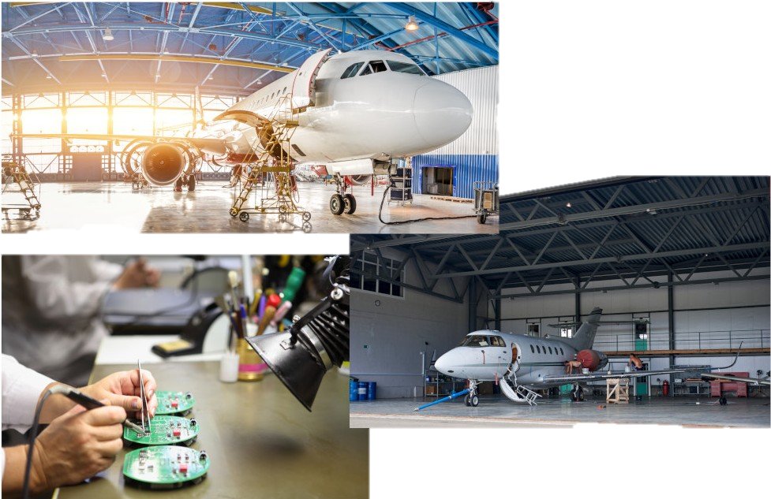
See us at AEA Booth 1206
Ask us about our ODA Project!
Trusted turnkey aircraft engineering solutions for: OEMs, owner/operators and Part 145 repair stations
Avionics
COVID-19 Elimination
Retrofit Displays
Complete Glass Cockpit
EMB-120
ADS-B Systems
Part 23, 25, 27, 29
CAS-67 TCAS II 7.1
Part 25 Airborne Image Recorder
Aircraft Systems
ACA Ionization STCs
Bombardier CL600 Series
Citation 560XL
Gulfstream GIV & GIV-SP
Flap/slat drive heater
G150
Hi-Rel Cooling blower
Hawker 4000
peregrine.aero
Over 10 Years Of Experience:
FAA, AFAC, EASA, ANAC Transport Canada & others
Part 23, 25, 27 and 29
AML STC
PMA
STC/TC
+1 (303) 325-3873
Peregrine Avionics LLC
7385 South Peoria Street, Unit C4
Englewood, CO 80112 USA

