Slide 1

Peregrine Web Analytics
Summary of Google Analytics Data
6 April – 11 May 2021
12 May 2021
Prepared by Forrest Colliver

Slide 2
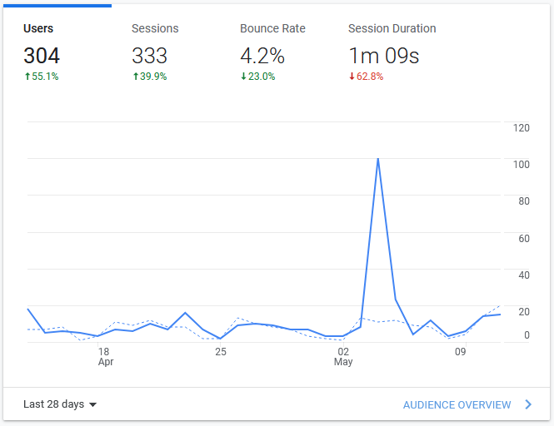
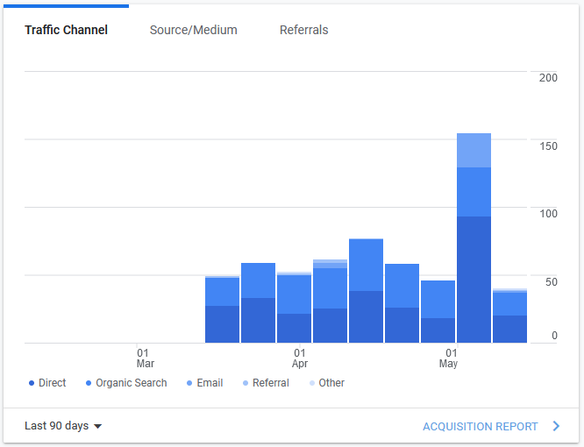
Audience Overview (28 Days)

Slide 3
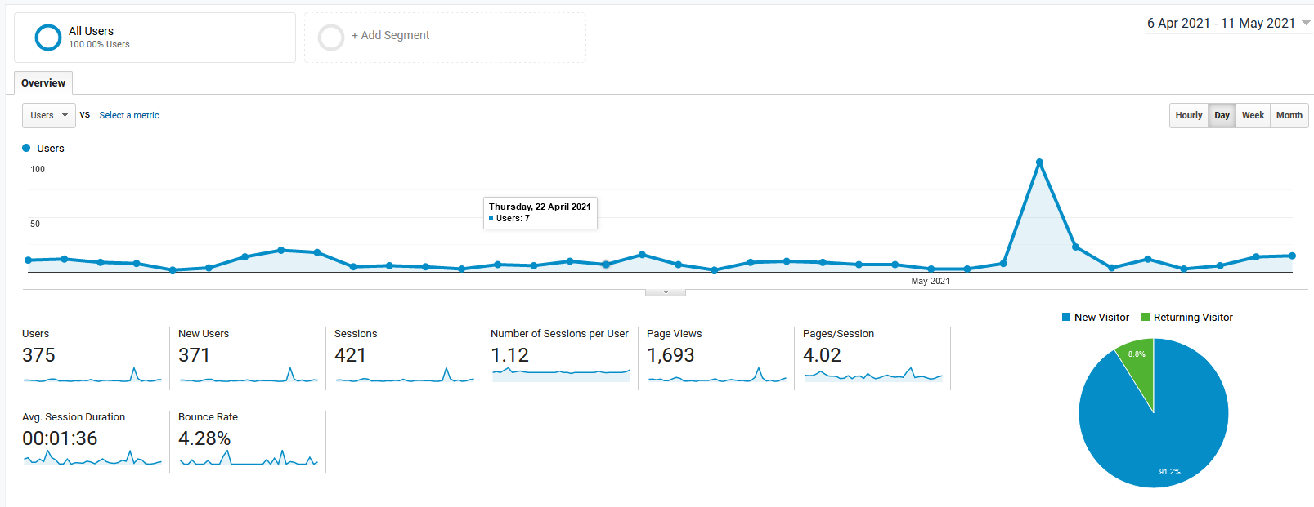
User Overview (28 Days)

Slide 4
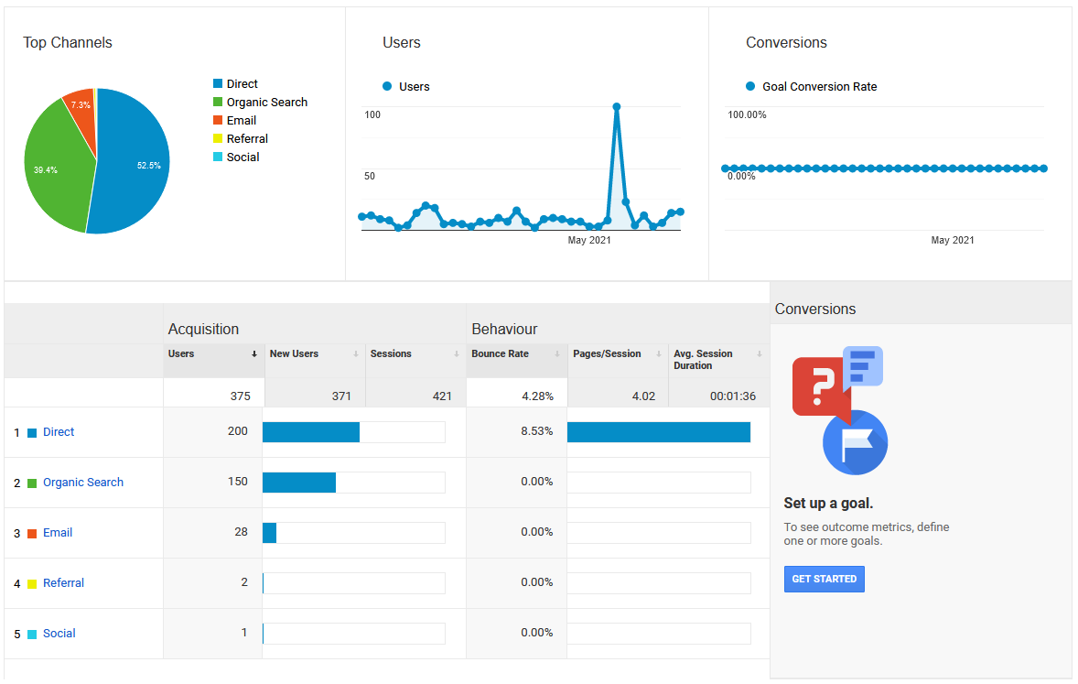
User Acquisition Overview (28 Days)

Slide 5
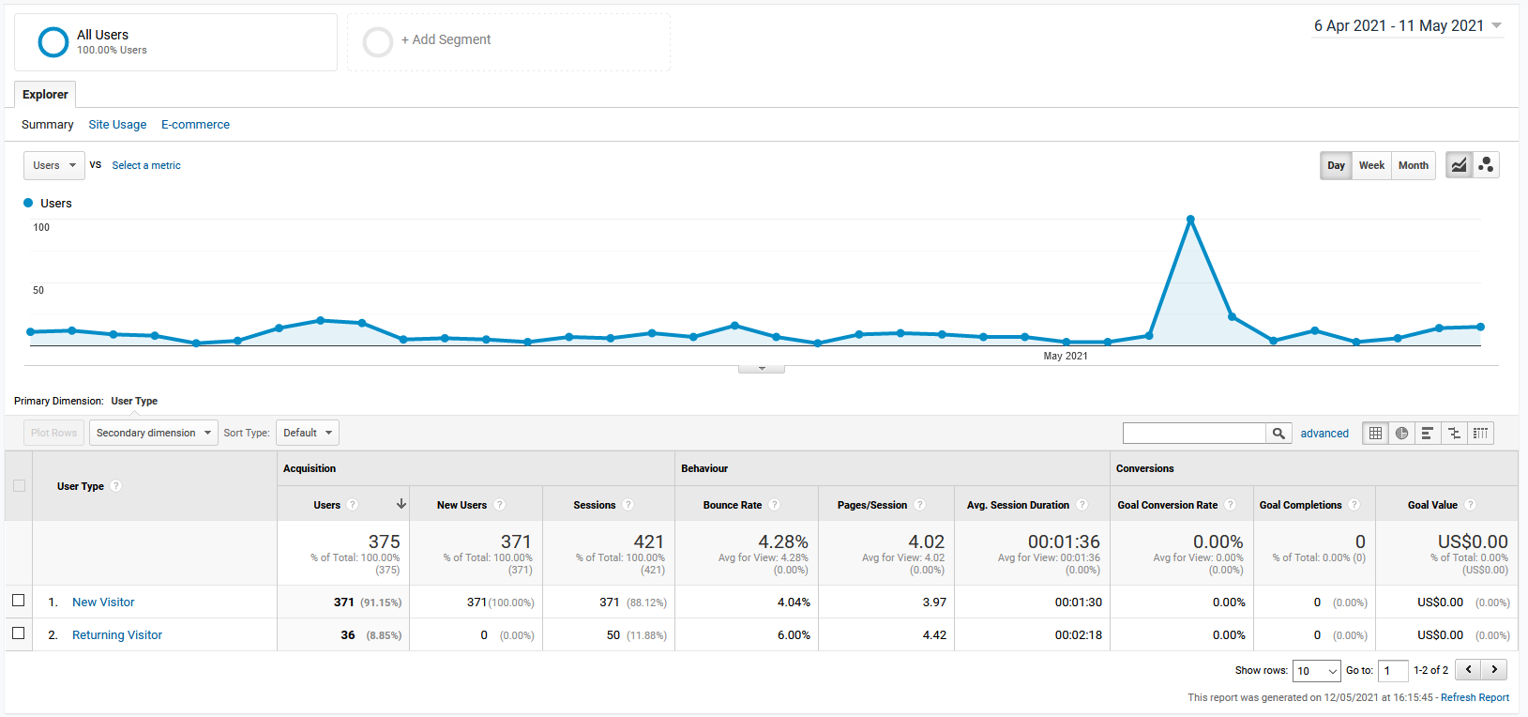
New vs. Returning Visitors (28 Days)

Slide 6
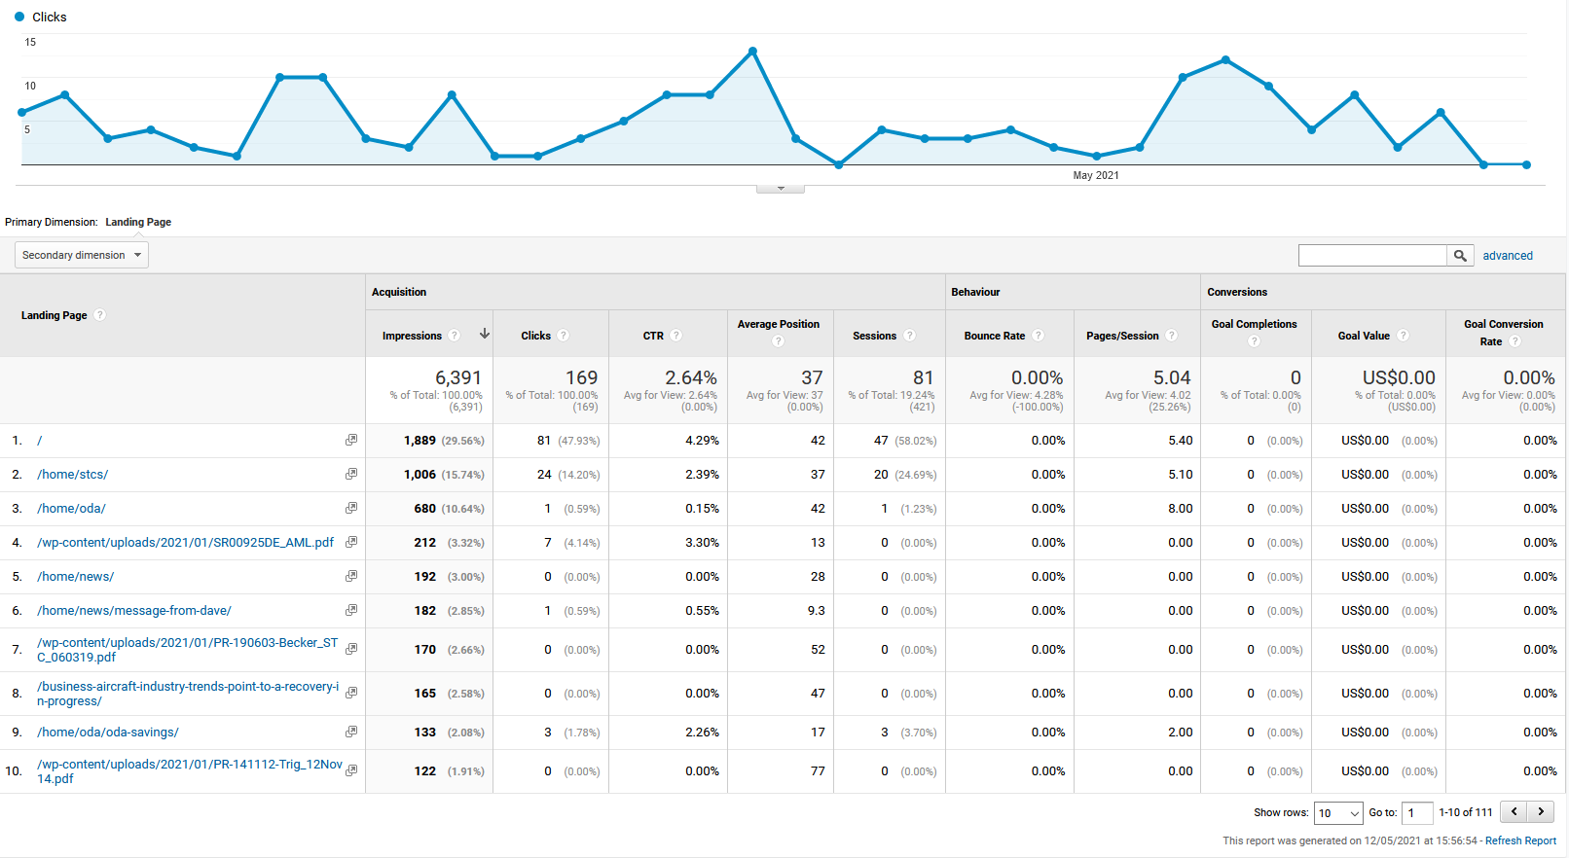
Clicks by Search Landing Pages (28 Days)

Slide 7
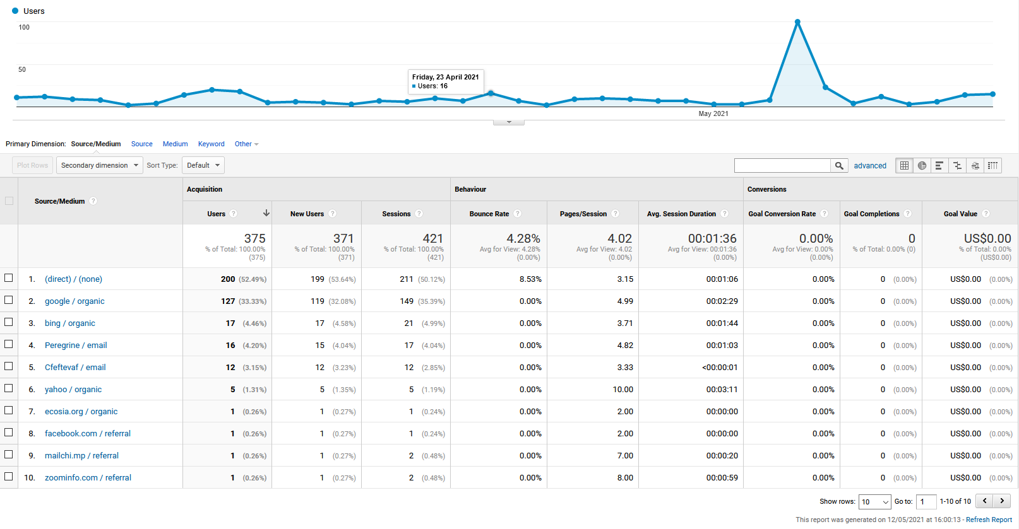
Clicks by Search Sources (28 Days)

Slide 8
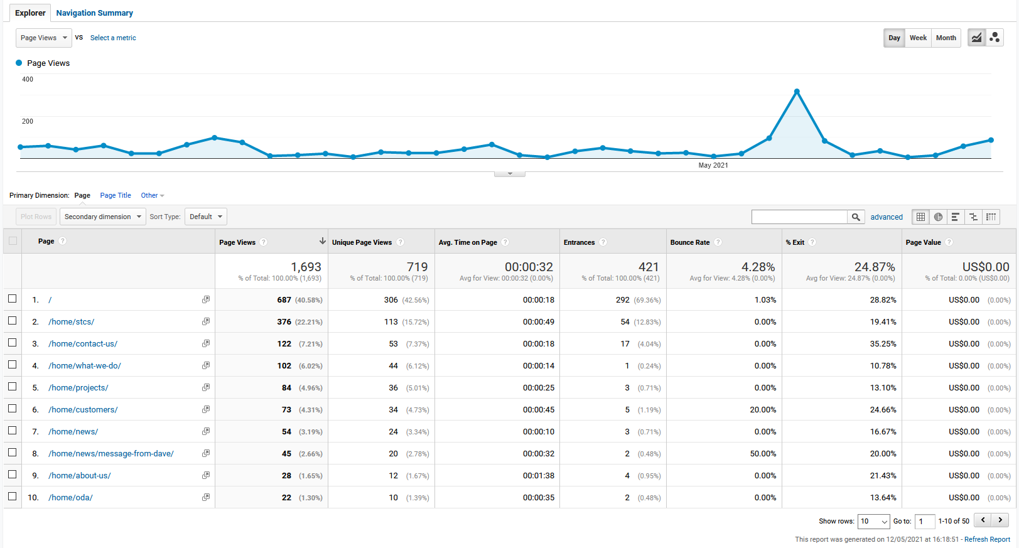
Site Content Behavior (28 Days)

Slide 9
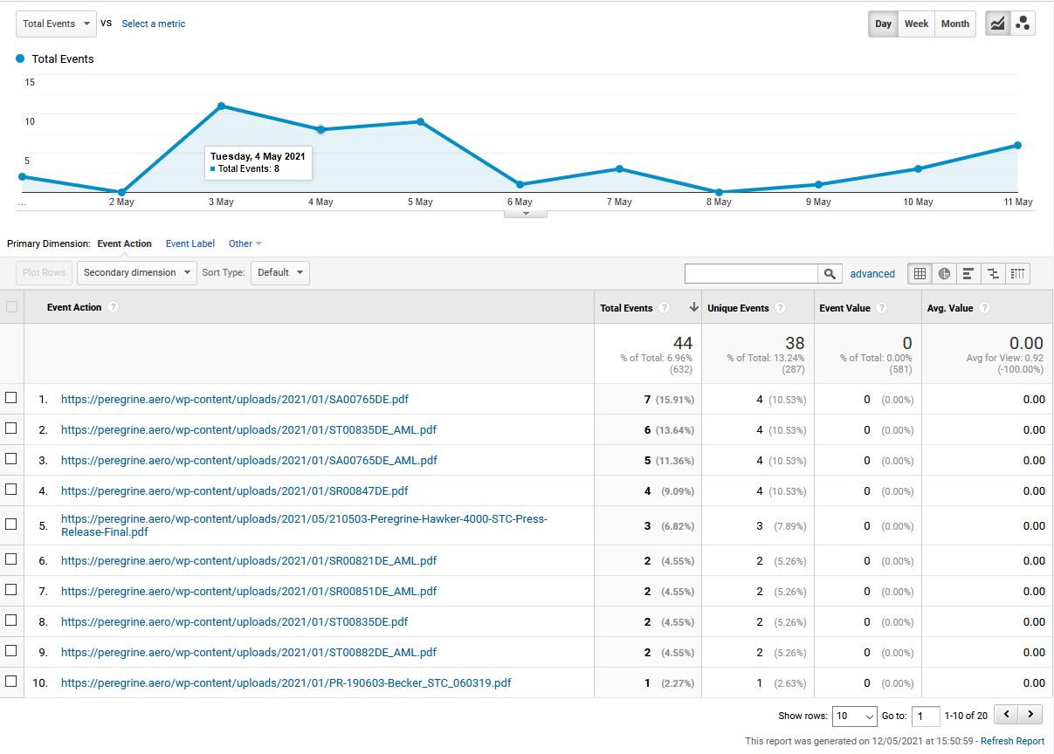
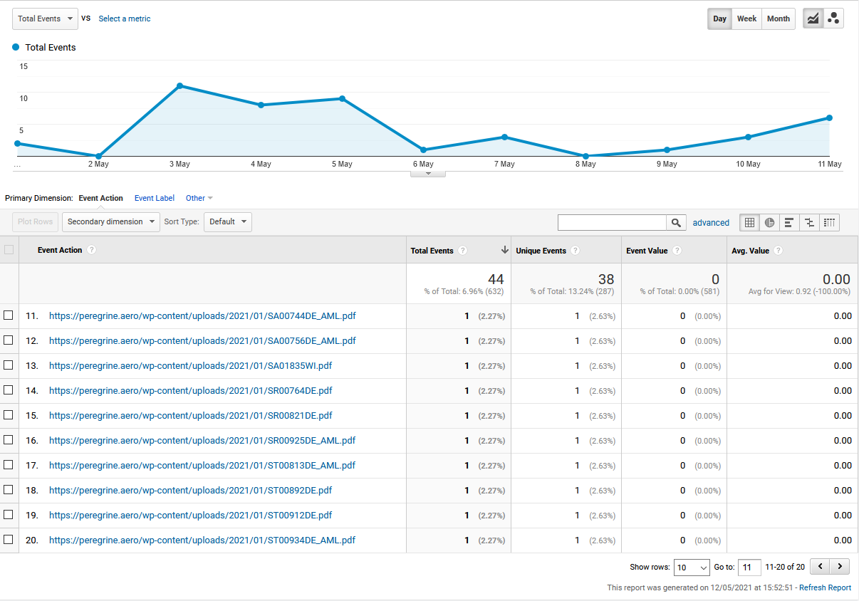
Downloads (Last 7 Days)

Slide 10
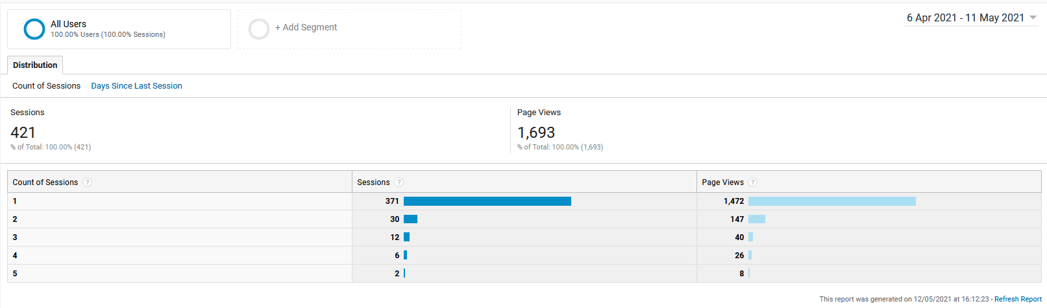
Frequency & Recency (28 Days)

Slide 11
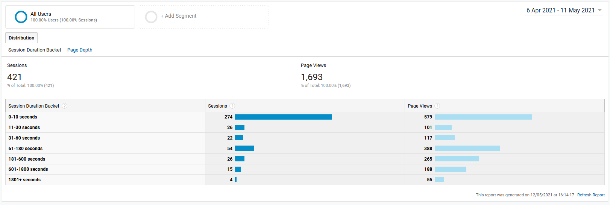
User Engagement (28 Days)

Slide 12
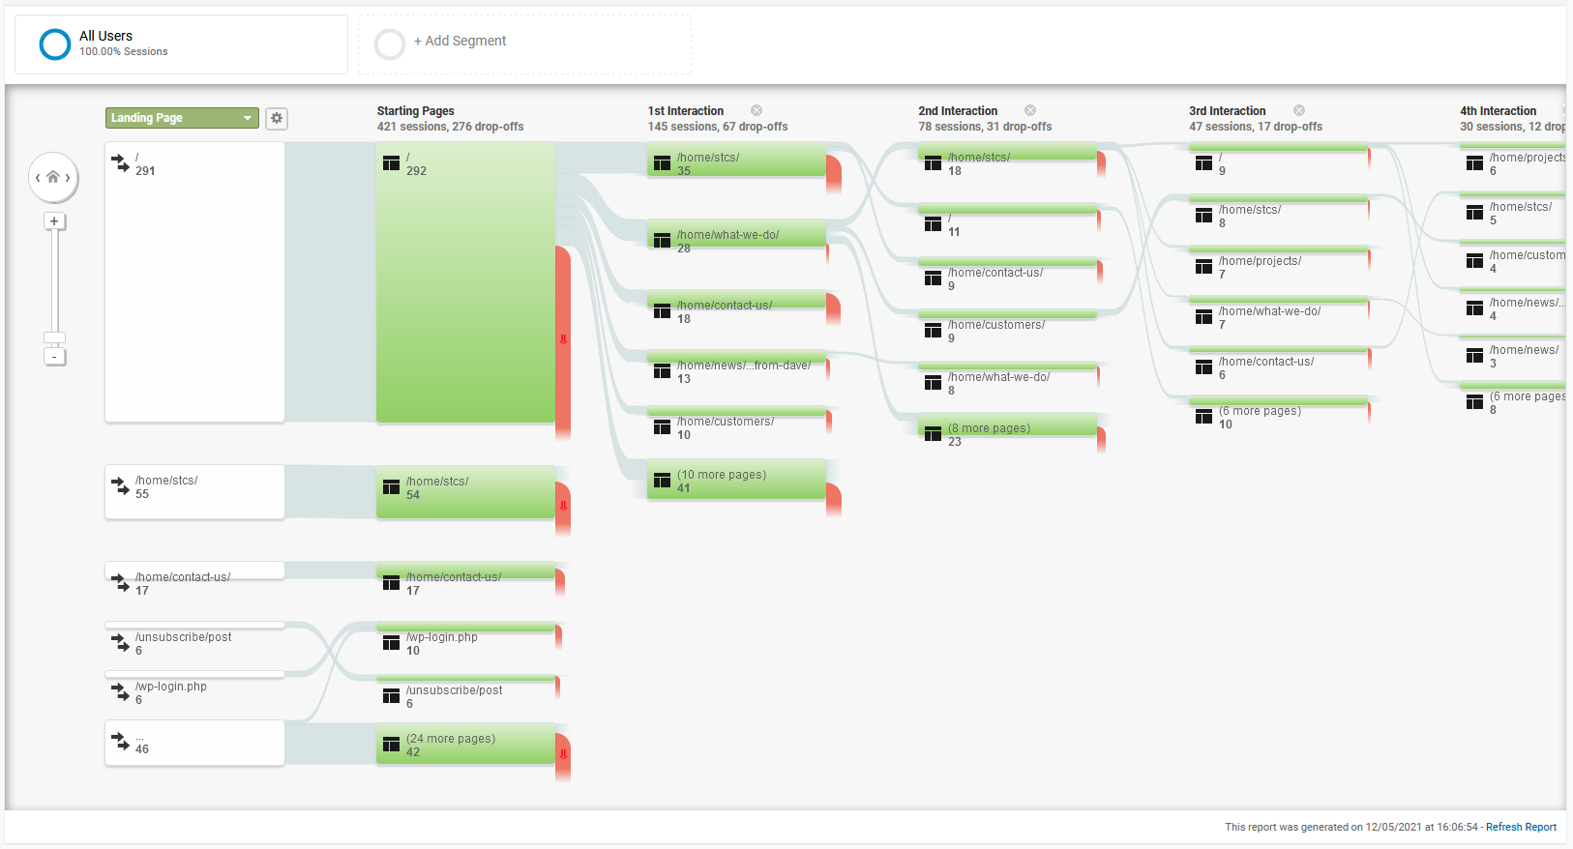
User Behavior Flow (28 Days)

Slide 13
Key Takeaways
Website SEO is clearly working – significant traffic from search engines
Email drives traffic to site – clear peak around recent Hawker campaign
Many first time visitors, although not enough return visitors – need to “liven up” the content and give people a reason to return
A significant number of visitors spend 2 minutes or more on the site, indicating a depth of interest
STC downloads are a clear draw
For the moment, not much interest in the ODA topic, which is understandable since there is not much news yet…

