Slide 1
Peregrine Avionics Web Marketing Report
06 May 2022

Slide 2
Tasks & Actions: Website Enhancement April 2022
Content
Updated monthly message, stressing project capabilities of Peregrine and linking these capabilities to custom STC creation
Modified menu item: “Products” ➔ “STC Availability”
Added G150 Campaign page, along with links and references throughout site, along with G150 Blog entries
Added keywords and tags throughout site
Form
Completed initial “look & feel” update conforming to Peregrine branding guide
Added second scrolling main image
Incorporated majority of suggestions from the Peregrine branding audit
Maintenance
Performed weekly security scans
Updated Plug Ins as needed during month
Continued monitoring email deliverability via AGG dmarcian.com account
Performed monthly privacy conformance form updates

Slide 3
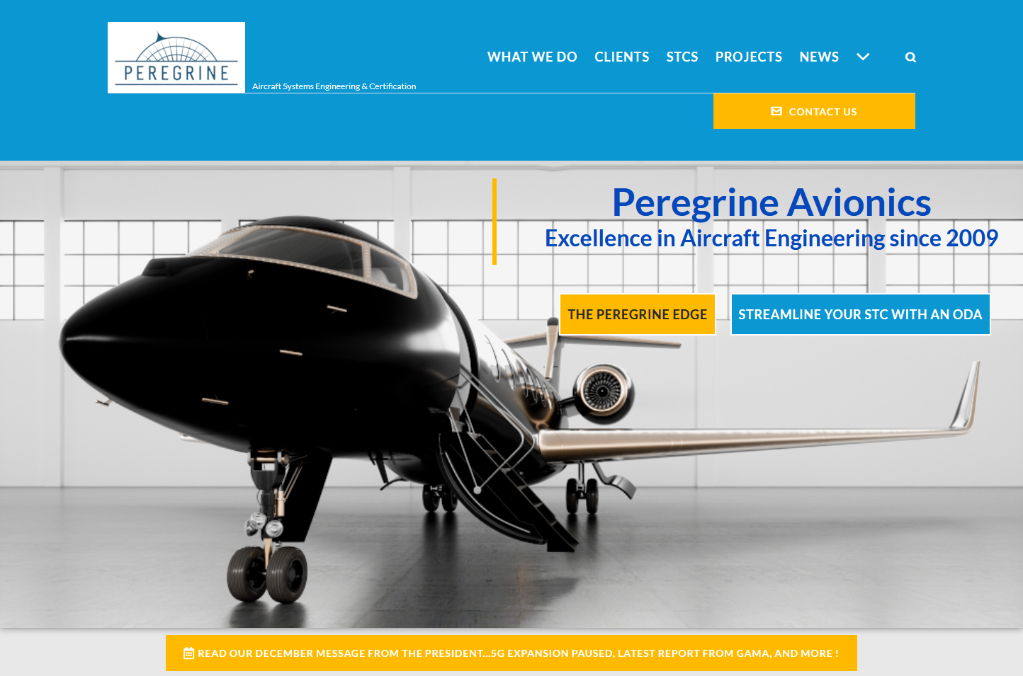
OLD HOME PAGE
Landing View

Slide 4
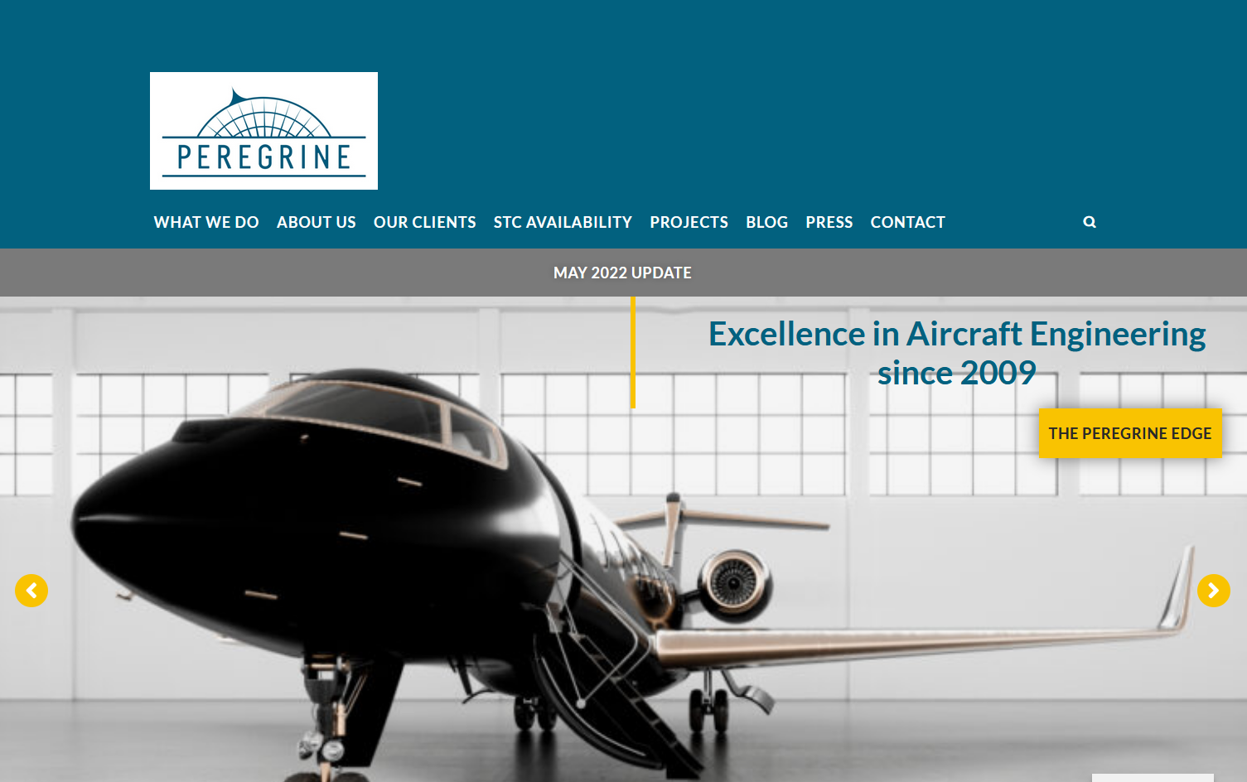
NEW HOME PAGE
Landing View
1st Image

Slide 5
NEW HOME PAGE
Landing View
2nd Image

Slide 6
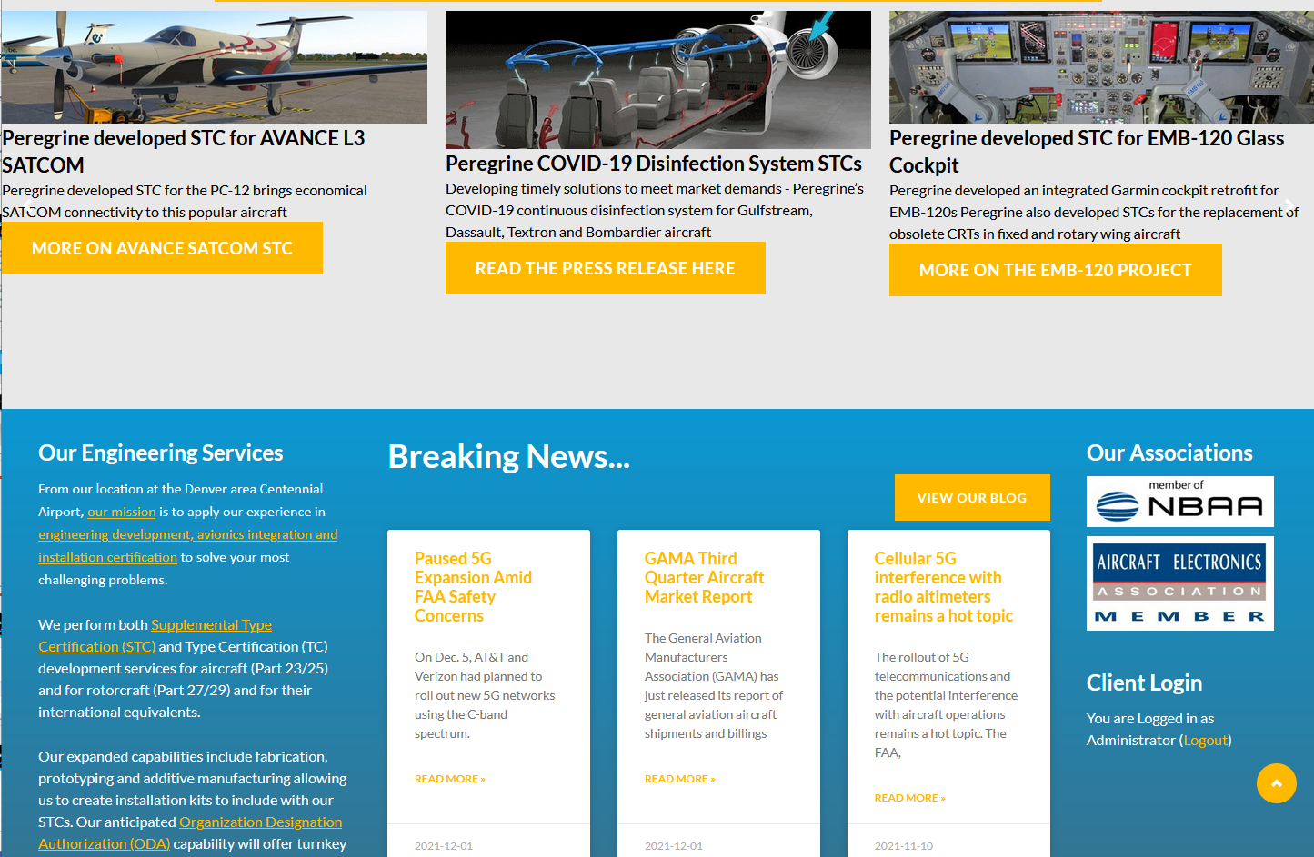
OLD HOME PAGE
Scroll Down

Slide 7
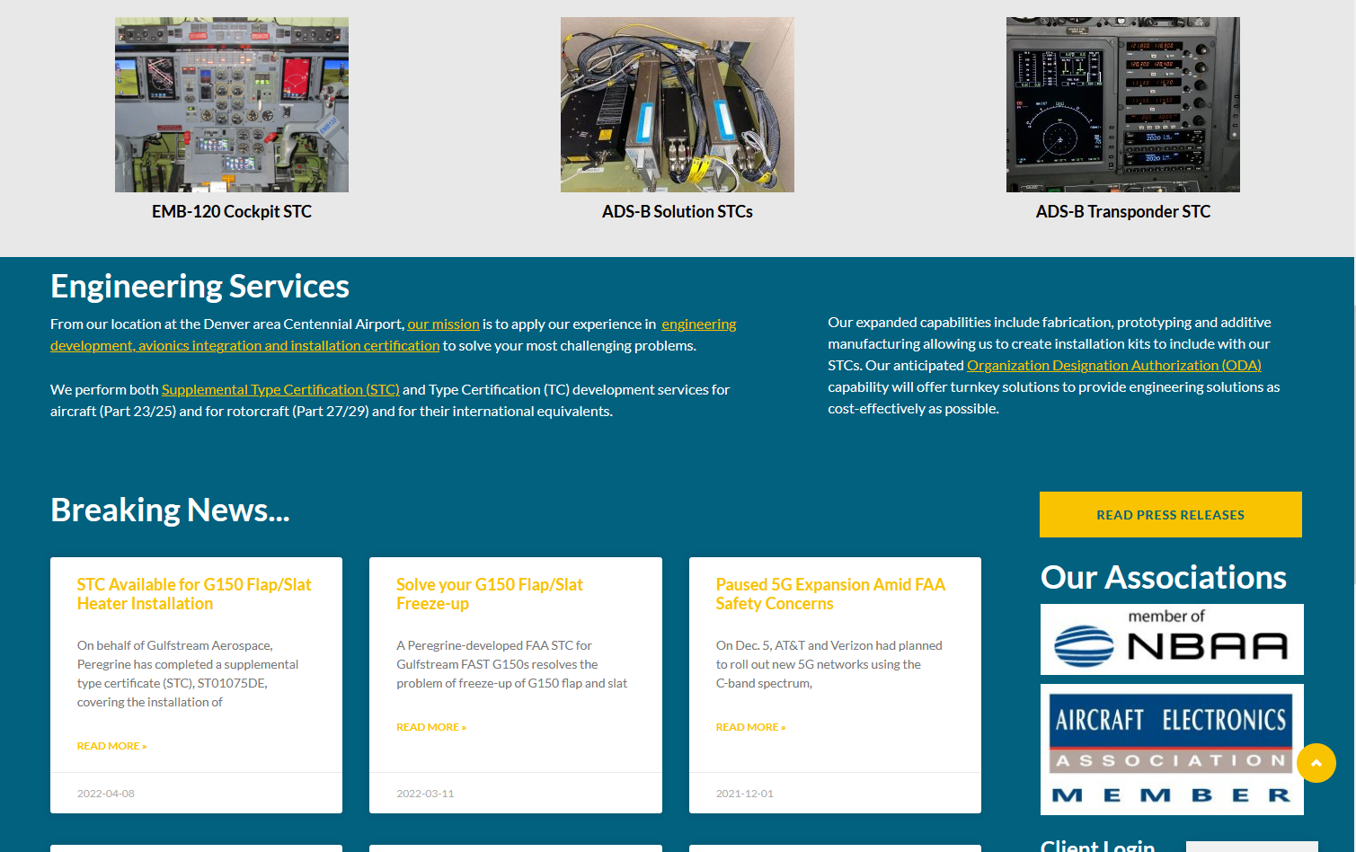
NEW HOME PAGE
Scroll Down

Slide 8
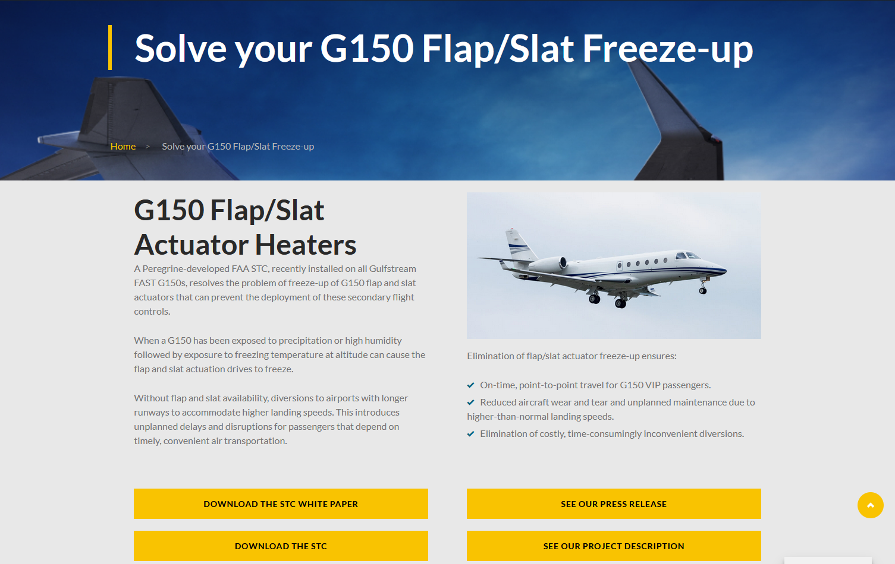
G150 Page
Landing

Slide 9
G150 Page
1st Scroll Down

Slide 10
G150 Page
2nd Scroll Down

Slide 11
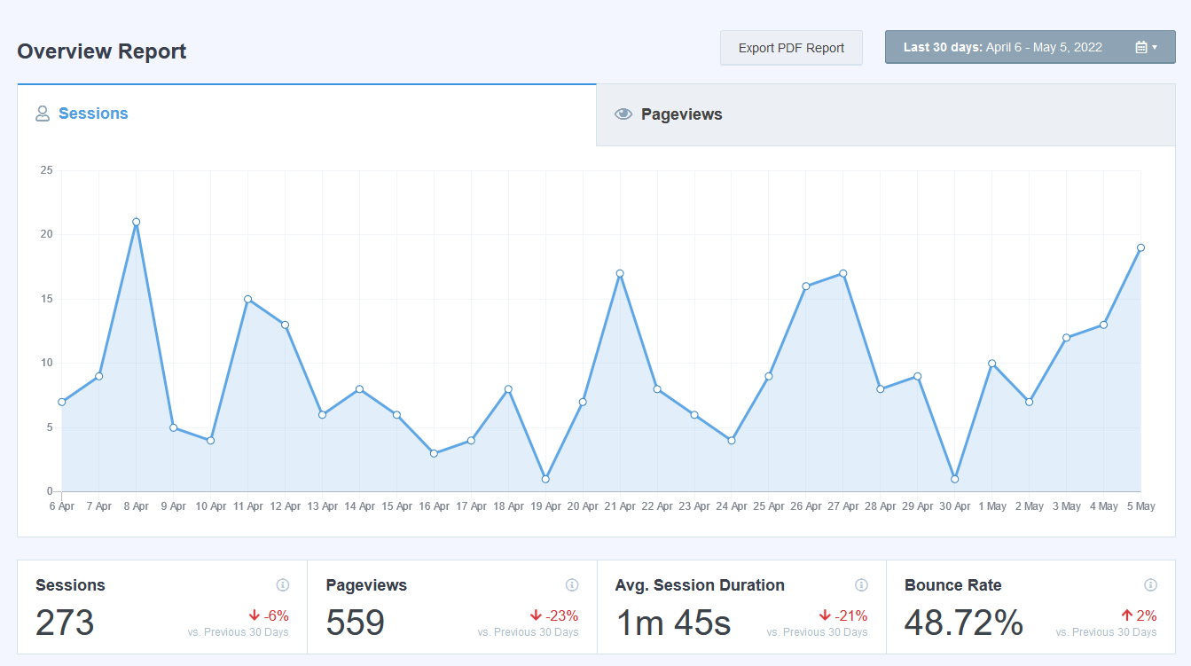
Google Analytics Overview 6 April – 5 May 2022

Slide 12
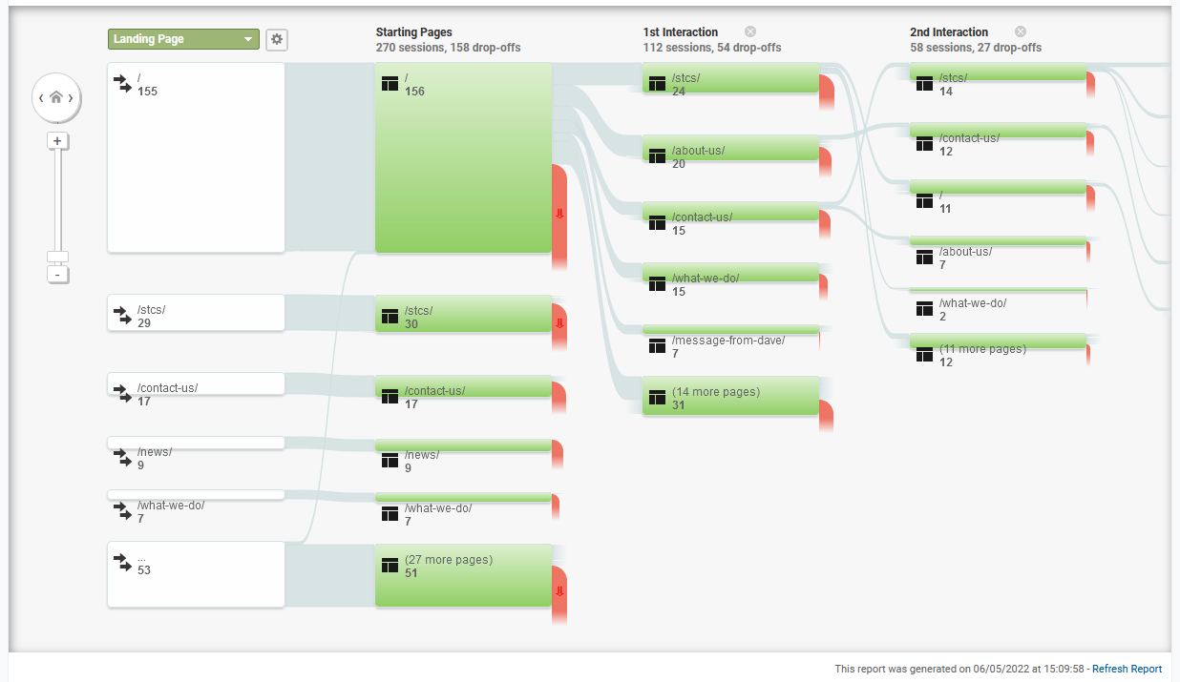
Google Analytics Behavior Flow 6 April – 5 May 2022

Slide 13
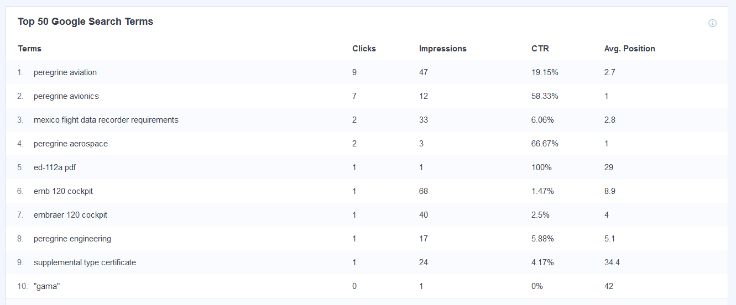
Google Search Console 6 April – 5 May 2022

Slide 14
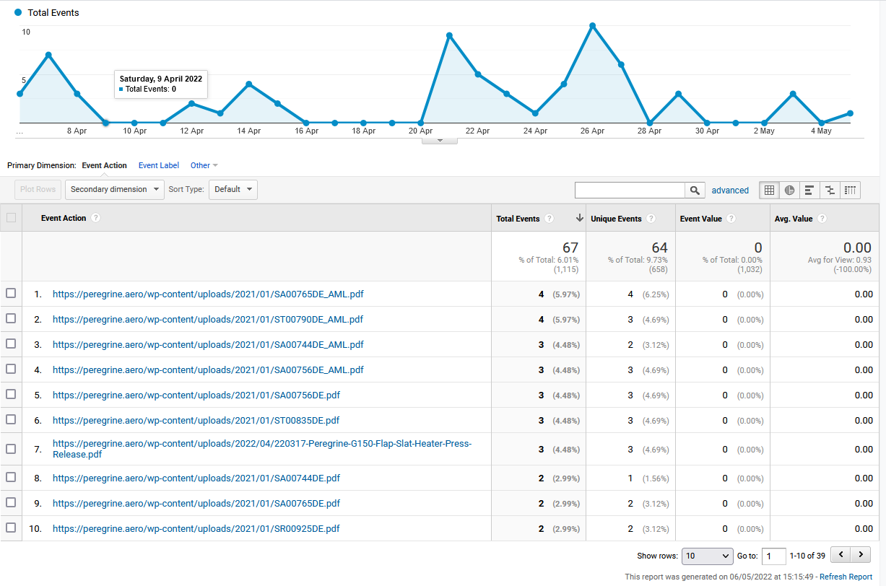
Top Download Events 6 April – 5 May 2022

Slide 15
Key Takeaways
Status end May 2022
Branding update generally complete (a few color details remain to be implemented)
Web support and dedicated page for G150 campaign implemented
Traffic has improved over two months ago, likely in response to SEO actions on site
Regular press releases and blog postings have kept the search position high
Observation
Based on agreed direction from 2020/2021, current site message is STC (product) focused while Peregrine business is on the other hand project focused
AviaGlobal recommends a restructuring of the website to merge STC/Product and Project pages, with new material developed around projects in progress, to reinforce the core business message
Focus should be on enhancing content related to project achievements and blog entries
Enhance depth of new Peregrine scope content including current in-progress project presentations; focus website on attracting new project clients
Website could be personalized with addition of a Peregrine Management blog, in addition to the current news feed

Slide 16
Peregrine Website Supplemental Google Analytics Results
6 April – 5 May 2022

Slide 17
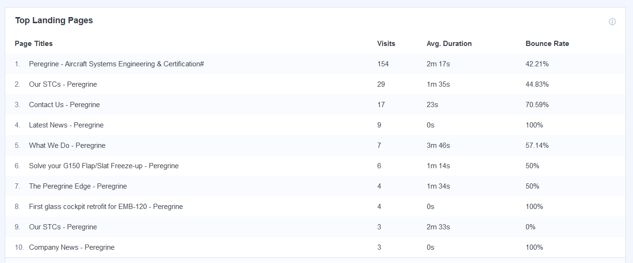
Top Landing Pages 6 April – 5 May 2022

Slide 18
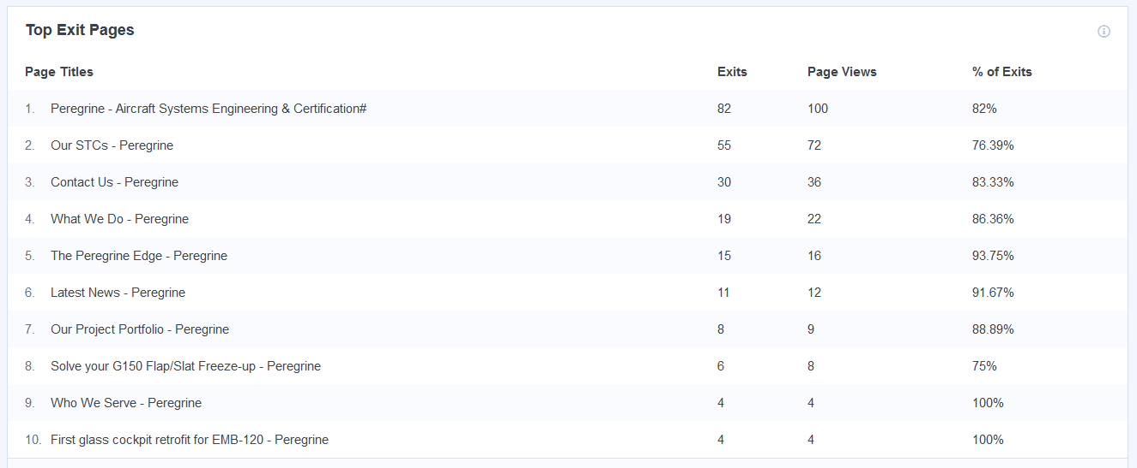
Top Exit Pages 6 April – 5 May 2022

Slide 19
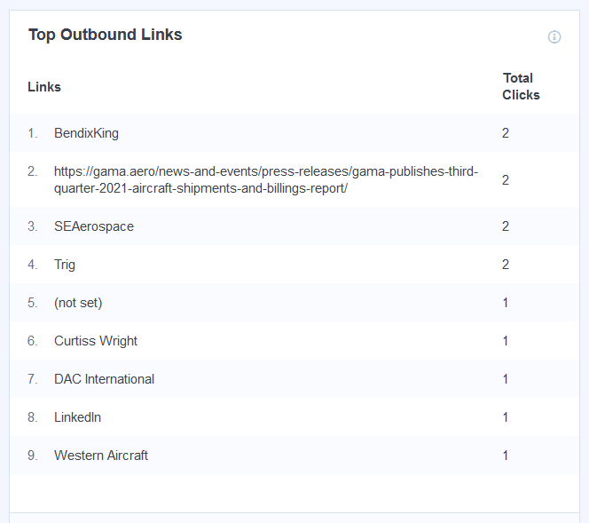
Top Outbound Links 6 April – 5 May 2022

Slide 20
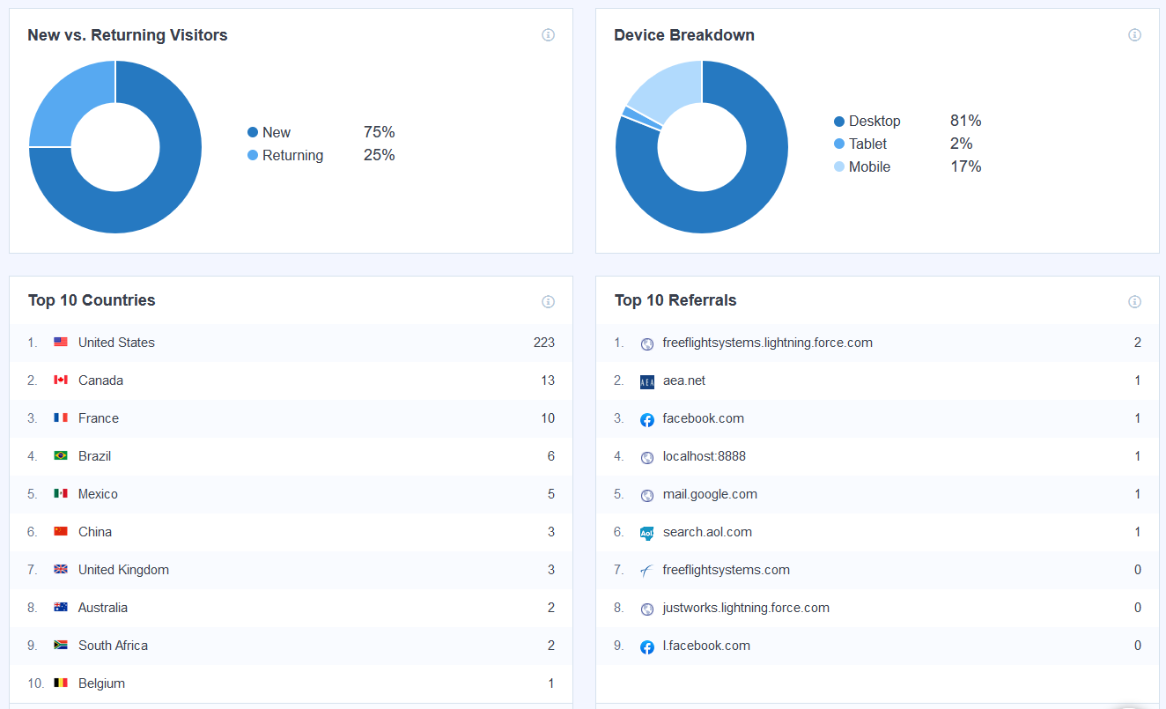
User Engagement 6 April – 5 May 2022

