Slide 1
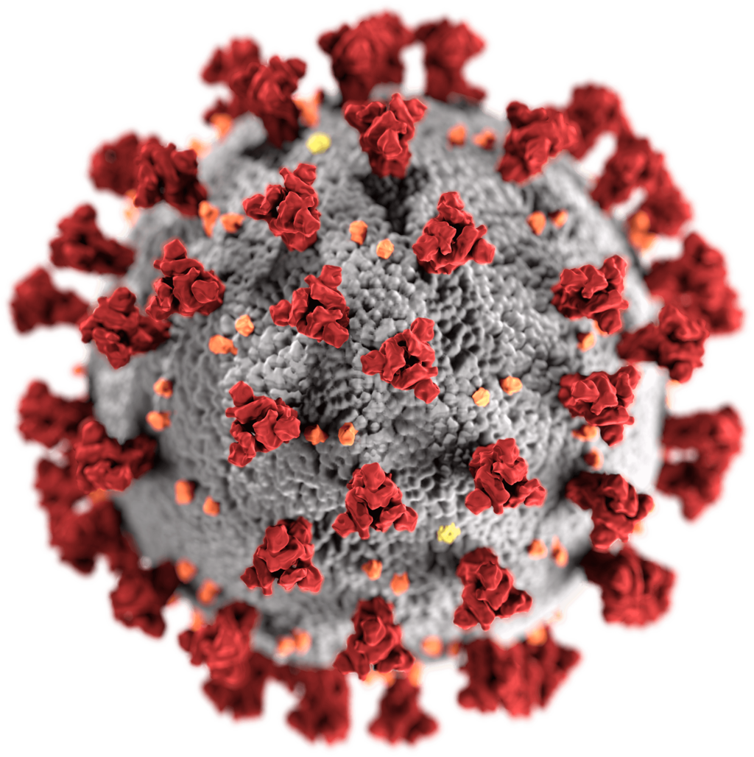
EUROCAE WG-121 / RTCA SC-241
Kick off meeting
20 August 2020
Virtual meeting

Slide 2
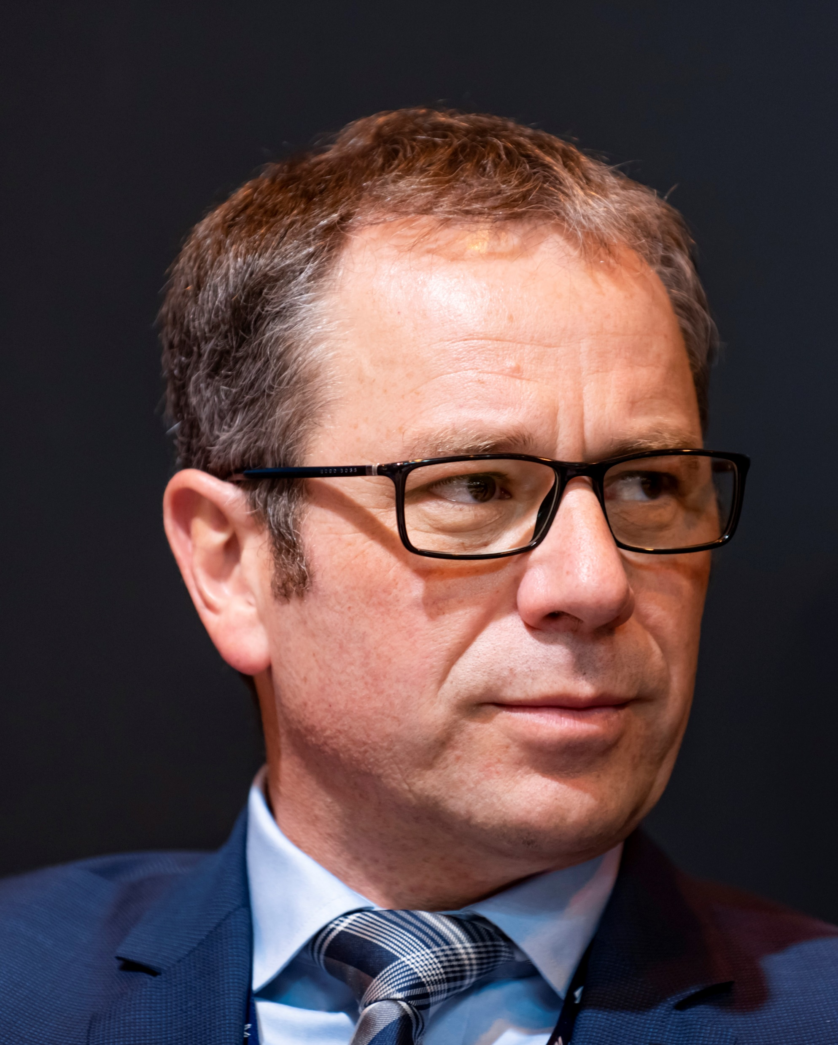

Welcome to WG-121 / SC-241
Christian Schleifer
EUROCAE Secretary General
Terry McVenes
RTCA President & CEO

Slide 3
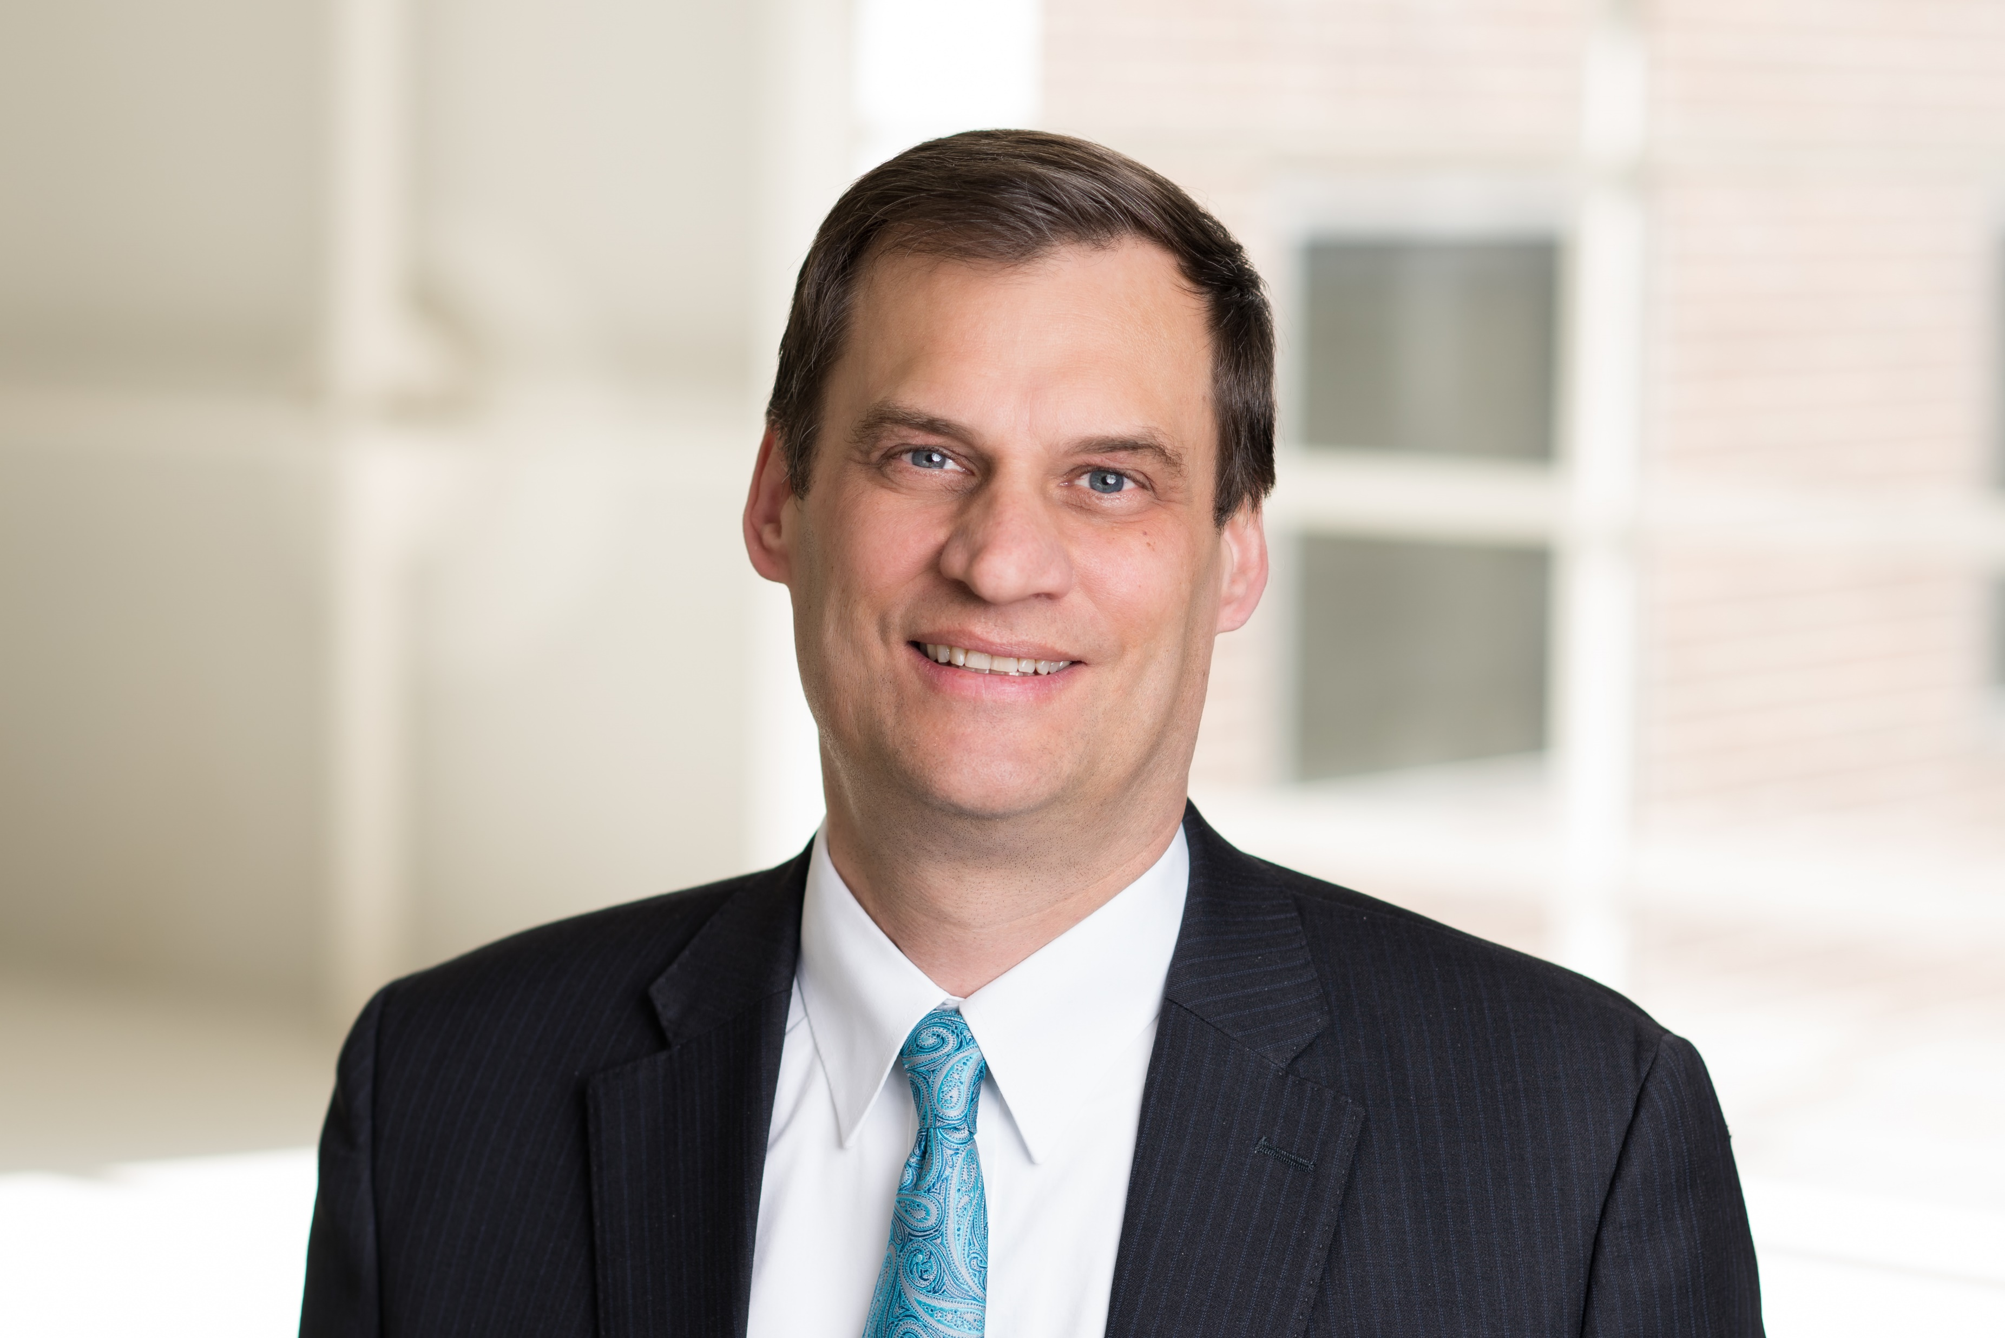
WG-121 / SC-241 Team
Al Secen
Vice President, Aviation Technologies and Standards

Slide 4
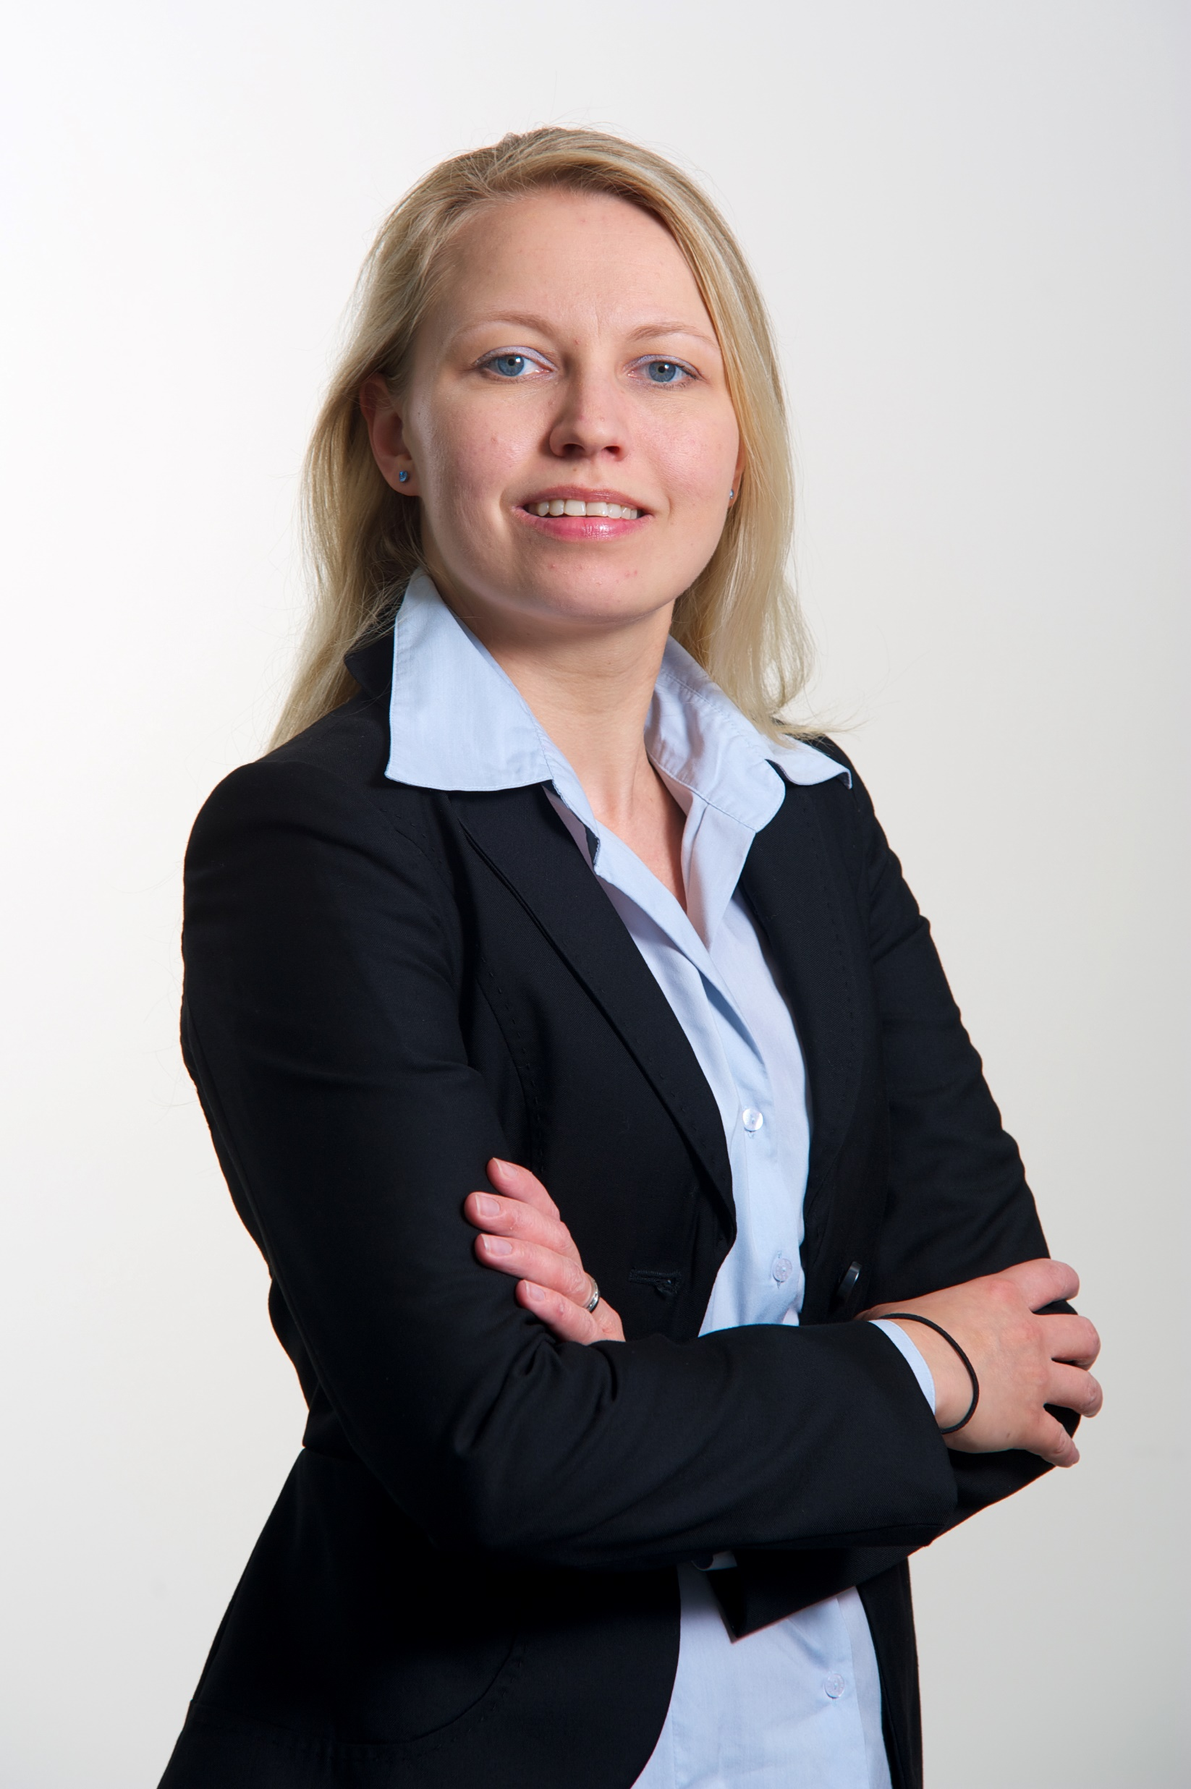

WG-121 / SC-241 Team
Anna von Groote,
Director Technical Programme
Sebastian Reschenhofer,
EUROCAE

Slide 5
Agenda
Welcome
Introductions – tour de table
Determination of EUROCAE WG-121 Chair and Secretary
Summary presentation of EUROCAE and RTCA and WG/SC process
Participants’ presentations of background, experience and expectations
Review of WG/SC objectives and ToR
Review of existing material & context
Development of draft Work Plan, schedule, deliverables & task allocation
Date of next meetings
AOB
Adjourn

Slide 6
Anti-Trust Policy
RTCA meetings are conducted in strict compliance with US antitrust laws. Meetings shall not consider, or be used to discuss, agreements on prices, including terms of sale or credit, production plans, marketing strategies or customer potential, or any other element of competition between participants.
RTCA staff will suspend any discussion that relates to such matters and the Meeting will proceed only after appropriate limitation of such discussions has been advised and agreed.
6

Slide 7
7

Slide 8
IPR Policy Call
“
Any party participating in the work of EUROCAE is requested, in the timeliest possible manner and to the best of their knowledge, to draw attention to any known patent or to any known pending application on patent, either their own or of other organisations, that, according to their own judgment, may be considered to be or become an essential patent for the deliverable.
Conditions for use of such material are further detailed in the EUROCAE Handbook.
Final decision by EUROCAE Council is based on justification provided by WGs.
8
Notes:
This IPR call must be read by the WG Chairperson or Secretary at the beginning of every WG meeting and recorded in the meeting minutes.
In case a (potential) IPR issue is raised, please contact your EUROCAE Technical Programme Manager for guidance without delay.
(same as in RTCA)
In accordance with the EUROCAE Handbook, Chapter 9 ‘IPR Policy’, attention is drawn to the following:
Disclosure of patents and other IPRs are intended to provide EUROCAE and its Members with information about Essential Claims that may affect the development and usability of EUROCAE deliverables.
Early disclosure of essential IPRs contributes significantly to the efficiency of the standards development process. Therefore, any party participating in the work of EUROCAE is requested, in the timeliest possible manner and to the best of their knowledge, to draw attention to any known patent or to any known pending application on patent, either their own or of other organisations, that, according to their own judgment, may be considered to be or become an essential patent for the deliverable.
EUROCAE is not in a position to verify the validity of such information, nor to give authoritative or comprehensive evidence on the validity or scope of patents or similar rights.
The conditions for use of such material are detailed in the EUROCAE Handbook.
The final decision for use of such material always rests with the EUROCAE Council based on justification provided by WG.

Slide 9
9

Slide 10
Participation in EUROCAE WGs
“
EUROCAE is a membership-based organisation
Participation to EUROCAE activities is reserved for EUROCAE members.
Non-members are welcome to participate for a limited period of time to understand the scope of activities (1-2 meetings / 3 months max). After this period, should they wish to continue their participation, they must become members. Otherwise, WG membership and workspace access will be suspended.
EUROCAE Council has reaffirmed this principle at its 287th meeting (Nov 2015).
10
Notes:
This membership policy must be read by the WG Chairperson or Secretary at the beginning of every WG meeting and recorded appropriately in the meeting minutes. (Same as in RTCA)
Participation to EUROCAE activities is reserved exclusively for EUROCAE members.
Full members may participate in all activities; limited membership allows participation in one WG only (they would have to upgrade their membership for participation in multiple WGs).
The EUROCAE Council has reaffirmed this policy at its 287th meeting (Nov 2015). The policy applies to all WGs (existing and newly created), and is mainly implemented through workspace access. It is consistent with the policies of other standards organisations. The purpose is to ensure fairness of support by all members and representativeness of the WGs.
In case of joint activities, the organisation must be member of at least one of the involved standardisation bodies.
Representatives of organisations that would like to participate but are not yet members are invited to contact the Technical Programme Managers.
If a non-member organisation nominating a participant to the WG does not apply for EUROCAE membership within the timeframes, all participants nominated by that organisation will be excluded from the WG (workspace access, mailing lists etc).
List of EUROCAE Members: https://www.eurocae.net/organisation/

Slide 11


Meeting tips
  Use the “connect audio via computer” if at all possible
  Please remember to MUTE your microphones if not speaking
  When dialing in (using your phone for audio) please announce yourself and ensure you are acknowledged
    If you are muted by the host, * 6 will mute and unmute your mic
  If you are on both the Webex and Phone, please connect your call to your Webex USERID
  Call in users who do NOT identify themselves will be placed into the lobby – email the Program Director (if only on the phone) or chat with the Host to be admitted and restore audio
  If you would like to speak, please raise your virtual hand to be recognized
YN
Your Name

Slide 12
Tour de table
Roll call of participants on WebEx

Slide 13
WG-121 / SC-241 Leadership
RTCA SC-241 Leadership
Chair: Chloe Morosetti, United Airlines
Secretary: TBA
GAR: Jeff Gardlin, FAA

Slide 14
WG-121 / SC-241 Leadership
Election of EUROCAE WG-121 Chair and Secretary
Chair: Manfred Mohr (Proposed)
Secretary: TBA

Slide 15
Summary presentation of EUROCAE and RTCA organisations

Slide 16
Agenda
RTCA Overview
RTCA Committees
Committee Positions
Committee Scope
Tools
16

Slide 17
RTCA Overview
17

Slide 18
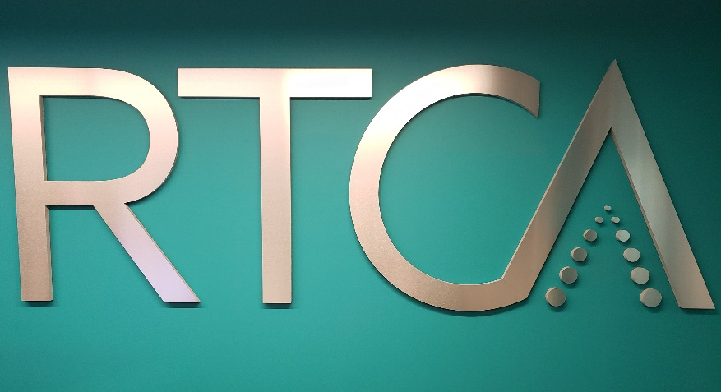
RTCA Operations
Operate as an Independent
Standards Development
Organization
FAA is member of RTCA
  Supports committees with
  Government Authorized
  Representative
RTCA Professional Staff ensures committee proceedings follow guidelines
Supports ICAO activities
Close coordination and interaction with EUROCAE
18

Slide 19
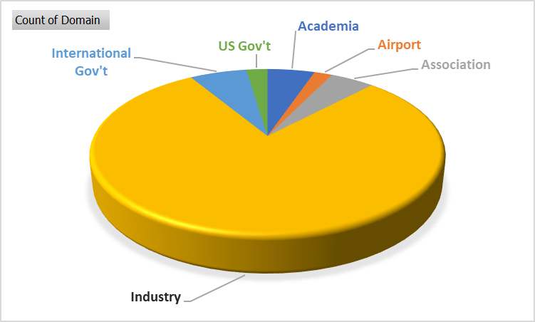
RTCA Non-profit Membership Organization
  Academia
  Airports
  Aviation service providers
  Government organizations
    FAA, DOD, TSA, NASA
  Manufacturers (OEMs and
  after-market)
  Operators
    Airlines, GA, Cargo, DOD, Drone/UAS
  Suppliers
    Automation, Infrastructure,
    Avionics
  Labor
    Pilots, Controllers, Dispatchers
  R&D organizations
580+ Members
19

Slide 20













Affiliations
20
Notes:
Aviation is a global industry and there is need for harmonization of standards to guide technological development. RTCA enjoys a close working relationship with the International Civil Aviation Organization (ICAO) as well as EUROCAE, and other worldwide standards bodies.

Slide 21
RTCA Organization
Board of
Directors
Governance
Advisory Board
RTCA President
Policy
PMC
Standards
Development
Special Committees
Special Committees
Special Committees
Special Committees
Special Committees
Special Committees
Special Committees
Special Committees
Special Committees
Special Committees
Special Committees
Special Committees
Special Committees
Special Committees
21

Slide 22
Types & Purpose of Documents
Operational Services and Environmental Definition
Operational, Safety & Performance Requirements
Interoperability Requirements
Understand environment in which equipment will operate
Safety Assessment, Ops Performance Assessment (Comm, Nav, Surv)
Ensure capability among system elements
Minimum Aviation System Performance Standards
Assuring system will perform its intended functions
Minimum Operational Performance Standards
Assuring equipment will perform its intended functions
22
Notes:
RTCA’s Special Committee products serve as the basis for government certification of equipment and approval of systems used by the tens of thousands of aircraft flying daily through the world’s airspace.
SPR-Interop standards should be developed whenever Minimum Operational Performance Standards (MOPS) are a near-term follow on activity within the Special Committee’s terms of reference. They contain a detailed description of the operational environment for the system/application, high-level performance requirements and “make the safety case” for the system/application being standardized through operational hazard and safety assessments.
A concept of Operations describes the functions of the decision makers in a system will interact with one another and with automation and decision support tools to carry out their functions. The conops serves as the reference for the work of a Special Committee, enabling the SC to set minimum performance standards for a system or equipment within the context of how that system or equipment will be used. Not all SCs will have a Conops as a reference point.
SPR: Operational, Safety & Performance Requirements
OSED: Operational Services and Environment Definition
IRR: Interoperability Requirements
ICD: Interface Control Document
Conops: Concept of Operations
Other Documents/products based on the needs of the FAA.
Not every committee produces every document/product

Slide 23
Document Process
US Gov’t
TOR
Call for participation
Tasking
PMC review
SC
Submission to PMC for Review
Industry
WG’s
WG’s
Published Document
Final Document
WG’s
WG’s
WG’s
WG’s
White Papers
V&V Test Plans
Simulations
Etc.
Public Review and Comment
Document Creation
DRAFT
23

Slide 24
RTCA Committees
24

Slide 25
Committee Structure
Committees can remain in a single body who work together on all aspects of the committee or can be further organized into Working Groups
  Committees may choose to break into areas of expertise
    Working Group leaders will be appointed by the SC during a Plenary meeting
    Working Group should capture meeting agendas, summaries to include attendance and significant working papers
    Working Groups are not necessarily open to the public
All outputs of Working Groups must be fully vetted in a plenary meeting
This committee will work as a JOINT committee with EUROCAE WG-121
25
Notes:
While meetings of Working Groups do not need to be announced to or open to the public, the committee’s RTCA Program Director should be informed of all Working Group meetings, including telecons.
Committees may choose Working Group leaders and assign membership to Working Groups. Working groups can meet as often as necessary to complete work. Working Group meetings do not need to be announced to the public

Slide 26
Joint Activities
Members of EUROCAE participating in joint activities are entitled to the same access to the joint activity and meetings as RTCA members.
  If EUROCAE members wish access to the RTCA workspace for SC-241, they need only indicate that and provide contact information; a USERID will be established for them.
  The same is true in reverse for RTCA members wishing access to WG-121 workspace area.
Final Review and Comment/Open Consultation span 28* days
26

Slide 27
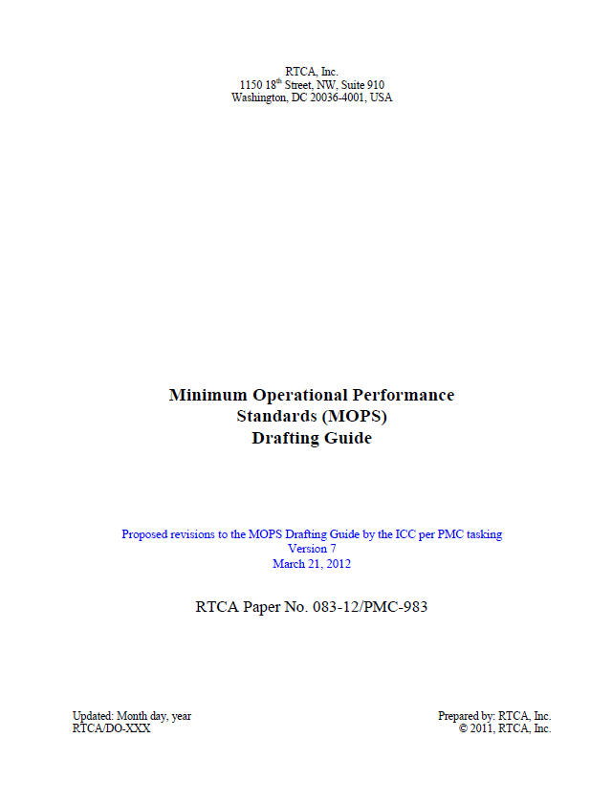
Committee Products
Committees must be familiar with the RTCA drafting guide rules and style guides and ensure adherence to document templates and style requirements!
An editor for the committee should be selected to help coordinate
27
Notes:
We recommend that committees start by using the templates provided – it can be difficult and timely to apply templates later in the process.

Slide 28
Reference to RTCA Documents
Documents are recommendations
ANSP can reference with :
  Regulation
  Advisory Circular
  Technical Standard Order
  SARP
Adherence to RTCA Standard is one means of compliance
28

Slide 29
EUROCAE Organisation
29

Slide 30

Governing Bodies
Founded in 1963 in Lucerne by ECAC
President and General Assembly
  Strategic decisions through “Full Members” votes
Council
  Final decision-making body
Technical Advisory Committee (TAC)
  Technical and operational advisor to the Council and the General Secretariat
General Secretariat
  Day to day management and further development of the Association
30
Notes:
ECAC European Civil Aviation Conference
1965 first published document
RTCA founded in the 1930s, first joint document published mid-1980s

Slide 31

Inputs for Standardisation
Membership
R&D
SESAR, CARATS, NextGen
Regulators (national, EASA)
Manufacturers
Organisations
(ECTL, ECA, IFATCA, CANSO)
International Bodies
ICAO
Service Providers
Other SDO
RTCA, SAE
ESO
31
Notes:
Membership open worldwide to all aviation stakeholders
All main stakeholder categories are represented:
Manufacturers – ground and airborne systems and equipment
Major R&D programmes
Regulators (national and regional)
Organisations, e.g. regional organisations like EUROCONTROL, professional and industry organisations
Service providers, including ANSPs, airlines, airports, …
ESO (European Standardisation Organisation)
Other Standards Development Organisations, mainly RTCA and SAE Aerospace
International level - ICAO

Slide 32
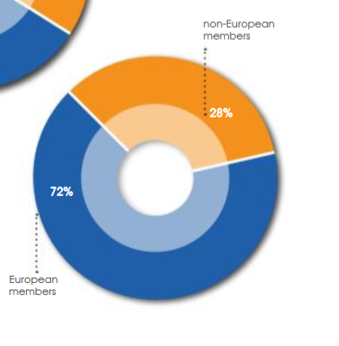
EUROCAE facts and figures
300+ Members (+10% p.a.)
  115 in 2010, 146 in 2013
43 active working groups
  26 in 2010
3000+ experts
32

Slide 33








EUROCAE partners
EUROCAE members & partners, …
ECSCG
33
Notes:
ICAO Panel member

Slide 34










EUROCAE partners
EUROCAE members & partners, …
34
Notes:
ICAO Panel member

Slide 35


Recognition
Recognised intern. organisation
Recognised intern. SDO (core4)
Listed as European SDO
DG MOVE and DG GROW partner
35
Notes:
WTO
WTO has adopted the Agreement on Technical Barriers to Trade framework to ensure that technical regulations are not used as trade barriers, developing a Code of Good Practice for the development of standards
Scope of the Code of Good Practice: fight against discrimination and duplication, openness to comments and complaints, accessibility of the published standards and transparency, etc.
EUROCAE was recently added to the listing under the European Union category (like CEN, CENELEC and ETSI)

Slide 36

Global coordination
SRT
50 % joint WGs
10 % joint WGs
36
Notes:
50% of EUROCAE WGs and standardisation activities are joint with RTCA, resulting in technically identical standards. Same with SAE Aerospace (10% joint activities)
Some more activities are coordinated with RTCA and SAE, information exchange …
With ICAO, close cooperation and Memorandum of Understanding
Long-standing, very positive relationship with ICAO, updated Memorandum of Understanding signed in 2017
13th Air Navigation Conference (ANConf/13) took place in October 2018
ANConf/13-WP/55: Industry Standards in Support of ICAO Provisions
Joint working paper submitted by EUROCAE, RTCA, SAE and Arinc
ANConf/13 Recommendation for ICAO to further work with SDOs and support for performance-based approach to develop ICAO provisions supported by reference to industry standards
EUROCAE work programme mapped to ICAO
Global Air Navigation Plan GANP, Aviation System Block Upgrades ASBUs, Global Aviation Safety Plan GASP
Standards Roundtable
ICAO provisions reference EDs
Currently about 60 instances where ICAO makes reference to EUROCAE Documents (EDs)
Expect increase based on the
Global coordination through international membership

Slide 37

EUROCAE domains of activities
Avionics
Communication
Navigation
Surveillance
ATM Systems
Airports
SWIM
Electric
  Lightning protection
  High Voltage
Security
AIS / MET
RPAS, VTOL & GA
Miscellaneous
  Fuel Cells
  Hybrid propulsion
  Space
  Ice detection
  C-UAS
  NGAP
37
Notes:
Coming from Aircraft equipment certification, used to work with EASA

Slide 38

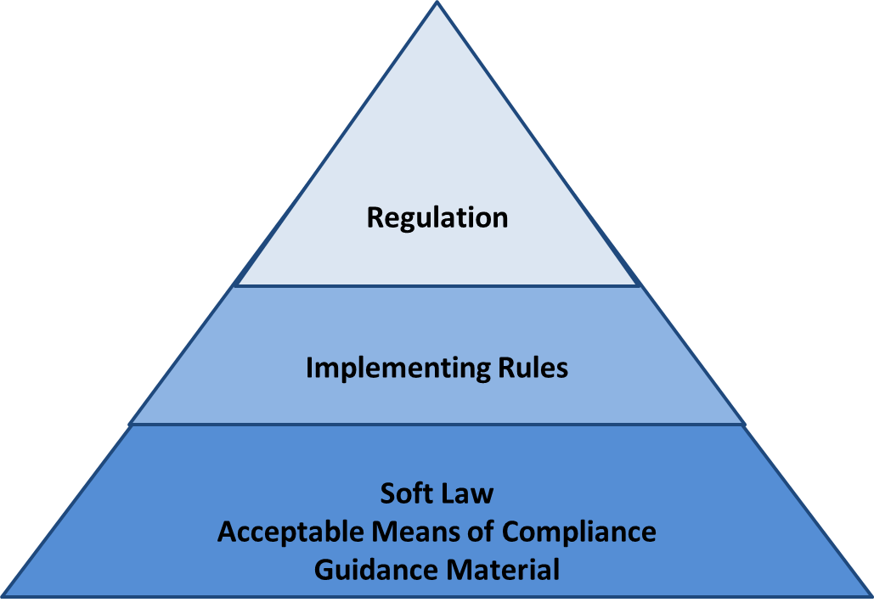
Regulation – Standard
PB regulations by EASA, FAA, ICAO
  Reference to industry standards
standardisation reaction to regulation
forward looking
  in anticipation of regulatory requirements
referenced by the regulator
  EASA, EU Leg, FAA, ICAO
(E)TSO – MOPS, SW, Environment
38
Notes:
Regulation and implementing rule gives the strategic direction and sets the safety level
Bucharest and Warsaw declarations to work with SDOs

Slide 39

EUROCAE standards: EDs
Best industry practice
Soft law
Acceptable means of compliance
How to do and to comply
39

Slide 40
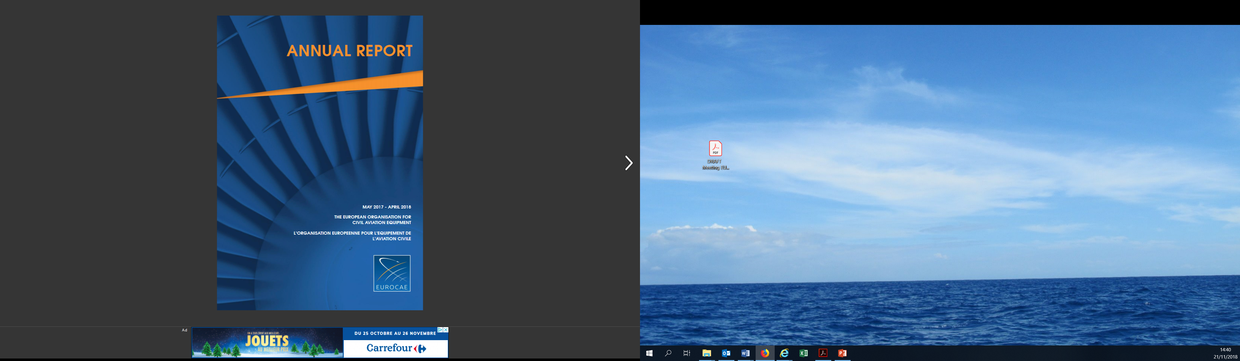
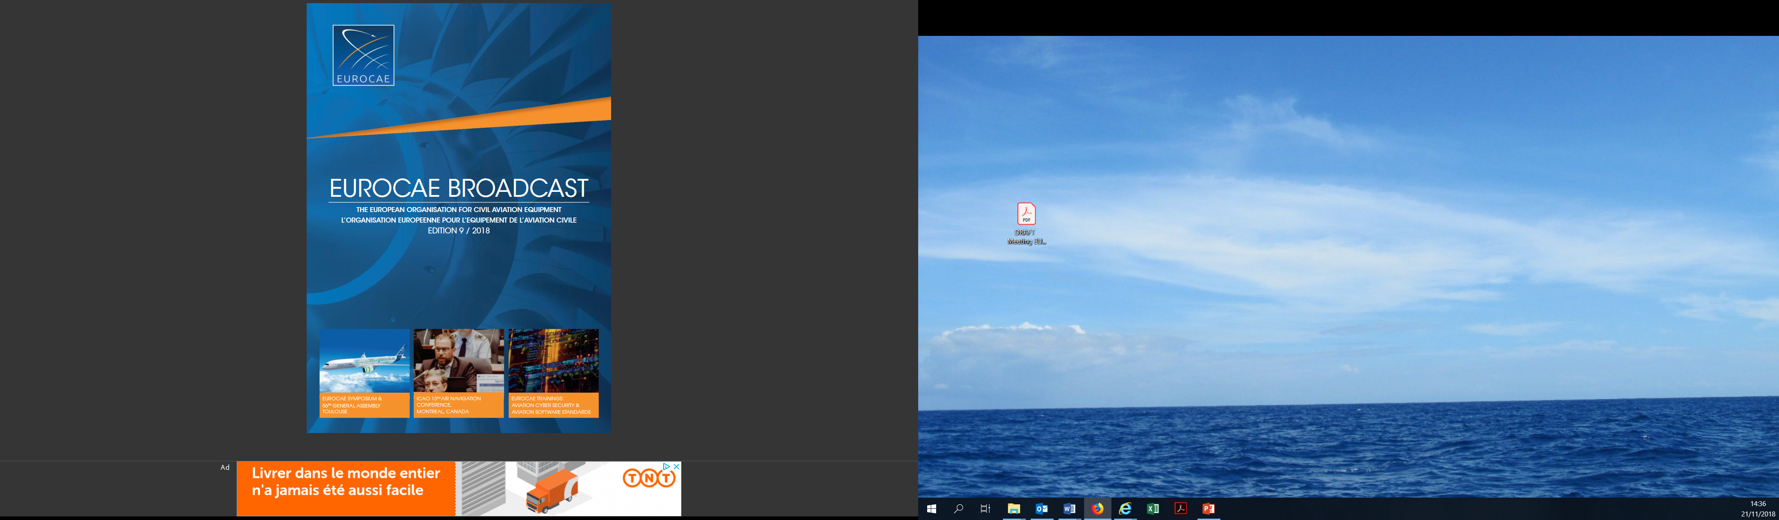
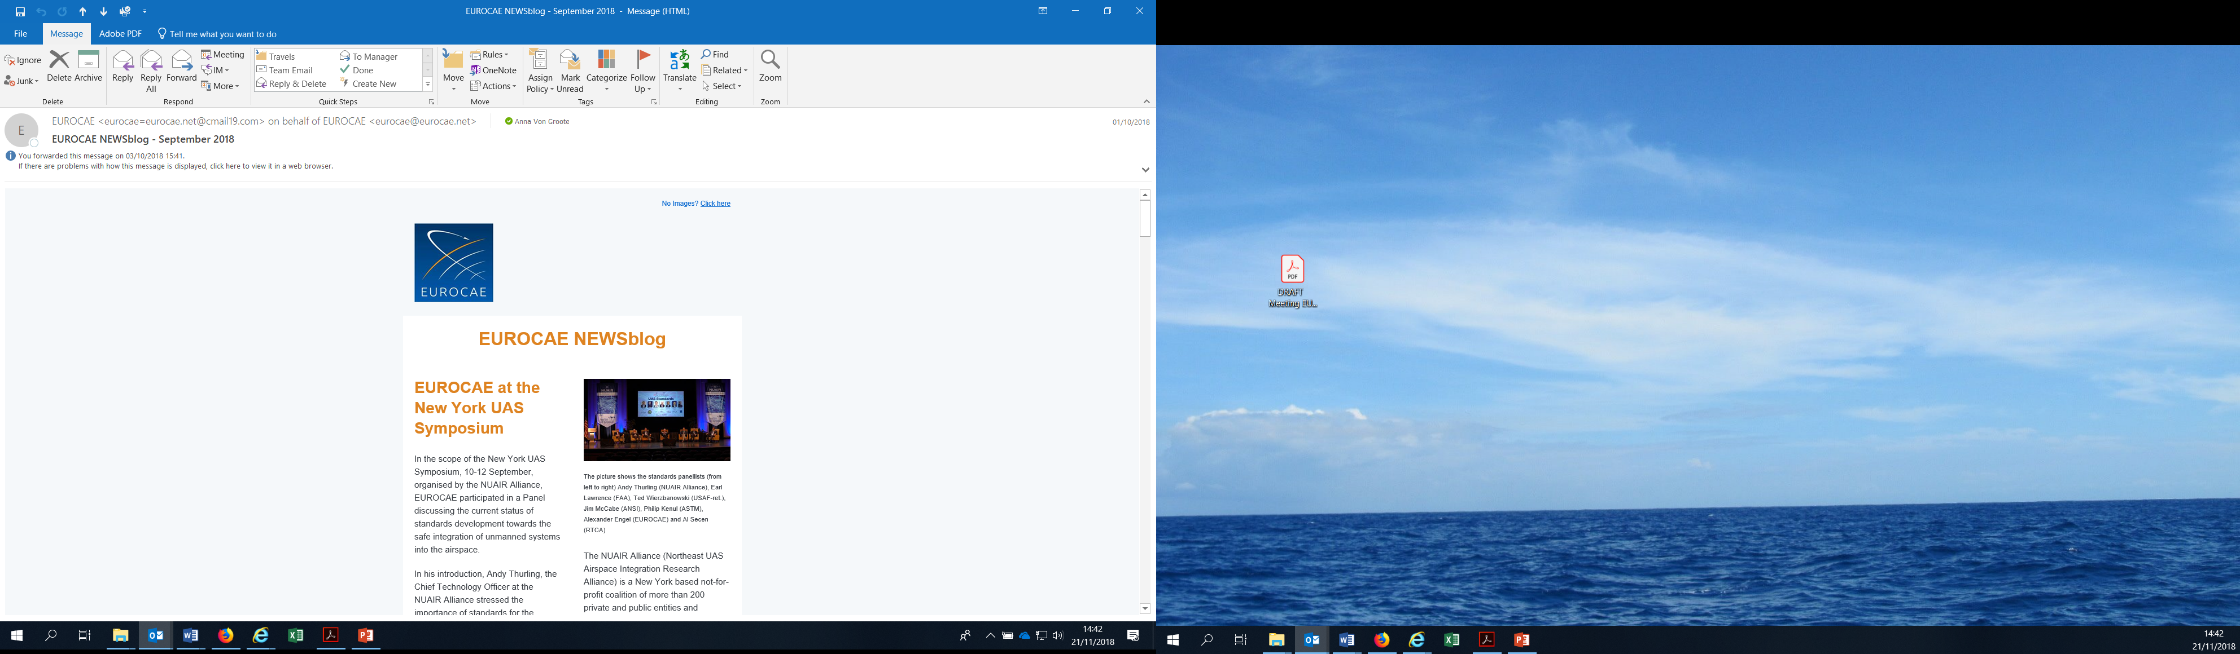
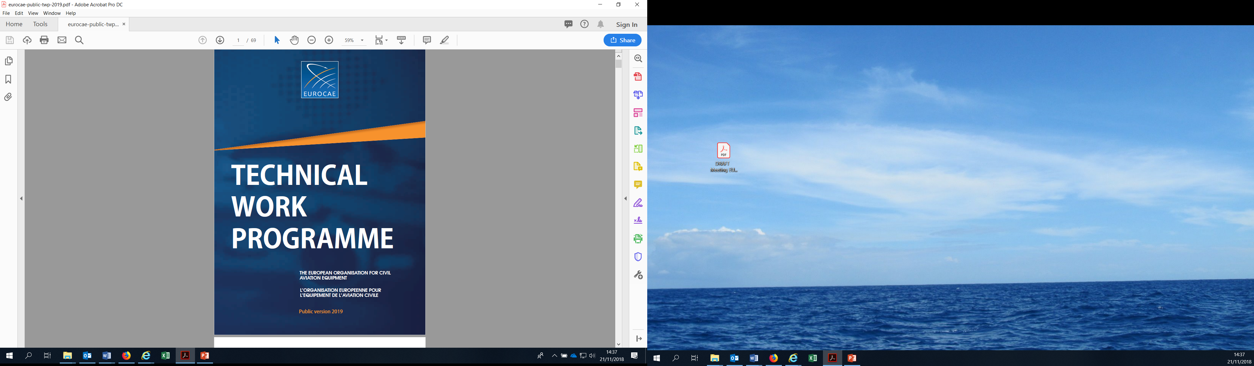


For further information…
www.eurocae.net
40
Notes:
Annual report
Broadcast magazine
NEWSblog (email newsletter)
Technical work programme
All available online on website and some paper copies available at conference

Slide 41
Presentation of WG/SC process

Slide 42
Joint document development
  Principle: Joint drafting and coordinated but separate procedures; template(s) of the lead organisation
  Synchronisation & coordination of procedures
SC-241
RTCA Secretariat
EUROCAE
Secretariat
WG-121
42

Slide 43
Process
Joint document development approved
Joint drafting of document by WG & SC
Consultation
EUROCAE Open Consultation
RTCA FRAC
EUROCAE Council
Joint comment resolution & Finalization of draft
Publication
Approval
RTCA PMC
ED-nnn
DO-XYZ
43

Slide 44
Consensus
The essence of the value that EUROCAE & RTCA bring to the aviation community
Not always 100% agreement
Members ‘can live with’ the results
All members should have a chance to be heard
  Even if their views are not adopted in full
Documentation should capture discussion and resolution
44

Slide 45
Drafting EDs / DOs
Be clear what is in the document
Be clear what is not in the document
Be as complete as necessary
Capture the conclusion of the discussion
  Not mentioning something is acceptable
Include references, notes, guidance
Pay attention to
  Terms and definitions
  Choice of reference documents
45

Slide 46
Open Consultation and FRAC
Why?
Ensure the document is understood by a wider audience
Validate content by peer review
Ensure stakeholder buy-in
Strengthen the document
46
Notes:
By the time we get to OC/FRAC, we hope that the document has reached maturity level and wide agreement within the WG/SC

Slide 47
O/C and FRAC (cont’d)
Launched to all EUROCAE & RTCA members
Announced on the public website
Duration: 28 days
Actions by WG/SC:
  To provide the draft document to EUROCAE & RTCA and
  To organize the comment resolution meeting.
47

Slide 48
O/C and FRAC (cont’d)
Comment levels
  Editorial
  Low
  Medium
  High
  Non-concur (dissenting opinion)
48

Slide 49
Comment Resolution
Following the O/C & FRAC, all comments need to be reviewed and answered
Comment resolution session
  Meeting / WebEx / email
Actions by WG/SC
  To hold the comment resolution session;
  To review and answer all comments;
  To record the acceptance of the document for Council/PMC approval/publication;
  To finalize the draft document and provide it to the Secretariat in Word and PDF format, together with the comment resolution table
49

Slide 50
Participants’ presentations

Slide 51
WG/SC objectives and ToR
WG / SC Objectives
Scope
Deliverables
ToR

Slide 52
Work Plan
Work Plan
Schedule
Deliverables
Task allocation
Workspace
Sub Groups
Templates

Slide 53
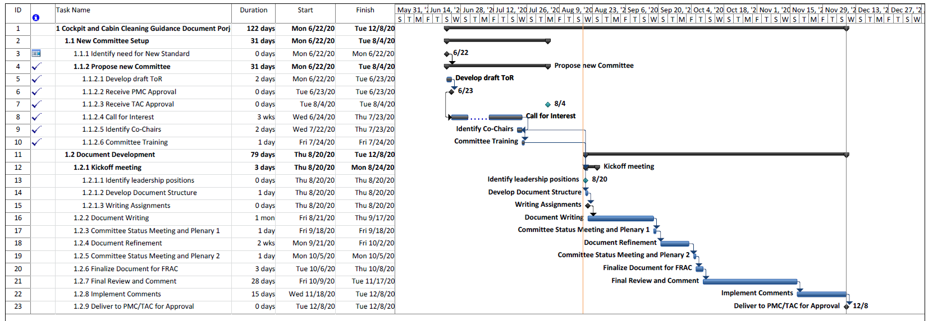
Schedule

Slide 54
WG-121/SC-241 Deliverables
Committee/ Working Groups | Document Name and EUROCAE Identifier and Title | RTCA TOR date FRAC closed and committee approved | EUROCAE Target date for submission to OC | EUROCAE Target Publication Date | RTCA Publication Date
SC-241/ WG-121 | C&CC Guidance Document | Oct 6 | October 2020 | December 2020 | Dec 17
Notes:
Action – update table with wording from Task Sheet/PMC.

Slide 55
Task Allocation/Writing Assignments

Slide 56

Source Workspace
Because both EUROCAE and RTCA have workspace areas, configuration management of material could be problematic
One workspace is designated as “truth” data and the second as “mirror”
RTCA’s workspace will contain “truth “ and EUROCAE’s will be mirror
  All pertinent material will be mirrored:
  CN, Minutes, Meeting announcements

Slide 57
Sub Groups
If desired to aid in the development of the document, sub groups may be defined to develop sections in parallel
  Pros: Work gets done faster
  Individual commitments can be reduced
  Cons: More time required to edit
  Document may appear disjointed (separate voices)

Slide 58
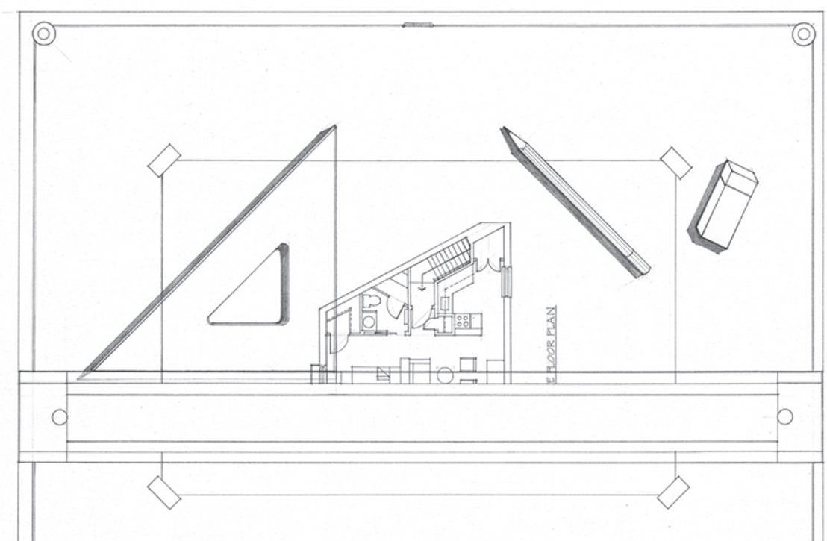
Guides
EUROCAE and RTCA have agreed to a DRAFTING guide and STYLE Guide
  All submissions of documents must be in MS Word format
  All graphics included in document must also be submitted in editable format (if not editable in the document)

Slide 59
Closing
Action Item Review
Next Meetings (suggested)
  Plenary #2
    September 18, 2020
  Plenary #3
    October 5, 2020

Slide 60
adjourn
Thank you for your commitment.

