Slide 1


Peregrine
Avionics Installation Designs and Approvals:
From the Drawing Board to the Sky
10
Years

Slide 2
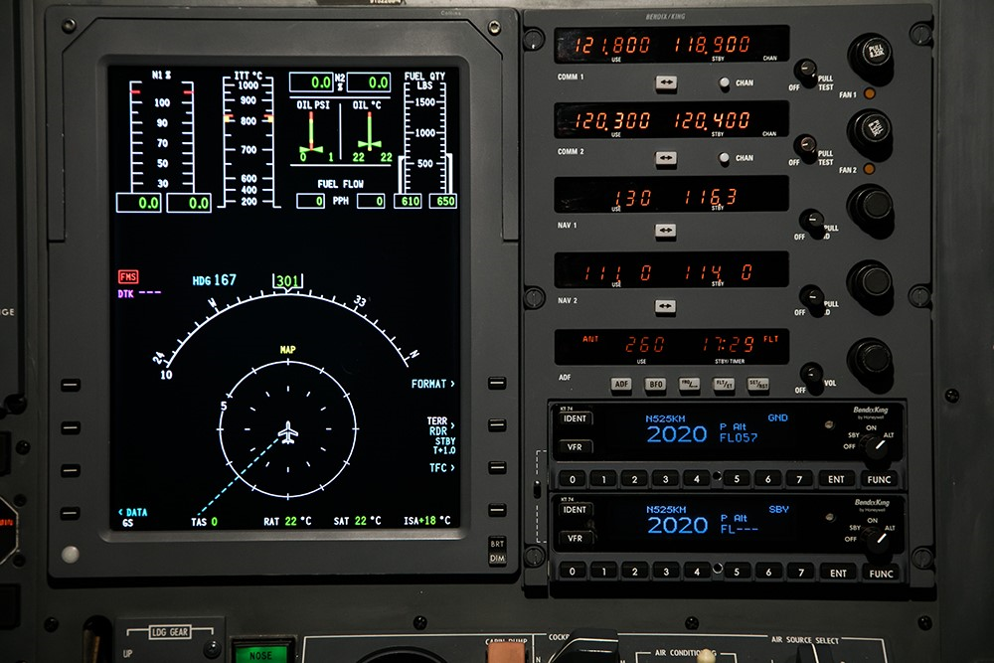



Our Mission
Provide end-to-end FAA-approved STC solutions for our customer/partner network using trusted avionics equipment and proven FAA certification methods
Peregrine
FAA STC Approval
Customer/ Partner Network
Trusted Avionics
Installing new avionics in existing airframes
  An STC (Supplemental Type Certificate) is an FAA-approved design change that supports alteration of an aircraft for the purpose of improving safety, functionality, performance, or maintainability

Slide 3
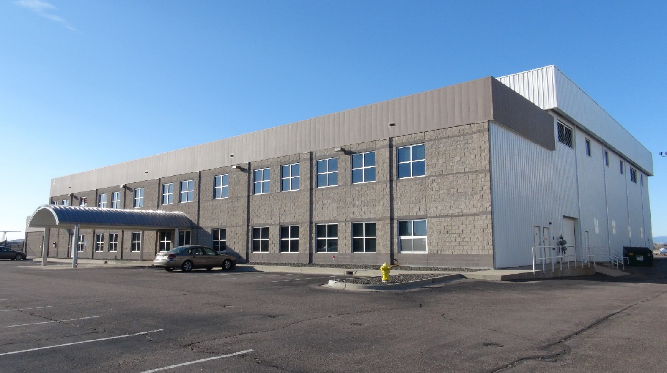
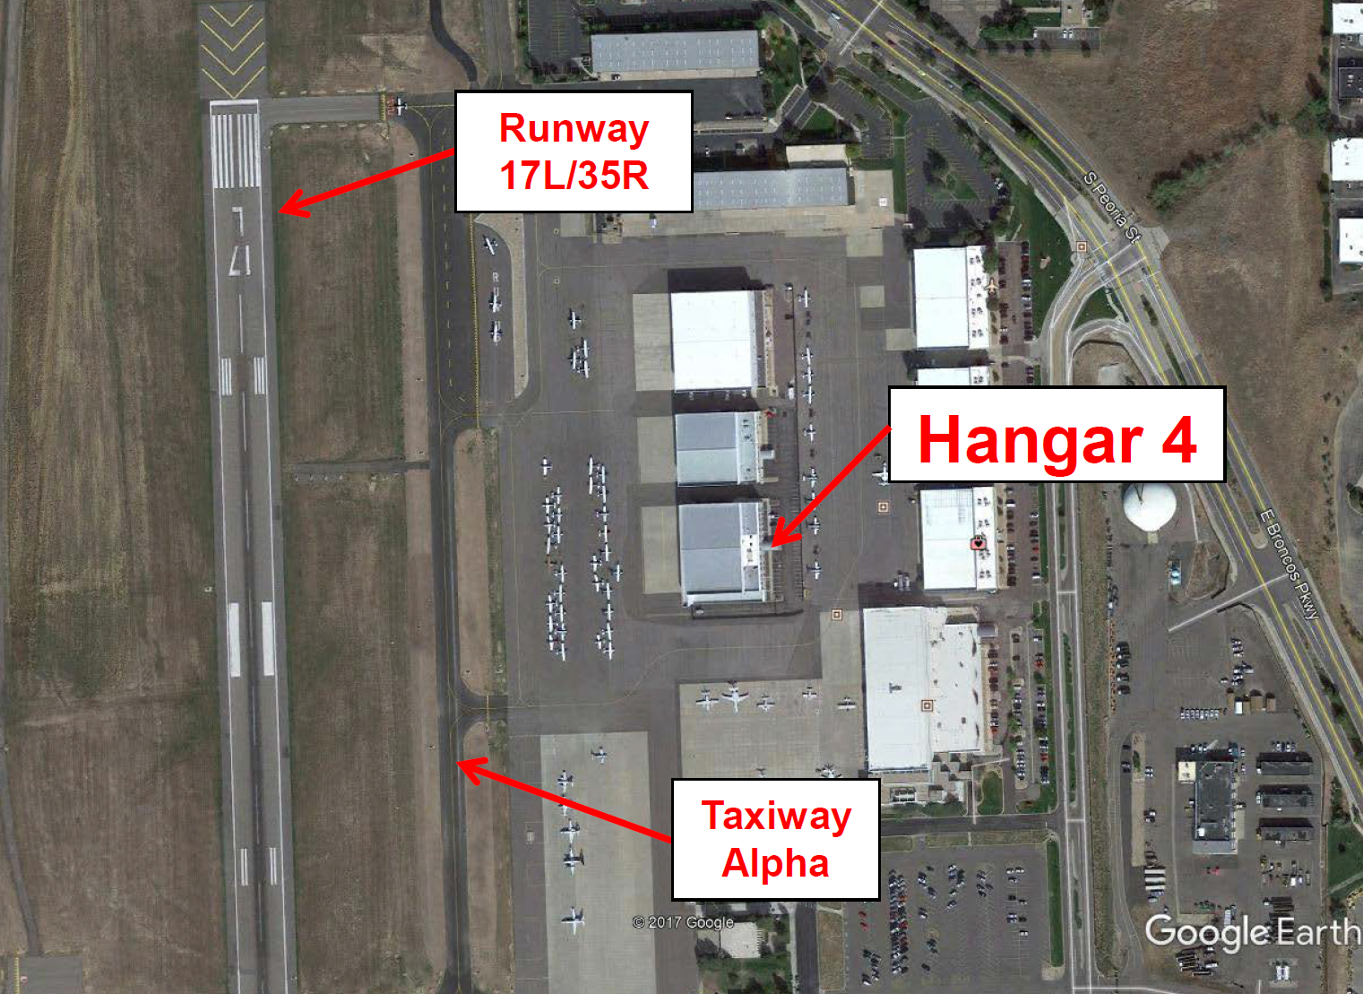
Excellent Facilities - Expansion Potential
Denver, Colorado Metropolitan Area
Centennial Airport (APA)
Peregrine
7385 S Peoria Road
Englewood, CO 80112
+1-303-325-3873
www.peregrine.aero
Centennial Airport
Leased offices in Hangar 4 at TACAir, east side of Centennial Airport (SE Denver area)
Engineering, admin offices and shop space totaling 3,250 sq. ft.
Growth
Ability to expand into hangar space within same building
Denver metropolitan area has large, diverse aerospace business & labor base
  The United States Census Bureau estimates that the population was 2,888,227 as of July 1, 2017, an increase of +13.55% since the 2010 United States Census, and ranking as the 19th most populous metropolitan statistical area of the United States
  http://www.metrodenver.org/industries/aerospace/

Slide 4

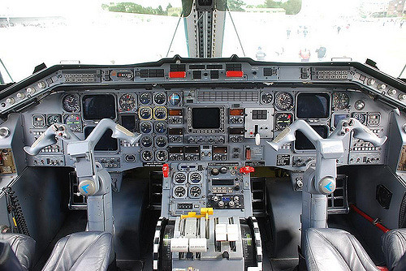
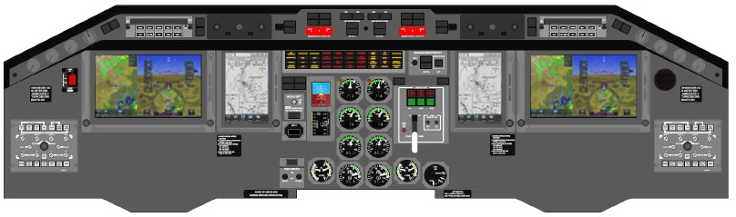
Peregrine Certification Experience
Many aircraft:
Many systems:
Flight deck updates
Attitude Heading Reference Systems (AHRS)
FANS 1/A system
ADS-B OUT system
ADS-B IN system
TCAS II system upgrades
TCAS II compatible Mode S
Flight data recorders
VHF COM radio
Parts obsolescence solutions
Replacing old avionics with modern systems

Slide 5
Our Institutional Knowledge Provides us with rare expertise in the Complex FAA STC Process
Project lengths influenced by many factors

Slide 6
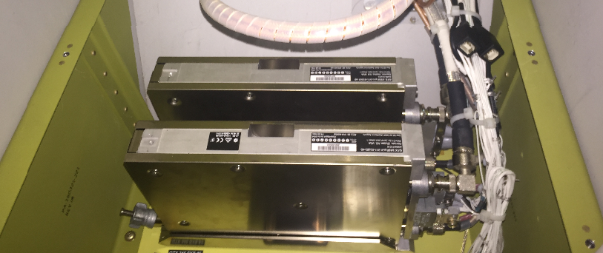
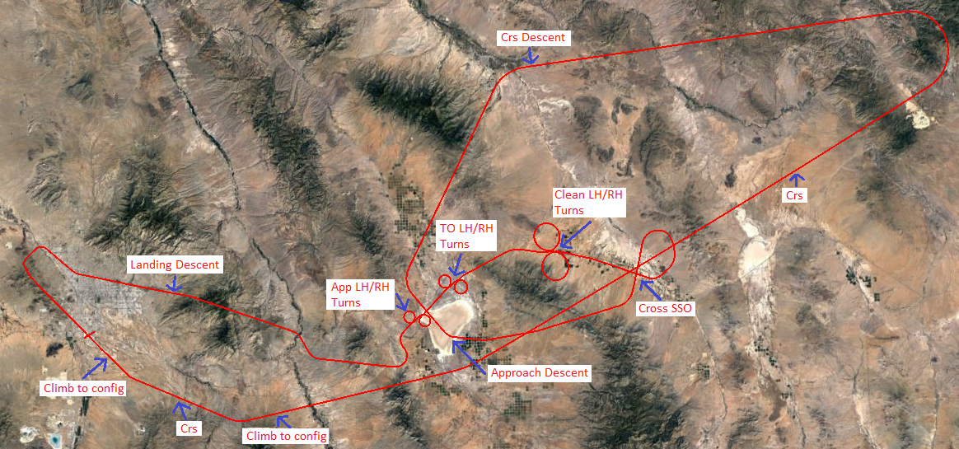
Typical STC Project
Data Package
Initial System Installation
Certification Documents
Document | Description
BAS63022920 | Project Specific Certification Plan
BAS63022921 | Conformity Inspection Plan
BAS63010136 | Master Drawing List
BAS63230215 | System Substantiation
BAS63120222 | Ground Test Procedure
BAS63180177 | Ground Test Report
BAS63110139 | Flight Test Plan
BAS63370031 | Flight Test Report
BAS63050061 | Instructions for Continued Airworthiness
BAS63040223 | Airplane Flight Manual Supplement
BAS63070149 | System Safety Assessment
BAS63130177 | Structural Substantiation
BAS63380025 | Compliance Summary Report
Design Data
Document | Description
BAS63033126 | TDR-94D Transponder Installation
BAS63033127 | IOC-4000 Card Installation
BAS63022919 | ADS-B System Wiring Diagram
Ground and Flight Testing
Typical project includes test plan development, test coordination/management, and final test reports.

Slide 7
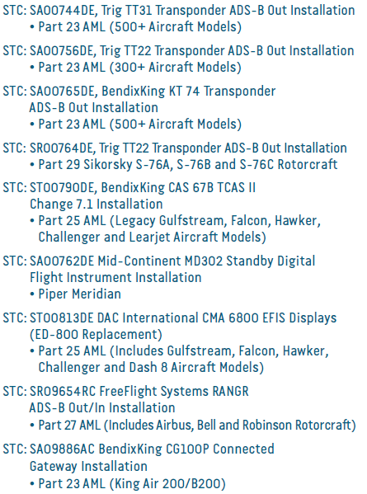
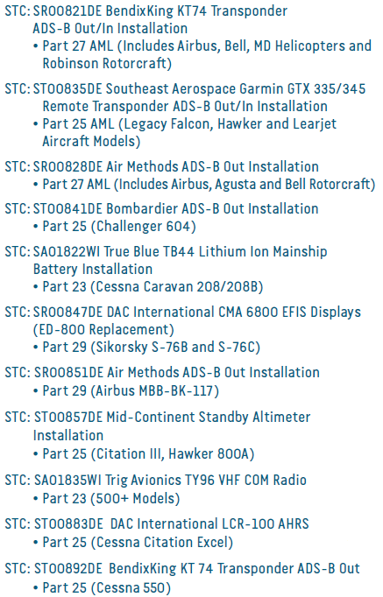
Peregrine Key STC Completions

Slide 8

Peregrine Growing - ODA In Progress
FAA Rule 8100.15B (Organization Designation Authority)
  2- 1.FAA Appointment of ODAs. The FAA may not grant an ODA to every qualified applicant. The FAA will only grant ODAs when it determines the following:
  The organization's FAA workload is large enough to warrant approval;
  The FAA will benefit from granting the ODA; and
  The FAA has the resources available to manage the authorization.
Allows ODA to approve certain aspects of certification activities on behalf of the FAA, typically resulting in streamlining the process (faster turn times)
Peregrine submission encouraged by FAA DEN ACO
  Peregrine submitted application to the FAA for Organization Designation Authorization (“ODA”), in January 2020 and currently working the approval process with FAA

Slide 9
Peregrine Growing - ODA In Progress
Peregrine is planning ahead, leveraging its skills and knowledge to obtain ODA authorization
Peregrine has ability to achieve and operate under ODA delegation
Objective of Peregrine ODA delegation adds significant credibility & capability
ODA is key enhancement that will allow Peregrine to serve customers in a more efficiently and expeditiously
To date, only 9 ODA (STC) entities have been authorized to make approvals in avionics and electrical systems, and offer their services to the broader aviation industry

Slide 10
Skilled and Experienced Team
David Rankin
President
Electrical DER
Jeff Kistler
Senior Engineer Company DER
Cory Smith
Electrical Engineer
Jennie Alfs
Controller
David Sam
Quality Control
Neil Schroeder
Engineering Avionics Technician
Bobby Childers
Lead CAD Designer
Wes Lumry
Business Development
Lee Carlson
Product Support
Mirza Baig
Electrical Engineer
Laura Wilding
Certification Engineer
Bob Lazaroff
ODA Consultant
Kevin Gould
Board of Advisors
Business
Bill Shields
Board of Advisors
Regulatory
Hal Adams
Board of Advisors
Technical
More details in Supplemental Information

Slide 11
David Rankin Leadership Profile
Peregrine Avionics 2009 - present
  Founder, President and Electrical Systems DER
  Led development of 20 STC’s covering Parts 23, 25, 27 and 29 aircraft including Gulfstream, Challenger, Falcon, Hawker, Lear, Sikorsky, Piper, Beechcraft, Bell, Robinson, MD Helicopters, Airbus Helicopters, Augusta, Cessna, Citation Jet, and several AML’s
  Grew company to 10 employees and $1.3m in revenue
Adam Aircraft Industries 2001 - 2009
  Director of Systems Engineering: Led 25 engineers and designers to develop electrical and avionics systems included in the Type Certificate for the A500 aircraft in conjunction with both the Denver and Chicago ACO’s
  FAA Designated Engineering Representative for electrical systems on the A500 aircraft
  Electrical Systems Manager for systems on A500 and A700 models; supported flight test
US Air Force 1995 - 2001
  Officer, Development Engineer, Defense Contract Management Agency - Lockheed Martin Astronautics
  Officer, Development Engineer, Electronic Combat Support Flight - Special Operations Command
Education
  Georgia College & State University – Masters of Business Administration, 1998
  United States Air Force Academy – Bachelors of Science in Electrical Engineering, 1995

Slide 12










Peregrine Customer/Partner Network
Peregrine has established itself as a reliable STC resource, trusted by some of the most respected companies in the aviation industry

Slide 13
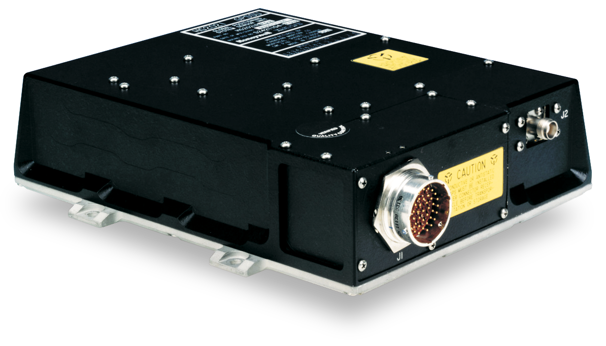
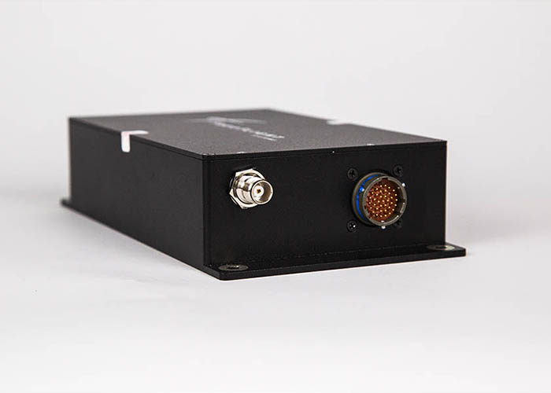
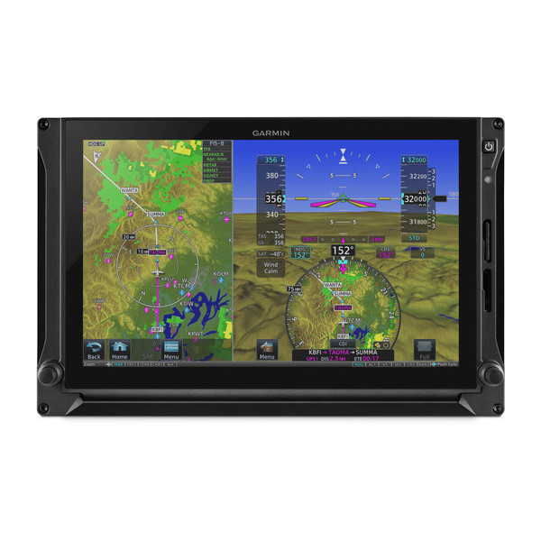
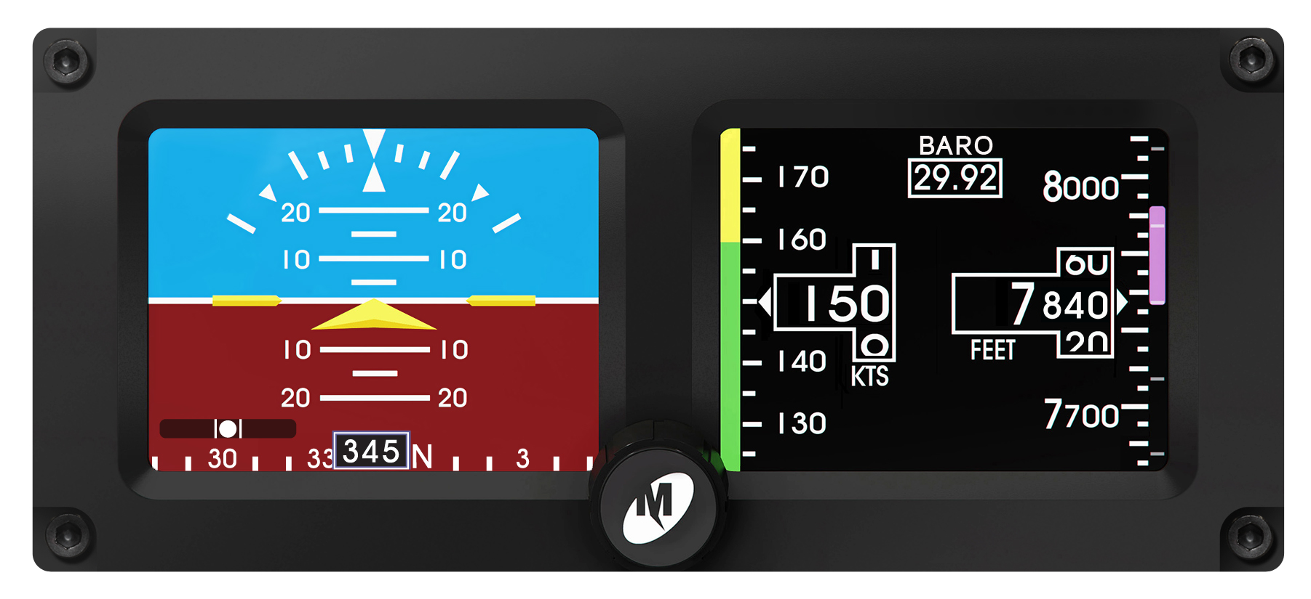


Trusted/Preferred Equipment
Trig Avionics
  ADS-B OUT Mode S Transponders
FreeFlight Systems
  ADS-B OUT/IN UAT Transceivers and GPS WAAS Sensors
Becker Avionics
  ADS-B OUT Mode S Transponders
Garmin Avionics
  ADS-B OUT Mode S and Flight Displays
Mid-Continent Standby Attitude Module
True Blue Power
  Main Ship Lithium Battery
CMC Electronics
  Flight Display and GPS WAAS Sensors
BendixKing
  TCAS II (Traffic Collision Avoidance System)
Northrop Grumman LITEF
  Attitude Reference Heading System

Slide 14
Customers Feedback
“Peregrine has been a big help on short notice in providing engineering support for our Learjet avionics installations. We appreciate their experience and responsiveness.”
James Bohart, Avionics Manager, Trine Aero
“I really appreciate everything that the Peregrine team has done to support our ADS-B Out installations on the Citations. With their STC data and their engineering support, we have been able to install and release aircraft in a timely manner with a quality system installation. Our customers have been very happy with the low down time for installation as well as the exceptional performance of their new system."
Ben Doying, Avionics Department, Eagle Aviation

