Slide 1


G150 Info Page
The Peregrine-developed FAA STC, recently installed on all Gulfstream FAST G150s, resolves the problem of freeze-up of G150 flap and slat actuators that can prevent the deployment of these secondary flight controls.
When a G150 has been exposed to precipitation or high humidity followed by exposure to freezing temperature at altitude can cause the flap and slat actuation drives to freeze.
Without flap and slat availability, diversions to airports with longer runways to accommodate higher landing speeds present unplanned delays and disruptions for passengers that depend on timely, convenient air transportation.
Elimination of flap/slat actuator freeze-up ensures:
On-time, point-to-point travel for G150 VIP passengers.
Reduced aircraft wear and tear and unplanned maintenance due to higher-than-normal landing speeds.
Elimination of costly, time-consumingly inconvenient diversions.

Slide 2

FAQ
How do I equip my G150 with this STC?
Peregrine is ready to schedule your STC installation or the delivery of the STC and installation package to your repair station. The STC and associated components are available directly from Peregrine.
Peregrine also offers a turnkey solution including labor, STC and project management for complete installation and return to service of your G150 at our selected KAPA, Englewood, Colorado, authorized Part 145 repair station, Air Agency Certificate #OMKR399L.
Why did Peregrine develop this STC?
Gulfstream operates several ‘Gulfstream Field and Airborne Support Teams (FAST)’ G150 aircraft, Figure 4, to provide factory service for customers.
The FAST G150 aircraft encountered this flap/slat actuation issue and worked with Peregrine and their selected authorized repair facility to develop a retrofit solution.
Peregrine answered the challenge and developed a complete STC solution that has subsequently been installed on the FAST aircraft.

Slide 3
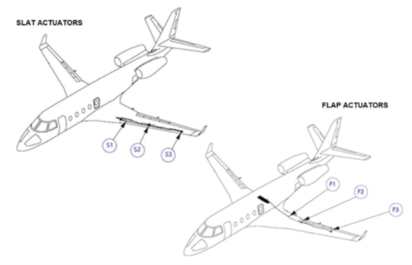
What is added to my aircraft?
The G150 flap and slat drive system is composed of a Power Drive Unit (PDU), flexible drive shafts and twelve linear ball screw actuators (3 per wing, 2 systems).
The STC adds heater components to each of the twelve (12) actuator devices, a control module located in the fuselage, a cockpit switch/annunciator and associated bracketry and wiring.
The component weight totals less than six (6) lbs.
How does this affect operation and maintenance of the aircraft and the flap/slat systems?
The STC does not modify the G150 Flap/Slat drive system including controls, indications, safety mechanisms or recommended lubrication maintenance procedures.
The existing Flap/Slat actuators are modified by the installation of external supplemental heaters only.
What changes are made to the flight deck?
An On/Off switch/annunciator is added to the control pedestal.

Slide 4
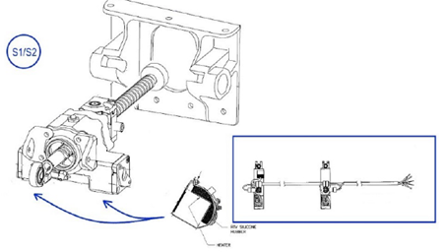
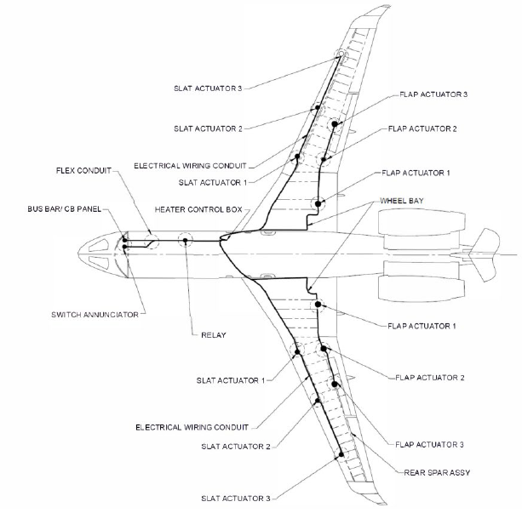
What is involved in the installation of the system?
The flaps and slats are removed to access the drive system. Once the heaters, control modules and wiring are installed, the flaps and slats are replaced and, if necessary, rigged in accordance with Gulfstream service procedures detailed in G150 ATA 100 documentation. (ATA 27-82-01, 27-80-00-AT, 27-51-05-RI, 27-50-00-AT).
Wrap-around, cuff-style, design and are mounted on the exterior of the actuators
Wiring and component installation locations are described fully in the STC

Slide 5
Does the system provide freeze-up protection automatically?
The system will automatically heat the actuators when temperatures are below 40° F. Thermistors installed on each heater are used to both activate the heaters at the proper temperature and ensure the actuators never reach the upper operating temperature limit of 130° F.
What does the STC cost?
The STC and installation kit including Peregrine-specific heaters and control module, installation materials, brackets, switch and permission letter for installation by your repair station
$99,950
The STC and installation kit including Peregrine-specific heaters and control module, installation materials, brackets, switch and permission letter for installation by our affiliated repair station at KAPA
$149,950
A xxxx deposit is required to initiate the order and delivery of the STC and/or installation; the balance due prior to delivery.
When can I schedule my aircraft?
The installation requires approximately three (3) weeks for installation and a six (6) month lead time from order placement to delivery of the STC and installation hardware to the installing facility.
Is there a Gulfstream Service Bulletin?
While not a Service Bulletin from Gulfstream, the STC has been recognized by Gulfstream FAST operation as solving the issue with high lift actuation system freeze-up.
Will my Gulfstream Service Center install this for me?
Yes, inquire with you Service Center for pricing and scheduling.

Slide 6
Who can do this work?
The STC and associated components are available directly from Peregrine.
Peregrine is ready to deliver of the STC and installation package to your repair station.
Peregrine is ready to schedule the installation as a turnkey solution including labor, STC, project management and return to service of your G150 at our selected KAPA, Englewood, Colorado, authorized Part 145 repair station, Air Agency Certificate #OMKR399L.
Who is your affiliated repair station?
Straight Flight at KAPA is a Sierra Nevada company and they performed the installation of the STC on the Gulfstream FAST G150 aircraft
Can the STC be purchased from Peregrine and parts sourced by my installer?
The heaters and control system components are available exclusively through Peregrine as part of the STC.

