Slide 1


G150 Info Page
Peregrine has developed an FAA approved, Gulfstream endorsed, solution to resolve potential secondary flight control issues with the G150 flap and slat actuation systems. that may arise during approach and landing in certain situations.
When you’re a G150 has been is exposed to precipitation or high humidity, subsequent exposure to freezing temperature at altitude can cause the flap and slat actuation drives to freeze, preventing the high lift devices from deploying properly. When this occurs it can lead irregular operations and associated additional costs:
  Abnormal, unplanned ops:
    Shallow approaches, and high speed landings without flaps or slat deployment
    leading to d Possible diversions to an alternate destination with a runway of suitable length that allows for higher than normal approach and landing speeds
  Business mission impacts:
    Business disruptions such as VIP pax missing meetings, logistics replan; tangible and intangible delay costs
    Costly additional direct operating costs such as landing fees, fuel surcharges, parking fees, crew RON costs
    Additional indirect operating cost such as adding ops time to airframe, engines and systems

Slide 2
Peregrine is ready to schedule your STC installation or the delivery of the STC and installation package to your repair station. The STC and associated components are available directly from Peregrine.
Peregrine also offers a ‘turnkey’ solution including labor, STC and project management for complete installation and return to service of your G150 at our selected KAPA, Englewood, Colorado, authorized Part 145 repair station, Air Agency Certificate #OMKR399L.

Slide 3

FAQ
Why did Peregrine develop this STC?
Gulfstream operates several ‘Gulfstream Field and Airborne Support Teams (FAST)’ G150 aircraft, Figure 4, to provide factory service for customers.
The FAST G150 aircraft encountered this flap/slat actuation issue and worked with Peregrine and their selected authorized repair facility to develop a retrofit solution.
Peregrine answered the challenge and developed a complete STC solution that has subsequently been installed on the FAST aircraft
Who can do this work?
The STC and associated components are available directly from Peregrine.
Peregrine is ready to deliver of the STC and installation package to your repair station.
Peregrine is ready to schedule the installation as a ‘turnkey’ solution including labor, STC and project management and return to service of your G150 at our selected KAPA, Englewood, Colorado, authorized Part 145 repair station, Air Agency Certificate #OMKR399L.
Can’t I just buy the parts on eBay and DIY the install?
The heaters and control system components are available exclusively through Peregrine as part of the STC

Slide 4
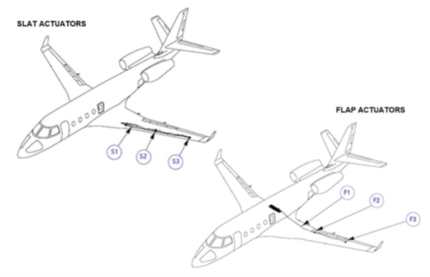
What is added to my aircraft?
The G150 flap and slat drive system is composed of a Power Drive Unit (PDU), flexible drive shafts, and twelve linear ball screw actuators (3 per wing, 2 systems).
The STC adds heater components to each of the twelve (12) actuator devices, a control module located in the fuselage, a cockpit switch/annunciator and associated bracketry and wiring.
The components total less than six (6) lbs.
How does this affect operation and maintenance of the aircraft and the flap/slat systems?
The STC does not modify the G150 Flap/Slat drive system including controls, indications, safety mechanisms or recommended lubrication maintenance procedures.
The existing Flap/Slat actuators are modified by the installation of external supplemental heaters only
What changes are made to the flight deck?
An On/Off switch/annunciator is added to the control pedestal.

Slide 5
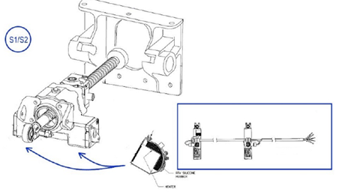
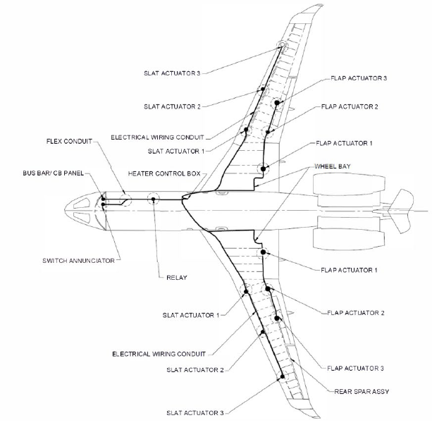
What is involved in the installation of the system?
The flaps and slats are removed to access the drive system. Once the heaters, control modules and wiring is installed, the flaps and slats are replaced and if necessary, rigged, in accordance with Gulfstream service procedures detailed in G150 ATA 100 documentation. (ATA 27-82-01, 27-80-00-AT, 27-51-05-RI, 27-50-00-AT)
Wrap-around, cuff-style, design and are mounted on the exterior of the actuators
Wiring and component installation locations are described fully in the STC

Slide 6
Does the system provide freeze-up protection automatically?
Yes, the system will automatically heat the actuator when temperatures are below 40° F. Thermistors installed on each heater are used to both activate the heaters at the proper temperature and ensure the actuator never reaches the upper operating temperature limit of 130° F
What does the STC cost?
The STC and installation kit including Peregrine-specific heaters and control modules and installation materials, brackets, switch and permission letter for installation by your repair station
$99,950
The STC and installation kit including Peregrine-specific heaters and control modules and installation materials, brackets, switch and permission letter for installation by our affiliated repair station at KAPA
$149,950
A nominal deposit is required to initiate the order and delivery of the STC and/or installation.
Is there a Gulfstream Service Bulletin?
While not a Service Bulletin from Gulfstream, the STC has been recognized by Gulfstream FAST operation as solving the issue with high lift actuation system freeze-up.
Will my Gulfstream Service Center install this for me?
“Gee, Wally, that is a great question! We’ll get back to you on that!”
Who is your affiliated repair station?
Straight Flight at KAPA is a Sierra Nevada company and they performed the installation of the STC on the Gulfstream FAST G150 aircraft
Should I install an ACA ionization system at the same time?
Of course! We can sell that STC at the same time!

