Slide 1
Initial G150 Heater STC Chase & Capture
Challenges
Discovery
Execution Plan/ Plan

Slide 2
G150 Heater STC Challenges
Challenges of finding the actual operator and decision maker
  Identify people who are buying influences
    Economic Buyer = yes/no/veto
    User
    Technical
Competition is “DO NOTHING”

Slide 3
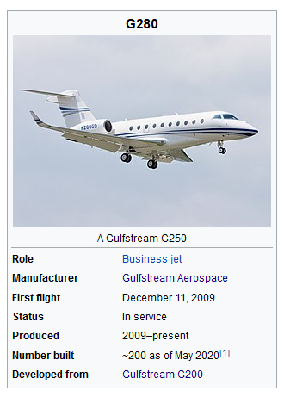
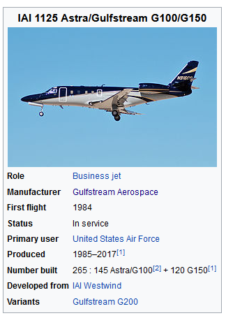
Initial G150 Heater STC Action Planning
Discovery Understanding – Peregrine Collaboration: (HA WIP)
  Secure details & share in AGG
    Pricing and structure of the STC
    Details of the heater STC and high level pro/ con expectations
  G1/200/2(5)80 with same issues? No STC even if problem? Opportunity? Gulfstream?
    S.S. White Flexible Rotary Shafts Drive Flap And Slat Actuation
    Systems On The Gulfstream G150 and G200 Business Jets
Discovery Research (LC – WIP)
  Compiled list of G-150 serial number
    Correlated serial numbers with registration data
    Data mining operators WIP (~10% done)
  Reviewing, refining target list and contact info
    Existing, new data gathering , etc., as needed.
    Target aircraft in US and Canada first (100 airframes)

Slide 4
Initial G150 Heater STC Action Planning
G150 Countries of Registration/ Quantity
USA | 90
Canada | 10
Mexico | 5
Australia | 3
Brazil | 3
Chile | 2
Philippines | 2
Austria | 1
Cayman Islands | 1
India | 1
Isle of Man | 1
Malta | 1
Poland | 1
Turkey | 1
Venezuela | 1
Initial Opportunities Priority
  Primary USA, Canada
  Secondary (?)
  Tertiary/ Unlikely

Slide 5
Initial G150 Heater STC Action Plan
Initial Execute Plan/ Plan (Chase & Capture)
  Primary = Engage direct PERSON<>PERSON influencers
    Follow up with calls based on Mailchimp responses
    Continuous process until all opportunities processed
  Secondary = Indirect contacts via targeted email, trade shows (AEA)
    Mailchimp – to operators, owners, shops that work on g-150s
    Indirect contact - web site, snail mail, trade shows (Peregrine AEA booth handouts, media blasts/ press release)
    Snail mail follow up to operators, owners, shops that work on G150s
    Develop collateral marketing items to support AEA (others), direct mail
    Media advertising opportunities?? NBAA, Gulfstream owners orgs (none found in web search)
  Simultaneous primary & secondary actions … continuous refinement process
Communication process - who is Peregrine POC for processing STC RFQ and purchases
Other actions ... WIP/ TBD

