Slide 1
Update - G150 Heater STC Chase & Capture
Challenges
Discovery
Execution Plan/ Plan
(Please see HA comments, added from discussions with Dave Rankin on 22 Feb 22)
Update v05 23FEB2022

Slide 2
G150 Heater STC C&C Reminder
NO Gulfstream Service Bulletin/ Info Letter(?)
  Seems a very low, no consideration at GS
Low or no operator awareness
Competition is “DO NOTHING”
Challenges of finding the actual operator and decision maker
  Identify people who are buying influences
    Economic Buyer = yes/no/veto
    User
    Technical
See Strengths & Weaknesses Chart, to follow
Update v05 23FEB2022

Slide 3
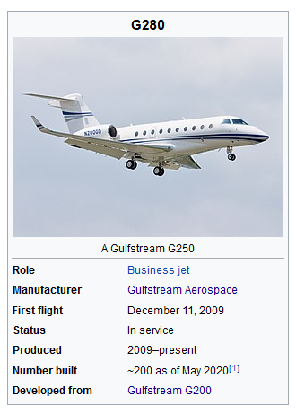
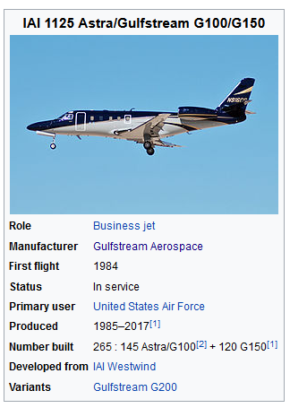
Initial G150 Heater STC Activity
Discovery Understanding – Peregrine Collaboration: (HA WIP)
  Pricing and structure of the STC
  Details of the heater STC and high level pro/ con expectations
  Create “Strawman” offer structure
Discovery Research (LC – WIP)
  Correlated serial numbers with registration data
  Data mining operators WIP – Almost Complete
  JetNet data received, processed
  G150 qualified shops – FAA Part 145 ticket information (WIP)
  G150 Gulfstream Service Center census w/ contact info
Reviewing, refining target list and contact info
  Existing, new data gathering , etc., as needed.
  PRIMARY G150 targets (Confirmed)
    US and Canada first (100 airframes … see following)
Update v05 23FEB2022

Slide 4
Initial G150 Heater STC Action Planning
G150 Countries of Registration/ Quantity
USA | 90
Canada | 10
Mexico | 5
Australia | 3
Brazil | 3
Chile | 2
Philippines | 2
Austria | 1
Cayman Islands | 1
India | 1
Isle of Man | 1
Malta | 1
Poland | 1
Turkey | 1
Venezuela | 1
Initial Opportunities Priority
  Primary USA, Canada
  Secondary
  Tertiary/ Unlikely
Update v05 23FEB2022

Slide 5
Initial G150 Heater STC Action Plan
Initial Execute Plan/ Plan (Chase & Capture)
  Primary = Engage direct PERSON<>PERSON influencers
    Follow up with calls based on Mailchimp responses
    Continuous process until all opportunities processed
  Secondary = Indirect contacts via targeted email, trade shows (AEA)
    Mailchimp – to operators, owners, shops that work on g-150s
    Indirect contact - web site, snail mail, trade shows (Peregrine AEA booth handouts, media blasts/ press release)
    Snail mail follow up to operators, owners, shops that work on G150s
    Develop collateral marketing items to support AEA (others), direct mail
    Media advertising opportunities?? NBAA, Gulfstream owners orgs (none found in web search)
  Simultaneous primary & secondary actions … continuous refinement process
Communication process - who is Peregrine POC for processing STC RFQ and purchases? (David Sam – dsam@peregrine.aero)
Other actions ... WIP/ TBD
Update v05 23FEB2022

Slide 6
G150 “Heater” STC
Discovery & Understanding WIP
  Pricing And Structure
  STC Details
  High Level Pro/ Con Expectations
  Create “Strawman” Offer Structure
Update v05 23FEB2022

Slide 7
STC Pricing & Structure Understanding
Standalone STC package Considerations
  Pricing = $45K (Confirmed)
    Parts kit included, parts list (Confirmed)
  Lead time (Confirmed)
    License & paperwork
    Parts, included (6 months lead time for Cox heaters)
  Secure GS referral POC (TBD, WIP – Wes)
    Need discussion with GAC FAST contact to get better feel for ops issues
    Secure referral process at Flight Safety (re N15PV experience)
G150 Operator-Preferred MRO - Peregrine Info Assist (Confirmed)
  Peregrine additional documentation; install “guidance” (Q&A?)
  Non-binding, disclaimer, info for consideration ONLY doc
  Need to help installer “get it right”
Update v05 23FEB2022

Slide 8
STC Pricing & Structure Understanding
Preferred turnkey installation = Peregrine/ Straight Flight (Confirmed)
  Straight Flight, Inc and/or Straight Flight Conversions, Inc.
    Sierra Nevada’s FAA/EASA Part 145 Certified Repair Station
  Price X-Peregrine = $164.5K (N15PV quote basis) (Confirmed)
    Install parts via Peregrine or Straight Flight
    Straight Flight = Subcontract
    Assumes Peregrine overall program management
  Lead time; Peregrine & Straight Flight?
    About 6 months parts lead time due to Cox heater availability
  Downtime about 3 weeks installation time
    Slats/ Flaps removal and reinstall required (calibration considerations – slats)
IFF G150 operator preferred MRO/ Non-Straight Flight (Confirmed)
  STC package only = $45K
  Peregrine info assist, on info basis
    Peregrine additional documentation; install “guidance” (Q&A?)
    Non-binding, disclaimer, info for consideration ONLY doc
  Approach select entities re interest in working with Peregrine STC (WIP AGG)
    Need action plan
    Duncan is primary (contact at Duncan?)
    G150 authorized MROs (WIP – Lee)
    Others?
Update v05 23FEB2022

Slide 9
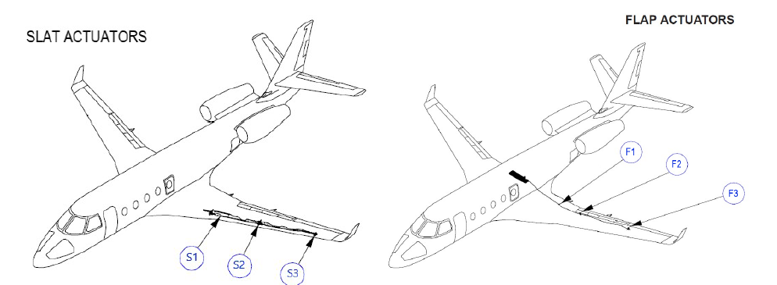
STC Detail Considerations
Existing G150 Flap/Slat System
  G150 Flap/Slat drive system
    Power Drive Unit (PDU)
    Flexible drive shafts
    Twelve linear ball screw actuators (3 per wing, 2 systems)
  Relative location of the actuators for each wing shown in drawing
  STC does not modify the G150 Flap/Slat drive system including controls, indications, safety mechanisms or recommended lubrication maintenance procedures
  Existing flap/slat actuators are modified by the installation of external supplemental heaters only.
Update v05 23FEB2022

Slide 10
STC Detail Considerations
Supplemental Heater System (Confirmed)
Flap/Slat Actuator Heating System (FSAHS) supplied by Cox and Company
  Flap/Slat (F/S) Heat Controller
  Six flap actuator heaters
  Six slat actuator heaters
  ON/OFF switch/ annunciator
Heat controller automatically cycles power to the Flap and Slat heaters if the actuator temperature drops below 40° Fahrenheit (F)
Thermistor on each actuator is used to activate the system
Installation includes an automatic load shed feature, that will remove power from the system in the event of a loss of an engine generator
Update v05 23FEB2022

Slide 11
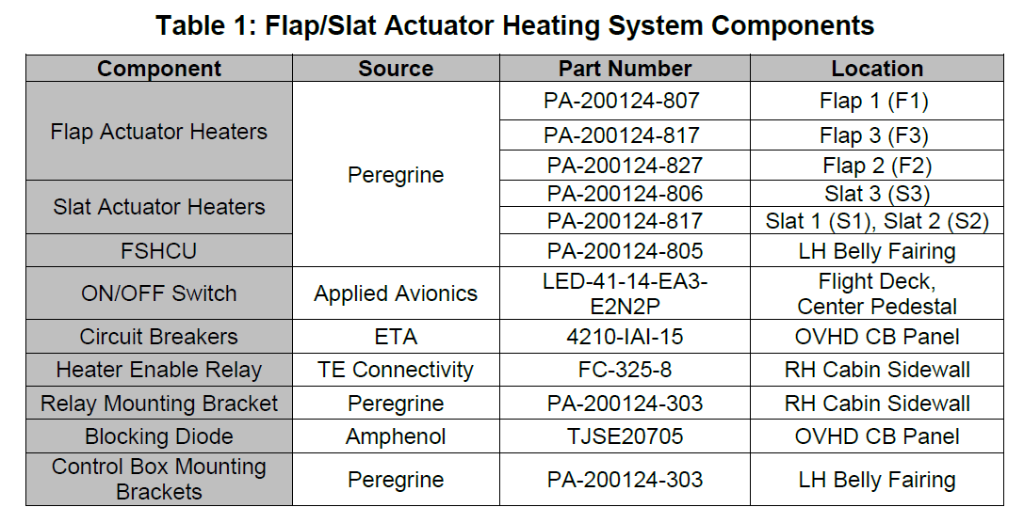
STC Detail Considerations
Update v05 23FEB2022

Slide 12
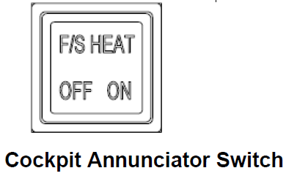
STC Detail Considerations
Heaters
  Cox has designed four heater part numbers for the Flap/Slat actuators on the G150
    All are of the wrap-around, cuff-style, design and are mounted on the exterior of the actuators
    Secured with stainless-steel band clamp(s)
    Thermistor installed on each heater
  Provides temperature feedback data to the FSHCU allowing automatic cycling of actuator heaters and ensures the upper limit of 130° F is not reached
Heater Enable Switch/Annunciator
  The system is enabled by an ON/OFF Switch installed on the aft end of the center pedestal of the flight deck, within the reach of either pilot
Update v05 23FEB2022

Slide 13
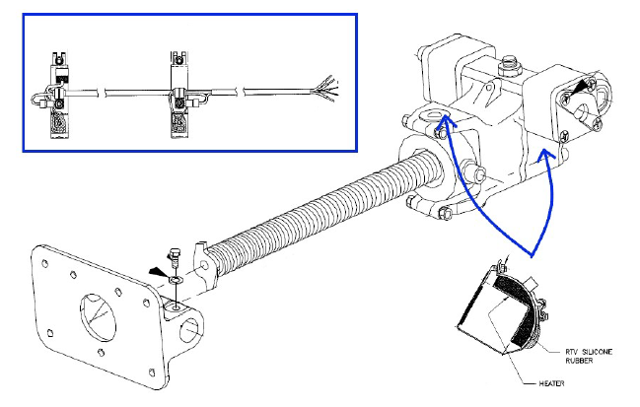
STC Detail Considerations
Controller
F/S heat controller is mounted on the right side of the lower fuselage under the belly fairing
  Accessed by opening the emergency brake access panel (141AB)
Flap Actuator Heaters
  Actuator #1 requires PA-200124-807 heater
  Actuator #2 requires PA-200124-827 heater
  Actuator #3 requires PA-200124-817 heater
Each heater consists of two heating elements and a thermistor
The heaters may be inspected with the flap extended
Update v05 23FEB2022

Slide 14
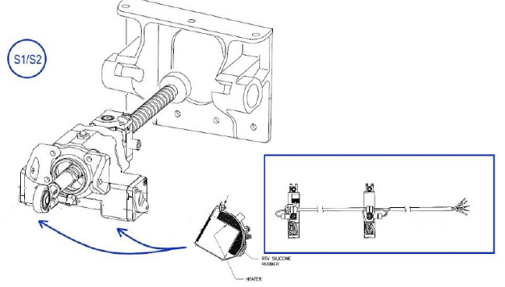
STC Detail Considerations
Slat Actuator Heaters
  Two heating elements and a thermistor, or a single heating element and thermistor depending on specific slat on which to be installed
  Secured to the square portion of the slat actuators as shown.
  The other type heater is a circular design to fit securely around actuator 3
Update v05 23FEB2022

Slide 15
STC Detail Considerations
System Power Source
  28 Volt direct current (Vdc) power is supplied to the controller via two 15 Ampere (A), Circuit Breakers (CBs) located on the cockpit overhead panel
  One CB powers the flap heater channel and the other powers the slat heater channel
Update v05 23FEB2022

Slide 16
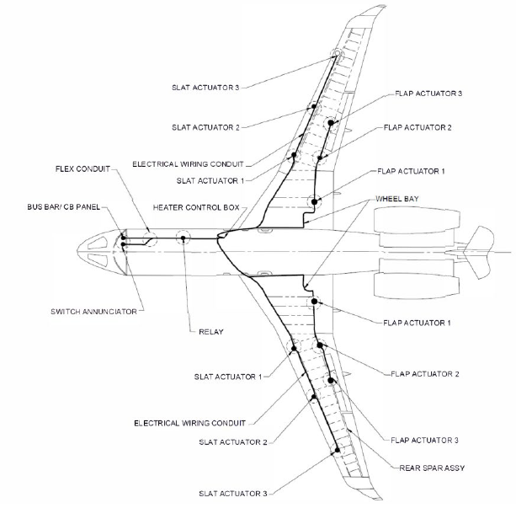
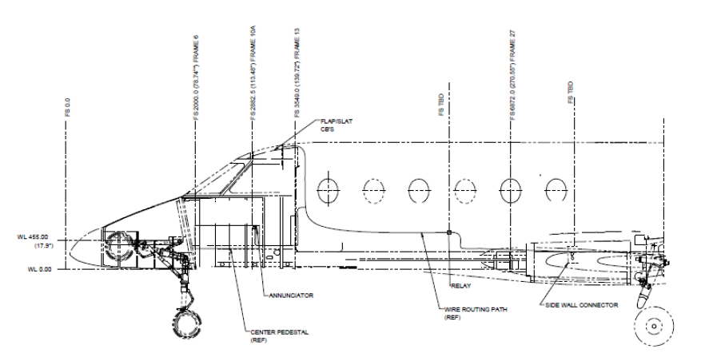
STC Detail Considerations
Wire Routing
  Figures depict routing of installed wires
  Wires are routed adjacent to existing airplane wire bundles to the maximum extent possible.
  Wiring in cabin is accessed by removing the sidewall, ceiling, or center pedestal access panels
  Wiring external to the aircraft is accessed by removing the necessary access panels
Update v05 23FEB2022

Slide 17
STC Detail Considerations
Control Logic
  The FSHCU is comprised of two separate sections (channels)
    One channel controls six flap actuator heaters
    Other channel controls the six slat actuator heaters
  Activates all heaters on a channel when any of the thermistors on that channel sense temperature below 40ºF
  Deactivates all heaters when all sensors readings are above 60ºF to prevent a thermal overheat
  Any sensor temperature exceeds 130º F, the system will de-power all heaters on that channel
    System will reactivate once the actuator has cooled below 110º F.
Built in Test Function
  The control unit contains Built-In-Test Equipment (BITE) that checks the system integrity
    Test is performed at Power-on and periodically during normal operation
Update v05 23FEB2022

Slide 18
STC Detail Considerations
MAINTENANCE CONSIDERATIONS
  Particular attention should be given to clamping of wire harnesses in the wing leading and trailing edge areas
  The system installation allows for the heater clamps to be secured to the actuator housing in a position that is clear of the moving actuator components
  When servicing wiring to the heater clamps, ensure that the wiring is securely clamped, clear of moving parts prior to aircraft return to service
F/S Control Box
  Contains no line serviceable components
  Controller maintenance is “on condition”
    Requires no periodic checks, tests, inspections
    No mandatory replacement intervals
    Recommended that approximately every six months, the system test is accomplished
Actuator Heaters
  Contains no line serviceable components
  Maintenance is “on condition”
    Requires no periodic checks, tests, inspections
    No mandatory replacement intervals
    Recommended that approximately every six months the following maintenance actions should be performed to ensure the actuator Heater will function correctly
      Visually inspect the heaters for any damage
      Inspect the heater wires for signs of chaffing or environmental damage
      Verify the heater is securely attached to the actuator
Update v05 23FEB2022

Slide 19
STC High Level Strength/ Weakness
Strengths
Weaknesses
Comprehensive G150 contract info
  G150 data from JetNet
Flight Safety training advised client of STC (N15PV)
Fixes operational issue for added value
  Payback visibility – how many diversions?
Reasonably inexpensive fix (~$165K turn key or $45K STC)
GAC G150 FAST fleet retrofit completed
  SV/ Straight Flight – ARA
  Learning curve complete (i.e. S/ F calibration issue)
GAC FAST Team Chief Pilot Possible Reference (WIP Wes)
  Tips & insights possible via GAC FAST effort
SV/ Straight Flight MRO (If operator already using)
Reaching the decision makers/ influencers
  Investment & payback need clarification
“Real” op issue? = education/ What problem?
  No industry “alerts” on ops issue
  Need FAST xface discussion
  Ops issues from actual operator
  Real value-added – why did DAC do this?
No GAC formal support (i.e. SB)
No GAC formal endorsement
Long lead time for parts (COX)
Only MRO is Straight Flight ARA
  Location adds costs, i.e. ferry flights
  If not operators preferred MRO
Update v05 23FEB2022

Slide 20
G150 “Heaters” C&C Actions
Finish “Discovery” phase re STC basics – HA WIP
  GAC FAST feedback, info xface discussion – WL/ HA WIP
GAC FAST referral – WL WIP
Explore Flight Safety referral process & duplicate – HA Coord/ WL
Contact Duncan re interest in teaming – HA Coord
Determine other MROs interest/ positioning re interest in teaming – HA Coord
Vet G150 JetNet data to establish priorities – LC, HA WIP
  Direct & indirect contact action plan
Discover G150 hourly TOC (IOC + DOC) re value-added & payback calc – LC/ HA WIP
Others?
Update v05 23FEB2022

Slide 21
G150 Heater STC Campaign
Market Research Updates v05 23 Feb 2022
Update v05 23FEB2022

Slide 22
G150 Heater STC C&C Update
Primary market research data
  Owner, operator data
    Received dataset from JetNet
      AviaGlobalGroup\AGG Client Info\Peregrine\G150 STC CnC\220211 - Contact Summary Data.xlsx
    Statistics:
      118 with phone numbers, 6 without
      91 with email addresses, 30 without
        7 invalid email addresses per zero bounce
      2 aircraft with zero contact information
    2 aircraft missing (s/n 241-written off 251)
  Key to direct C&C activity
Update v05 23FEB2022

Slide 23
Missing Aircraft
s/n 241 – Written off
  https://www.flyingmag.com/news-no-injuries-hendrick-gulfstream-crash/
s/n 251 – Status unknown
  https://www.wsav.com/news/local-news/jet-lands-in-swampy-area-at-ridgeland-airport/
  https://aviation-safety.net/database/record.php?id=20210505-0
Update v05 23FEB2022

Slide 24
“Systems Related” Service Bulletins from GS
Gulfstream Releases Three Service Bulletins for the G150
September 2015
Gulfstream has released three Service Bulletins (SB) for the G150 aircraft, and the company recommends that all three be taken care of at the same time.
SB 150-27-169 is to replace the flap and slat power drive units (PDUs) and ballscrew actuators. This SB affects serial numbers 201 through 313 and was issued because the current configuration has not demonstrated the expected reliability. The recommended compliance period is within 24 months of the release date of the SB (August 28, 2015).
Service Bulletin 150-27-181 is to replace the flap/slat electronic control unit (FSECU). This SB affects serial numbers 201 through 315 and was issued because operators say in certain actuator positions, the FSECU flap system protection circuit didn't work. Continuing to apply power in this situation could degrade or damage the flap PDU motor drive components. The recommended compliance period is within 24 months of the release date of the SB (August 28, 2015).
Service Bulletin 150-27-180 is to upgrade the Flap/Slat flexible shaft. This SB affects serial numbers 201 through 317 and was issued because a new configuration for the flap and slat flexible shaft assembly is available. The new configuration uses Aeroshell 33 grease, incorporating MIL-PRF-23827, Type I (Lithium based), and it replaces MIL-PRF-23827, Type II (clay based).
All three Service Bulletins are part of a Managed Program thru Gulfstream. Operators will need to contact Gulfstream to have the parts allocated and ordered for their aircraft. Please refer to the Service Bulletins for compliance times and warranty provisions.
Because Duncan Aviation is a Gulfstream Authorized Warranty Facility, all three of our main sites (Lincoln, Nebraska; Battle Creek, Michigan and Provo, Utah) are approved to perform the Service Bulletins under Gulfstream warranty as listed.
Update v05 23FEB2022

Slide 25
Indirect Marketing
Gather contact data for direct contact
Create Collateral
  Press Release – Strawman written (WIP) – circulating for review
  Mailchimp
    Multiple - Send press release to press types – press list ready
    Multiple - Send details to identified contacts with emails – email list ready. All contacts identified by JETNET w/emails
  Brochure
    Draft snailmail mail piece - available for review
    Mailchimp attachment brochure will be based on snailmail piece
  Trade show planning & scheduling (WIP) – plan to use mail piece and FAQ
    Repeatable process for trade show participation (booth or roaming)
    AEA (prototype process)
      Materials & contact plan for G150 MRO Peregrine booth visit invites & follow-through - developing list of airframe Part 145 shops for email blast to visit Peregrine booth for additional information
      Booth material – Mail piece, FAQ…
      Targeted web page
      Coordinate creation of giveaways with Peregrine
Update v05 23FEB2022

Slide 26
Workflow
T₀
Develop material
All Approvals
Telephone cold calling, follow ups, etc.
Send Mail Piece
Press blast
Email blast
Update v05 23FEB2022

