Slide 1
Peregrine Introduction to GE Aerospace
System and Installation Designs, Approvals and Hardware: From the Drawing Board to the Sky

Slide 2
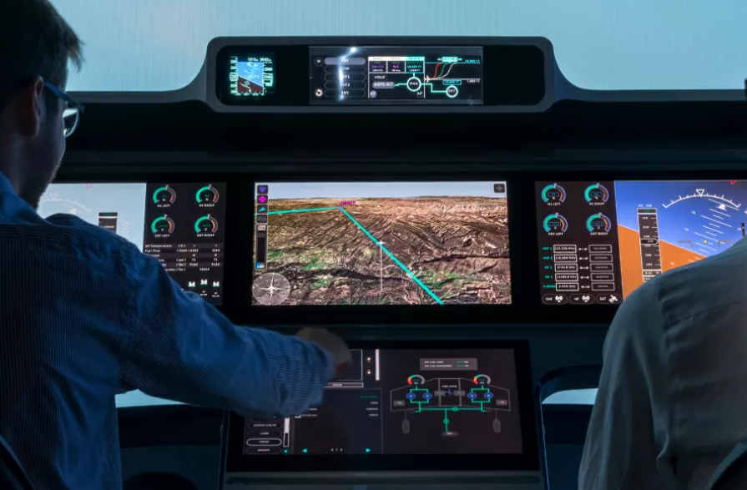
Our Mission
Provide end-to-end FAA-approved STC solutions for our customer/partner network using trusted avionics equipment and proven FAA certification methods
Peregrine
FAA STC Approval
Customer/ Partner Network
Trusted Avionics
Installing new avionics in existing airframes
An STC (Supplemental Type Certificate) is an FAA-approved design change that supports alteration of an aircraft for the purpose of improving safety, functionality, performance, or maintainability

Slide 3
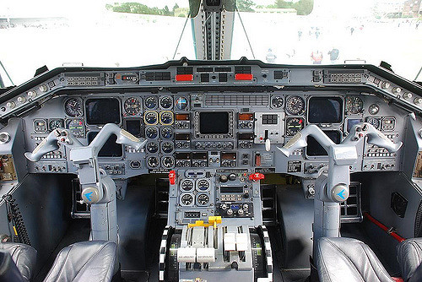
Peregrine Certification Experience
Many aircraft:
Many systems:
Flight deck updates
Attitude Heading Reference Systems (AHRS)
FANS 1/A system
ADS-B OUT system
ADS-B IN system
TCAS II system upgrades
TCAS II compatible Mode S
Flight data recorders
VHF COM radio
Parts obsolescence solutions
Replacing old avionics with modern systems

Slide 4
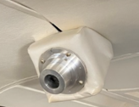
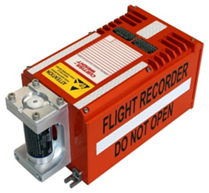
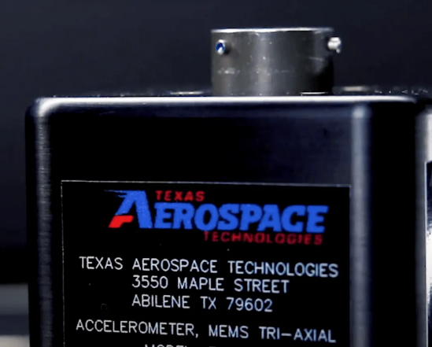
Capabilities
Engineering, certification and manufacturing.
ODA application submitted 2020; expecting 1Q23 award
Peregrine has been in business 13 years.
Has obtained 30 unique STC’s with installations and PMA’s on thousands of aircraft.
Experience with Garmin, Honeywell, Universal, Becker, Mid-Continent/True Blue, Trig, Freeflight, and others.
Gulfstream, Dassault, Bombardier, Lear, Textron

Slide 5
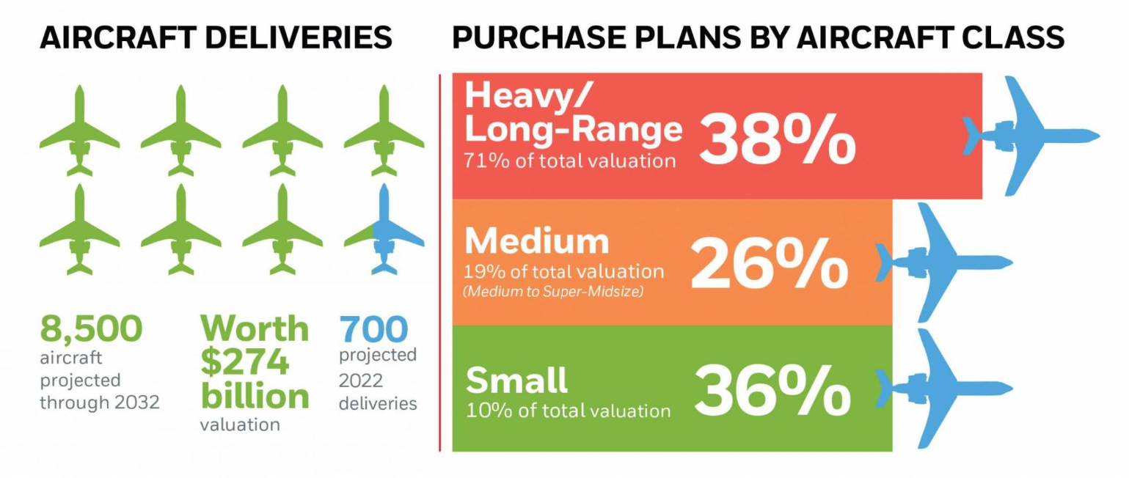
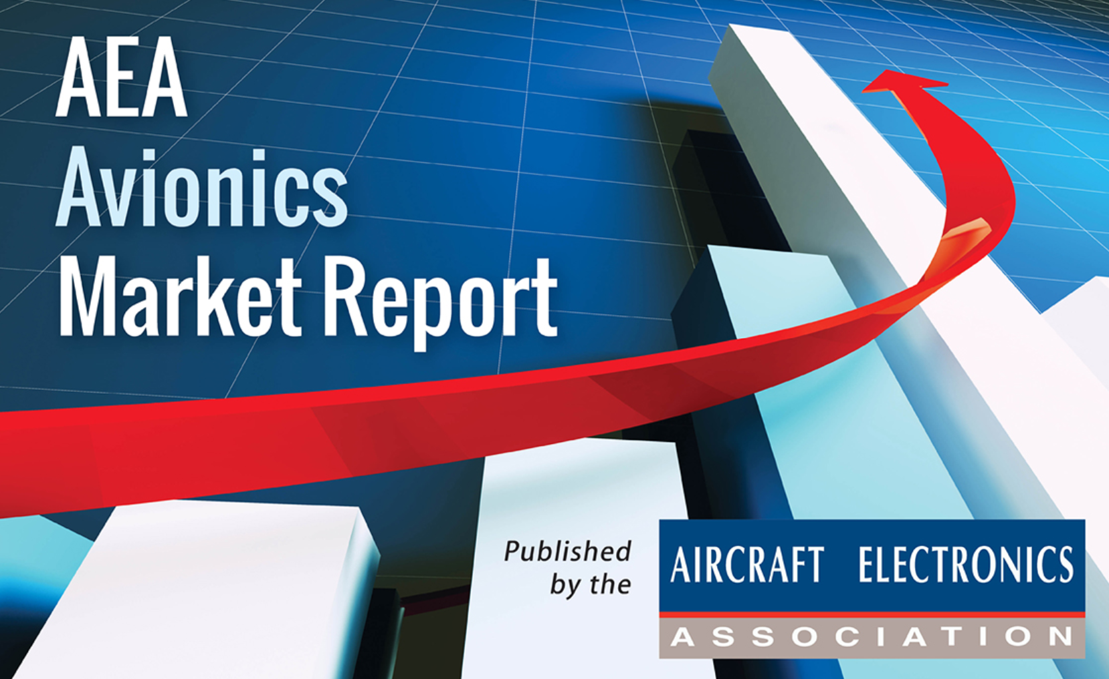
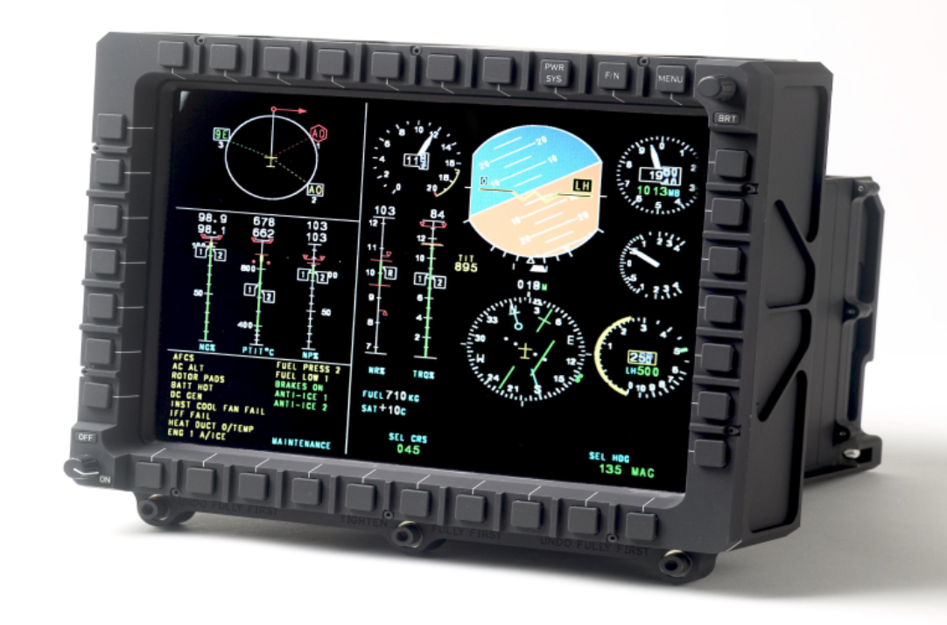
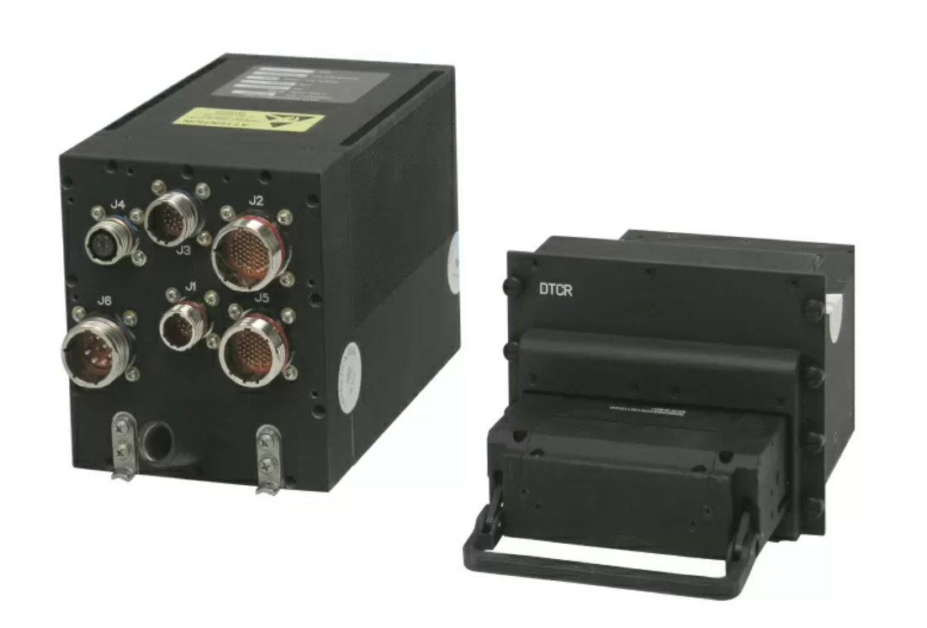
Corporate Aviation: a Growth Market
Honeywell forecasts continued rebound and growth in Business Aviation.
AEA reports 16% increase in avionics segment 2022 over 2021.
New aircraft sales up; older airframes are being retrofitted, not retired.
Avionics growth drivers:
New products in high demand (airborne WiFi).
Regulatory requirements (ADS-B, FANS, NextGen).
Parts obsolescence solutions (OEM fleet support).
Pilot retention

Slide 6
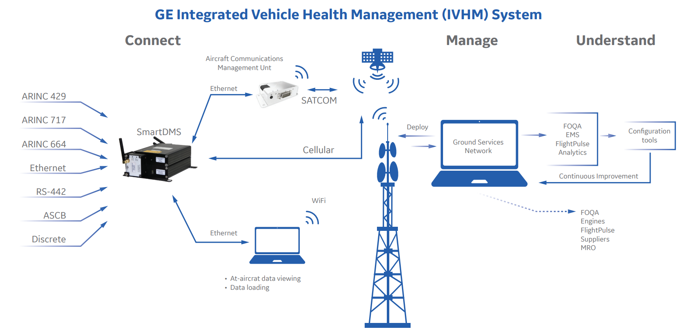
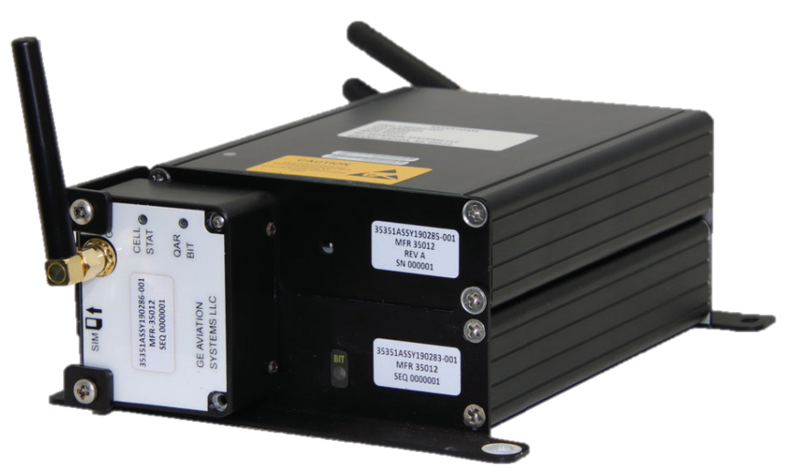
Potential Project with GE Aerospace
STC on a corporate aircraft such as the Cessna 750 to install GE’s data management system as part of a FOQA program

Slide 7
Expertise in Corporate Aviation
Engineering + Certification + Manufacturing expertise is a rare combination.
Peregrine is known for high quality, on-budget, on-schedule.
Aircraft OEM’s focus on forward fit, not retrofit.
Equipment manufacturers are often resource-constrained due to primary emphasis on component level development.
Upgrade decisions are driven by commercial needs.
Business aviation traffic remains 16% above pre-COVID levels:

Slide 8
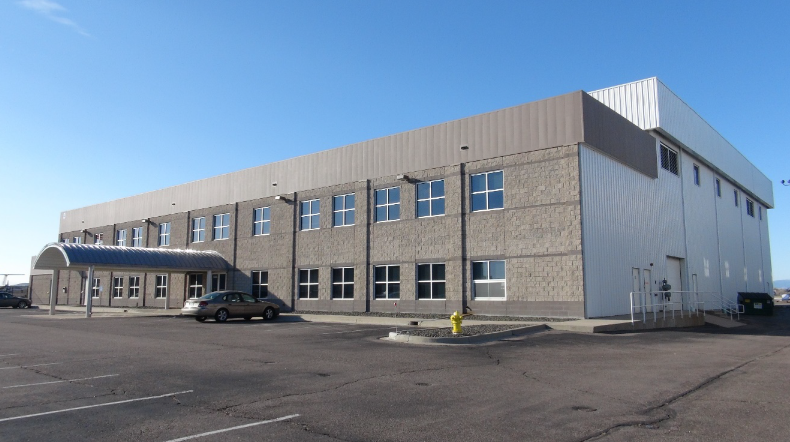
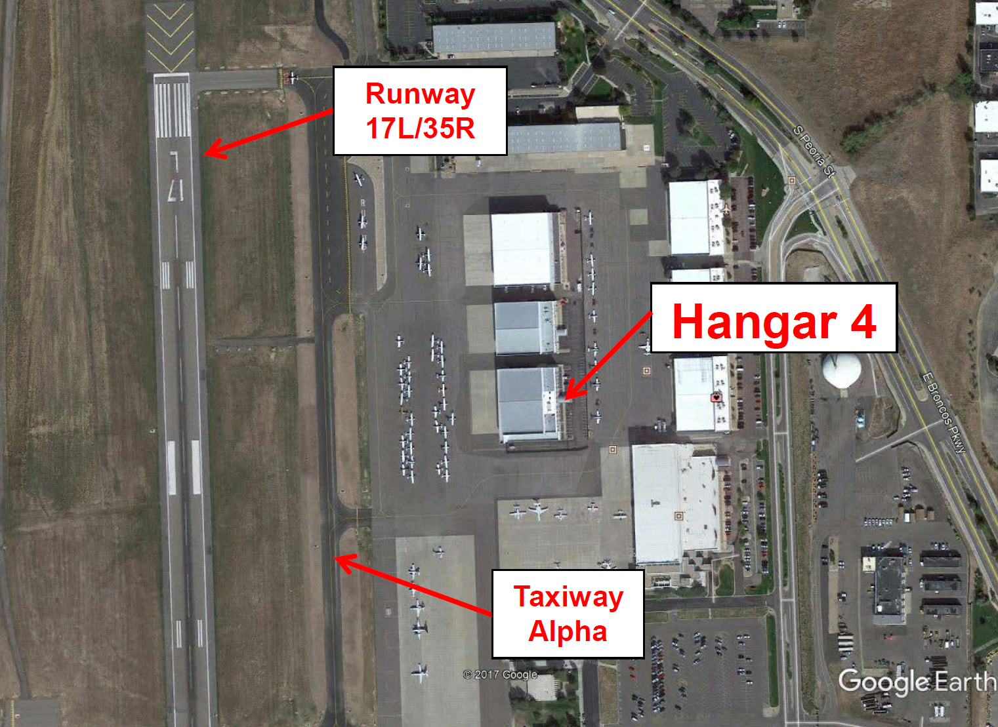
Excellent Facilities with Expansion Potential
Denver, Colorado Metropolitan Area
Centennial Airport (APA)
Peregrine 7385 S Peoria Road Englewood, CO 80112
+1-303-325-3873
www.peregrine.aero
Centennial Airport
Leased offices at TACAir, Centennial Airport (SE Denver area)
Engineering, admin. offices and shop space totaling 3,250 sf.
Growth
Ability to expand into hangar space within same building
Denver has large, diverse aerospace business & labor base

Slide 9
David Rankin, CEO
Peregrine Avionics 2009 - present
Founder, President and Electrical Systems DER.
Led development of 20 STC’s covering Parts 23, 25, 27 and 29 aircraft including Gulfstream, Challenger, Falcon, Hawker, Lear, Sikorsky, Piper, Beechcraft, Bell, Robinson, MD Helicopters, Airbus Helicopters, Augusta, Cessna, Citation Jet, and several AML’s.
Grew company to 10 employees and $1.9m in revenue.
Adam Aircraft Industries 2001 - 2009
Director of Systems Engineering: Led 25 engineers and designers to develop electrical and avionics systems included in the Type Certificate for the A500 aircraft in conjunction with both the Denver and Chicago ACO’s.
FAA Designated Engineering Representative for electrical systems on the A500 aircraft.
Electrical Systems Manager for systems on A500 and A700 models; supported flight test.
US Air Force 1995 - 2001
Officer, Development Engineer, Defense Contract Management Agency - Lockheed Martin Astronautics
Officer, Development Engineer, Electronic Combat Support Flight - Special Operations Command
Education
Georgia College & State University – Masters of Business Administration, 1998
United States Air Force Academy – Bachelors of Science in Electrical Engineering, 1995

