Slide 1
Flying & COVID-19
Helping Eliminate The Airline Exposure GAP
Aviation Clean Air Ionization System Solution
Peregrine & AviaGlobal Group Turnkey - ACA Device Provider

Slide 2
COVID-19 & Air Travel Situation
Issues
  Fear Of Flying
  Economic Restrictions
    Business Travel Reductions Due to Budgets & Health Safety
    Reduced Or Complete Loss Of Discretionary Income
  Institutional Restrictions
    Governmental Barriers On Travel
Impacts
  Extreme Airline Business Interruption
  Idled Aircraft Per A4A = 1,758 (16AUG20 – not flown in previous 7 days)
  Extremely Low PAX Totals & Low Load Factors = Reduced Cash Flow/ Revenue
  Negative Multiplier Effect Throughout World Economies

Slide 3
COVID-19 & Air Travel Situation - PAX
Addressable, Problematic Solutions – “Afraid To Fly”
Less Controllable Solutions – Institutional, Economic Restrictions
PAX Volume Slowly Increasing
  Load Factors About 50%
    Flights Better Match Demand
    Parked Aircraft Factor
  Sustainable? Est 2024 > Recover Growth
  Relapses?
    Recovery A Series Of “W” Curves?
  Vaccine Seems To Be Cure To Travel Recovery
Overwhelming Need - Immediately Accelerate Increase In PAX Count
Addressable Solutions Are In Progress – Lower Fear, Instill Confidence
Obvious To Airline Businesses – We Understand, Can Help, ON Aircraft

Slide 4
COVID-19 & Air Travel Situation - Aircraft

Slide 5
Fear Of Flying – Most Controllable
IF Safe To Fly, Then Create & Deliver The Message – In Progress
  Individual Airlines & A4A Ramping Up Safe To Fly Messaging … Daily!
  Joint RTCA SC-241/ EUROCAE WG-121 To Issue Harmonized Cleaning Guidance ~08DEC20
Flying Needs Holistic Approach To COVID-19 Defense
Exposure & Layer Defense COVID-19 (SARS-CoV-2 Virus)
Airport GROUND SIDE DEPATURE
AIRBORNE
Airport GROUND SIDE ARRIVAL
Social Distancing
Masks
PAX Temp Checks
Touchless Check In
Faster TSA Checks
TSA Staff PPE
Expanded Air Filtering
Facilities Ionization Installations
ON Aircraft
Social Distancing
Masks
Faster Bag Delivery - UNKN
Bag Disinfecting - UNKN
Expanded Air Filtering
Facilities Ionization Installations
Social Distancing – Very Limited
Masks – Defense Limited
Disinfecting – Self & Cabin Crew
ECS HEPA Filters
Airflow Capture
Captures COVID-19 Virus In ECS
Mixes With Outside Air
2-8 Minute Complete Refresh
Off Airport Transportation Is Still An Issue & Extent Of Defense Is Unknown

Slide 6
A4A SmartBrief – COVID-19 Defense PR
Behind the scenes how airlines are protecting passengers
NBC took an inside look at how Delta Air Lines is protecting passengers and crew onboard with HEPA air filtration filters. The filters circulate a combination of fresh and filtered air through the aircraft every two to four minutes, resulting in the quality of air circulated being similar to that of a hospital operating room. "It turns out the time on the airplane in the seat is the lowest risk," according to an expert.
Full Story: Today (7/7)

Slide 7
The Onboard Issue – “GAP” In Defenses
“Anyone who’s paying attention knows that increasingly, virologists are finding that fomites (surfaces) are a minor infection path. Exhaled droplets and aerosols are the real worry and the physical distancing that airliner cabins simply can’t provide is the best defense against that, with masks as a distant second. The airlines may be catching on to this, too. I saw an in-depth story on how cabin air is cleaned through HEPA filters in the air packs. All good stuff, of course, but still ignores that a person coughing or sneezing nearby represents some level of unknown risk and it overlooks the crowd on the jet bridge, in the boarding area and when deplaning.”
“Avweb” – Paul Bertorelli, 09 July 2020
https://www.avweb.com/insider/the-airline-biz-clawing-back-can-hardly-be-called-a-recovery/?MailingID=393

Slide 8
COVID-19 Virus Defense “GAPs”
Temp Check Is A Feel Good Measure That Does Not Begin To Catch All COVID-19 Carriers
  COVID-19 Carriers Can Be On A Flight – No Way To Catch 100%
  If There Is A COVID-19 Carrier On Board, The Virus Has Good Chance Of Escaping Into The Cabin, In Form Of Aerosol And Surface Distribution
Problematic Masks
  Homemade, Ineffective Masks
  Not Constantly In Place – Breathing, Eating, Drinking, Sneezing, Coughing, Not Wearing In Defiance
  Even When Wearing A Mask, Sneezing Send Aerosol Virus Out As Far As Two Rows Forward And Aft As Well As Laterally Past Several Seats

Slide 9
COVID-19 Virus Defense “GAPs”
Limitations To Aircraft Preparation Disinfecting
  Many Variables To Manage
    Skill Set, Motivation Of Cleaners
    Repetitive Task Diligence
    Span Of Control - Supervision & Quality Control
Limitations To In-Operation Onboard Disinfecting
  Generally Limited To Wipes, Some Unique Use of UV-C On Flight Decks, Lavs
  Aerosol Disinfectants
    Limited Use Or Not Allowed Due to Allergies & Toxicity
    Portable Ionization Sprayer Use?
    As Good As Use
  Takes Active Participation By PAX And Crew

Slide 10
COVID-19 Virus Defense “GAPs”
Problematic Onboard Social Distancing
  Some Airlines Are Examples Of Trying To Social Distance By Blocking Seats
  Some Airlines Are Not Blocking Any Seats = NO EFFECTIVE SOCIAL DISTANCING ON BOARD
  Boarding & Leaving Aircraft Using Social Distancing Is Helpful

Slide 11
COVID-19 Virus Defense “GAPs”
HEPA Filters Are Key Element Of The Layered Defense
  Inflight Cabin Air Is Mixed With Outside, Clean Air
    Engine Bleed Air On All But B787
  All Air Introduced To Aircraft, Ground & Flight, Pass Air Through HEPAs
  Aircraft Air Distribution Replenishes Air Every 2-4 Minutes
    Faster On Flight Deck, Then Cabin Front To Back
    Replenishment Slower In Back
    Aerosols Pathogens, Like Covid-19 Virus, Lingers & Settles, Not All HEPA Captured
  HEPA Does Not Filter Virus That Is Not Sent Though The ECS
    Pathogens Settle On Surfaces
    People, Seats, Tray Tables, Floors, etc.

Slide 12
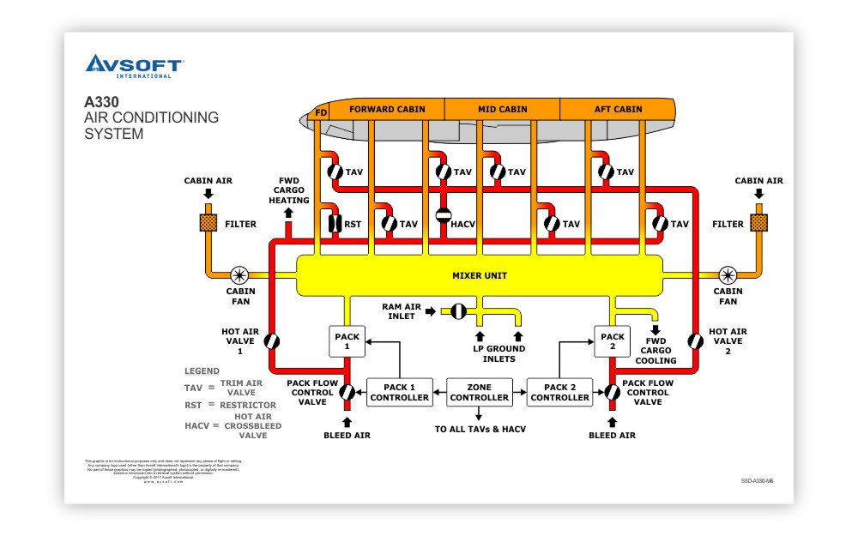
Aircraft Ground Operation = Layer GAP
Ground Operation Higher Risk
Air Flowing Through HEPAs Comes From Cabin
  On Ground, APU/ Engines Not Operating
    Mixed With Un-, Poorly Filtered PCA Air
    See “LP Ground Inlets” In Diagram
      Introduction Point For Ground Air
  APU Or Engines In Operation, ECS On
    Mixed With Bleed Air, Heat Sterile

Slide 13
COVID-19 Virus Defense “GAPs”
Covid-19 Virus Can Be Transmitted In Aerosol Form, Per Below
  “Converging Lines Of Evidence Indicate That SARS-CoV-2, The Coronavirus Responsible For The COVID-19 Pandemic, Can Pass From Person To Person In Tiny Droplets Called Aerosols That Waft Through The Air And Accumulate Over Time. After Months Of Debate About Whether People Can Transmit The Virus Through Exhaled Air, There Is Growing Concern Among Scientists About This Transmission Route.” “Nature” Magazine, 08 July 2020
  Aerosol Virus Can Suspend In The Air For 2-8 Minutes Before Flowing Into The ECS Intake To Be Captured By The HEPAs
  While HEPAs Are ~99.7% Effective, Not All The Cabin Particulates, Including The Virus Make It To The HEPAs

Slide 14
COVID-19 Virus Defense “GAPs”
  Virus Settles On Physical Surfaces – People, Clothes, Seats, Seat Trays, Bulkhead, Decks, Aircraft Cabin Equip, Etc.
    Surface Virus Active For Up To 72 Hours
    Particular Issue In Small Concentrate Areas Like Galley And Restrooms
    ECS Mixes Outside Air And Filtered Cabin Air
      While Airborne, The Outside Air Is Likely Not To Contain Active Virus
      Ground Operation Can Introduce Virus Through Ground PCA Unit Via ECS Using Outside Ramp Air To Mix With HEPA Filtered Air

Slide 15
COVID-19 Virus Defense “GAPs”
Airlines Marketing Spin Is That Aircraft Are Indeed Safe, But Only Tell Part Of The Story
Does Not Address The Ground & Airborne Gap In Virus Defense
  Will The Spin Work Or Will PAX, Media Decode The Spin And Airlines Face Blow-back?

Slide 16
ACA Ionization – Filling Defense GAP
ACA (Aviation Clean Air) Ionization Systems Solution
  Aviation Adaptation Of Solution Used, Approved For Clean Room Applications, Such As Hospitals – ACA Design Patented (https://www.aviationcleanair.com/)
    Independent Lab Testing Reports Available Online
  Licensed Technology From GlobalPlasma (https://globalplasmasolutions.com/ionization/), Utility Patented
Simple Installation & Cert
  Component Mounted On To The Existing Environmental Control System (ECS) Supply Duct
  Electronically Creates Positive & Negative Ions From The Hydrogen And Oxygen Molecules In The Water Vapor Present In The Air
  Ions Cluster Around Micro Particles, Gases, Airborne Mold Spores, Viruses And Bacteria
Natural Reaction Results, Pathogens Are Inactivated, Dissipate Quickly

Slide 17
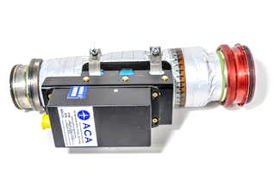

ACA Ionization – Filling Defense GAP
The ACA Component Is Designed To Be Simple To Install On Virtually Any Aircraft With An Environmental Control System/ Recirculator
Integrates Into Existing Aircraft Cabin (Bleed) Air System Ducts
Utilizes Existing System Airflow To Distribute Ions Throughout The Aircraft Interior
No Additional Fans, Filters Or Air Handling Equipment Required
Can Be Easily Installed By Qualified Technicians
  FAA STC Or 337 Field Approval
  Tested & Meets DO-160 Environmentals

Slide 18
TOTAL Layered COVID-19 Defense
Flying Needs Holistic Approach To COVID-19 Defense
Exposure & Layer Defense COVID-19 (SARS-CoV-2 Virus)
ACA Ionization System Solution Completes The Defense – Closes “GAP”
Airport GROUND SIDE DEPATURE
ONBOARD - “COMPLETE LAYERED DEFNSE”
Airport GROUND SIDE ARRIVAL
ON Aircraft
Social Distancing
Masks
PAX Temp Checks
Touchless Check In
Faster TSA Checks
TSA Staff PPE
Expanded Air Filtering
Ionization Installations
Social Distancing – Very Limited
Masks – Defense Limited
Disinfecting – Self & Cabin Crew
ECS HEPA Filters
Airflow Capture
Captures COVID-19 Virus In ECS
Mixes With Outside Air
2-8 Minute Complete Refresh
ACA Ionization Realtime Capture & Inactivation Of The COVID-19 Virus
Social Distancing
Masks
Faster Bag Delivery - UNKN
Bag Disinfecting - UNKN
Expanded Air Filtering
Ionization Installations
Complete Layer Defense Against COVID-19 (SAR-CoV-2) Virus

Slide 19
Peregrine Turnkey ACA Solution
From the Drawing Board to the Sky
Authorized Reseller of Aviation Clean Air Ionization System
Designs and Approvals – ODA Process
  US FAA ODA – Organization Design Authorization – STC
  End-to-end FAA-approved STC solution & proven FAA certification methods
  Extensive US FAA STC Experience
Operator Product Support Via ACA??
Hal Note: Needs new Peregrine overview, relevant to ACA Ionization

