Slide 1
Date | Name | Email | Telephone | Message | STC | Disposition
22-Jun-23 | Sergio Blazquez | sergio.blazquez@avionics.com.br | +55-11-5031-2801 | I would like a quotation for use of the STC No. ST00790DE in a Citation C550 in Brazil | ST00790DE | TJ
22-Jun-23 | Fred Elliott | fred.elliott@flyglobalnow.com | 5038070265 | I would like pricing for the kit to install ST01070DE in a Lear 35A. | ST01070DE | TJ
26-Jun-23 | Jordan Salmons | jordan@rotorgearsolutions.com |  | We are a helicopter equipment manufacturer looking to gain certification on some of our current spray systems. | ST01070DE | TJ
27-Jun-23 | nixon hincapie | ingenieria@centralaerospace.com | 3058126455 | It is possible to install the STC SA00765DE in an aircraft model DC-3 and BT-67 belonging to the Colombian National Police. | SA00765DE | TJ
29-Jun-23 | Matthew Fahrenkrog | mfahrenkrog@elliottaviation.com | 5633706634 | The Exchange unit for TCAS 7.1 is coming from Peregrine | ST00790DE | TJ
5-Jul-23 | Blankenship Dry Goods | tj@blankenshipdrygoods.com | 2034410872 | Blankenship Dry Goods - we have interest in becoming a new vendor for your firm's corporate embroidered apparel. |  | TJ
5-Jul-23 | MIGUEL VITE | vite.miguel.als@gmail.com | +52 722 468 8918 | STC for a TEXTRON CESSNA 500 S/N 0409 ADS-B CAPABILITY | ST00882DE | TJ
6-Jul-23 | Colt dos Santos Frazão | frazaocsf@fab.mil.br | +55 31 97157-0376 | logistics and engineering of the EMB-120 aircraft modernization project. | ST00895DE | TJ
6-Jul-23 | Nelson Brown | brown@scaviation.net | 16083288400 | Hello, we are interested in your STC ST01985WI for our Hawker 800XP. Can you please advise if kits are available and what costs may be associated. | ST01985WI | TJ
6-Jul-23 | John Ricardo Amortegui Sayer | ngcavionica@hotmail.com | +573103412760 | avionics company in South America and we have a client with an AirBus helicopter model MBB-BK 117 A-4, we are interested in the STC No. SR00925DE | SR00925DE | TJ
11-Jul-23 | Amy Watts | amy.watts@luzdata.net | 8888888888 | Would you be interested in an email list of Aerospace and Aviation Industry Executives? |  | TJ
11-Jul-23 | Alexander Petschelt | alexander.petschelt@fai.ag | +49-30-634118-0 | customer with a Hawker 800XP SN: 258417 and he wants to install a Flight Data Recorder. | ST01070DE | TJ
17-Jul-23 | John Amortegui Sayer | ngcavionica@hotmail.com | +573103412760 | I have two MBB-BK117A-4 helicopters and I am interested in the STC SR00851DE | SR00851DE | TJ
18-Jul-23 | John Lachmann | satecsa@hotmail.com | 3053964729 | Hello, we arr distributor for Colombia of Trig Avionics. We sold some TT31 | SA00744DE | Jon Roper @ Trig
19-Jul-23 | Kevin Gould | kevinjgould@hotmail.com | 14252183723 | Should we add a section for job postings? |  | TJ
20-Jul-23 | Thevenon | gthevenon@dassault-business.com | +41797999265 | We currently have in our hangar the following aircraft : PC-12/45, SN 0538, S2-AED | SA00765DE | TJ
20-Jul-23 | Linda Hopkins | lindahopkinsmkt@gmail.com | - | Send you a comprehensive SEO strategy & Proposal to help improve your Google rankings dramatically |  | TJ

Slide 2
Key additions to the website
Leadership team: photos and bios
Testimonials
Certificates (AS 9100, …)
Gallery of Project Summaries with photos of work/aircraft
Outline specific services and design capabilities
Project tracking methodologies and deliverables
… and the ODA rollout
Cleanup:
Ticker
Blogs
Homepage
Timeline

Slide 3
Leadership and Bios
Dave
TJ
Todd
Kevin
Wes
ODA Manager/Director
Others?

Slide 4
Testimonials
“These guys are the best! They helped us get a jumpstart on the ADS-B Market”
Jon Roper, Trig Avionics
“Quality work, done on time. Continued great customer service”
Luke Gomoll, Southeast Aerospace
“We were awarded our STC more quickly than we thought possible.”
Frank Aileron, Worldwide Aircraft Services
“Depth of knowledge, quality of work and delivered as promised.”
Bill Nacelle, Bendix King
“Validated our STC with EASA, CAA, ANAC, AFAC to boost our worldwide sales”
Larry Empennage,

Slide 5
ODA Rollout

Slide 6
MARKETING PLAN v1.0
PHASES I and II
June 13, 2023
For internal use only

Slide 7
Phase I: When ODA Granted
Message: (is this the correct message?)
Peregrine now has its ODA. Ability to directly issue STC’s, mitigating any impact of FAA’s heavy workload and reducing overall project timelines.
We specialize in STC’s for Avionics & Electrical Systems, and associated structural & mechanical modifications.
We are your one-stop shop for:
Engineering, design and integration
Flight test
Certification
We hold and manage your STC’s
Installation hardware kits (PMA)
Proprietary products (TSO)
Dealer equipment sales
By now having predictable timelines, we will strengthen our reputation by being on-time, with fixed costs and highest quality.

Slide 8
Phase I: When ODA Granted
Channels:
Before press release, send direct personalized emails to all Trusted Partners and Customers ← draft text of emails. From Dave Rankin. Include offer to take on projects before we announce to the world. Allows projects to be worked with impact of FAA workload (3 cycles to 1).
Website update ← AGG to draft, us to approve.
Graphic comparing timelines w/o and w/ ODA (18 mos. down to 6-8 mos.).
Press release:
TJ to Draft PR to AGG to finalize.
Make sure it gets published in all Aero-news, AIN, AEA, NBAA.
LinkedIn posting ← draft text; DR will post?
Direct USPS mailings / post cards? ← ask AGG to sketch out.
Ask AGG re other channels.

Slide 9
Phase II: After Initial ODA announcement
Message:
Same as Phase I message, but add reference to 2 initial ODA projects:
PC24 L5 Avance system install
Gulfstream G-IV and –V MB13 antenna

Slide 10
Phase II: After Initial ODA announcement
Channels:
Conferences: Booth or just have meetings? Presentations?
NBAA in October
AEA conference gatherings
MRO trade show (4/9/24 in Chicago)
Heli-Expo (partner with someone who knows rotorcraft arena)
OEM owner/operator major conferences
Scholarly articles re avionics STC’s (like Mike Ingraham)
Call 145’s and 135’s we don’t have relationship with for 30 minute introductory meetings (Zoom or face-to-face).
Powerpoint + digital brochure

Slide 11
Action Plan
Phase I:
AGG to draft website
Draft emails to Trusted Partners and Customers
Draft text of LinkedIn article
AGG to draft direct mailing / postcards
Ask AGG re other channels
Phase II:
Identify conferences
Decide mode of participation at each conference
Identify 145’s
Identify 135’s
Make outreach to schedule 145 and 135 meetings
Prepare ppt and brochure for 145 and 135 meetings

Slide 12
Overshadowing The Rest

Slide 13
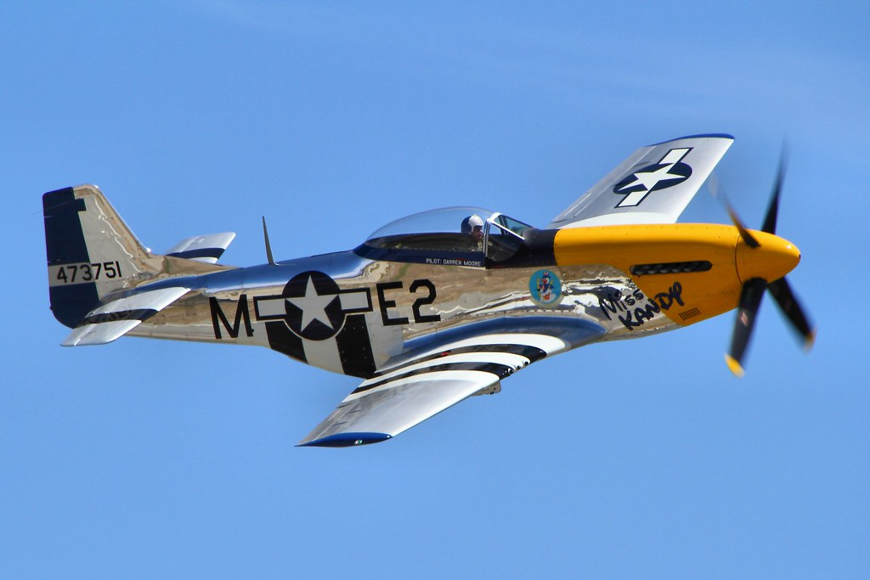
Leading Edge Opportunities Part 23, 25, 27 and 29

Slide 14
Leading Edge Opportunities

Slide 15
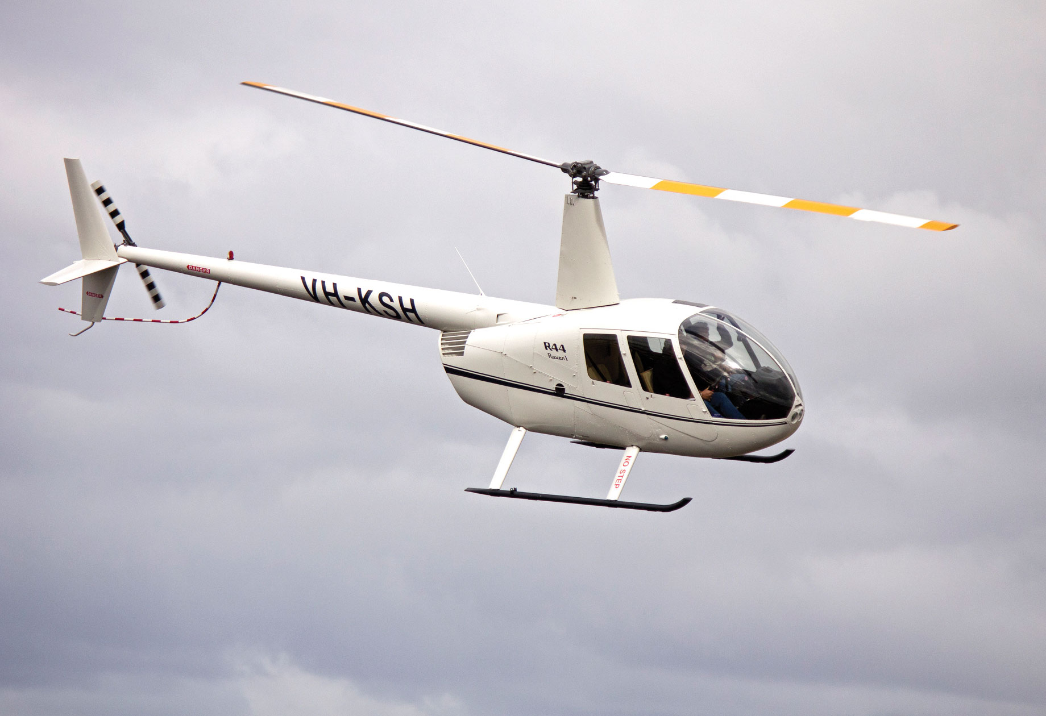
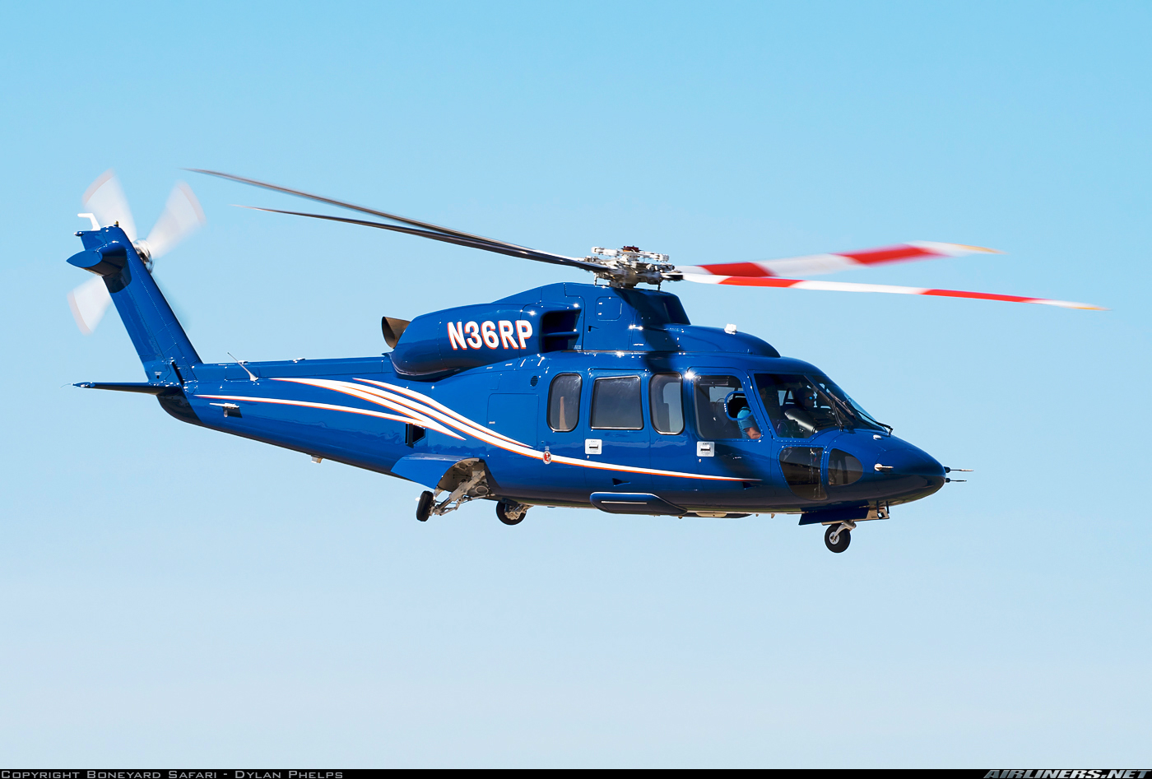
Peregrine STC ODA
Leading Edge Capabilities for your STC Requirements
Part 23
Part 25
Part 27
Part 29

Slide 16
ODA Message development

Slide 17
Key Messaging (Kevin’s Slide)
We specialize in STC’s for Avionics & Electrical Systems, and associated structural & mechanical modifications.
We are your one-stop shop for:
Engineering, design and integration
Flight test
Certification
We hold and manage your STC’s
Installation hardware kits (PMA)
Proprietary products (TSO)
Dealer equipment sales
With our ODA and having predictable timelines, we will strengthen our reputation by being on-time, with fixed costs and highest quality.

Slide 18
AEA, AEEC, MRO?
Avionic OEMs
Garmin
HW
Trig …
Niche, specialized jobs. Overflow
NBAA, RACCA
Completion Centers
Freighter Conversion
Centers
“You build avionics, not mountains of paper”
AMC, MRO, NBAA
Big Shops
Std Aero
WSA
Duncan
Peregrine
Specialized jobs. Overflow
“Your shop is too busy”
Repeat customers
Current Customers
Oshkosh, AEA
NBAA, RAA, RACCA
One-off Projects
Owner operators
Local and regional shops
One off, quick turn
“We can do it faster and cheaper”

Slide 19
Market | Value Proposition | Key Message | First Contact | Second Contact
Avionic OEMs | You’re busy creating avionics, let us do the STC | You build avionics, not mountains of paper | Personal call | Email blast
Big Shops | We can help with your overflow work | Keep your shop doing the big jobs, we can handle the rest | Personal mail-piece, call | Targeted email,
Current Customers | You liked us before, now we can do more for you | We’re ready to tackle your next project, even more efficiently | Personal call | Targeted email, mail piece
Small Regional Shops | Let us handle the FAA for you | We can do it faster and cheaper | Email blast | Follow-up with those that opened email
Owner Operators | We can help you with your fleet upgrades | We can make your project a reality; quickly and cost effectively | Targeted email | Follow-up with those that opened email

Slide 20
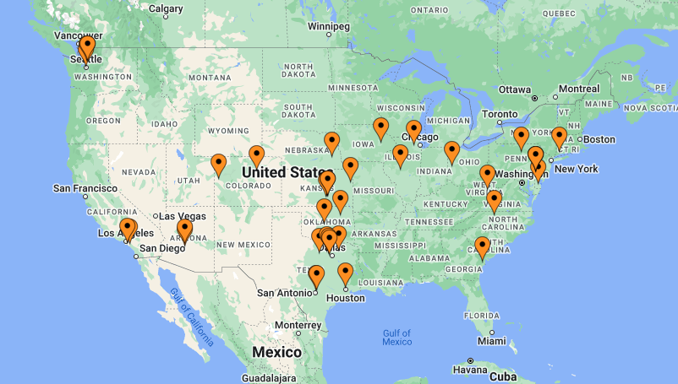
All STC ODAs

Slide 21
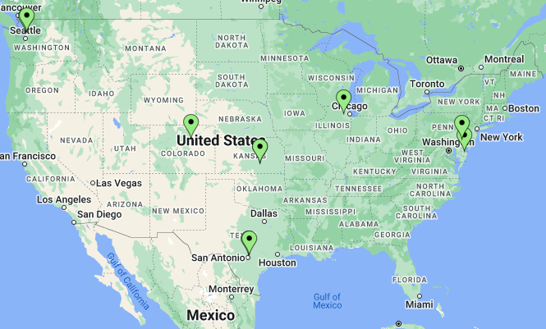
Jamco America
AeroMech
Envoy
3S
Aeronautix
ALOFT
Cert Works
Aerospace Design & Compliance LLC
JANA ASM
ST Engineering
Competitive ODAs

Slide 22
Name: | City:.1 | City:.2 | People | Revenue
3S | Wichita | KS | <25 | 5.4M
AeroMech | Everett | WA | 31 | 9.2M
Aeronautix ODA | Wichita | KS | <25 | <5M
Aerospace Design & Compliance LLC | New Castle | DE |  | <5M
Cert Works | Watkins | CO | 7 | <5M
Envoy Aerospace | Aurora | IL | <25 | <5M
Jamco America | Everett | WA | 300 | 81.4M
JANA | Universal City | TX | 128 | 24.5M
PATS/ALOFT | Georgetown | DE | 282 | 65M
VT DRB Aviation | San Antonio | TX | 1200 | 9B
Competitive ODAs

Slide 23
Value prop Peregrine vs. others
Greater Experience: 30+ STCs for Parts 23,25,27,29
Greater Worldwide Capabilities: FAA, EASA, CAA, ANAC, AFAC ...
Price & Performance
Well located

Slide 24
Collateral

Slide 25
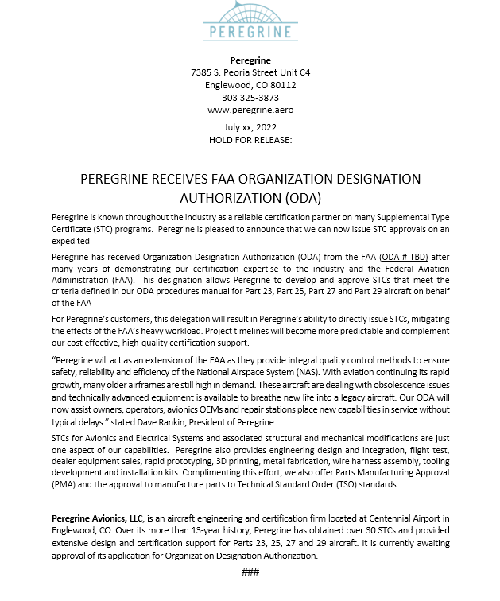
Mailpiece
Press Release Draft
Email
Show Collateral

