Slide 1
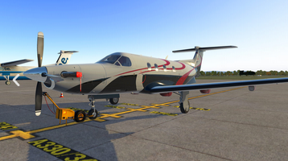
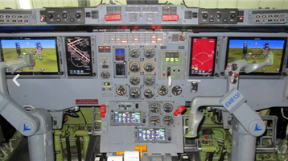
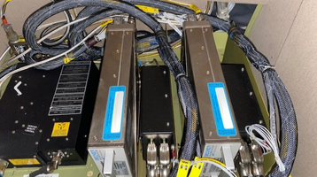
“Hover words”
Detail and link
Peregrine developed STC for AVANCE L3 SATCOM
Peregrine developed STC for the PC-12 brings economical SATCOM connectivity to this popular aircraft
Develop project page for AVANCE
Peregrine developed an integrated Garmin cockpit retrofit for EMB-120s
See project link EMB-120
Peregrine also developed STCs for the replacement of obsolete CRTs in fixed and rotary wing aircraft
See project link for DAC
Peregrine STC EMB-120 Glass Cockpit
Peregrine developed fist AML STC applications for Part 23 ADS-B equipage
Develop project page for FreeFight and Trig
Peregrine also developed Part 25 STCs for integration of ADS-B transponders into legacy aircraft
Develop project page for Becker and BendixKing
ADS-B Transponder Solution STCs from Peregrine

Slide 2
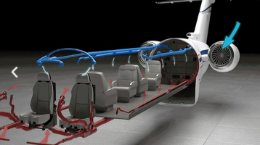
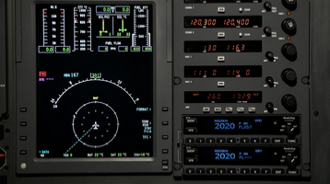
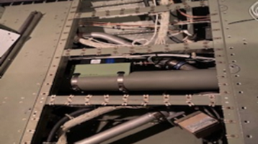
“Hover words”
Detail and link
COVID-19 Disinfection system STCs from Peregrine
Developing timely solutions to meet market demands are demonstrated by Peregrine’s continuous COVID-19 disinfection system for Gulfstream, Dassault, Textron and Bombardier aircraft
Develop project page for AML STC
Link to Lee Aerospace project page
Integrated ADS-B Transponder solution for Legacy Jets
How to integrate an ADS-B transponder into an existing cockpit design? Look to Peregrine for innovative and complete solutions
Develop project page for BendixKing KT-74
Not all of Peregrine’s solutions are avionics. The ACA COVID-19 disinfection system installation, STC and kits incorporate integration with environmental control systems; demonstrating Peregrine’s engineering versatility
Link to Lee Aerospace project page
STC, Kits and Installation solutions for Aviation Clean Air systems

Slide 3
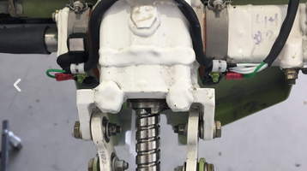
“Hover words”
Detail and link
Peregrine specializes in developing solutions that renew and update legacy aircraft….
Custom solutions for legacy aircraft from Peregrine
Engineered solutions to systems inside and outside the cockpit
Got a hard problem? Look to Peregrine innovation. Peregrine developed a cost-effective solution for Gulfstream G150 flap and slat actuators that ensure operation in the harshest temperature challenges.
Develop project page for G150

Slide 4
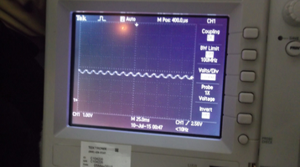
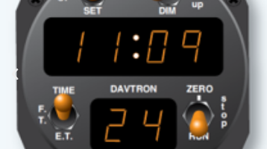
“Hover words”
Detail and link
Engineering experience and thorough testing and future capabilities
With staff DERs, design and fabrication expertise, Peregrine rapidly and accurately tackles each project. As Peregrine moves toward ODA capabilities, ….
Focused attention, personal commitments to project timelines, solid project management oversight and the ability to draw on key experts ensure customers ….
Peregrine delivers on time and on budget

