Slide 1
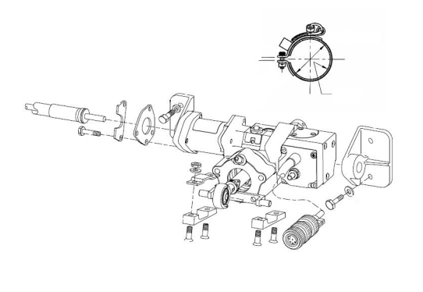
HEATER
Example Slat Actuator Heater Installation

