Slide 1
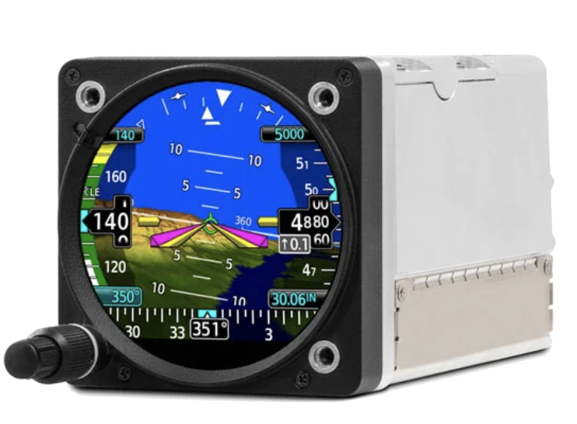

Partner with Peregrine for:
STCs, AMLs and PMAs for Part 23, 25, 27 and 29
Garmin GI 275 Part 25 IVSI AML STC
Garmin GI 275 Part 25 ESI AML STC
Hot Link
Hot Link

Slide 2

Partner with Peregrine for:
STCs, AMLs and PMAs for Part 23, 25, 27 and 29
Garmin GI 275 Part 25 IVSI AML STC
Garmin GI 275 Part 25 ESI AML STC
Hot Link
Hot Link

Slide 3

Partner with Peregrine for:
STCs, AMLs and PMAs for Part 23, 25, 27 and 29
Garmin GI 275 Part 25 IVSI AML STC
Garmin GI 275 Part 25 ESI AML STC
Hot Link
Hot Link

