Slide 1
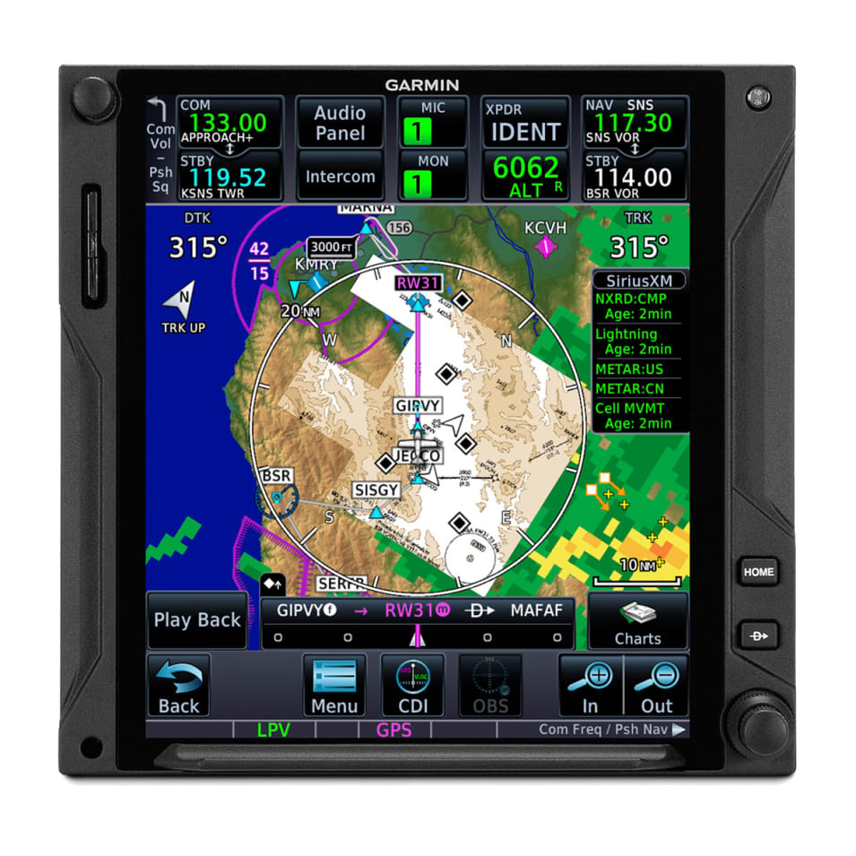
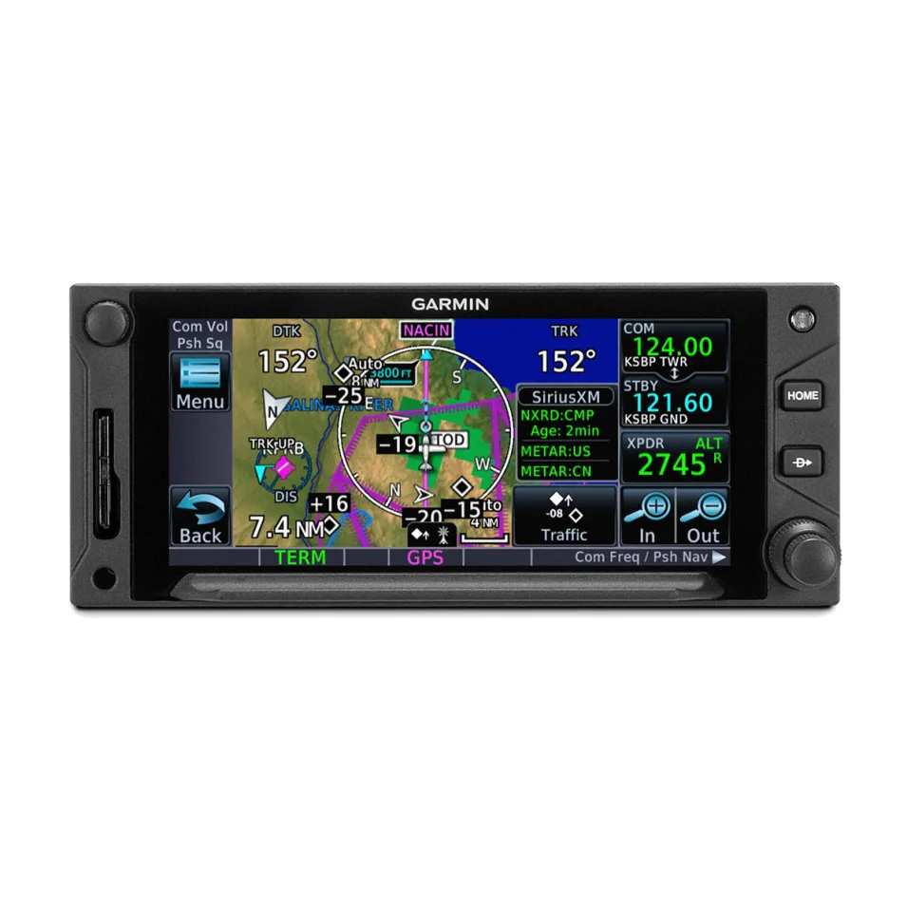
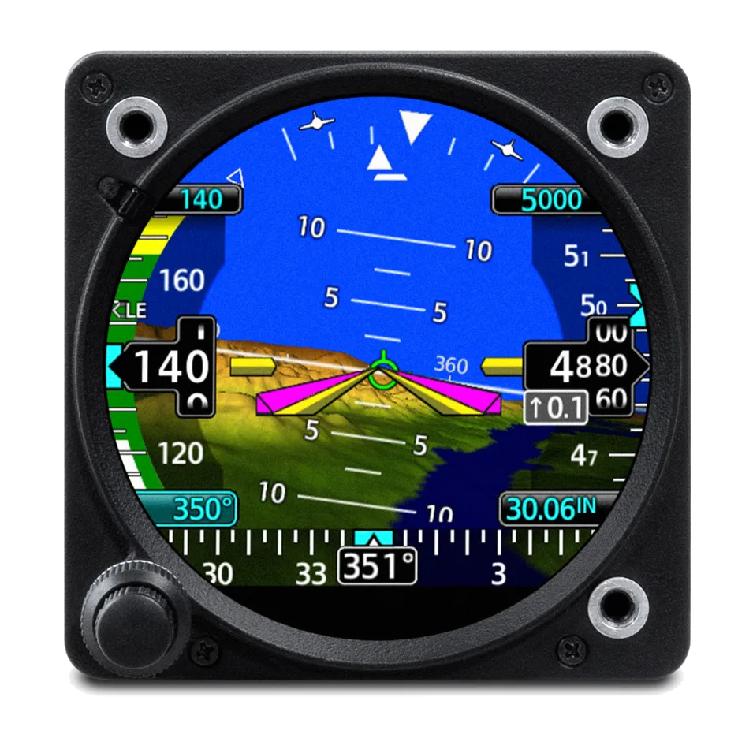
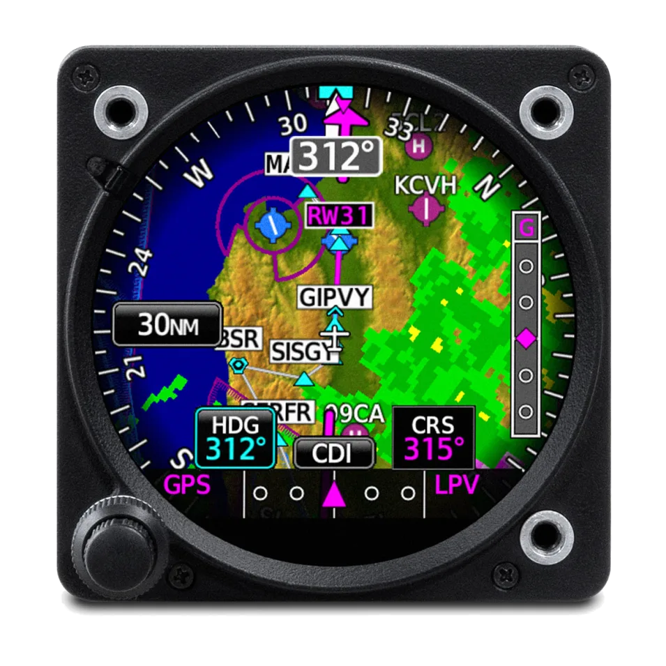
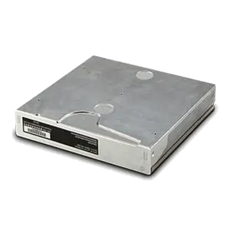
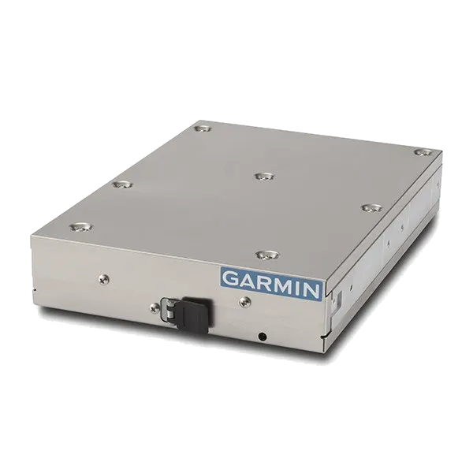
Garmin GTN750Xi GPS/NAV/COM
Garmin GTN650Xi GPS/NAV/COM
Garmin Class III GI275 ADI
Garmin Class III GI275 HSI
Garmin GMA35C Audio Panel
Garmin GTX345R ADS-B IN/OUT Transponder

