Slide 1
Peregrine Web Analytics Summary of Google Analytics Data 1 April – 3 May 2021
04 May 2021
Prepared by Forrest Colliver

Slide 2
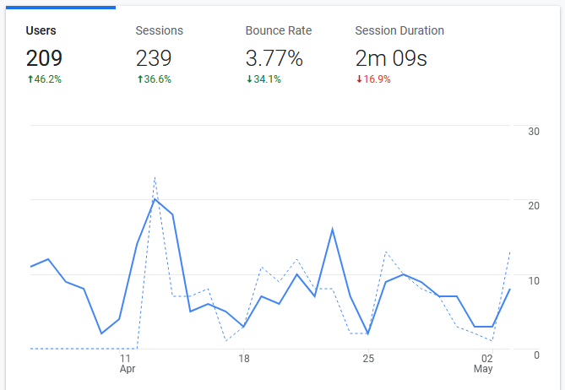
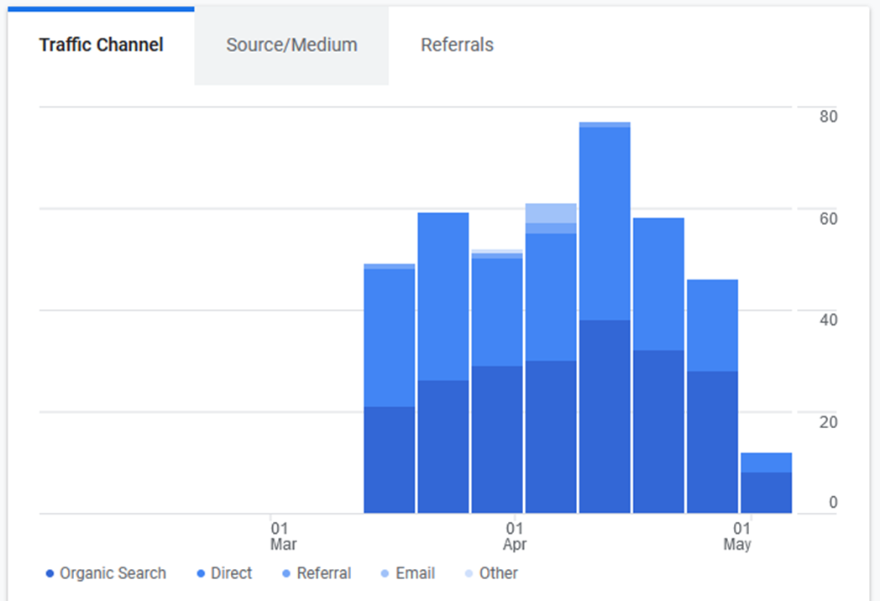
Audience Overview

Slide 3
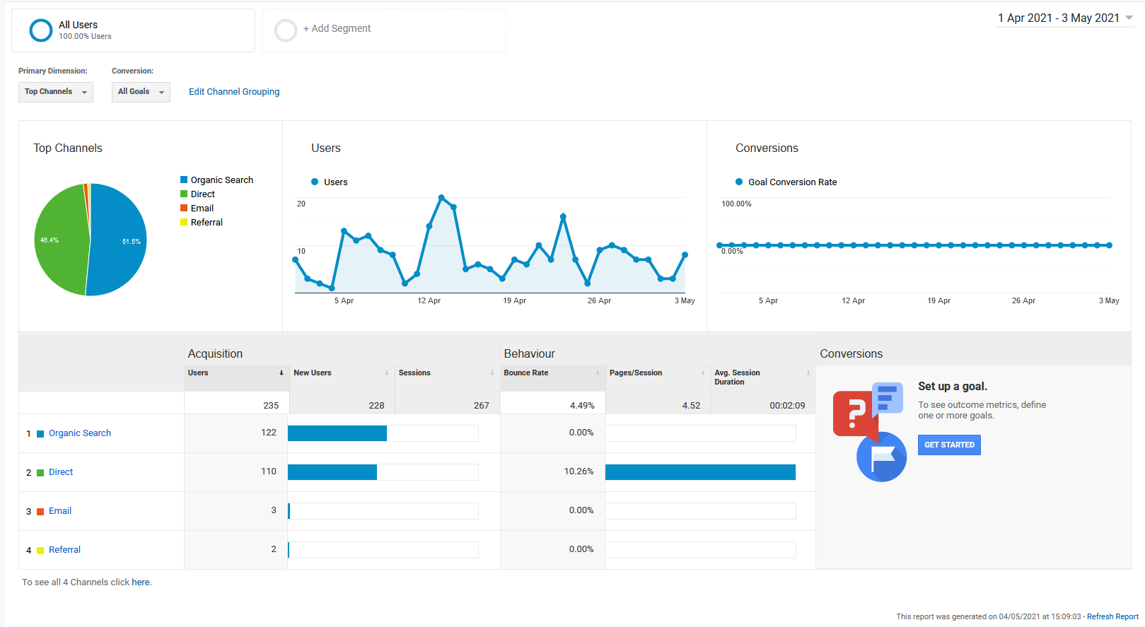
User Acquisition Overview

Slide 4
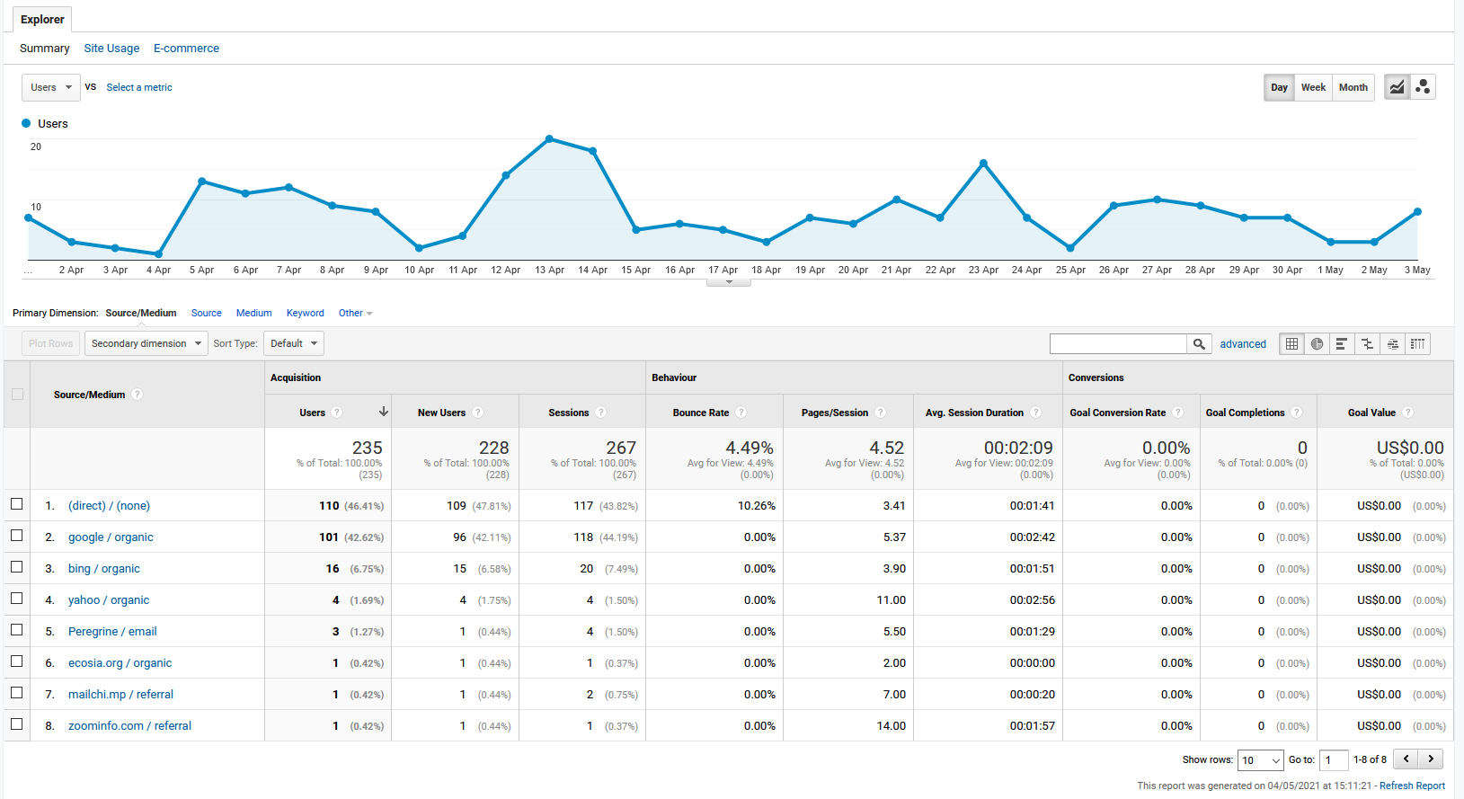
Organic Search Sources

Slide 5
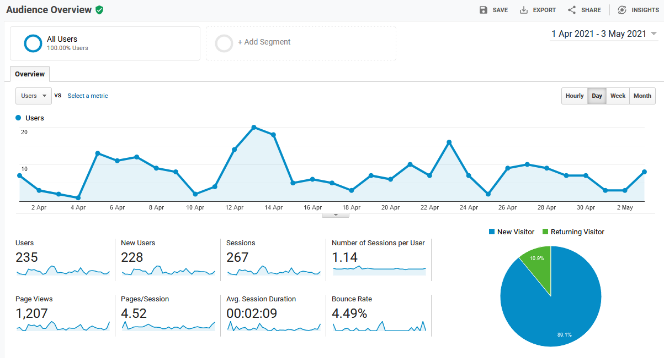
Active Users

Slide 6
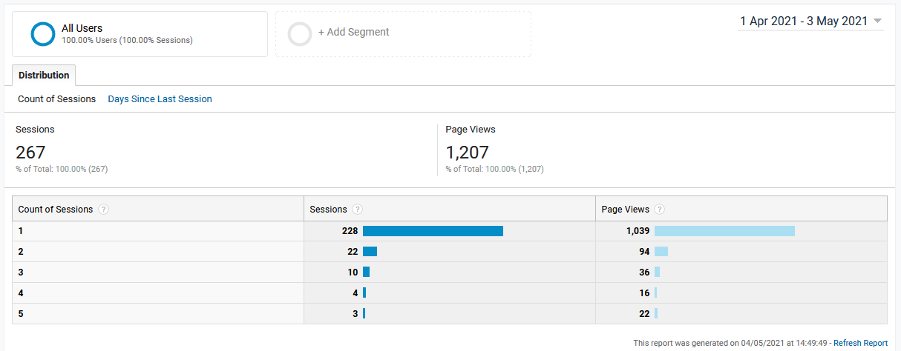
Frequency & Recency

Slide 7
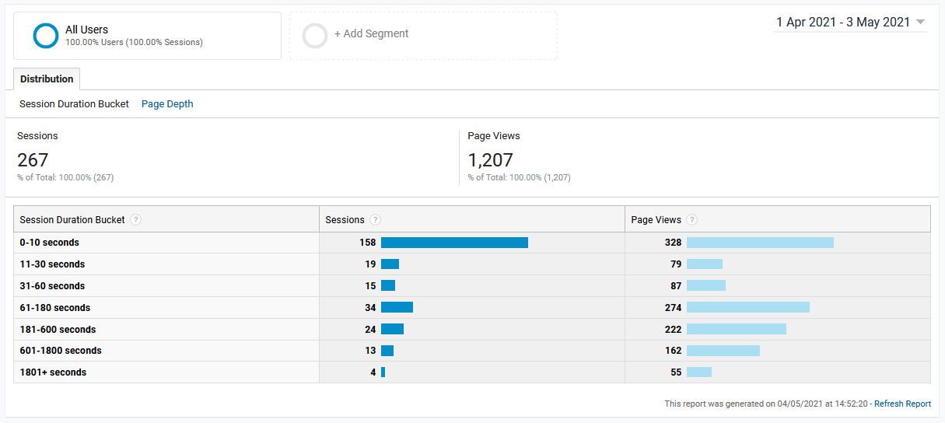
User Engagement

Slide 8
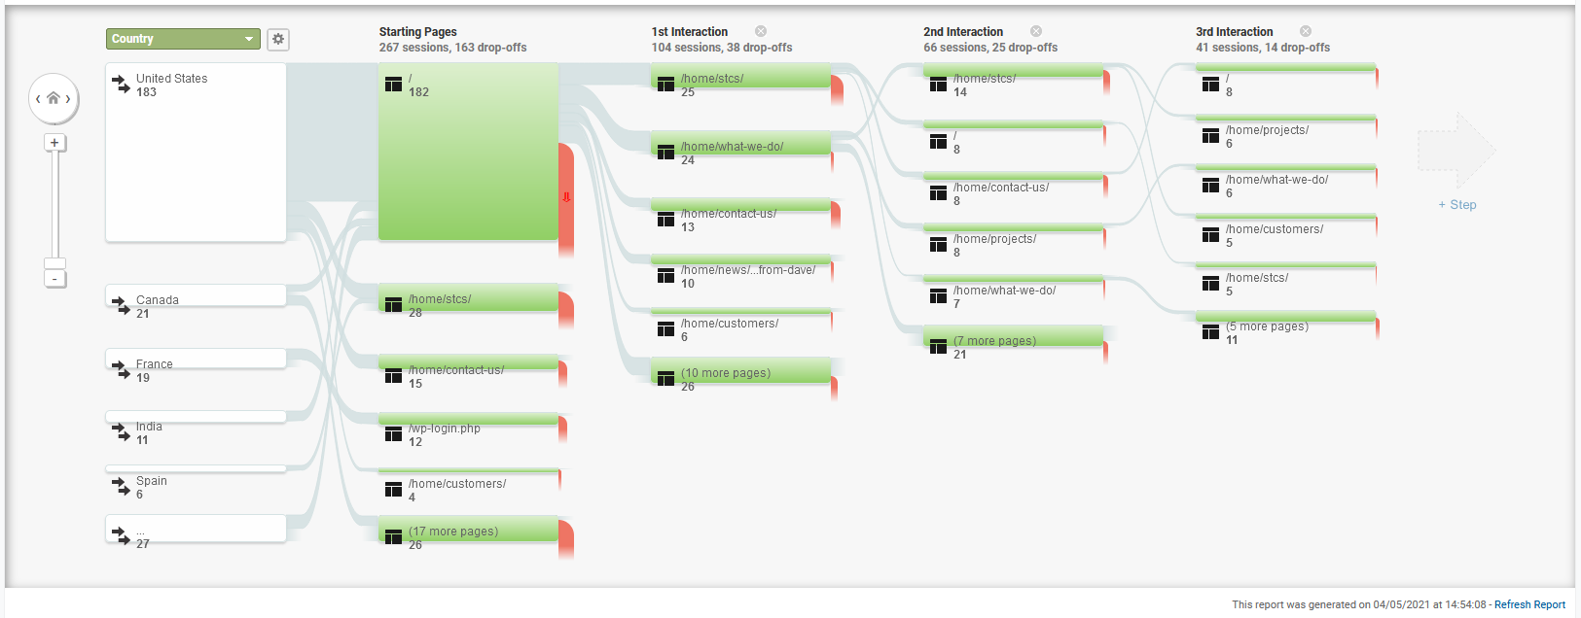
User Page View Flow

Slide 9
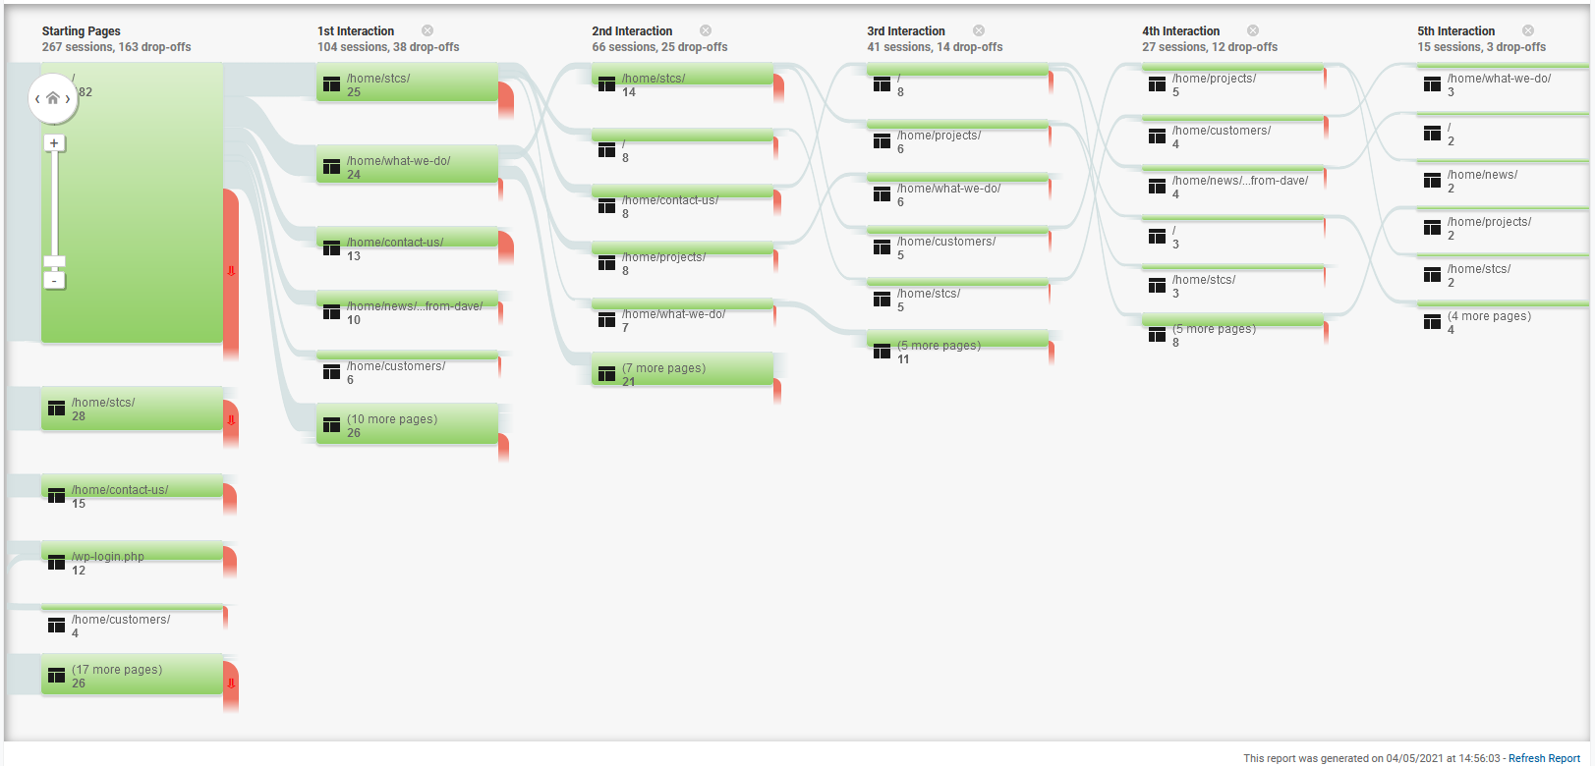
User Behavior Flow

Slide 10
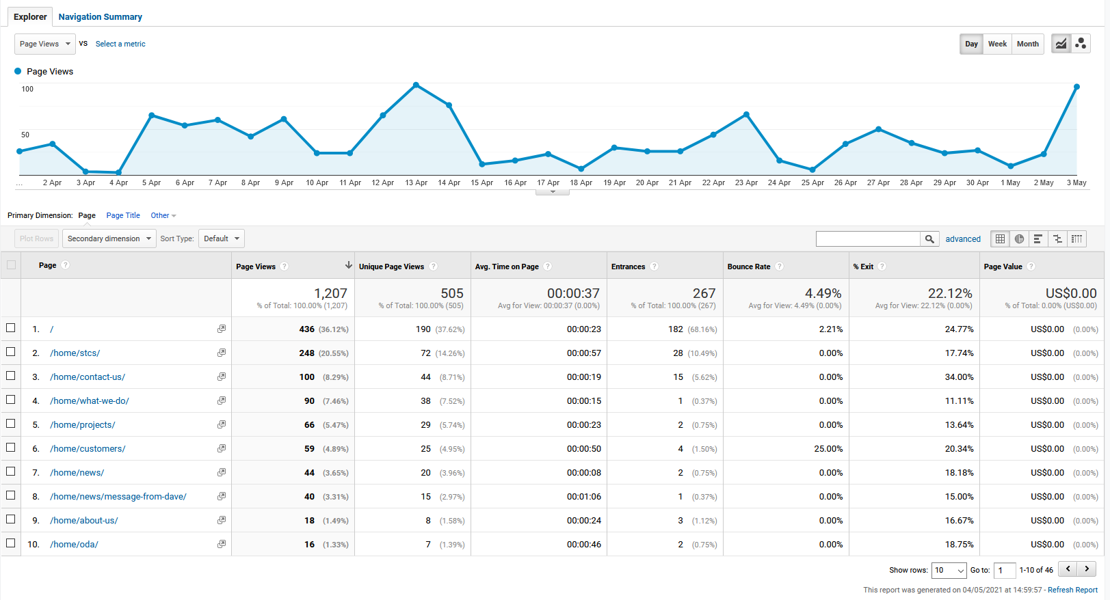
Site Content Behavior

Slide 11
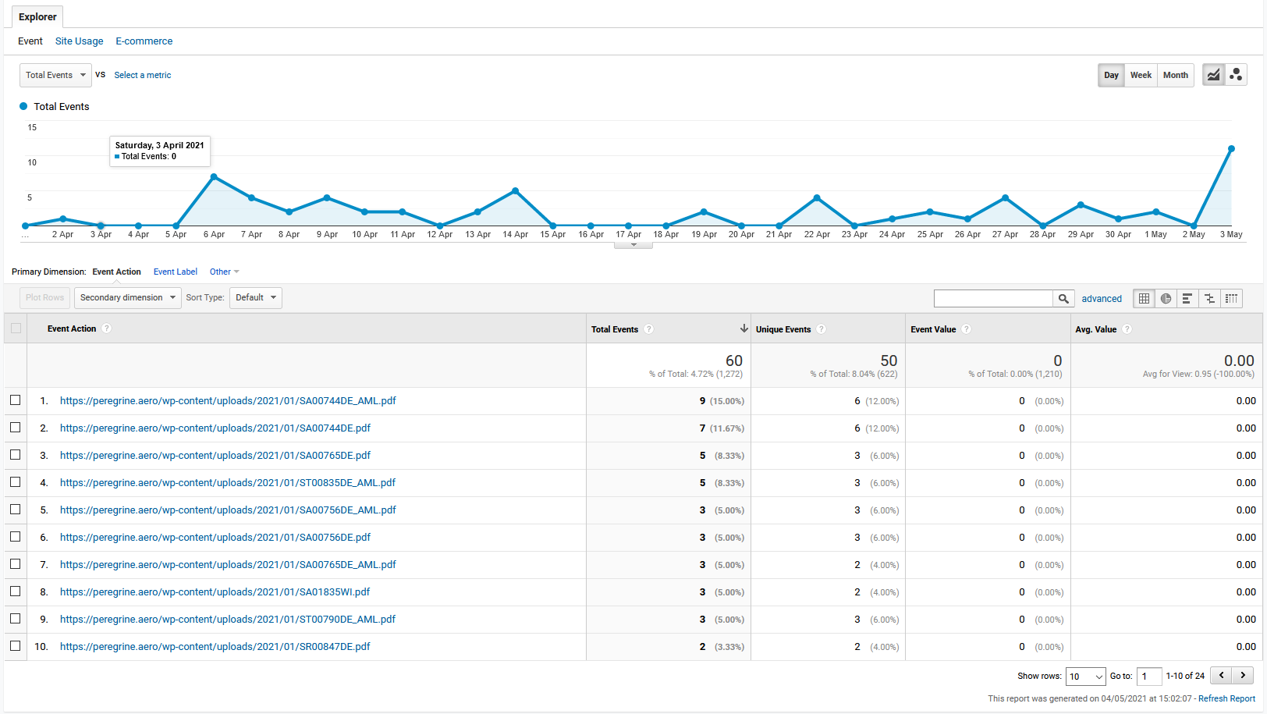
Download Events

