Slide 1
Peregrine Web Analytics Summary of Google Analytics Data 11 May – 25 May 2021
26 May 2021
Prepared by Forrest Colliver

Slide 2
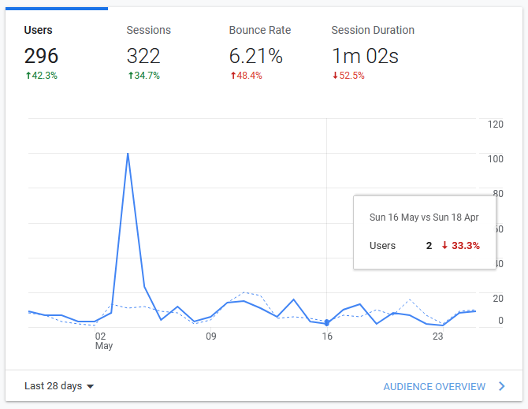
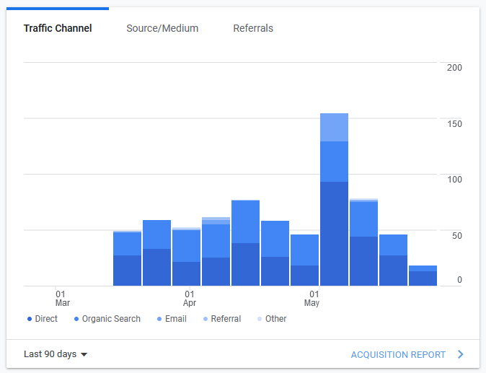
Audience Overview (28 Days)

Slide 3
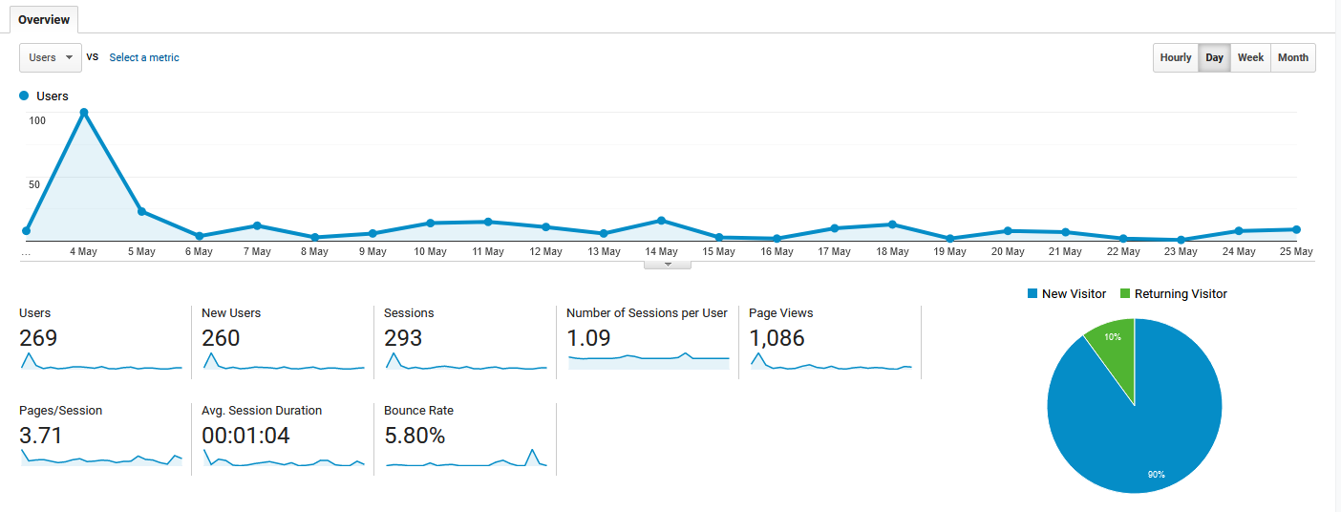
User Overview (28 Days)

Slide 4
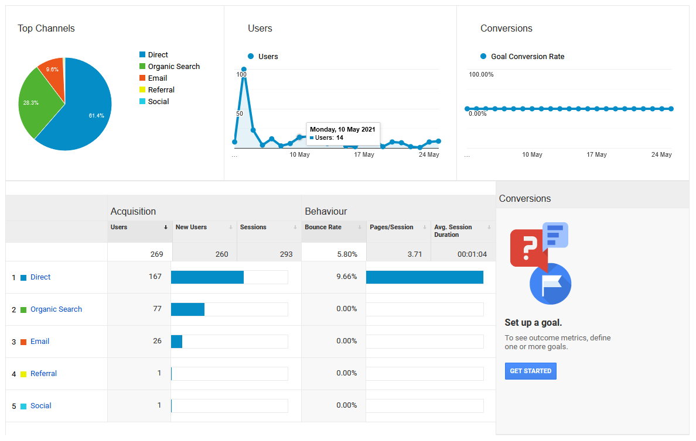
User Acquisition Overview (28 Days)

Slide 5
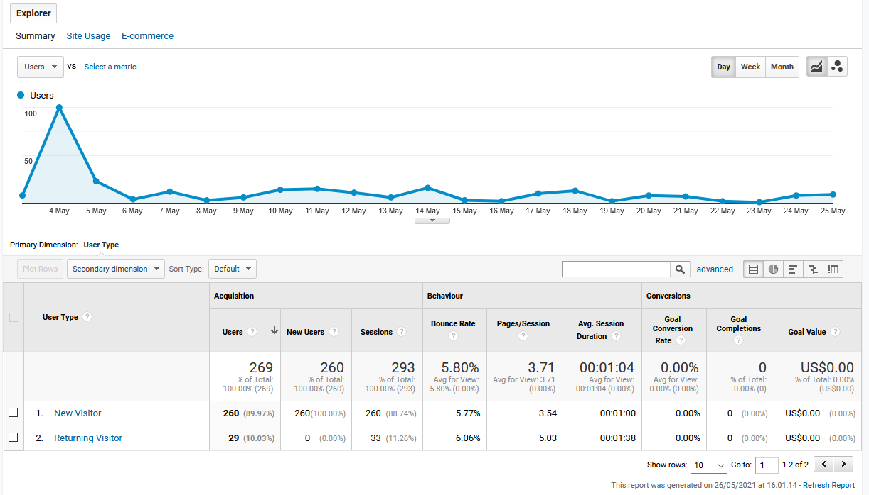
New vs. Returning Visitors (28 Days)

Slide 6
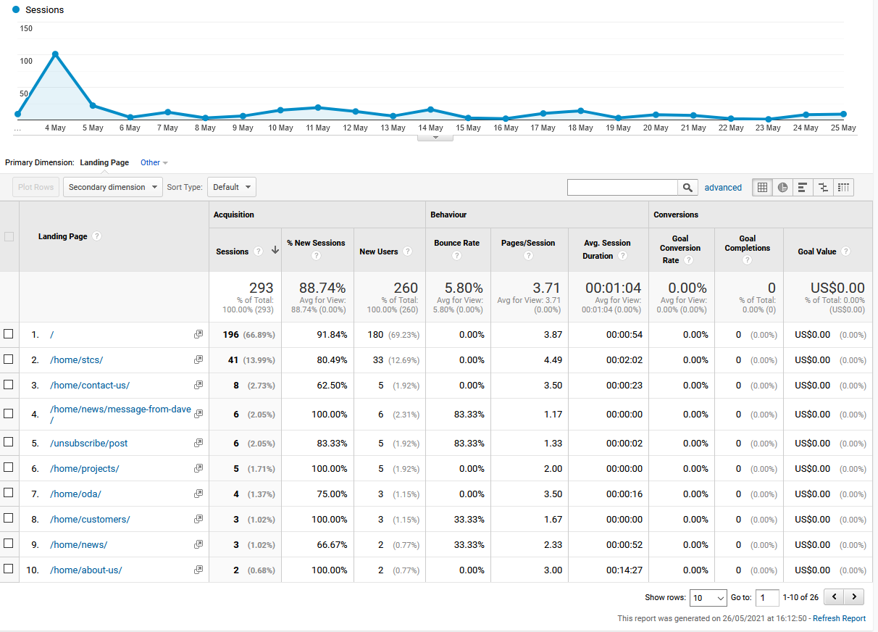
Sessions by Search Landing Pages (28 Days)

Slide 7
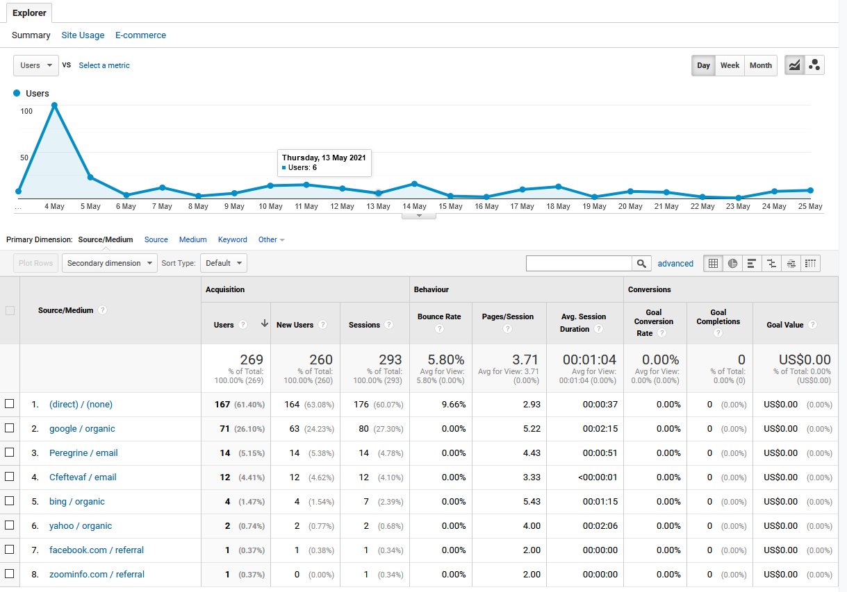
Sessions by Search Sources (28 Days)

Slide 8
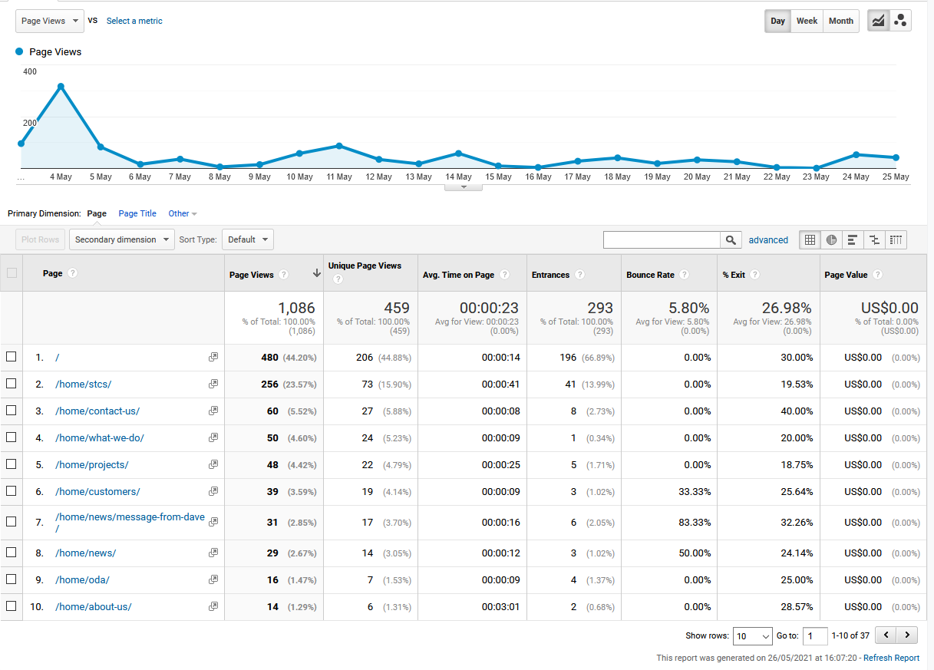
Site Content Behavior (28 Days)

Slide 9
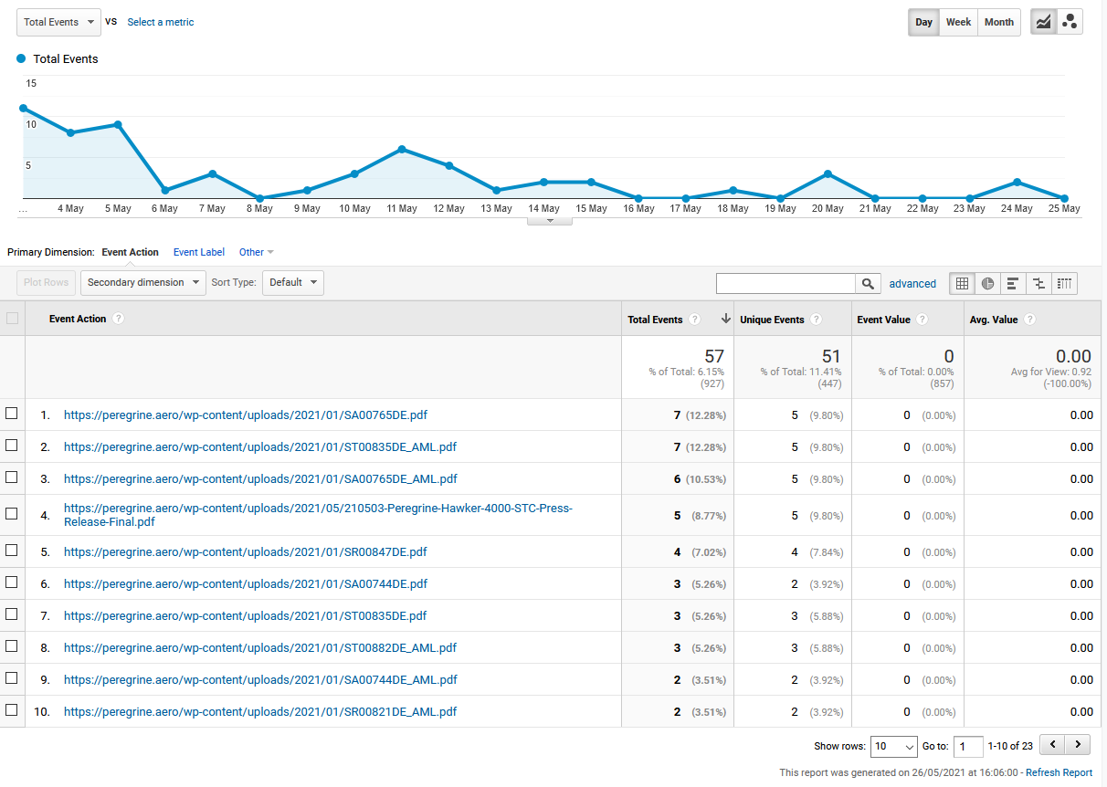
Downloads (Last 28 Days)

Slide 10
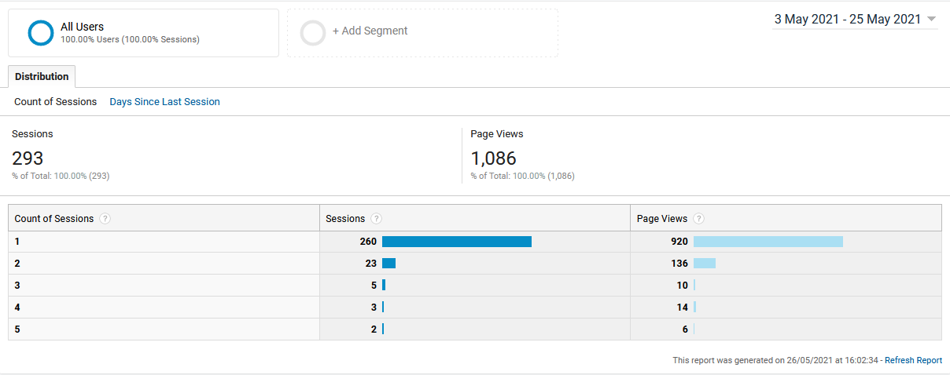
Frequency & Recency (28 Days)

Slide 11
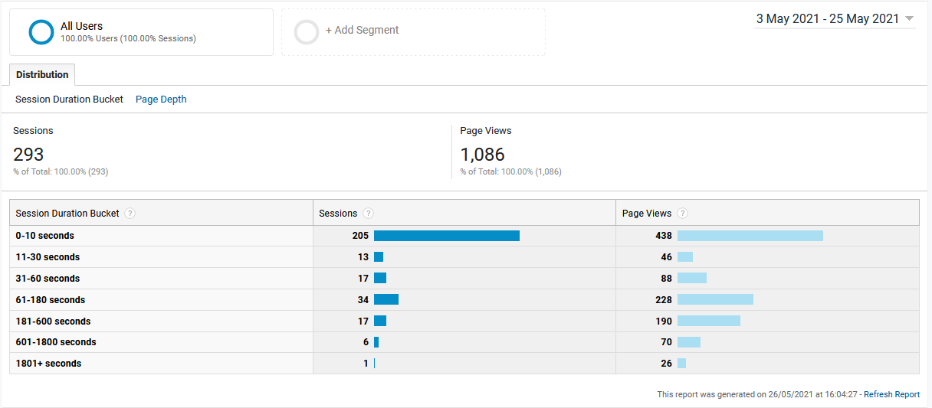
User Engagement (28 Days)

Slide 12
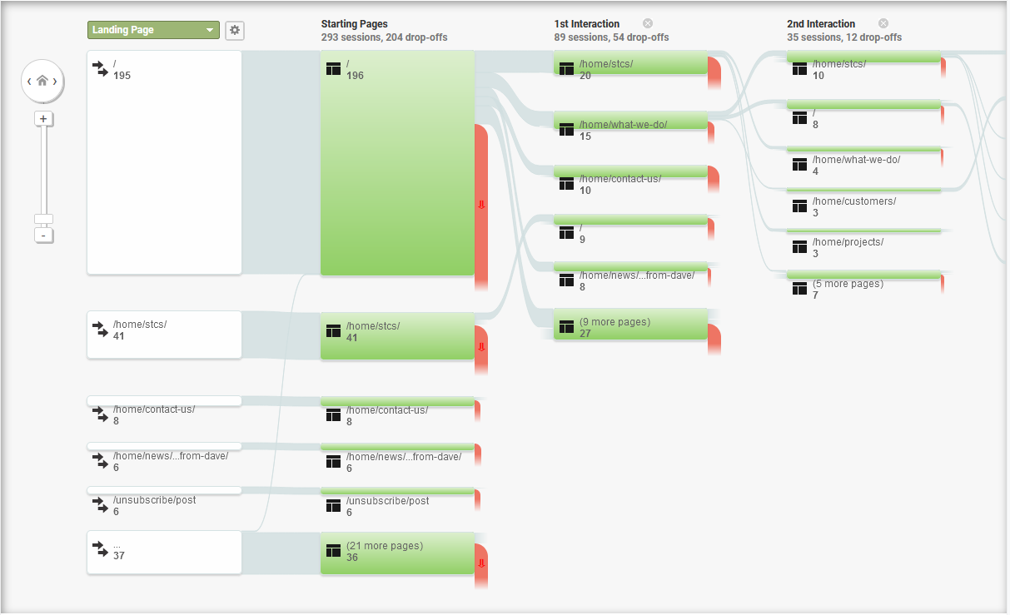
User Behavior Flow (28 Days)

Slide 13
Key Takeaways
Website SEO is clearly working – significant traffic from search engines
Email drives traffic to site – clear peak around recent Hawker campaign; significant roll-off since then due to lack of further email campaigns
STC downloads remain the clear draw
To maintain website effectivity, actions must include:
Broad and frequent email campaigns and blog/news updates, keeping Peregrine constantly in view, and not just based on press releases
Increased use of web links, both from Peregrine site and to Peregrine site
Development of testimonials page

