Slide 1
Peregrine Website 2.0 Development Review
29 January 2021
Content Status
Next Steps

Slide 2
Website Status (as of 29 Jan 2021)
Live as of 25 January with full content complement
Marketing Collateral, STCs, Project Summary, Contact Forms, Breaking News Blog
Key Technical Features
WordPress with Elementor Content Management System (CMS)
Theme/Template: Fabricator
Includes Cherry Plugin Pack (MailChimp + 11 site productivity improvements + blog functionality)
Plugins Installed
Loginizer Security: Brute Force Protection, 2FA (Two Factor Authentication), Security Enhancements
Complianz Privacy Suite (GDPR/CCPA) Pro (compliant with US, UK, Canada, California & European laws)
Really Simple SSL Pro (manages SSL certificate operations)
Download Manager (allows user-specific upload/download capabilities based on login)
Under Construction Page Pro (maintenance tool with human interface & messaging during downtime)
All non-Peregrine sourced images licensed from Shutterstock

Slide 3
Next Steps
Technical Aspects
Complete implementation of File Manager
Complete implementation of SEO management, Google Analytics & analytics user interface
Tune presentation on tablets and smartphones
Content Aspects
Enter “breaking news” blog posts for press releases & events to be highlighted on landing page
Create ACA content, and load user file content as required
Monthly Activities
Create/upload & blog-post breaking news items
Freshen content (ODA Information, “Message from Dave”, STCs, Projects, White Papers…)
Monitor security scans, perform regular site software updates & manage critical backups
Monitor and dispatch contact form and MailChimp communications
And of course, load new content as identified by Peregrine !

Slide 4
Landing Page Screenshot

Slide 5
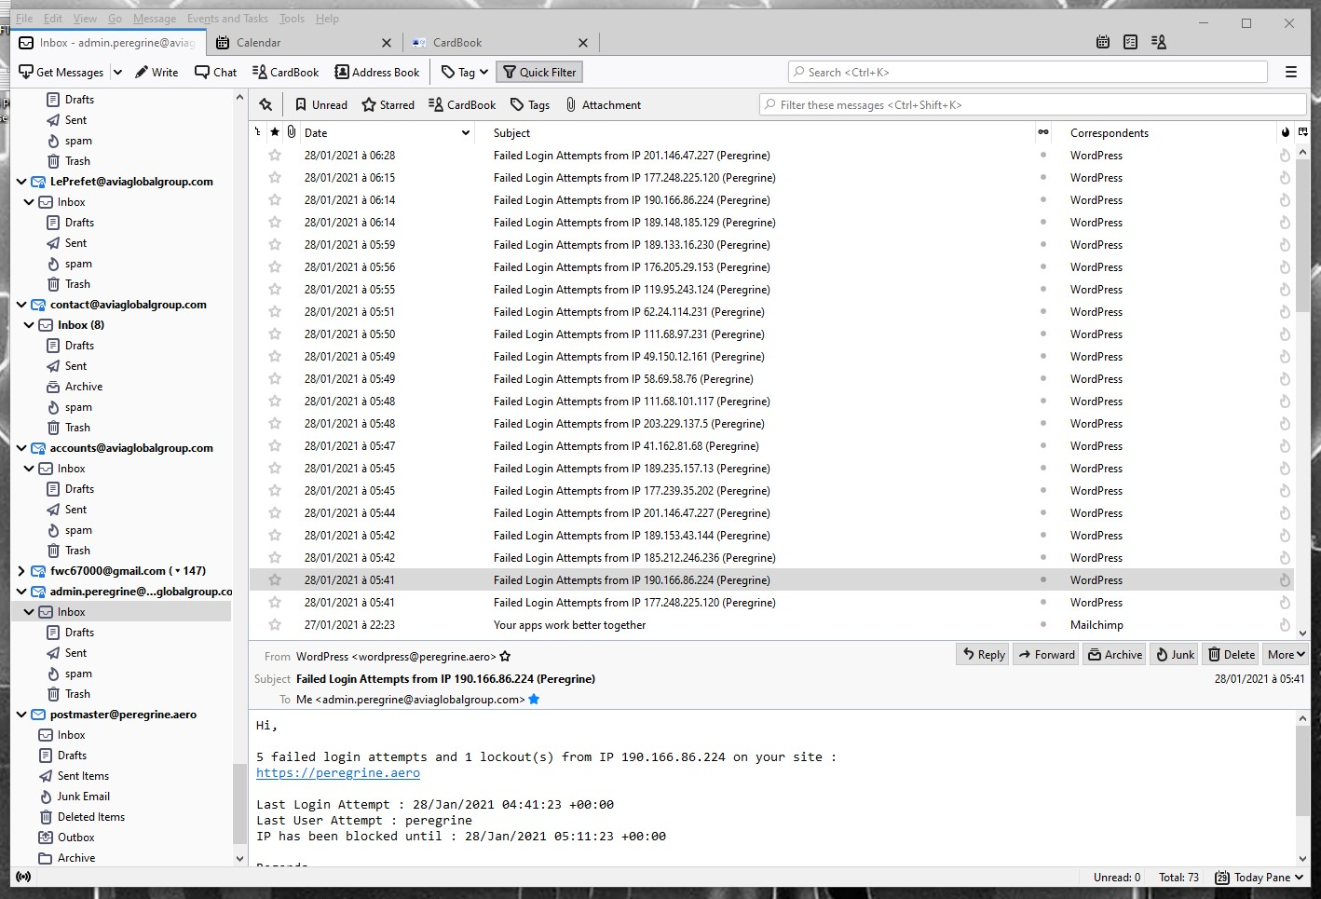
Why Security Enhancements?

