Slide 1

Peregrine Website Enhancement and Initial Targeted Campaign Proposal Overview
5 January 2022
Notes:
To change the image on this slide, select the picture and delete it. Then click the Pictures icon in the placeholder to insert your own image.

Slide 2
Proposal Overview
Background
Website Enhancements
Initial Targeted Campaign
Next Steps

Slide 3
Background
AviaGlobal Group, LLC (AGG) is pleased to provide this proposal to Peregrine for leveraging the Peregrine online presence, enhancing revenue generation beyond current projections.
There are a number of solid activities that can promoted beyond a presence on the current Peregrine web site.
A prime example is the G150 Flap and Slat Actuator Heater where our efforts are aimed at securing specific opportunities through targeted direct marketing, leveraging tailored web presence.

Slide 4
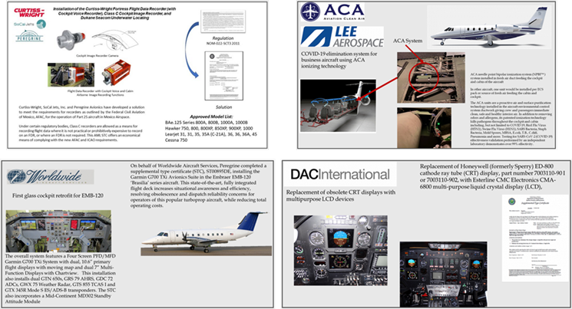
Website Enhancement Proposal
Expand the “Project Gallery” to include information for the STC projects that Peregrine has undertaken to date.
Develop each element of the project gallery as “web content” that will be available to search engines and SEO algorithms.
  AGG will develop a template for the gallery elements.
  Peregrine will provide, upon AGG inquiry, with details necessary to complete each project gallery element.
  AGG will create the content for each project gallery element.
  Peregrine will provide a timely review to ensure accuracy of the developed information.

Slide 5
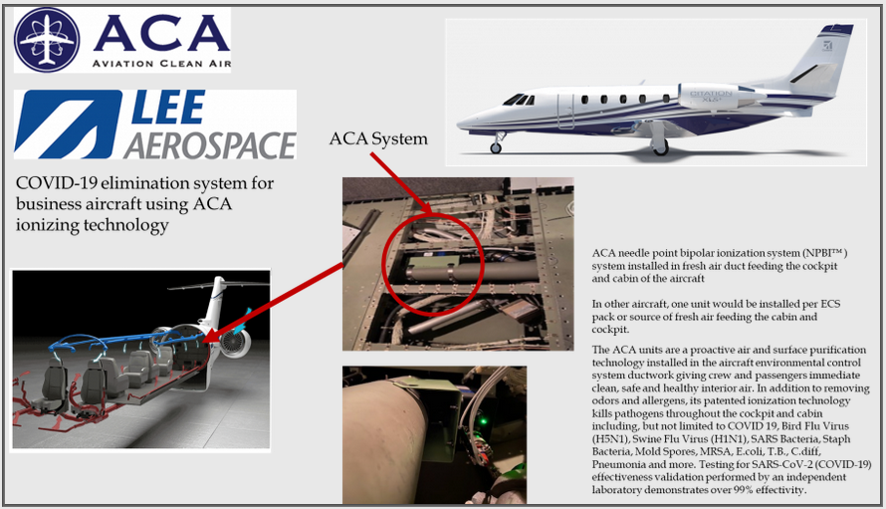

Project Enhancement
Each project in the project gallery will have cross references to:
  Press releases (if applicable).
  STC and AML information.
  Availability and “contact us” for more information or quotation.
Add Search feature
Link to Press Release
Link to STC Page

Slide 6
STC Page Enhancement
Restructure the STC table to allow for better interpretation by search engines and SEO algorithms.
Add links to the project gallery for further information about the project related to the STC.
Link to Project Page

Slide 7


Client Page Enhancement
Add links and other cross references between clients, customers and project sponsors to visually connect logos to projects, STCs and press information.
Include, expand client testimonials.

Slide 8
G150 Flap and Slat Heater Email and Web Campaign
AGG recognizes that the G150 flap and slat actuator heater STC offers a prime revenue opportunity by targeting operators, brokers and service centers regarding the details of this STC.
We will develop, maintain and adjust, as needed, promotional activities such as the website, email, physical collateral and campaign plan, thus stimulating sales of the G150 slap slat actuator heater STC and kitting.
Develop a target list of potential customers, including operators, service centers and brokers, including:
  Email, where available.
  Physical address where available.
  Curate a list of press contacts to enhance coverage of this STC that includes subcontracting with press release vendors, if desired by Peregrine.

Slide 9


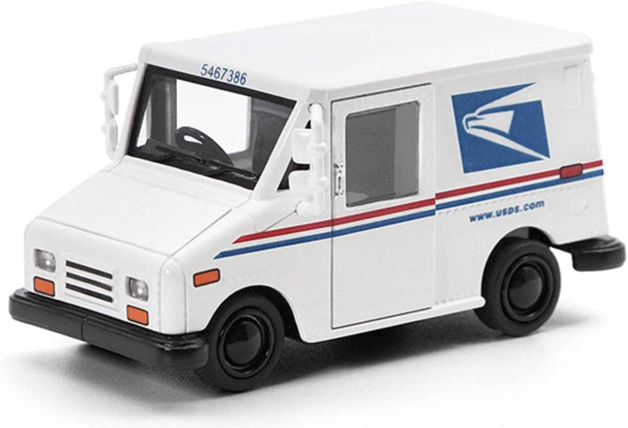
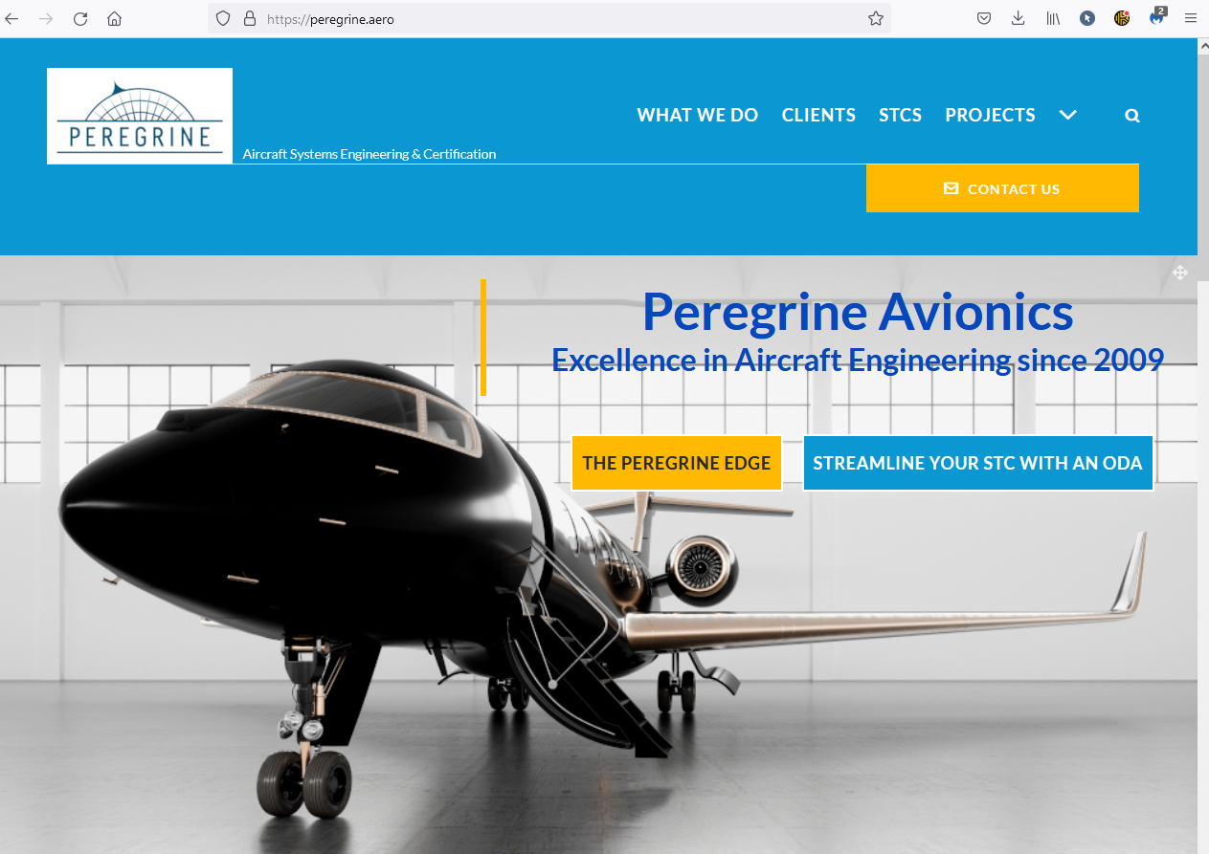
G150 Flap and Slat Heater Email and Web Campaign
Through a combination of Mailchimp and physical mail piece distribution, each target will be touched through one or both means.
Specific response mechanisms will be created to track responses and gauge effectiveness of the campaign as measurable by the campaign targets’ responses.
AGG will provide regular reports, as needed, to Peregrine detailing:
  Mailchimp response information.
  Website engagement information.
  Email response information.
Mailchimp
Press Release(s)
Mail Piece(s)
Website

Slide 10
Summary
Comprehensive plan to improve website visitor engagement
Initial target campaign using web, email, press and snailmail tools
Continue to perform maintenance
Ready to engage with the next and future campaigns
The new year provides a great platform for a great start on generating additional revenue

