Slide 1
Working Document for Peregrine Project Pages

Slide 2

















Slide 3
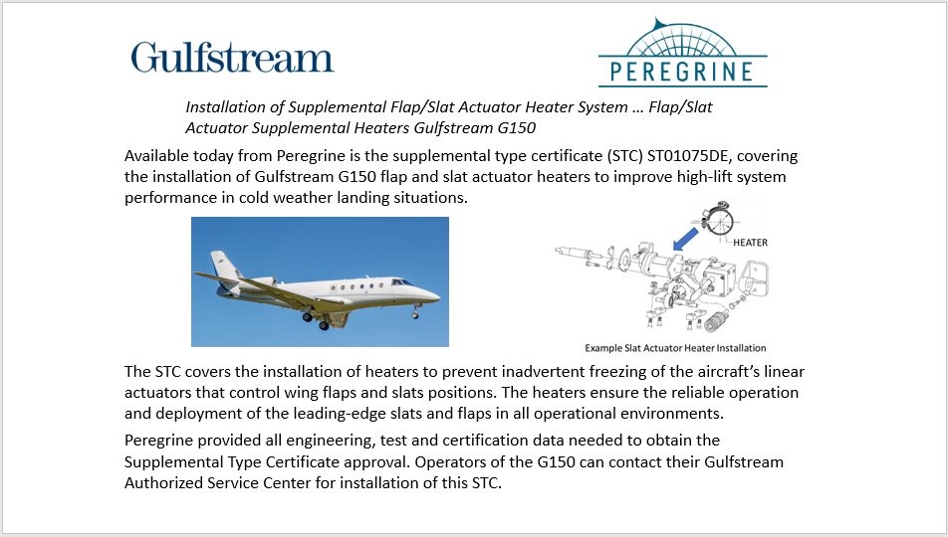
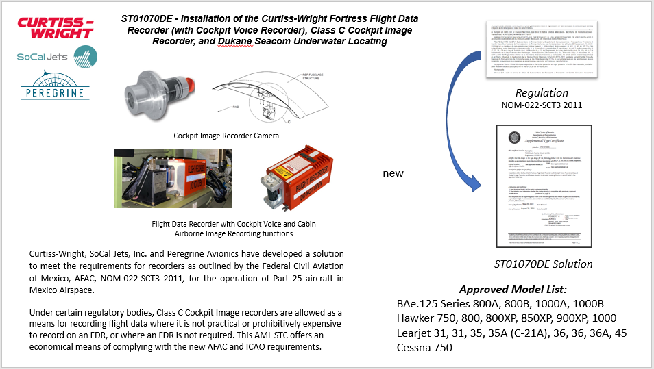
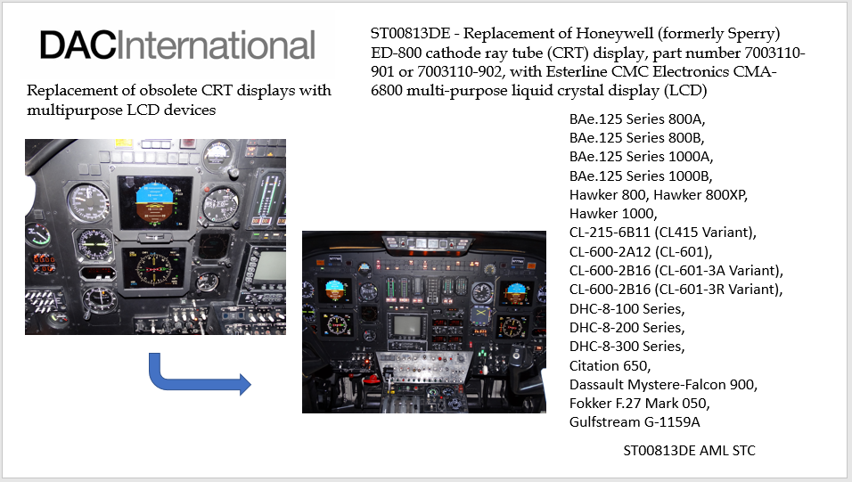
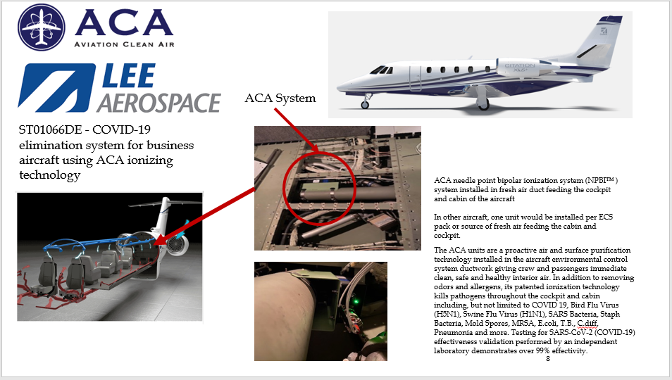

Slide 4

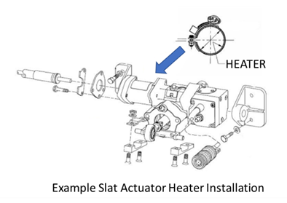

Installation of Supplemental Flap/Slat Actuator Heater System … Flap/Slat Actuator Supplemental Heaters Gulfstream G150
Available today from Peregrine is the supplemental type certificate (STC) ST01075DE, covering the installation of Gulfstream G150 flap and slat actuator heaters to improve high-lift system performance in cold weather landing situations.
Current project page
The STC covers the installation of heaters to prevent inadvertent freezing of the aircraft’s linear actuators that control wing flaps and slats positions. The heaters ensure the reliable operation and deployment of the leading-edge slats and flaps in all operational environments.
Peregrine provided all engineering, test and certification data needed to obtain the Supplemental Type Certificate approval. Operators of the G150 can contact their Gulfstream Authorized Service Center for installation of this STC.

Slide 5

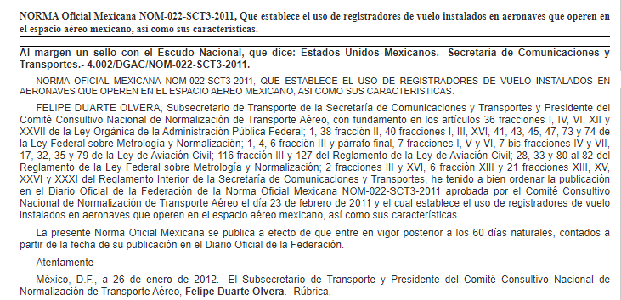

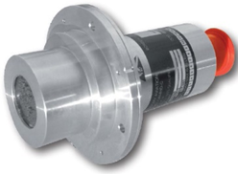
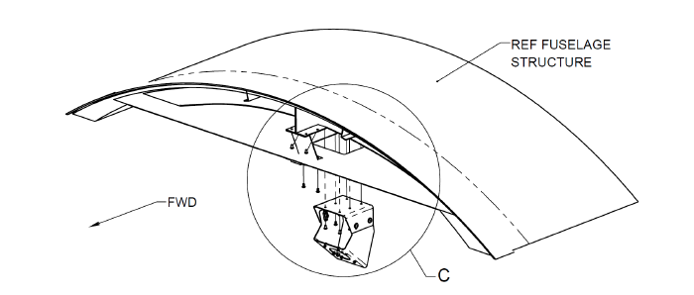
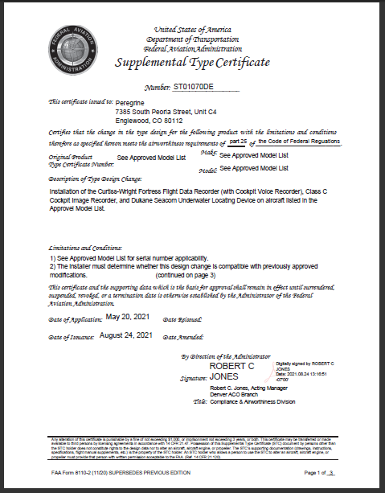
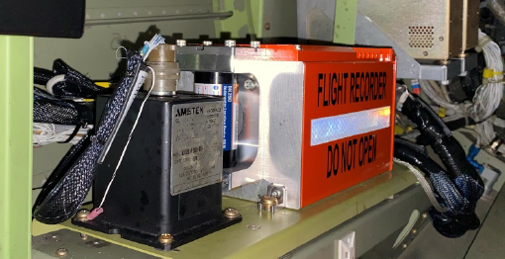
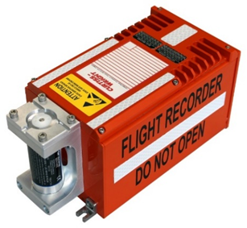
ST01070DE - Installation of the Curtiss-Wright Fortress Flight Data Recorder (with Cockpit Voice Recorder), Class C Cockpit Image Recorder, and Dukane Seacom Underwater Locating
Regulation
NOM‑022‑SCT3 2011
Cockpit Image Recorder Camera
Current project page
new
Flight Data Recorder with Cockpit Voice and Cabin Airborne Image Recording functions
Curtiss-Wright, SoCal Jets, Inc. and Peregrine Avionics have developed a solution to meet the requirements for recorders as outlined by the Federal Civil Aviation of Mexico, AFAC, NOM‑022‑SCT3 2011, for the operation of Part 25 aircraft in Mexico Airspace.
ST01070DE Solution
Approved Model List:
BAe.125 Series 800A, 800B, 1000A, 1000B
Hawker 750, 800, 800XP, 850XP, 900XP, 1000
Learjet 31, 31, 35, 35A (C-21A), 36, 36, 36A, 45
Cessna 750
Under certain regulatory bodies, Class C Cockpit Image recorders are allowed as a means for recording flight data where it is not practical or prohibitively expensive to record on an FDR, or where an FDR is not required. This AML STC offers an economical means of complying with the new AFAC and ICAO requirements.

Slide 6
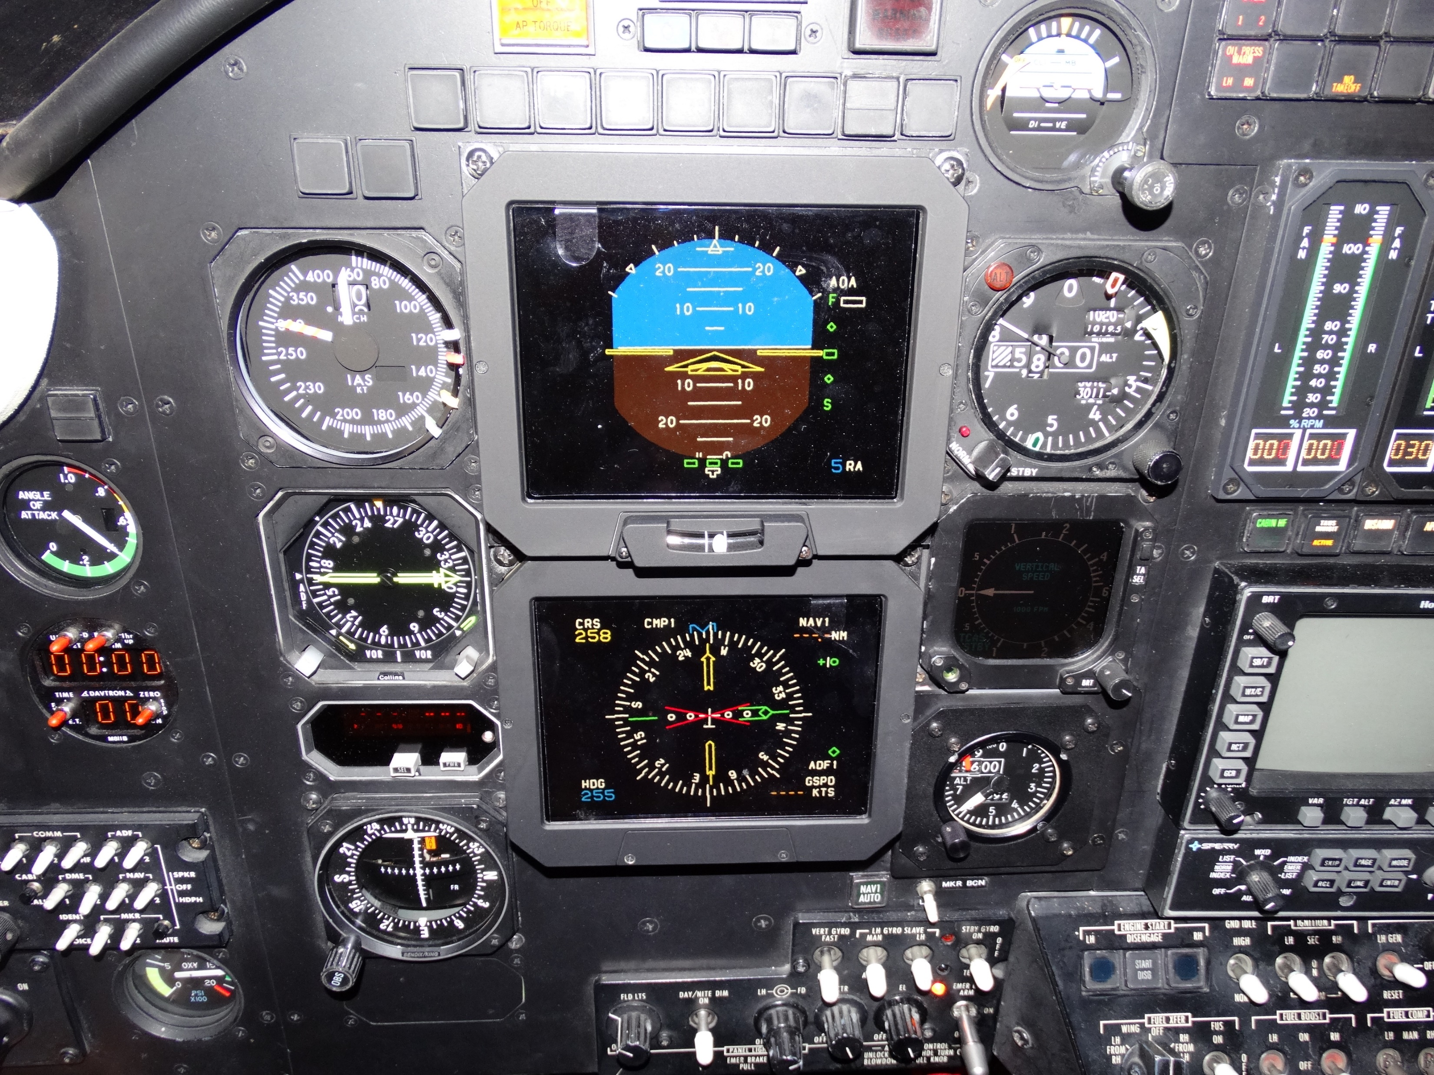
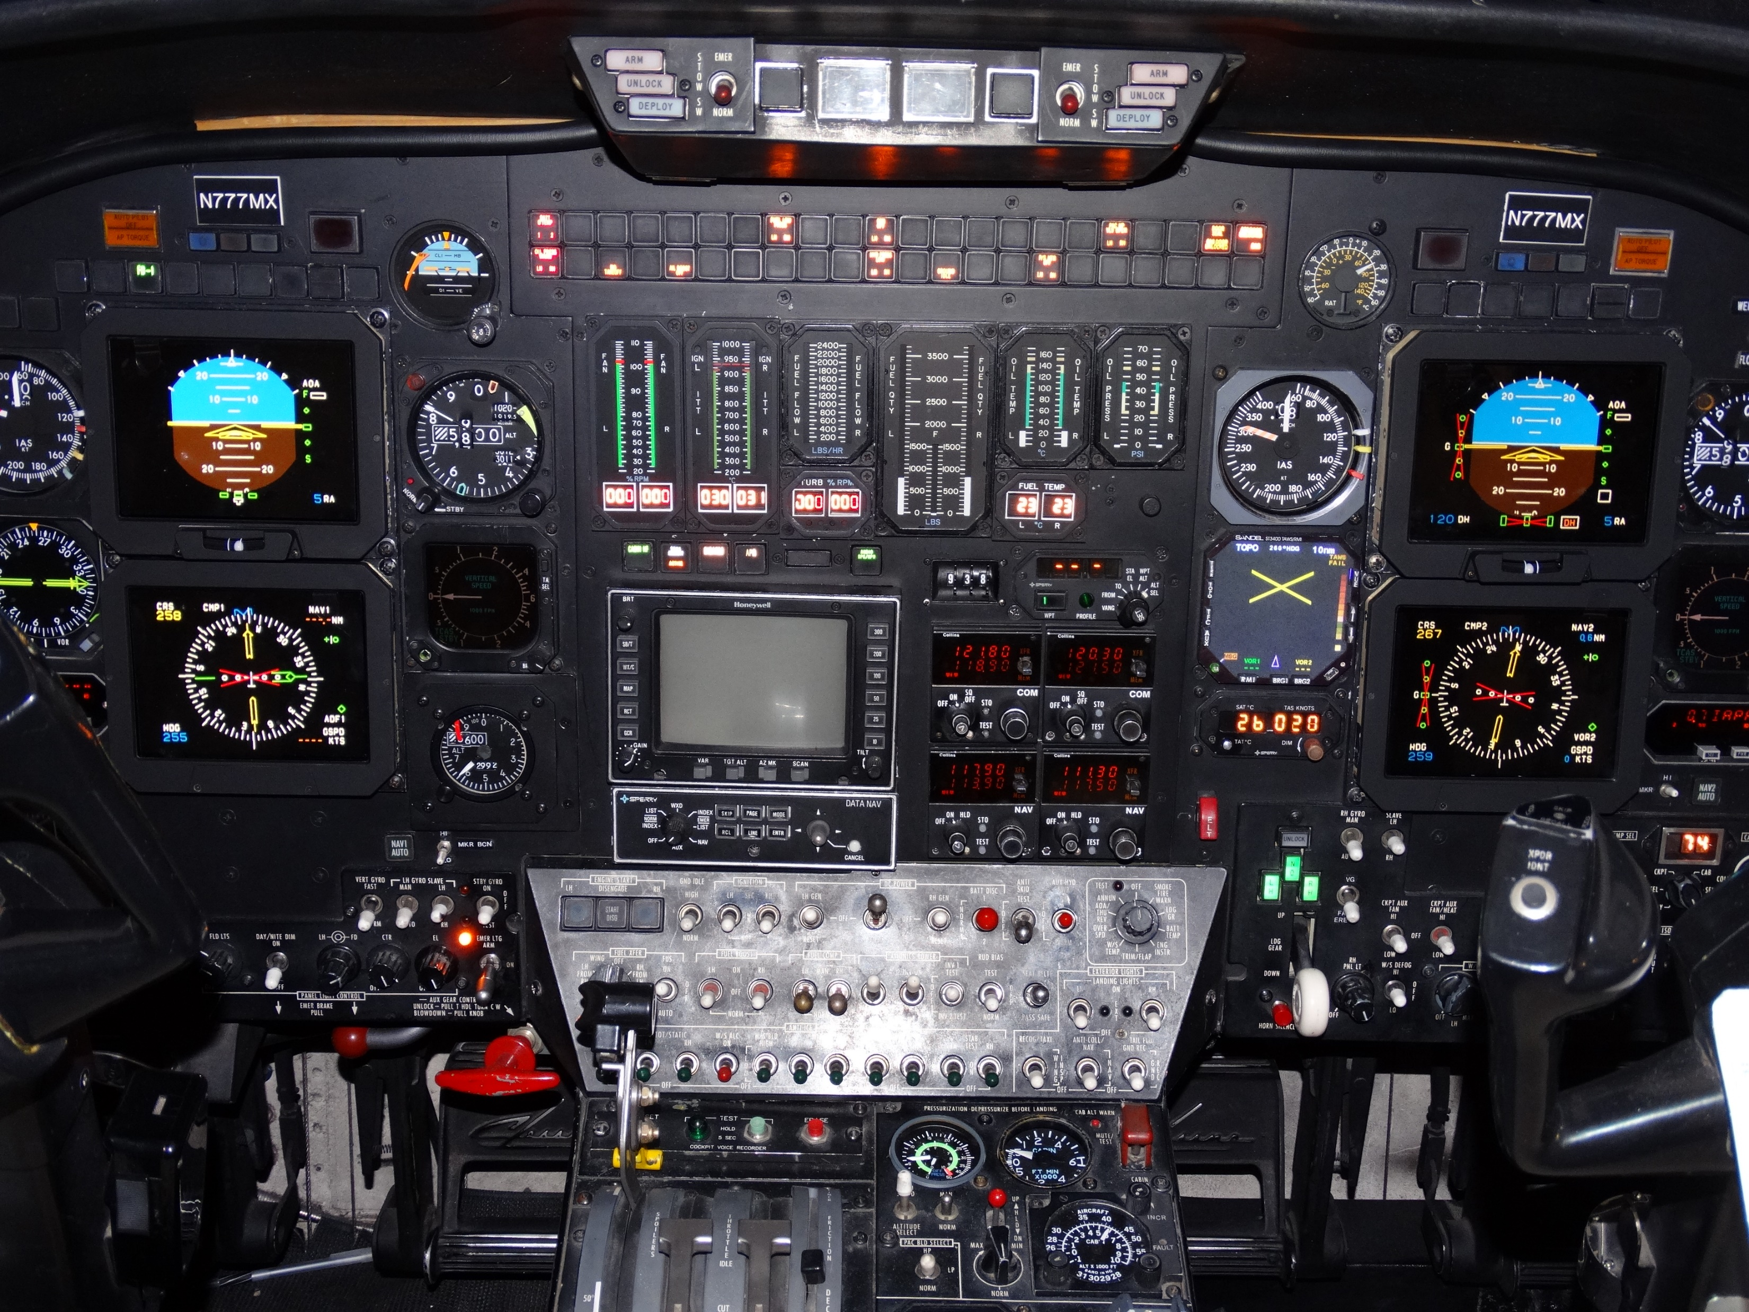
ST00813DE - Replacement of Honeywell (formerly Sperry) ED-800 cathode ray tube (CRT) display, part number 7003110-901 or 7003110-902, with Esterline CMC Electronics CMA-6800 multi-purpose liquid crystal display (LCD)
Replacement of obsolete CRT displays with multipurpose LCD devices
BAe.125 Series 800A,
BAe.125 Series 800B,
BAe.125 Series 1000A,
BAe.125 Series 1000B,
Hawker 800, Hawker 800XP,
Hawker 1000,
CL-215-6B11 (CL415 Variant),
CL-600-2A12 (CL-601),
CL-600-2B16 (CL-601-3A Variant),
CL-600-2B16 (CL-601-3R Variant),
DHC-8-100 Series,
DHC-8-200 Series,
DHC-8-300 Series,
Citation 650,
Dassault Mystere-Falcon 900,
Fokker F.27 Mark 050,
Gulfstream G-1159A
Current project page
ST00813DE AML STC

Slide 7
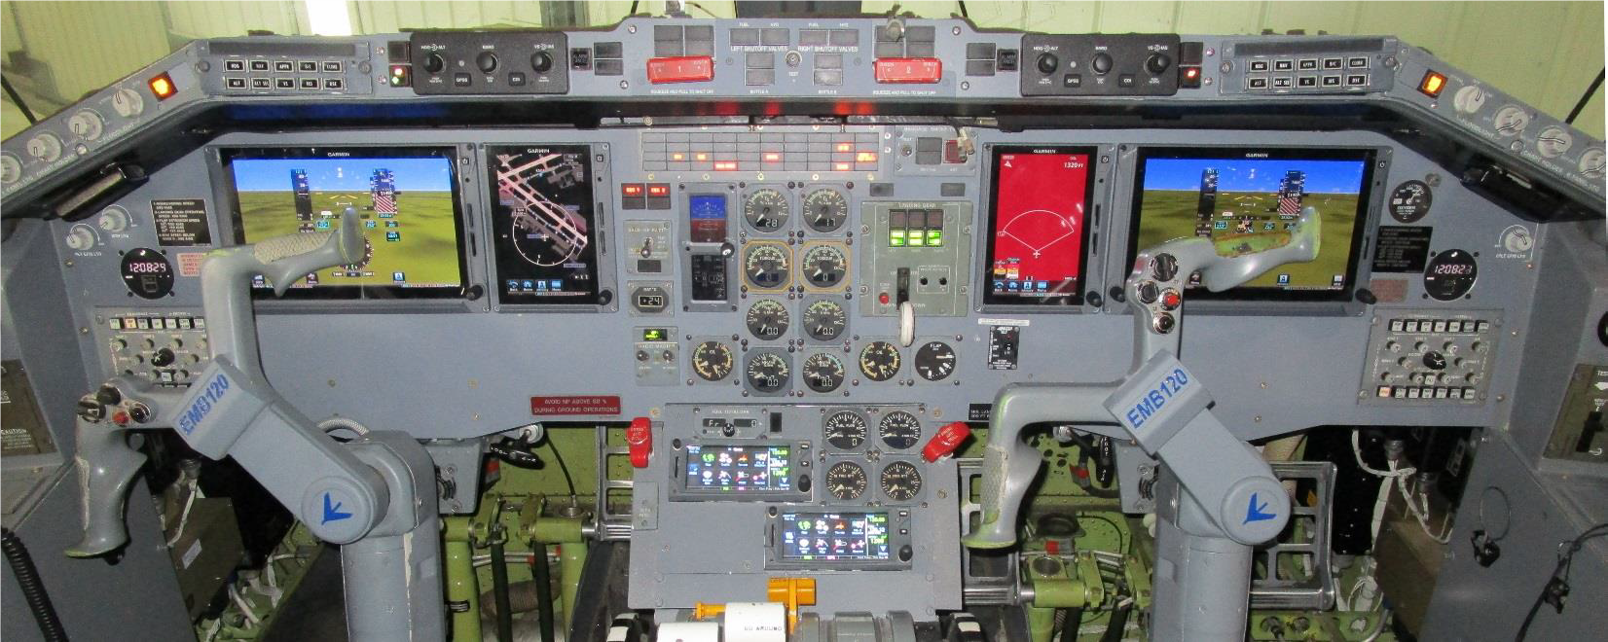
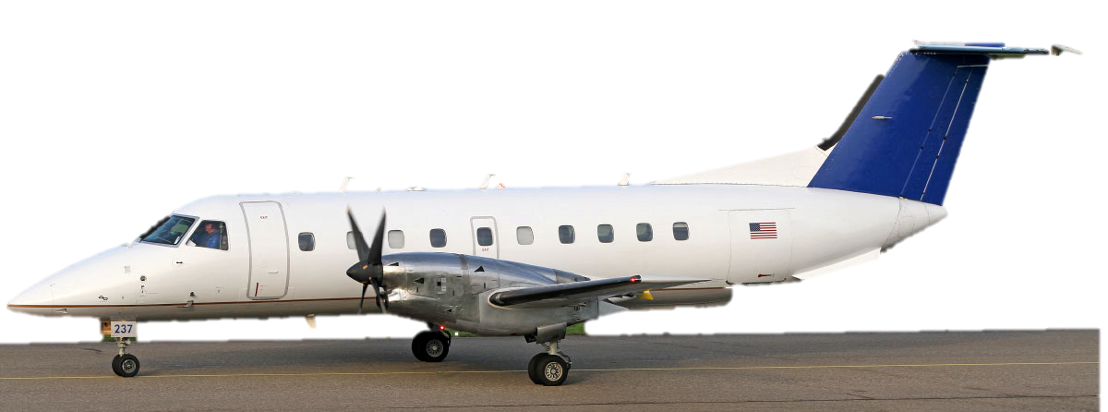
On behalf of Worldwide Aircraft Services, Peregrine completed a supplemental type certificate (STC), ST00895DE, installing the Garmin G700 TXi Avionics Suite in the Embraer EMB-120 ‘Brasilia’ series aircraft. This state‑of‑the‑art, fully integrated flight deck increases situational awareness and efficiency, resolving obsolescence and dispatch reliability concerns for operators of this popular turboprop aircraft, while reducing total operating costs.
First glass cockpit retrofit for EMB-120
Current project page
The overall system features a Four Screen PFD/MFD Garmin G700 TXi System with dual, 10.6” primary flight displays with moving map and dual 7” Multi-Function Displays with Chartview. This installation also installs dual GTN 650s, GRS 79 AHRS, GDC 72 ADCs, GWX 75 Weather Radar, GTS 855 TCAS I and GTX 345R Mode S ES/ADS‑B transponders. The STC also incorporates a Mid-Continent MD302 Standby Attitude Module

Slide 8

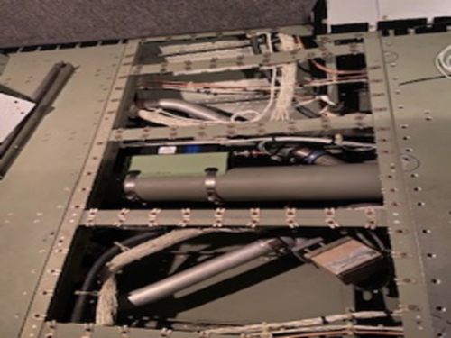
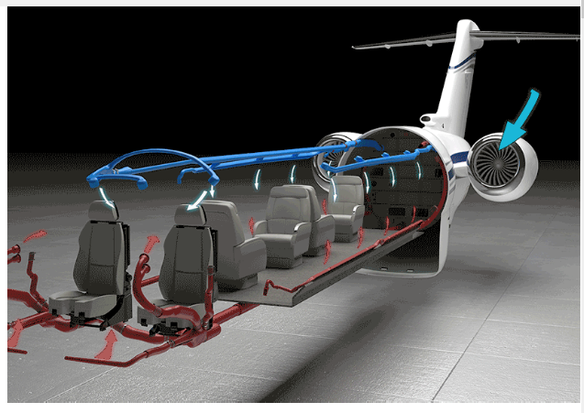
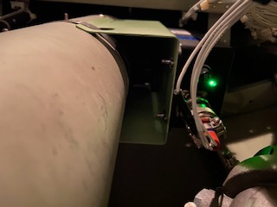
ACA System
ST01066DE - COVID-19 elimination system for business aircraft using ACA ionizing technology
Current project page
ACA needle point bipolar ionization system (NPBI™ ) system installed in fresh air duct feeding the cockpit and cabin of the aircraft
In other aircraft, one unit would be installed per ECS pack or source of fresh air feeding the cabin and cockpit.
The ACA units are a proactive air and surface purification technology installed in the aircraft environmental control system ductwork giving crew and passengers immediate clean, safe and healthy interior air. In addition to removing odors and allergens, its patented ionization technology kills pathogens throughout the cockpit and cabin including, but not limited to COVID 19, Bird Flu Virus (H5N1), Swine Flu Virus (H1N1), SARS Bacteria, Staph Bacteria, Mold Spores, MRSA, E.coli, T.B., C.diff, Pneumonia and more. Testing for SARS-CoV-2 (COVID-19) effectiveness validation performed by an independent laboratory demonstrates over 99% effectivity.

Slide 9

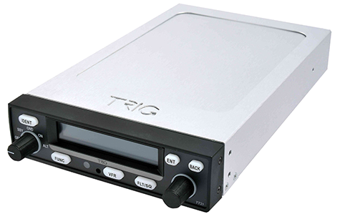
SA00744DE - ADS-B Out Trig Avionics TT31 Panel Mount Transponder
Peregrine partnered with Trig Avionics to produce one of the first ADS-B transponder AML STC for general aviation use compatible with the FAA equipage mandate.
When paired with an approved position sensor, the AML STC meets worldwide ADS-B Out requirements.
Additional Validations: EASA
Approved for 652 Small Airplane models
Contact: Trig at: www.trig-avionics.com/
STC: https://peregrine.aero/wp-content/uploads/2021/01/SA00744DE.pdf
AML: https://peregrine.aero/wp-content/uploads/2021/01/SA00744DE_AML.pdf

Slide 10
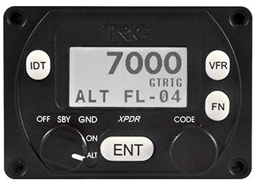
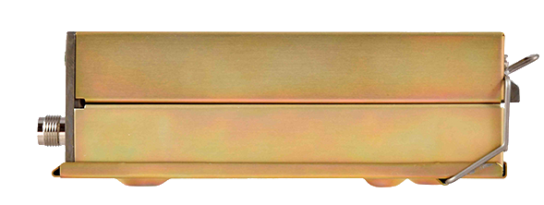
SA00756DE - ADS-B Out Trig Avionics TT22 Panel Mount Transponder
Peregrine developed an extensive approved model list STC for the Trig TT22 compact transponder. This early STC enabled early compliance with the FAA 2020 ADS-B Out mandate.
The TT22 is a fully compliant Mode S ES transponder with a built-in barometric sensor that combined with its small form-factor allows for easy installation in a variety of aircraft
Additional Validations: EASA, Mexico - AFAC
Approved for 627 Small Airplane models
Contact: Trig at: www.trig-avionics.com/
STC: https://peregrine.aero/wp-content/uploads/2021/01/SA00756DE.pdf
AML: https://peregrine.aero/wp-content/uploads/2021/01/SA00756DE_AML.pdf
TT22 ADS-B STCs are available free of charge from Trig Avionics and cover hundreds of aircraft types. STC approvals allow the use of popular WAAS GPS navigators – making installation practical and cost-effective. The Trig TA70 GPS antenna is also included on the STC equipment list.

Slide 11
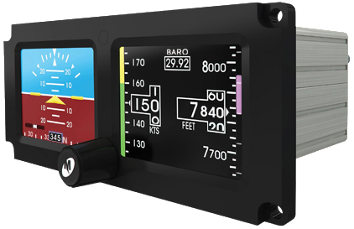
SA00762DE - MidContinent MD302 Standby Digital Flight Instrument System
Peregrine developed the STC for the SAM MD302 to simplify the installation of a digital LCD standby instrument in Piper Matrix, Malibu and Malibu Mirage aircraft.
The model MD302 series SAM® Standby Attitude Module is a self-contained situational awareness instrument that provides aircraft attitude, altitude, airspeed and slip indication. The compact and innovative design of the MD302 is specifically developed for maximum flexibility for installation in retrofit for modern instrument panels.
Approved for 3 models, including:
  Piper: PA-46-350P, PA-46-500TP, PA-46R-350T
Contact: Mid-Continent at: www.mcico.com/
STC: https://peregrine.aero/wp-content/uploads/2021/01/SA00762DE.pdf

Slide 12
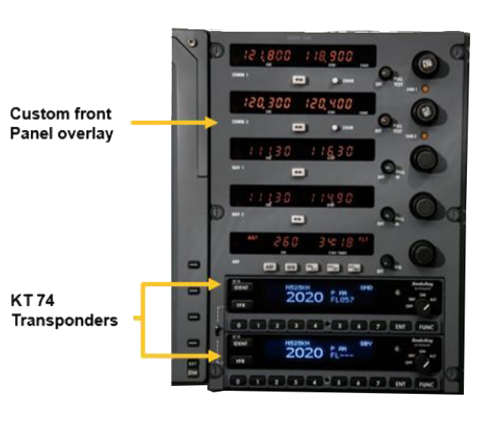
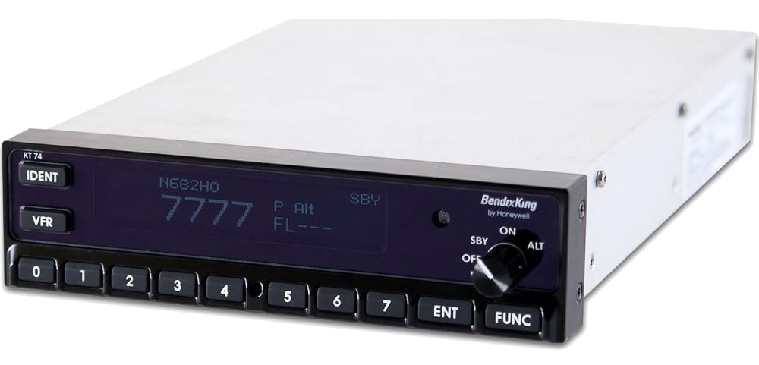
SA00765DE - ADS-B Out BendixKing KT74 Transponder
Peregrine in partnership with BendixKing developed the STC for the KT74 that addresses a large number of models in its Approved Model List.
Additionally, Peregrine and BendixKing addressed the requirements of older aircraft with dual transponders.
Peregrine developed this STC and innovative custom overlay simplifying an ADS-B retrofit solution for legacy CitationJets
The CNI 5000 ADS-B Out upgrade provides a direct replacement of the two KT 70 transponders with two of the KT 74 ADS-B Out transponders.
Additional Validations: Mexico - AFAC, Brazil - ANAC, Argentina, Venezuela - INAC
Approved for 786 Small Airplane models
Contact: BendixKing at: www.bendixking.com/
STC: https://peregrine.aero/wp-content/uploads/2021/01/SA00765DE.pdf
AML: https://peregrine.aero/wp-content/uploads/2021/01/SA00765DE_AML.pdf

Slide 13
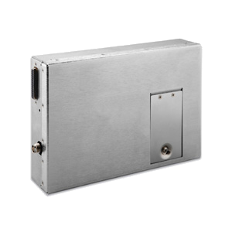
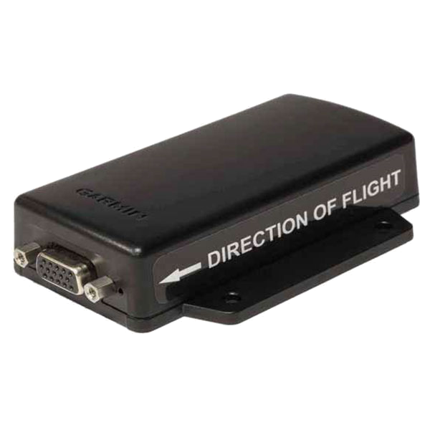
SA01031DE - Garmin GSR 56 SATCOM Flightstream 210 transceivers
Garmin FlightStream 210
Bluetooth Wireless Gateway
Garmin GSR 56
SATCOM Transceiver
Additional Validations: Brazil - ANAC
Approved for the Daher Kodiak 100
Contact: Daher at: www.daher.com/
STC: https://peregrine.aero/wp-content/uploads/2021/01/SA01031DE.pdf

Slide 14
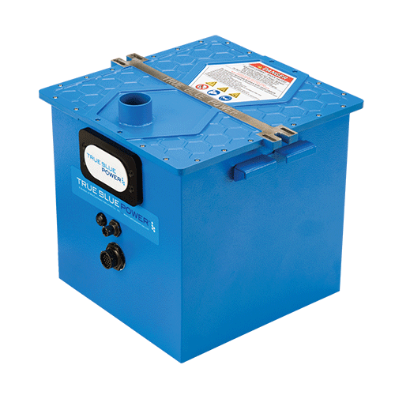
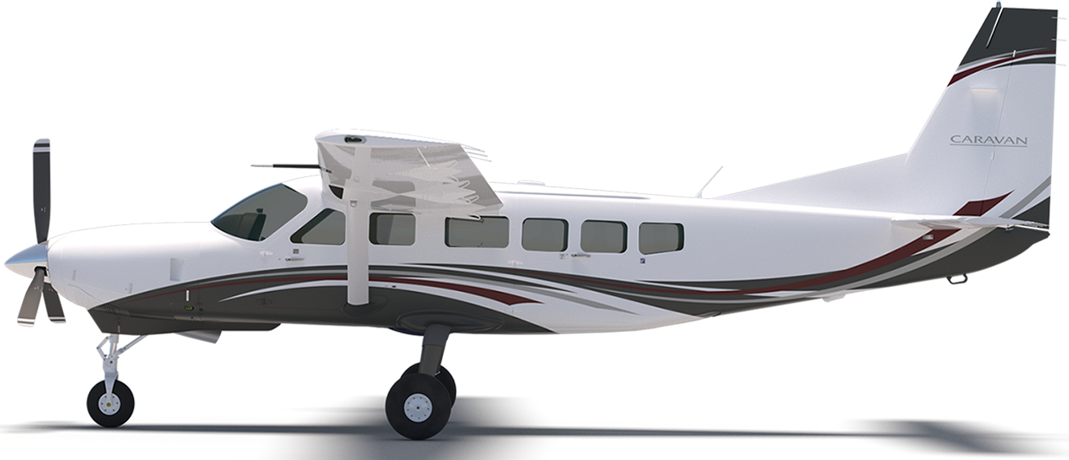
SA01822WI - True Blue TB44 Lithium Ion Battery
True Blue TB44 Lithium Ion Battery
True Blue Power’s TB44 lithium-ion batteries offers operational and performance improvements over nickel-cadmium or lead-acid batteries, including triple the energy per kilogram; double the lifespan; more rapid recharge; cooler and cleaner engine restarts; superior high temperature and cold weather performance; reduced weight maintenance cost and direct operating cost; and zero carbon emissions
Additional Validations: Canada - TCAA
Approved for 2 models, including:
  Textron: 208, 208B
Contact: Mid-Continent at: www.mcico.com/
STC: https://peregrine.aero/wp-content/uploads/2021/01/SA01822WI.pdf

Slide 15
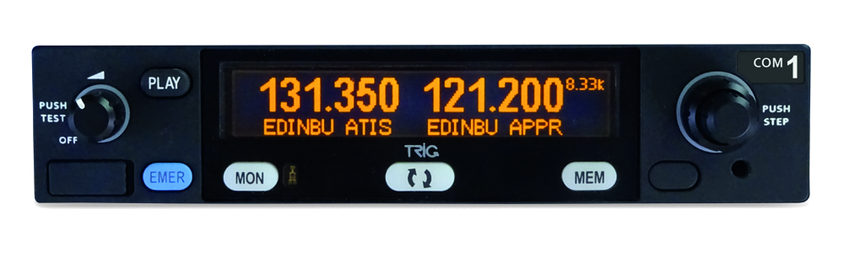
SA01835WI - Trig Avionics TY-96 or TY-97 VHF Communications Radio
The Trig stack radio provides crisp and clear stereo communication, faster tuning, a user friendly programmable USB database, dual watch and Trig’s popular ‘Say Again’ feature. At only 33mm high (1.3”) the radio saves valuable stack space, but retains innovative and practical features. Trig’s stack radios are designed for general and light-sport aviation. The TY96/TY97 is an 8.33 radio, the TY96A/TY97A is a 760 channel version.
Approved for 704 Small Airplane models
Contact: Trig at: www.trig-avionics.com/
STC: https://peregrine.aero/wp-content/uploads/2021/01/SA01835WI.pdf
AML: https://peregrine.aero/wp-content/uploads/2021/01/SA01835WI_AML.pdf

Slide 16
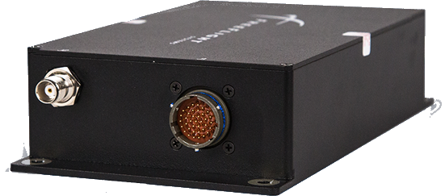
SR00764DE - ADS-B Out Trig Avionics TT22 Transponder and Freeflight Systems 1201 GPS
Additional Validations: Brazil - ANAC
Approved for 3 models, including:
  Sikorsky: S-76A, S-76B, S-76C
Contact: Trig at: www.trig-avionics.com/
STC: https://peregrine.aero/wp-content/uploads/2021/01/SR00764DE.pdf

Slide 17

SR00821DE - ADS-B Out and In: BendixKing KT74 Transponder and ADS-B In Receiver
Additional Validations: Brazil - ANAC
Approved for 40 models, including:
  Airbus Helicopters: EC135 P1, EC135 P2, EC135 P2+, EC135 T1, EC135 T2, EC135 T2+, EC135P3, EC135T3, AS-350B, AS-350B1, AS-350B2, AS-350B3, AS-350BA, AS-350C, AS-350D, AS-350D1, AS355E, AS355F, AS355F1, AS355F2, AS355N, AS355NP, EC 130 B4, EC 130 T2
  Bell: 206, 206A-1 (OH-58A), 206A, 206B-1, 206B, 206L-1, 206L-3, 206L-4, 206L, 407, 427
  MD Helicopters: 500N
  Robinson: R22, R22 ALPHA, R22 BETA, R22 MARINER
Contact: BendixKing at: www.bendixking.com/
STC: https://peregrine.aero/wp-content/uploads/2021/01/SR00821DE.pdf
AML: https://peregrine.aero/wp-content/uploads/2021/01/SR00821DE_AML.pdf

Slide 18
SR00828DE - ADS-B Out Garmin G330ES or G33H ES Transponder
Approved for 18 models, including:
  Agusta: A109
  Airbus Helicopters: EC135 P1, EC135 P2, EC135 P2+, EC135 T1, EC135 T2, EC135 T2+, AS-350B, AS-350B1, AS-350B2, AS-350B3, AS-350BA, AS-350C, AS-350D, AS-350D1, EC 130 B4, EC 130 T2
  Bell: 407
Contact: Peregrine Avionics at: peregrine.aero/home/contact-us/
STC: https://peregrine.aero/wp-content/uploads/2021/01/SR00828DE.pdf
AML: https://peregrine.aero/wp-content/uploads/2021/01/SR00828DE_AML.pdf

Slide 19
SR00847DE - Honeywell ED-800 CRT replacement with CMC Electronics CMA-6800 LCD for rotorcraft
Additional Validations: Canada - TCAA, Brazil - ANAC
Approved for 2 models, including:
  Sikorsky: S-76B, S-76C
Contact: DAC International at: dacint.com/
STC: https://peregrine.aero/wp-content/uploads/2021/01/SR00847DE.pdf

Slide 20
SR00851DE - ADS-B Out Garmin GTX 330ES transponder
Approved for 7 models, including:
  Airbus Helicopters: MBB-BK 117 A-1, MBB-BK 117 A-3, MBB-BK 117 A-4, MBB-BK 117 B-1, MBB-BK 117 B-2, MBB-BK 117 C-1, MBB-BK 117 C-2
Contact: Peregrine Avionics at: peregrine.aero/home/contact-us/
STC: https://peregrine.aero/wp-content/uploads/2021/01/SR00851DE.pdf
AML: https://peregrine.aero/wp-content/uploads/2021/01/SR00851DE_AML.pdf

Slide 21
SR00925DE - Garmin GTX 335/335R and GTX345/345R transponders for ADS-B Out and In
Additional Validations: EASA, Canada - TCAA, Mexico - AFAC, Brazil - ANAC, Columbia
Approved for 40 models, including:
  Airbus Helicopters: MBB-BK 117 A-1, MBB-BK 117 A-3, MBB-BK 117 A-4, MBB-BK 117 B-1, MBB-BK 117 B-2, MBB-BK 117 C-1, MBB-BK 117 C-2, AS-365N2, AS-365N3, EC 155B, EC155B1, SA-365N1, AS332C, AS332C1, AS332L, AS332L1, AS332L2, EC225LP
  Bell: 222, 222B, 222U, 230, 430, 205A, 205A-1, 212, 412
  Columbia Helicopters: 107-II, 234
  Erickson: S-64E, S-64F
  Leonardo: AW139
  Sikorsky: S-61L, S-61N, S-61NM, S-61R, S-76A, S-76B, S-76C, S-92A
Contact: SEAerospace at: www.seaerospace.com/
STC: https://peregrine.aero/wp-content/uploads/2021/01/SR00925DE.pdf
AML: https://peregrine.aero/wp-content/uploads/2021/01/SR00925DE_AML.pdf

Slide 22
ST00790DE - BendixKing CAS 67B Traffic Alert and Collision Avoidance System (TCAS) II Version 7.1
Additional Validations: Canada - TCAA, Mexico - AFAC, Brazil - ANAC, India - DGAC
Approved for 59 models, including:
  Beechcraft: BAe.125 Series 1000A, BAe.125 Series 1000B, BAe.125 Series 800A (C-29A), BAe.125 Series 800A (U-125), BAe.125 Series 800A, BH.125 Series 400A, Hawker 1000, Hawker 800 (U-125A), Hawker 800, Hawker 800XP, HS.125 Series 700A
  Bombardier: CL-600-1A11 (CL-600), CL-600-2A12 (CL-601), CL-600-2B16 (CL-601-3A), CL-600-2B16 (CL-601-3R), CL-600-2B16 (CL-604), DHC-8-101, DHC-8-102, DHC-8-103, DHC-8-106, DHC-8-201, DHC-8-202, DHC-8-301, DHC-8-311, DHC-8-315, DHC-8-402
  Dassault: Mystere-Falcon 50, Mystere-Falcon 900
  Gulfstream: G-1159, G-1159A, G-1159B, G-IV, GV, 1125 Westwind Astra
  IAI: 1124, 1124A
  Learjet: 25, 25A, 25B, 25C, 25D, 25F, 31, 31A, 35, 35A (C-21A), 36, 36A, 45, 55, 55B, 55C
  Sabreliner: NA-265-40, NA-265-60, NA-265-65
  Textron: 550, 560, 650, S550
Contact: Peregrine Avionics at: peregrine.aero/home/contact-us/
STC: https://peregrine.aero/wp-content/uploads/2021/01/ST00790DE.pdf
AML: https://peregrine.aero/wp-content/uploads/2021/01/ST00790DE_AML.pdf

Slide 23
ST00813DE - Honeywell ED-800 CRT replacement with CMC Electronics CMA-6800 LCD
After – CMA-6800 LCDs
Before – Obsolete ED-800 CRTs
Additional Validations: EASA, Canada - TCAA, Mexico - AFAC, Brazil - ANAC
Approved for 24 models, including:
  Beechcraft: BAe.125 Series 1000A, BAe.125 Series 1000B, BAe.125 Series 800A, BAe.125 Series 800B, Hawker 1000, Hawker 800, Hawker 800XP
  Bombardier: CL-215-6B11 (CL-415 Variant), CL-600-2A12 (CL-601), CL-600-2B16 (CL-601-3A), CL-600-2B16 (CL-601-3R), DHC-8-101, DHC-8-102, DHC-8-103, DHC-8-106, DHC-8-201, DHC-8-202, DHC-8-301, DHC-8-311, DHC-8-315
  Dassault: Mystere-Falcon 900
  Fokker: F27 Mark 050
  Gulfstream: G-1159A
  Textron: 650
Contact: DAC International at: dacint.com/
STC: https://peregrine.aero/wp-content/uploads/2021/01/ST00813DE.pdf
AML: https://peregrine.aero/wp-content/uploads/2021/01/ST00813DE_AML.pdf
Replacement of obsolete CRT displays with multipurpose LCD devices is made possible through the use of this Peregrine-developed STC. The new installation reduces weight, increases reliability with a plug-and-play upgrade (add actual ### weight saving), heat, power and contribution to improved MTBF for other panel equipment

Slide 24
ST00835DE - ADS-B Out and In Garmin GTX 335R and GTX 345R remote transponders
Additional Validations: Canada - TCAA, Mexico - AFAC, Brazil - ANAC, Columbia, Venezuela - INAC
Approved for 72 Small/Large Airplane models
Contact: SEAerospace at: www.seaerospace.com/
STC: https://peregrine.aero/wp-content/uploads/2021/01/ST00835DE.pdf
AML: https://peregrine.aero/wp-content/uploads/2021/01/ST00835DE_AML.pdf

Slide 25
ST00841DE - ADS-B Out Rockwell Collins TDR-94D Enhanced Surveillance Mode S Transponders, GPS-4000S WAAS GPS Receivers and IOC-4000
Additional Validations: EASA, Canada - TCAA
Approved for 3 models, including:
  Bombardier: CL-600-2B16 (CL-601-3A), CL-600-2B16 (CL-601-3R), CL-600-2B16 (CL-604)
Contact: Bombardier Service Center at: businessaircraft.bombardier.com/en/support/support-network
STC: https://peregrine.aero/wp-content/uploads/2021/08/ST00841DE.pdf

Slide 26
ST00857DE - MD215 Standby Altimeter
Approved for 2 models, including:
  Beechcraft: BAe.125 Series 800A
  Textron: 650
Contact: Mid-Continent at: www.mcico.com/
STC: https://peregrine.aero/wp-content/uploads/2021/01/ST00857DE.pdf
AML: https://peregrine.aero/wp-content/uploads/2021/01/ST00857DE_AML.pdf

Slide 27
ST00882DE - Becker Avionics BXT6553 transponder
Additional Validations: EASA, Mexico - AFAC
Approved for 22 models, including:
  Bombardier: CL-600-2A12 (CL-601), CL-600-2B16 (CL-601-3A), CL-600-2B16 (CL-601-3R)
  Dassault: Mystere-Falcon 900
  Gulfstream: G-1159A, G-IV, 1125 Westwind Astra
  Learjet: 31, 31A, 35, 35A (C-21A), 36, 36A, 55, 55B, 55C
  Textron: 550, BAe.125 Series 800A, BAe.125 Series 800B, Hawker 800, Hawker 800XP, 650
Contact: Becker Avionics at: www.becker-avionics.com/
STC: https://peregrine.aero/wp-content/uploads/2021/01/ST00882DE.pdf
AML: https://peregrine.aero/wp-content/uploads/2021/01/ST00882DE_AML.pdf

Slide 28
ST00883DE - LitefLCR-100 Attitude Heading and Reference System (AHRS) as replacement of LCR-93 AHRS
Additional Validations: Brazil - ANAC
Approved for the Textron 560XL
Contact: DAC International at: dacint.com/
STC: https://peregrine.aero/wp-content/uploads/2021/01/ST00883DE.pdf

Slide 29
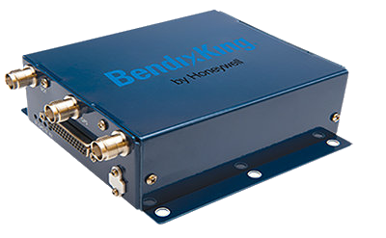
ST00892DE - Dual BendixKing KT 74 Transponders and optional BendixKing KGX 150 Receiver
Peregrine developed this STC and innovative custom front overlay simplifying an ADS-B retrofit solution for legacy Citation 550 Bravo aircraft
The CNI 5000 ADS-B Out with UAT ADS-B In upgrade provides a direct replacement of the two KT 70 transponders with two of the KT 74 ADS-B Out transponders and the addition of an KGX 150R WAAS GPS and ADS-B In Weather/Traffic Receiver.
Additional Validations: Canada - TCAA, Mexico - AFAC
Approved for the Textron 550
Contact: BendixKing at: www.bendixking.com/
STC: https://peregrine.aero/wp-content/uploads/2021/01/ST00892DE.pdf

Slide 30
ST00895DE - Garmin G700 TXi Avionics Suite Update of EMB-120
Approved for 5 models, including:
  YaborÃ£: EMB-120, EMB-120ER, EMB-120FC, EMB-120QC, EMB-120RT
Contact: Worldwide Aircraft Services at: www.worldwide-aircraft.com/
STC: https://peregrine.aero/wp-content/uploads/2021/01/ST00895DE.pdf

Slide 31
ST00912DE - FANS 1/A+, Remote Oceanic CPDLC, ADS-C and CPDLC Departure Clearance for Gulfstream Aircraft
Additional Validations: EASA, Canada - TCAA
Approved for 2 models, including:
  Gulfstream: Galaxy, Gulfstream 200
Contact: Gulfstream Service Center at: www.gulfstream.com/
STC: https://peregrine.aero/wp-content/uploads/2021/08/ST00912DE.pdf

Slide 32
ST00934DE - Becker Avionics BXT6553 transponder
Additional Validations: Mexico - AFAC, Brazil - ANAC, Argentina
Approved for 24 models, including:
  Bombardier: CL-600-2B16 (CL-601-3A), CL-600-2B16 (CL-601-3R)
  Dassault: Falcon 900EX
  Embraer: EMB-135BJ (Legacy 600), EMB-135BJ (Legacy 650)
  Gulfstream: G-IV, GIV-X
  Learjet: 45
  Textron: 550, 560, 560XL, 650, 680, 750, BAe.125 Series 1000A, BAe.125 Series 1000B, BAe.125 Series 800A (C-29A), BAe.125 Series 800A (U-125), BAe.125 Series 800A, BAe.125 Series 800B, Hawker 1000, Hawker 800 (U-125A), Hawker 800, Hawker 800XP
Contact: DAC International at: dacint.com/
STC: https://peregrine.aero/wp-content/uploads/2021/01/ST00934DE.pdf
AML: https://peregrine.aero/wp-content/uploads/2021/01/ST00934DE_AML.pdf

Slide 33
ST01035DE - Replacement aft bay Heat Exchanger Blower Fans for improved reliability
Approved for the Textron 4000
Contact: Peregrine Avionics at: peregrine.aero/home/contact-us/
STC: https://peregrine.aero/wp-content/uploads/2021/06/ST01035DE.pdf

Slide 34
ST01066DE - Aviation Clean Air Airborne Air & Surface Purification System for multiple aircraft models
Additional Validations: Canada - TCAA
Approved for 9 models, including:
  Bombardier: CL-600-1A11 (CL-600), CL-600-2A12 (CL-601), CL-600-2B16 (CL-601-3A), CL-600-2B16 (CL-601-3R), CL-600-2B16 (CL-604)
  Dassault: Falcon 900EX, Mystere-Falcon 50, Mystere-Falcon 900
  Gulfstream: G-IV
Contact: Peregrine Avionics at: peregrine.aero/home/contact-us/
STC: https://peregrine.aero/wp-content/uploads/2021/08/ST01066DE.pdf
AML: https://peregrine.aero/wp-content/uploads/2021/06/ST01066DE-AML.pdf

Slide 35
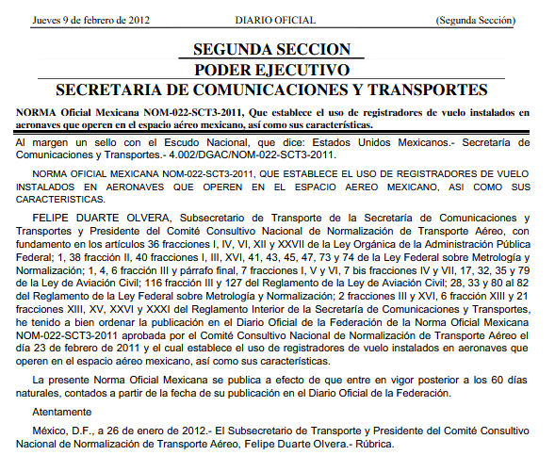

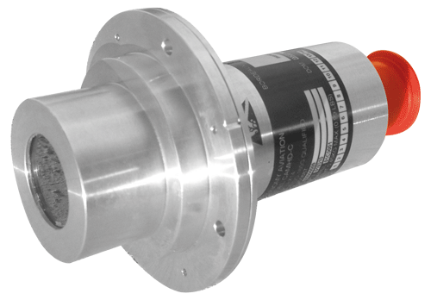
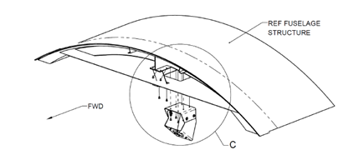
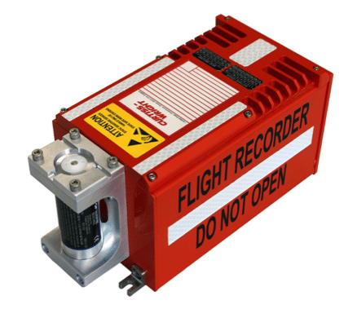
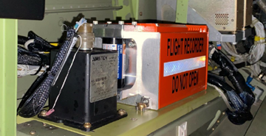
ST01070DE - Curtiss-Wright Fortress Flight Data Recorder (with Cockpit Voice Recorder) for compliant operations
Peregrine Avionics, Curtiss-Wright and SoCal Jets, Inc. have developed a solution to meet the requirements for recorders as outlined by the Federal Civil Aviation of Mexico, AFAC, NOM‑022‑SCT3 2011, for the operation of Part 25 aircraft in Mexico Airspace.
AFAC NOM‑022‑SCT3 2011
Cockpit Image Recorder Camera
Additional Validations: Mexico - AFAC
Approved for 18 models, including:
  Learjet: 31, 31A, 35, 35A (C-21A), 36, 36A, 45
  Textron: BAe.125 Series 1000A, BAe.125 Series 1000B, BAe.125 Series 800A, BAe.125 Series 800B, Hawker 1000, Hawker 750, Hawker 800, Hawker 800XP, Hawker 850XP, Hawker 900XP, 750
Contact: Peregrine Avionics at: peregrine.aero/home/contact-us/
STC: https://peregrine.aero/wp-content/uploads/2022/01/ST01070DE.pdf
AML: https://peregrine.aero/wp-content/uploads/2022/01/ST01070DE_AML.pdf
Under certain regulatory bodies, Class C Cockpit Image recorders are allowed as a means for recording flight data where it is not practical or prohibitively expensive to record on an FDR, or where an FDR is not required. This AML STC offers an economical means of complying with the new AFAC and ICAO requirements.

Slide 36

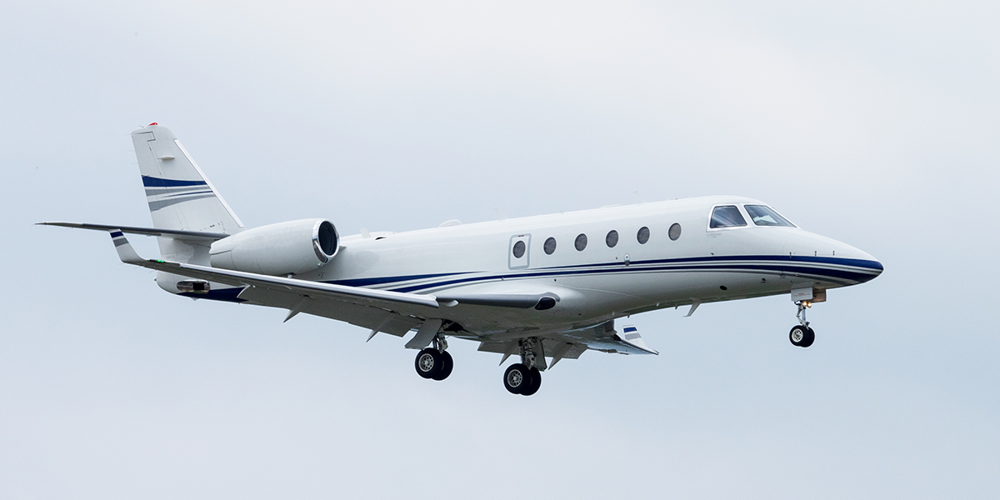

ST01075DE - Supplemental Flap/Slat Actuator Heater System
Peregrine provided all engineering, test and certification data needed to obtain the Supplemental Type Certificate approval.
ST01075DE - Supplemental Flap/Slat Actuator Heater System
Available today from Peregrine is the supplemental type certificate (STC) ST01075DE, to improve high-lift system performance in cold weather landing situations.
Operators of the G150 can contact their Gulfstream Authorized Service Center for installation of this STC.
Approved for the Gulfstream G150
Contact: Peregrine Avionics at: peregrine.aero/home/contact-us/
STC: https://peregrine.aero/wp-content/uploads/2021/01/ST01075DE.pdf
Approved for the Gulfstream G150
The STC covers the installation of heaters to prevent inadvertent freezing of the aircraft’s linear actuators that control wing flaps and slats positions. The heaters ensure the reliable operation and deployment of the leading-edge slats and flaps in all operational environments.

Slide 37
ST01083DE - Aviation Clean Air Airborne Air & Surface Purification System for multiple aircraft models with single ESC duct
Approved for 6 models, including:
  Gulfstream: G150
  Learjet: 35, 35A (C-21A), 36, 36A
  Textron: 560XL
Contact: Peregrine Avionics at: peregrine.aero/home/contact-us/
STC: https://peregrine.aero/wp-content/uploads/2021/10/ST01083DE.pdf
AML: https://peregrine.aero/wp-content/uploads/2021/10/ST01083DE_AML.pdf

Slide 38
SA01044DE - PC-12 True Blue Advanced Lithium-ion Battery
Additional Validations: Canada - TCAA
Approved for 3 models, including:
  Pilatus: PC-12, PC-12/45, PC-12/47
Contact: Finnoff at: finnoff.com/
STC: https://peregrine.aero/wp-content/uploads/2021/08/SA01044DE.pdf

Slide 39
SA01053DE - PC-12 Gogo Advance L3 Air To Ground System
Additional Validations: Canada - TCAA
Approved for 4 models, including:
  Pilatus: PC-12, PC-12/45, PC-12/47, PC-12/47E
Contact: Western Aircraft at: www.westair.com/
STC: https://peregrine.aero/wp-content/uploads/2021/08/SA01053DE.pdf

Slide 40
SR09654RC - FreeFlight Systems RANGR ADS-B Out and In Part 27 AML
Approved for 32 models, including:
  Airbus Helicopters: AS350B, AS350B1, AS350B2, AS350B3, AS350BA, AS350C, AS350D, AS350D1, EC130B4, EC130T2, AS355E, AS355F, AS355F1, AS355F2, AS355N, AS355NP
  Bell: 206A, 206B, 206B-1, 206L, 206L-1, 206L-3, 206L-4, 407, 427, 429
  Robinson: R22, R22 ALPHA, R22 BETA, R22 MARINER, R44, R44 II
Contact: Trig at: www.trig-avionics.com/
STC: https://peregrine.aero/wp-content/uploads/2021/08/SR09654RC.pdf
AML: https://peregrine.aero/wp-content/uploads/2021/08/SR09654RC_AML.pdf

Slide 41
SA09886AC - BendixKing CG100P Connected Gateway for King Air 200/B200
Approved for 2 models, including:
  Textron: 200, B200
Contact: BendixKing at: www.bendixking.com/
STC: https://peregrine.aero/wp-content/uploads/2021/08/SA09886AC.pdf
AML: https://peregrine.aero/wp-content/uploads/2021/08/SA09886AC_AML.pdf

Slide 42
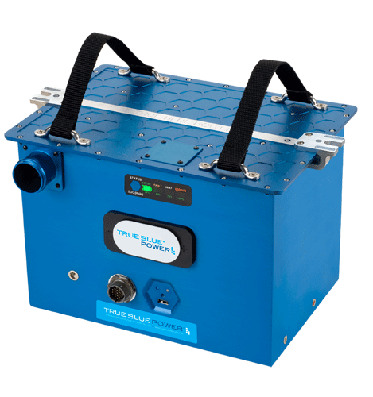

Beechjet TB40 Battery STC, Project Status, #P1398, FAA ST#ST06791WI-T
True Blue Power TB40 Mid-Continent Instruments
Approved for 2 models, including:
  Textron: BeechJet
Contact:
STC: https://peregrine.aero/wp-content/uploads/

Slide 43
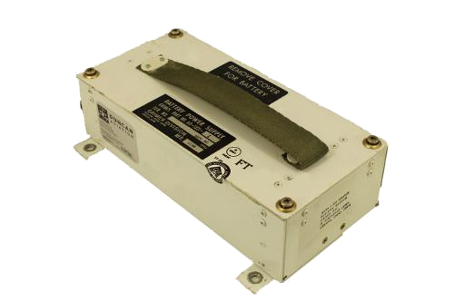
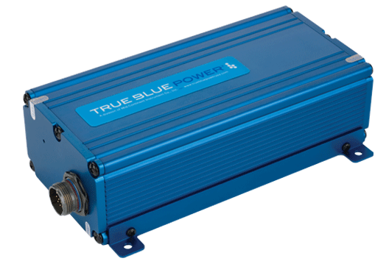
ST01086DE - Installation of the True Blue Power TS60 Lithium-ion Nanophosphate batteries as an alternate to existing Grimes Emergency Exit Lighting (EEL) Power Supply on aircraft listed in the Approved Model List.
Grimes 60-1321-1
True Blue Power TS60
Approved for 32 models, including:
  Bombardier: CL-600-1A11 (CL-600), CL-600-2A12 (CL-601), CL-600-2B16 (CL-601-3A), CL-600-2B16 (CL-601-3R), CL-600-2B16 (CL-604)
  Textron Aviation: BAe.125 Series 1000A, BAe.125 Series 1000B, BAe.125 Series 800A (C-29A), BAe.125 Series 800A (U-125), BAe.125 Series 800A, BAe.125 Series 800B, Hawker 1000, Hawker 750, Hawker 800, Hawker 800XP, Hawker 850XP, Hawker 900XP
  The Boeing Company: 737-200 Series, 737-200C Series
Contact: Mid-Continent at: www.mcico.com/
STC: https://peregrine.aero/wp-content/uploads/2022/03/ST01086DE.pdf
AML: https://peregrine.aero/wp-content/uploads/2022/03/ST01086DE_AML.pdf

