Slide 1
Report Update Status
17 July 2024

Slide 2
Farn

Slide 3
Model Input Update Process
Fix individual/ outlier numbers
Create yoy delta
Unit cost
(updater)
Inflation
Create production numbers
X
A/C production
X
Avionics OE Revenue
Aircraft retail price
X
Order of Magnitude Check
Avionics Content Factor

Slide 4
Regional & Air Transport Fleet Size Projection
3.3% CAGR

Slide 5
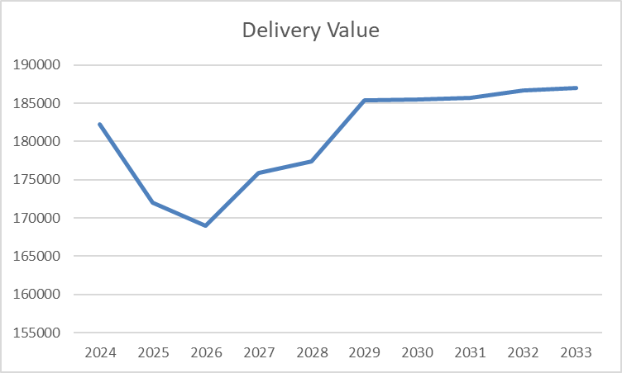
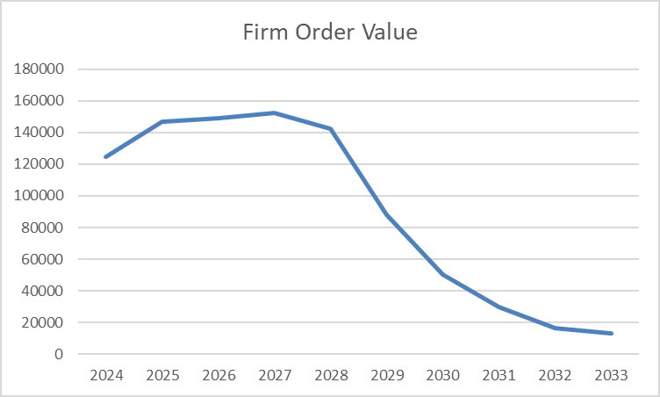
Regional and Air Transport A/C Value model
Look at aircraft production and value to determine trend line
Next, use avionics content factor to estimate avionics OE trend line
Use this to compare with model results to confirm model projections
Add other market segments to complete this analysis
Boeing quality problems
Supply Chain Problems

Slide 6
Activity
Completed:
Associated source (PW) data to Updater data
Developed regional and air transport aircraft market projections
In-work:
Add other markets to overall market projections
Developing method for updating Updater information
Look for outlier data and update known data
Apply inflation/de-escalation factors to cost values
Statistics:
component_ids: 178
aircraft_id/component_id combinations: 13343
Unique component_id cost values: 1127
component_id cost values associated with PW data 208

