Slide 1
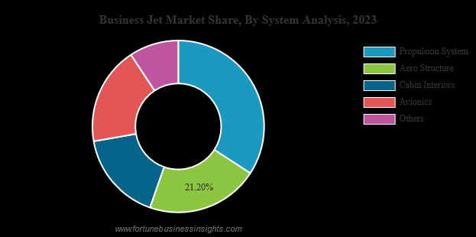

Slide 2
hw
Boeing 737
FMS
40000
hw
FMGC
FCU
FMS
85000
Airbus
FA

Slide 3
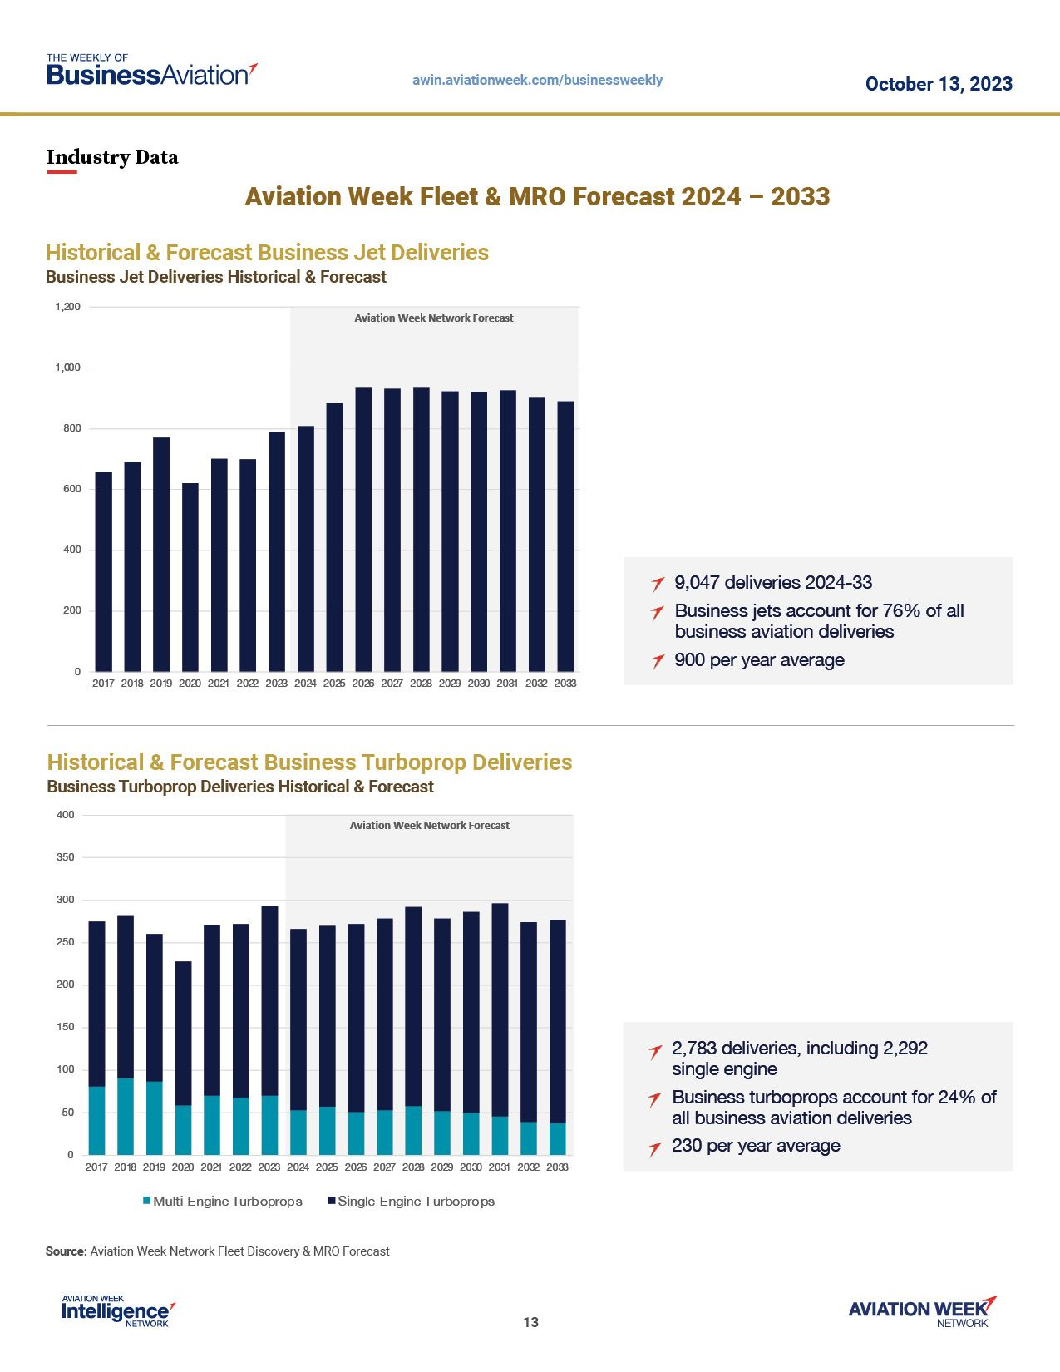
900
700

Slide 4
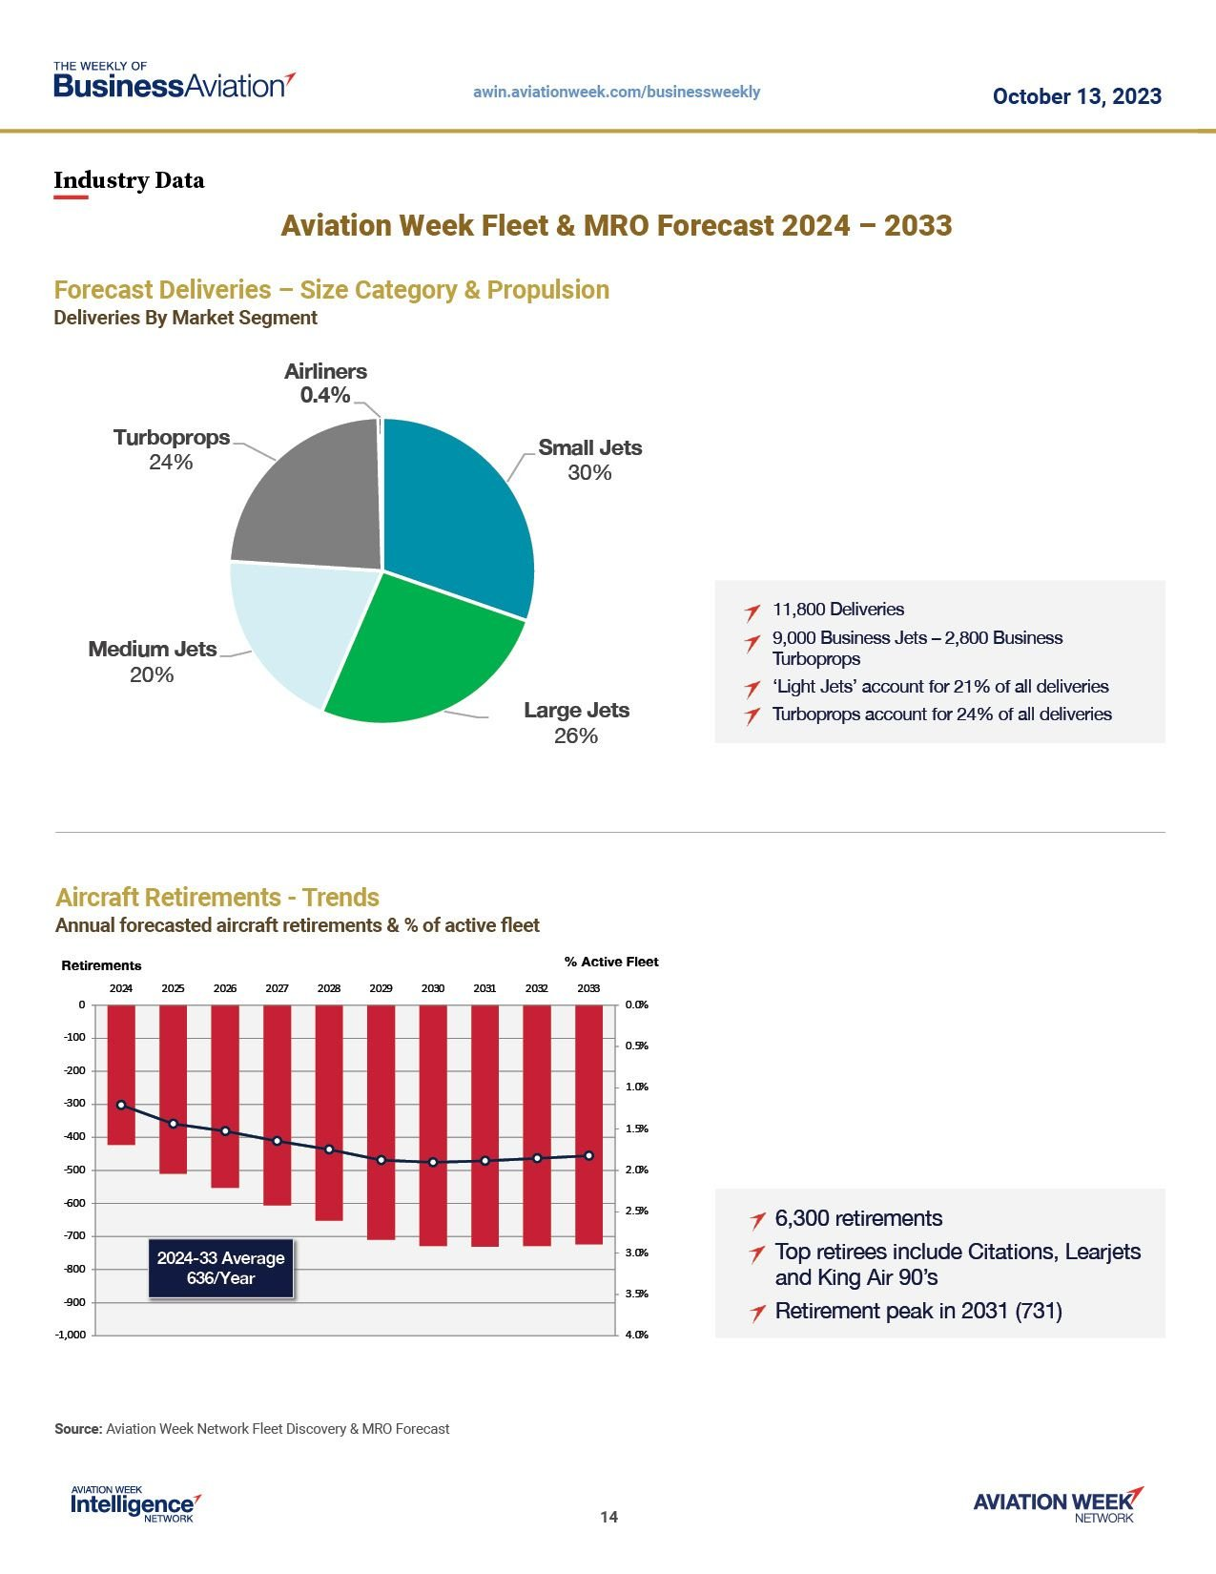

Slide 6
