Slide 1
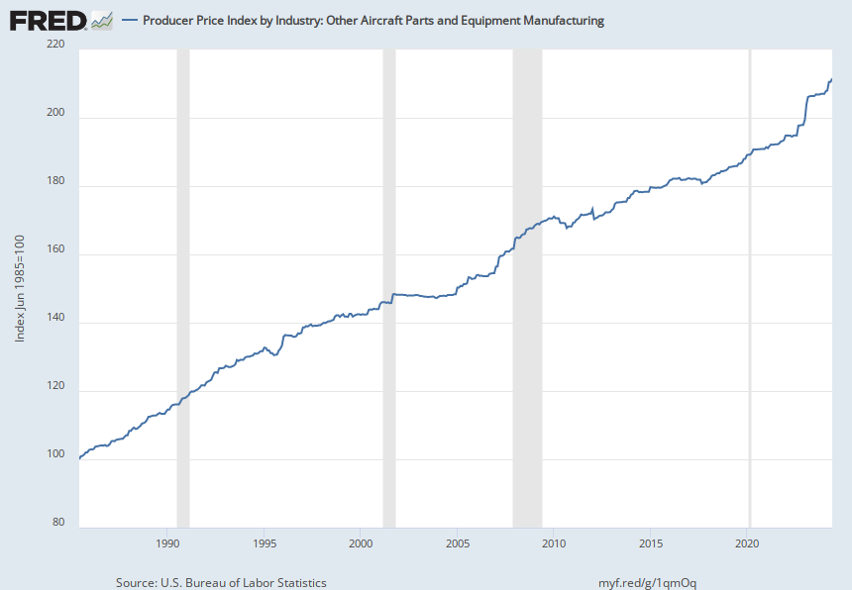
Notes:
Source: U.S. Bureau of Labor Statistics Release: Producer Price Index Units: Index Jun 1985=100, Not Seasonally Adjusted Frequency: Monthly U.S. Bureau of Labor Statistics, Producer Price Index by Industry: Other Aircraft Parts and Equipment Manufacturing [PCU336413336413], retrieved from FRED, Federal Reserve Bank of St. Louis; https://fred.stlouisfed.org/series/PCU336413336413, July 19, 2024.

