Slide 1
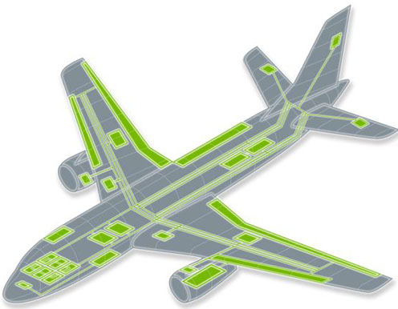
Avionics Architecture

Slide 2
Avionics System Architecture
What is an architecture? – “The structure of components, their relationships, and the principles and guidelines governing their design and evolution over time”
Establishing the basic architecture is the first and the most fundamental challenge faced by the designer.
The architecture must conform to the overall aircraft mission and design while ensuring that the avionics system meets its performance requirements.
These architectures rely on the data buses for intra and intersystem communications.

Slide 3
Avionics Architectures
First Generation Architecture (1940s – 1950s)
Disjoint or Independent Architecture ( MiG-21)
Centralized Architecture (F-111)
Second Generation Architecture (1960s – 1970s)
Federated Architecture (F-16 A/B)
Distributed Architecture (DAIS)
Hierarchical Architecture (F-16 C/D, EAP)
Third Generation Architecture (1980s – 1990s)
Pave Pillar Architecture (F-22)
Fourth Generation Architecture (Post 2005)
Pave Pace Architecture (Joint Strike Fighter)
Open System Architecture

Slide 4
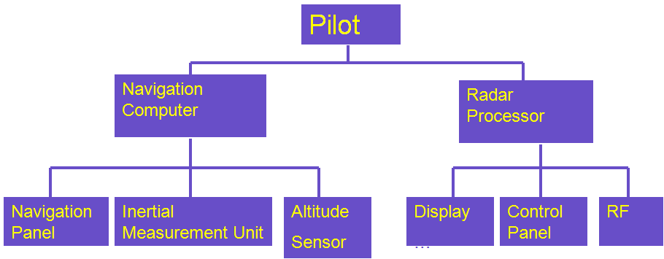
First Generation – Disjoint Architecture
The early avionics systems were stand alone black boxes where each functional area had separate, dedicated sensors, processors and displays and the interconnect media is point-to-point wiring.
The system was integrated by the air-crew in addition to flying the aircraft. This was feasible due to the simple nature of tasks to be performed and due to the availability of time.

Slide 5
First Generation – Centralized Architecture
As the digital technology evolve, a central computer was added to integrate the information from the sensors and subsystems.
The central computing complex is connected to other subsystems and sensors through analog, digital, synchro and other interfaces.
Signal conditioning and computation take place in one or more computers in a Line Replaceable Unit (LRU) located in an avionics bay, with signals transmitted over one way data bus.
Data are transmitted from the systems to the central computer and the data conversion takes place at the central computer.
Commonly found in rockets, missiles and satellites.

Slide 6
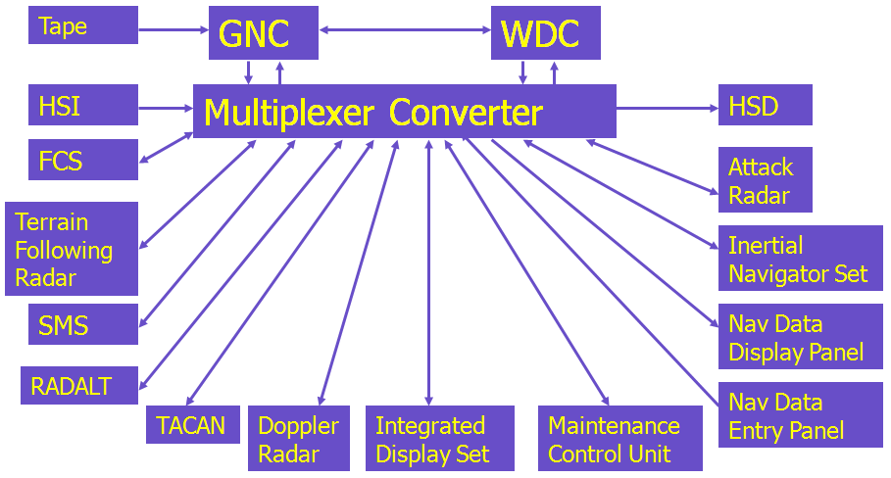
First Generation – Centralized Architecture
F-111 Avionics Systems

Slide 7
First Generation – Centralized Architecture
Advantages
Simple Design.
Software can be written easily.
Computers are located in readily accessible avionics bay.
Disadvantages
Requirement of long data buses.
Software changes somewhat difficult.
Increased vulnerability to damage.
Different conversion techniques needed at Central Computer.

Slide 8
Second Generation – Federated Architecture
Each system acts independently but united (Loosely Coupled).
Data conversion occurs at the system level and the data are send as digital form – called Digital Avionics Information Systems (DAIS).
Several standard data processors are often used to perform a variety of Low-Bandwidth functions such as navigation, weapon delivery, stores management and flight control .
Systems are connected in a Time Division Multiplexing (TDM) Highway.
Resource sharing occurs at the last link in the information chain – via controls and displays.

Slide 9
Second Generation – Federated Architecture
Advantages
Contrast to analog avionics – digital processing provide precise
solutions over long range of flight, weapon and sensor
conditions.
Sharing of Resources.
Use of TDM saves hundreds of pounds of wiring.
Standardization of protocol makes the interchangeability of
equipments easier.
Allows Independent system design and optimization of major
systems.
Changes in system software and hardware are easy to make.
Fault containment – Failure is not propagated.
Disadvantages
Wasteful of resources.

Slide 10
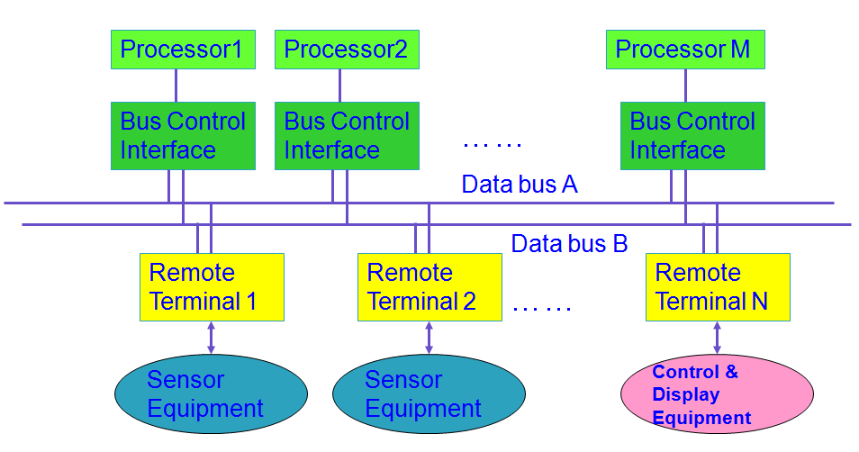
Second Generation – Federated Architecture

Slide 11
Second Generation – Distributed Architecture
It has multiple processors throughout the aircraft that are designed for computing takes on a real-time basis as a function of mission phase and/or system status.
Processing is performed in the sensors and actuators.
Advantages
Fewer, Shorter buses.
Faster program execution.
Disadvantages
Potentially greater diversity in processor types which aggravates
software generation and validation.

Slide 12
Second Generation – Hierarchical Architecture
This architecture is derived from the federated architecture.
It is based on the Tree topology.
Most of the military avionics flying today based on Hierarchical architecture.
Advantages
Critical functions are placed in a separate bus and Non-Critical
functions are placed in another bus.
Failure in non-critical parts of networks do not generate
hazards to the critical parts of network.
The communication between the subsystems of a particular
group are confined to their particular group.
The overload of data in the main bus is reduced.

Slide 13
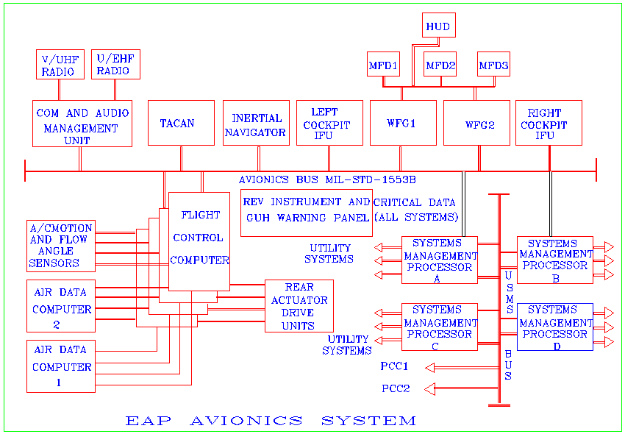
Second Generation – Hierarchical Architecture

Slide 14
Third Generation – Pave Pillar Architecture
Pave Pillar is a generic, conceptual architecture developed by the USAF specifically targeted for advanced tactical fighters.
In general for all military aircraft applications, either air-to-air and air-to-ground missions.
The Pave Pillar core avionics consists of the following functional areas:
Digital Signal Processing.
Mission Processing.
Vehicle Management Processing.
Avionics Systems Control.

Slide 15
Third Generation – Pave Pillar Architecture
The Mission Processing Area – mission and system management such as fire control, target acquisition, navigation management, defense management, stores management, and crew station management.
The mission processing area collects the health and status of all avionics components.
The Vehicle Management Systems area provides the resources to support the fundamental flight and airframe related control functions: Flight Control, Inlet Control, Propulsion Control, Vector Thrust Control, Air Data Measurement, Aircraft Inertial Measurement, Electrical Power Control, Utility systems (Fuel Measurement and Transfer, Crew escape system, Hydraulic System, Landing Gear etc).

Slide 16
Third Generation – Pave Pillar Architecture
Avionics Systems Control is of all of the software in the system.
The avionics systems control functions of the operating system shall be partitioned into three elements:
The system executive which will provide the monitoring of system state and the reconfiguration based upon mission requirements and detected system failures;
the distributed executive which will provide for decentralized system control in each processor;
the kernel executive which will provide those operating system functions which are common to all processors.

Slide 17
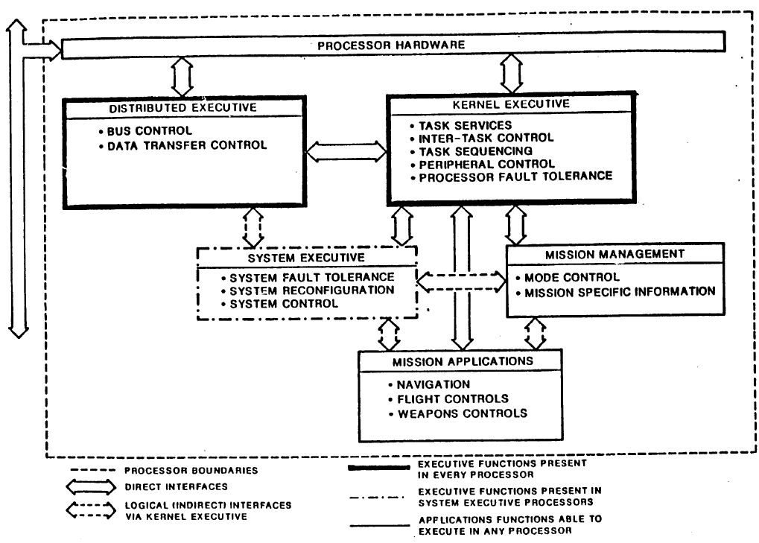
Pave Pillar System software

Slide 18
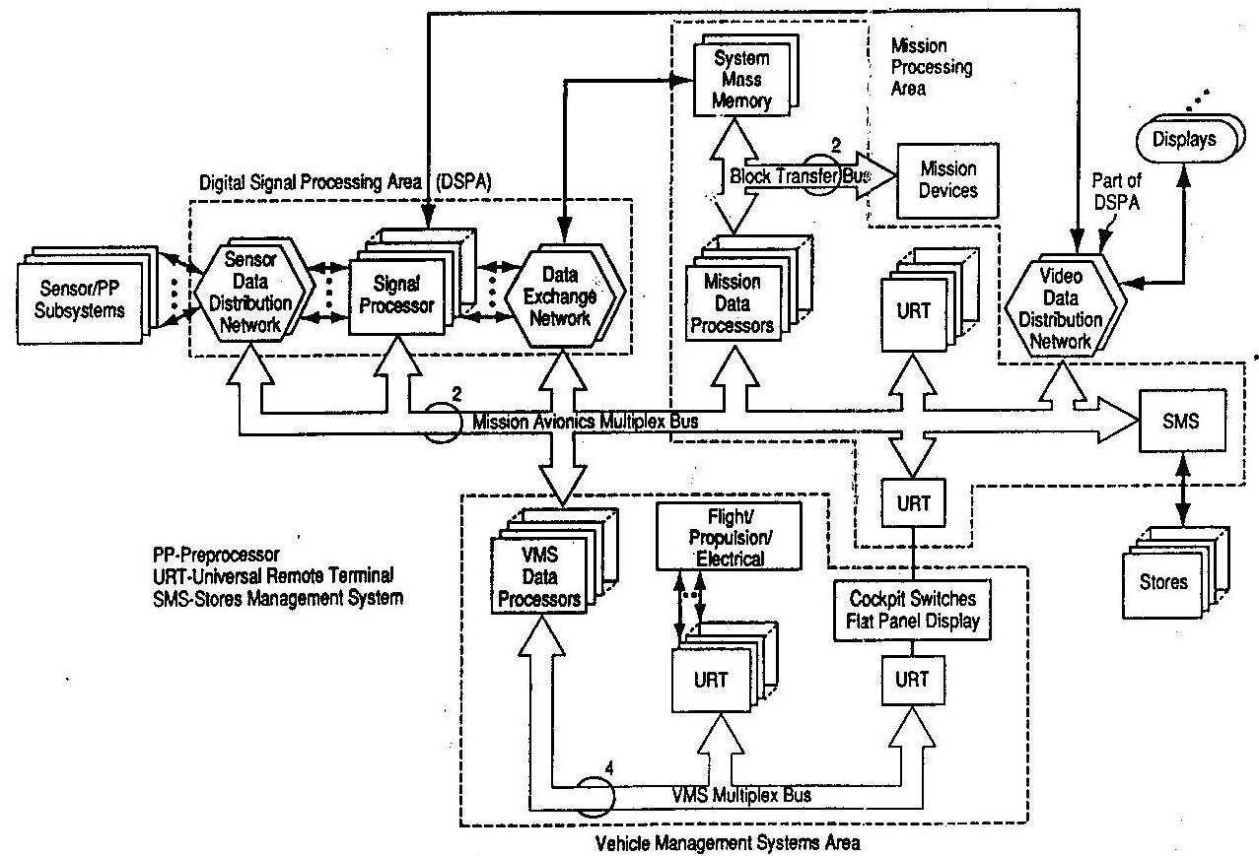
Pave Pillar conceptual Architecture

Slide 19
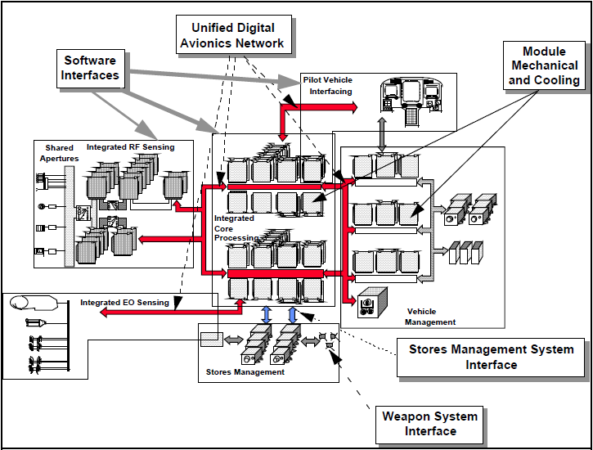
Pave Pace Architecture

Slide 20
Open Systems Integrated Modular Avionics (IMA)
‘Open systems’ – Architecture (design) whose specifications are made public.
Integrated Modular Avionics is a term used to describe a distributed real-time computer network aboard an aircraft. This network should consist of a number of computing modules capable of supporting numerous applications of differing safety criticality levels.
A core computer that performs the majority of avionics functions. Looking inside this core computer several modules (LRM) can be identified performing a specific function, like display modules, flight management modules, auto pilot module, etc.
Functionality split between modules (Power supply modules, Processing, IO, etc).

Slide 21
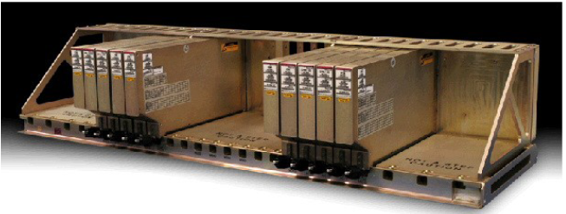
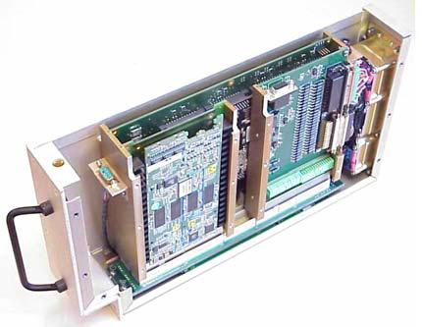
Open Systems Integrated Modular Avionics (IMA)
Figure: IMA rack approach CPU/IO module

Slide 22
Integrated Modular Avionics – Features
Layered architecture using standard programming interface layers to hide hardware and applications from one another.
Reconfiguration of applications on the modules. This can be static reconfiguration (whilst the aircraft is not in use) or dynamic reconfiguration (in flight).
Protection mechanisms to allow resources like memory to be shared by multiple criticality level applications, and to allow applications to be inserted/altered without impact on the rest of the system. This is called partitioning.
Code re-use and portability.
An operating system to manage the applications.
Physical integration of networks, modules and IO devices.

Slide 23
Integrated Modular Avionics – Features
The software concept is also modular, comprising a number of application programs running under the control of an executive operating system.
A ‘Three layer stack’ modular software concept

Slide 24
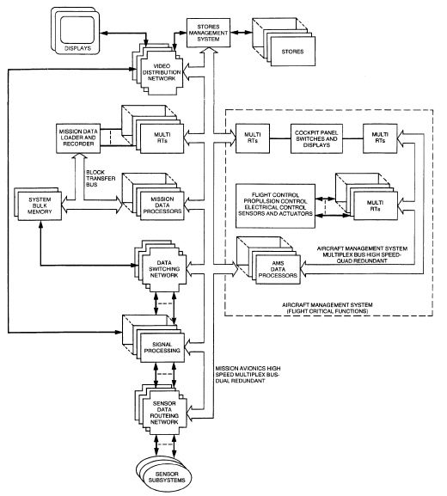
Integrated avionic systems architecture (military)

Slide 25
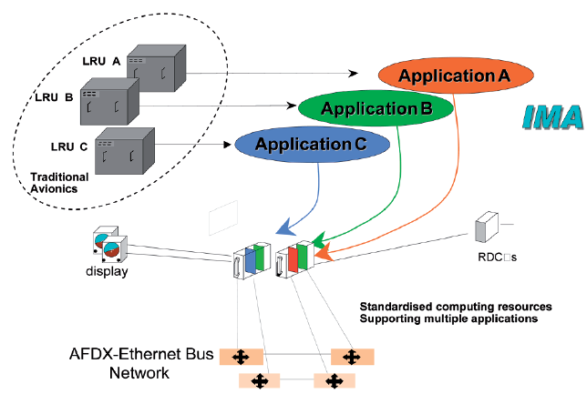
Integrated Modular Avionics – A380 Airbus

Slide 26
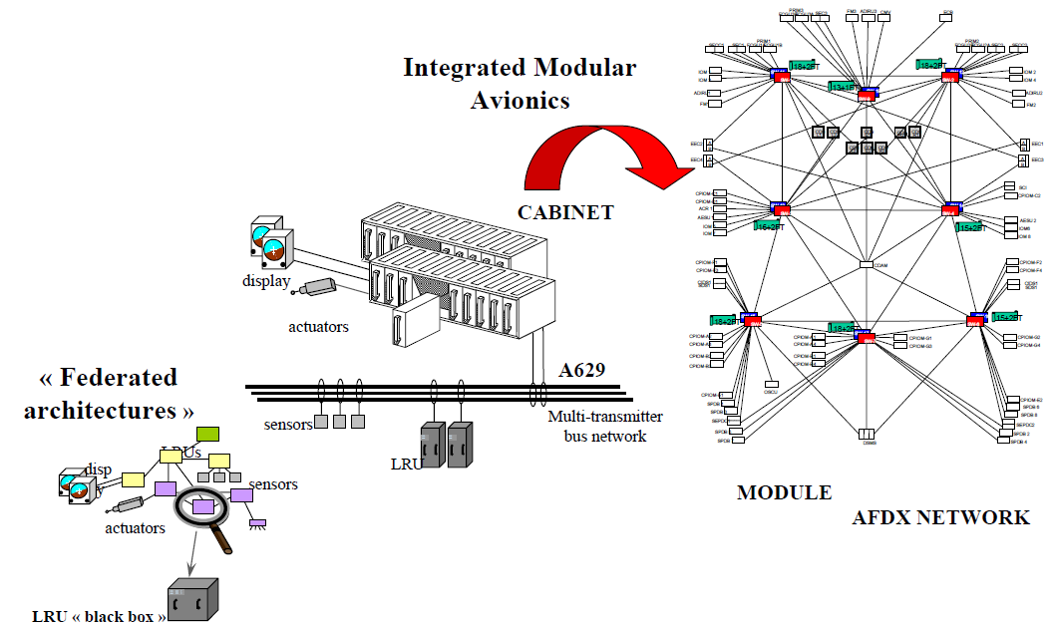
Integrated Modular Avionics – A380 Airbus

Slide 27
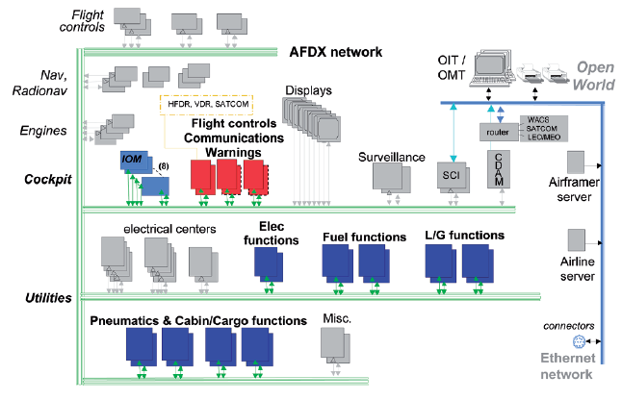
Integrated Modular Avionics – A380 Airbus

Slide 28
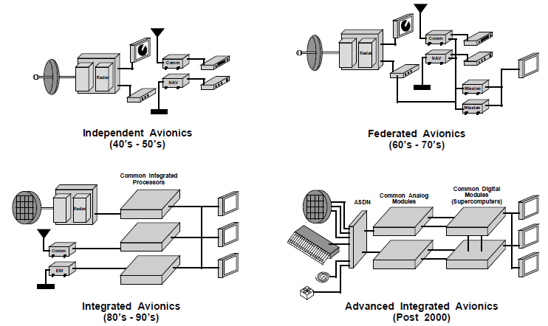
Summary – Architecture Evolution

Slide 29
Reference(s)
K.Soundararajan and P.M.Soundar Rajan, “Avionics Integration Facilities”, Aeronautical Development Establishment (ADE), Bangalore, 2011.
AFWAL-TR-87-1114 “Architecture Specification for Pave Pillar Avionics”, Final Technical Report, January 1987.
Cary R.Spitzer, Digital Avionics Systems, Chapter 7, Prentice-Hall, 1987.
“Avionics Architecture Definition – Appendices”, Version 1.0 document, US Air Force Joint Advanced Strike Technology Program, August 1994.
R.P.G. Collinson, Introduction to Avionics Systems, Chapter 9, Springer Publications, 2011.

