Slide 1
Press Mailing Status

Slide 2
Email Blast
Mailchimp Press List
132 Successful deliveries (7 bounced) – 1st wave
9 Sent – 2nd wave (corrected bounces and several new emails)
Results (as of 10:45pm Aug 16, 2023)
46 external opened emails (not Peregrine or Aerospace Edge)

Slide 3
Press list – Opened emails (1/2)
Email Address | First Name | Last Name | Company | Job Title
askjoe@smartglass.com | Joseph | Harary | Research Frontiers Inc./Ask Joe Column | Editor In Chief
josh.cochran@aopa.org | Josh | Cochran | AOPA Media | Associate Producer
hessel@america24h.tv | Fernando | Hessel | America24H Corp | Chief, The White House Correspondent
h49flying@gmail.com | Al | Gilson | Hangar 49 | Host
ben@generalaviationnews.com | Ben | Sclair | General Aviation News | Author
michael.verdon@verizon.net | Michael | Verdon | Robb Report | Aviation Editor
joanna@simpleflying.com | Joanna | Bailey | Simple Flying | Editor
ctrautvetter@ainonline.com | Chad | Trautvetter | AIN: AINalerts | News Editor
jenglish@ainonline.com | Jennifer | Leach English | Business Jet Traveler | Editorial Director - Business Jet Traveler
tim@heliwebmedia.com | Timothy | Pruitt | Heliweb Media | Photojournalist
jon.hemmerdinger@flightglobal.com | Jonathan | Hemmerdinger | Flight International Online | Americas Aerospace Editor
newsreleases@aea.net | News | Releases | Avionics News | News Releases
emorales@aeroermo.com | Erwing | Morales | AeroErmo Aviation Magazine | General Director
comercial@aeroermo.com | Orlando | Suarez | AeroErmo Aviation Magazine | Journalist
martin@businessaviationworld.com | Martin | Dixneuf | Business Aviation World | Blogger
stephen@businessairnews.com | Stephen | Campbell | Business Air | Handbook Editor
vickie@inflightusa.com | Vickie | Buonocore | In Flight USA | Publisher & Managing Editor
rich@personalwings.com | Rich | Pickett | Twin & Turbine Magazine | Journalist
asf@bonanza.org | Tom | Turner | American Bonanza Society Magazine | Aircraft Technical Editor
julie.boatman@bonniercorp.com | Julie | Boatman | Flying Magazine | Editor-in-Chief
geoffh@aea.net | Geoff | Hill | Avionics News | Editor
michael.bruno@aviationweek.com | Michael | Bruno | Aerospace Daily & Defense Report | Senior Business Editor
info@aeroermo.com | Ivan | Pena | AeroErmo Aviation Magazine | Photographer
janice@generalaviationnews.com | Janice | Wood | General Aviation News | Editor
rmark@commavia.com | Rob | Mark | CommAvia | Publisher
james@code7700.com | James | Albright | Business & Commercial Aviation Magazine | Chief Pilot
editor@blonigen.net | Kim | Blonigen | King Air Magazine | Editor
jkeller@endeavorb2b.com | John | Keller | Intelligent Aerospace | Editor-in-Chief

Slide 4
Press list – Opened emails (1/2)
Email Address | First Name | Last Name | Company | Job Title
tmalik@space.com | Tariq | Malik | The Space | Editor-in-Chief
molly.mcmillin@aviationweek.com | Molly | McMillin | Aviation Week & Space Technology | Editor-In-Chief, Weekly Of Business Aviation
mthurber@ainonline.com | Matt | Thurber | AIN: AINonline | Editor-in-Chief
editorial@kitplanes.com | Marc | Cook | Kitplanes | Editor-in-Chief
kmurphy@wai.org | Kelly | Murphy | AeroErmo Aviation Magazine | Director of Communications
caroline@businessairnews.com | Caroline | Hodge | Business Air | Reporter
leslie.josephs@nbcuni.com | Leslie | Josephs | CNBC Online | Airline Reporter
enkalawson@gmail.com | Enka | Lawson | Enka Lawson Photography | Professional Photographer
alan@geekwire.com | Alan | Boyle | GeekWire | Aerospace & Science Editor
annamarie@inflightusa.com | Annamarie | Buonocore | In Flight USA | Associate Publisher
mikea@aea.net | Mike | Adamson | Aircraft Electronics Association | President
airlinersgallery@gmail.com | Bruce | Drum | World Airline News | Owner and Editor
eli@bizavjetsusa.com | Elijah | Stepp | BizAvJets USA Magazine | Co-Owner / Co-Publisher
aherrera@propilotmag.com | Anthony | Herrera | Professional Pilot | General Manager
jim@aero-news.net | Jim | Campbell | AeroNews Network | Publisher
jkeller@pennwell.com | John | Keller | Military & Aerospace Electronics | Editor-in-Chief
gordon.smith@keypublishing.com
news@skiesmag.com |  |  | Skies Magazine | Editor-in-Chief

Slide 5
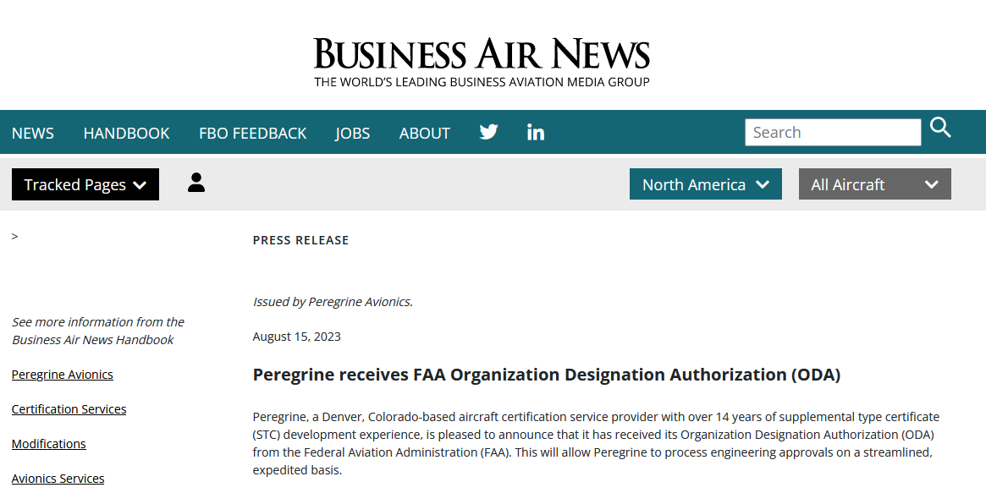
Results (so far)

Slide 6
Follow-ups
Mike Adamson, AEA President
Had read the PR and was excited for Peregrine
We discussed:
Podcast featuring the news
Near-future “Member Spotlight”
Geoff Hill to follow-up with Lee
Jim Campbell, AeroNews Network
Discussed the value of the story
Was following up with his editors
Matt Thurber, AINonline
Left message, and they already picked up the story
AvWeek – To do
NBAA – To do

Slide 7
Next Steps
Launch Part 145 and others blast (1293 Part 145 emails)
Need to cull out those that Peregrine wishes to contact first
Launch Current Customer follow-up blast
Will send after personal contact made
Need to refine this list
Current email lists created from AEA, NBAA, dealer list, other hand digging
Consider buying aviation journalist/blogger/podcaster email list
~ $500+
Consider aviation industry contact email list
~ $2000

Slide 8
Part 145 & Others List
1293 Part 145 emails
201 more “Garmin Dealers”
17 more “TCAS Customers”
179 more “BK Dealers”
64 more “cats and dogs” – possible interest not included in other

