Slide 1
New Approval Processes
Presentation to
R. A. Miller Industries, Inc
AviaGlobal Group, LLC

Slide 2
New Approval Processes
Thanks to Ric Peri, AEA for key insight and material
Product Examples
Changes to 14 CFR 21.8 and 14 CFR 21.9
NORSEE
New Opportunities

Slide 5
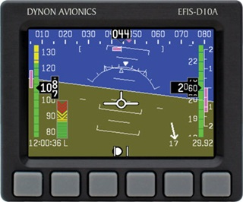
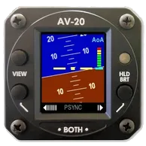
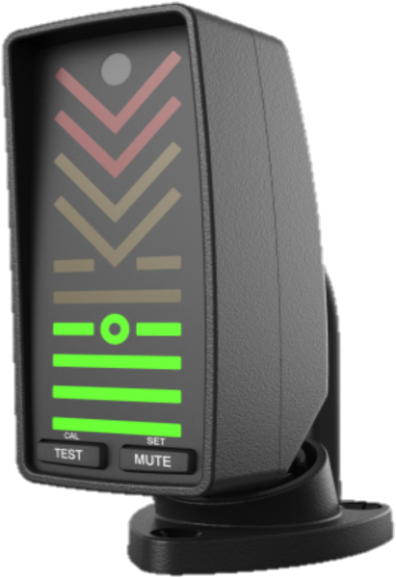
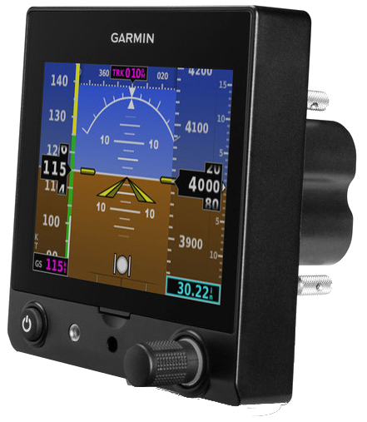
Journey of Several Products
Generation 1: February 5, 2014
AOA Indicators
Generation 2: December 3, 2015
Dynon EFIS-D10A STC
Generation 3: March 31, 2016
Commercial Part + STC
§21.9 Replacement and modification articles
NORSEE
§21.8 Approval of articles
§21.8 Approval of articles
Generation 4: 2017
Electronic Replacement for Vacuum Indicators
Generation 5: Example - Feb 2019
PMA + STC
§21.9 Replacement and modification articles
Autopilots
PMA + STC
§21.9 Replacement and modification articles

Slide 6
Non Required Safety Enhancing Equipment (NORSEE)
Non Required Safety Enhancing Equipment addresses equipment that is not required by any Federal regulation with the intent to measurably increase aircraft safety.
NORSEE Equipment. Most NORSEE categories fall under the avionics, electronic instrument, and display categories. However, mechanical and other NORSEE categories can use the same methodology and evaluation approach, as outlined in this policy statement. The types of equipment that may be considered NORSEE include, but are not limited to, the following:
Traffic advisory system (TAS);
Terrain advisory (such as a Terrain Awareness and Warning System (TAWS));
Attitude indicator;
Weather advisory,
Crashworthiness improvement;
Configuration advisory (e.g., gear advisory for floats and takeoff/landing configuration);
Supplemental indication (e.g., a fuel flow or a fuel quantity indicator);
Monitoring/detection system (e.g., a smoke, carbon monoxide, or fire detector);
Extinguishing system (e.g., a fire extinguisher); and
Stability and control (e.g., an autopilot or stability augmentation system).

Slide 7
12/30/16 Revision
PART 21—CERTIFICATION PROCEDURES FOR PRODUCTS AND ARTICLES
In § 21.9, revise paragraphs (a)(5), (a)(6), and add paragraph (a)(7) to read as follows:
§ 21.9 Replacement and modification articles.
(a) * * *
(5) Produced by an owner or operator for maintaining or altering that owner or operator’s product;
(6) Fabricated by an appropriately rated certificate holder with a quality system, and consumed in the repair or alteration of a product or article in accordance with part 43 of this chapter; or
(7) Produced in any other manner approved by the FAA.
* * * * *

Slide 8
Oct 2009 Revision
§ 21.8 Approval of articles.
If an article is required to be approved under this chapter, it may be approved—
(a) Under a PMA;
(b) Under a TSO;
(c) In conjunction with type certification procedures for a product; or
(d) In any other manner approved by the FAA.

Slide 9
So what does this mean?
Approval of “commercial parts”
Production of replacement or modification articles “in any other manner approved by the FAA”
Articles can be incorporated via
NORSEE
PMA + STC
Commercial Part + STC

Slide 10
Limitations
STCs are specific to functions allowed for replacement
For example, Garmin G5 replaces an attitude indicator, but not other instruments.
Functions can still be displayed (airspeed, turn and slip, altitude)
Cannot remove those instruments; contrary to STC
May require placard:

Slide 11
NORSEE Limitations
Specific limitations on approval:
“This approval is based on the authorized functions as stated in the above table. Uses outside of this authorized function have not been reviewed by the FAA to comply with the requirements of FAA Policy PS-AIR-21.8-1602 and may require additional evaluation. It should also be noted that NORSEE production approval does not grant Installation Approval, Parts ManufacturerApproval (PMA) or Technical Standard Order Authorization (TSOA).
We also accept the statement that your quality system meets the requirements of FAA Policy PS-AIR-21.8-1602. We authorize production of this NORSEE equipment at your ... Facility located at ...
All major components of the articles produced under this approval must be permanently and legibly marked with the authorization holder’s name, or trademark, or symbol, part number and “14 CFR 21.8(d)”...”

Slide 12
What does this mean for RAMI?
Development of a “commercial part” for incorporation with other system
Incorporation of specific parts into a specific STC that might not be broadly applied to other installations
Reduced interchangeability
Might be a valid business case

