Slide 1
Additional Company Information
Presentation to
R. A. Miller Industries, Inc
AviaGlobal Group, LLC

Slide 2
Open action items
RAMI-signed NDA
Meeting date confirmation
Thales Contact program
  Have names and emails
  Need some context: titles, phone, location…
AviaGlobal Group
  Alternate certification paths presentation
  Additional information for EU pitch

Slide 3
Additional Information
Key company data will:
  Help European customers understand RAMI
    RAMI will be a solid supplier-partner
    RAMI has the financial resources, security and backing to support their customers
  Give a sense of why RAMI is so good at what it does
  Help place RAMI on the map … literally
Key info
  History
  Leadership bios
  Usual org charts and staff demographics
  Pictures of the production area
  Drone overhead shot of the facilities
  Expansion plans

Slide 4
XYZ Avionics at a Glance
EXAMPLE
Recognized brand; established industry provider who provides affordable products that solve aviation avionics issues
Key provider of avionics solutions for service providers, aircraft & avionics OEMs and aircraft owners/ operators
  …
  …
  …
Series of industry firsts including introduction of transistor circuitry to avionics and pioneering of digital audio for mission intercom systems
Deep technical expertise driving research and product development
  Strong R&D in RF (radio frequency) and Digital Audio
  Proven flexibility to adapt products and technologies to meet customer needs

Slide 5
Location
EXAMPLE
Grand Haven, Michigan
  Near Lake Michigan, 5th largest fresh water lake in the world
  Growing community, attractive to …
  Near Grand Rapids, 2nd largest city in Michigan; fastest growing city …
  53 craft breweries within 10 miles
Grand Haven “Coast Guard City USA”
  Former port of call of the largest fresh water whaling fleet
  Home of the largest musical fountain
  Home of Pere Marquette 1223, sibling to 1225 the “Polar Express” locomotive
  World Headquarters of Pronto Pup
Within 50 miles of 27 colleges and universities
Near Holland, Michigan, home the annual Tulip Festival
Major industries:
  Tourism, craft beer, sand mining, geocaching, antenna manufacturing

Slide 6
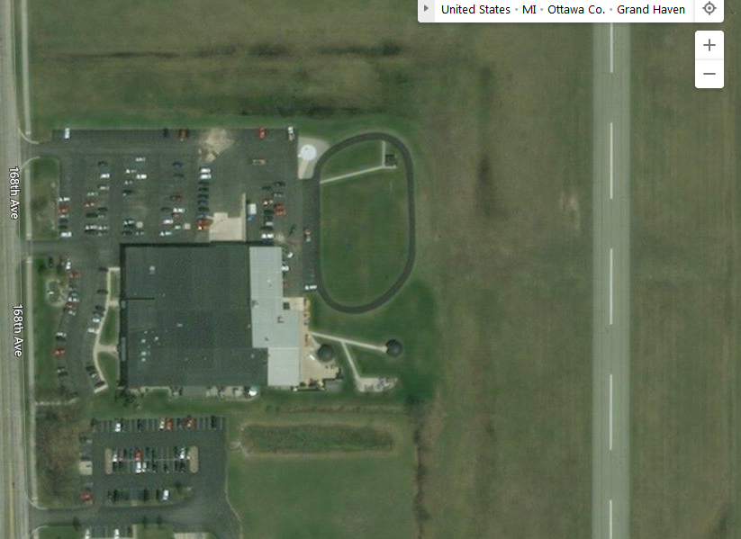
Facilities…
EXAMPLE

Slide 7
The Becker Avionics Group structure
EXAMPLE
XYZ Avionics
Country A
XYZ, SARL
GERMANY
XYZ Avionics
GmbH
HQ, QA, DEV ICS,
PROD, Sales
Elbonia
XYZ Avionics
Elbonia
DEV CNS & ATC
USA Overisel
XYZ Avionics Inc.
PROD ICS, Sales
CHINA, Beijing
China
Sales

Slide 8
XYZ Avionics Sales Channels – Revenue Streams
EXAMPLE
XYZ Avionics Avionics/Component Manufacturer, 3rd Party Production, Repair & Overhaul
3rd Party Contract Manufacturing
Direct
(Aftermarket)
Repair & Overhaul
Avionics OEM
(Garmin, Selex, Rockwell Collins…)
Aircraft OEM
(Airbus, Pilatus, Bell, Grob, Leonardo…)
Dealers/ Distributors
(Aftermarket)
3rd Party Clients
Aircraft Owner/ Operator
Civil & Military

Slide 9




















EXAMPLE

Slide 10
EXAMPLE
RAMI
R&D 40 FTE
Production 50 FTE
10 Technicians
10 Engineers
10 Inspectors
20 Engineers
Support 5 FTE
30 Production
2 Sales support
3 Field Service
G&A 10 FTE
5 Clerical
5 IT, HR, ...

Slide 11
R&D Organization and Skills
EXAMPLE
Development department in 14 employees
Responsibilities:
  Maintenance of the existing product portfolio (all products)
  New Product Development for
  Airworthiness Office
Skill | #
Avionics (Master) | 1
Computer Science (Master) | 3
Electrical Eng. (Master) | 6
Mechatronics (Bachelor) | 1
Technician (vocational) | 2
Signal Processing (PhD) | 1

Slide 12
R&D Organization and Skills
EXAMPLE
Development department in
33 employees
Responsibilities:
  Maintenance of the existing product portfolio for
  New Product Development for
Skill | #
Computer Science (Master) | 14
Computer Science (PhD) | 1
Signal Processing (PhD) | 1
Electrical Eng. (Master) | 13
Mechanics (Master) | 2
Technician (Dipl.) | 2

Slide 13
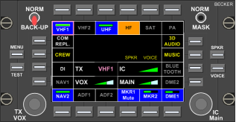
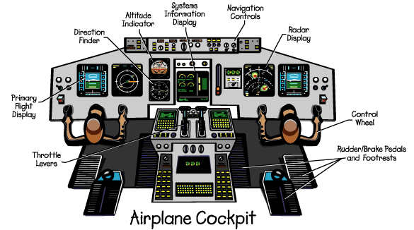
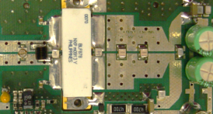


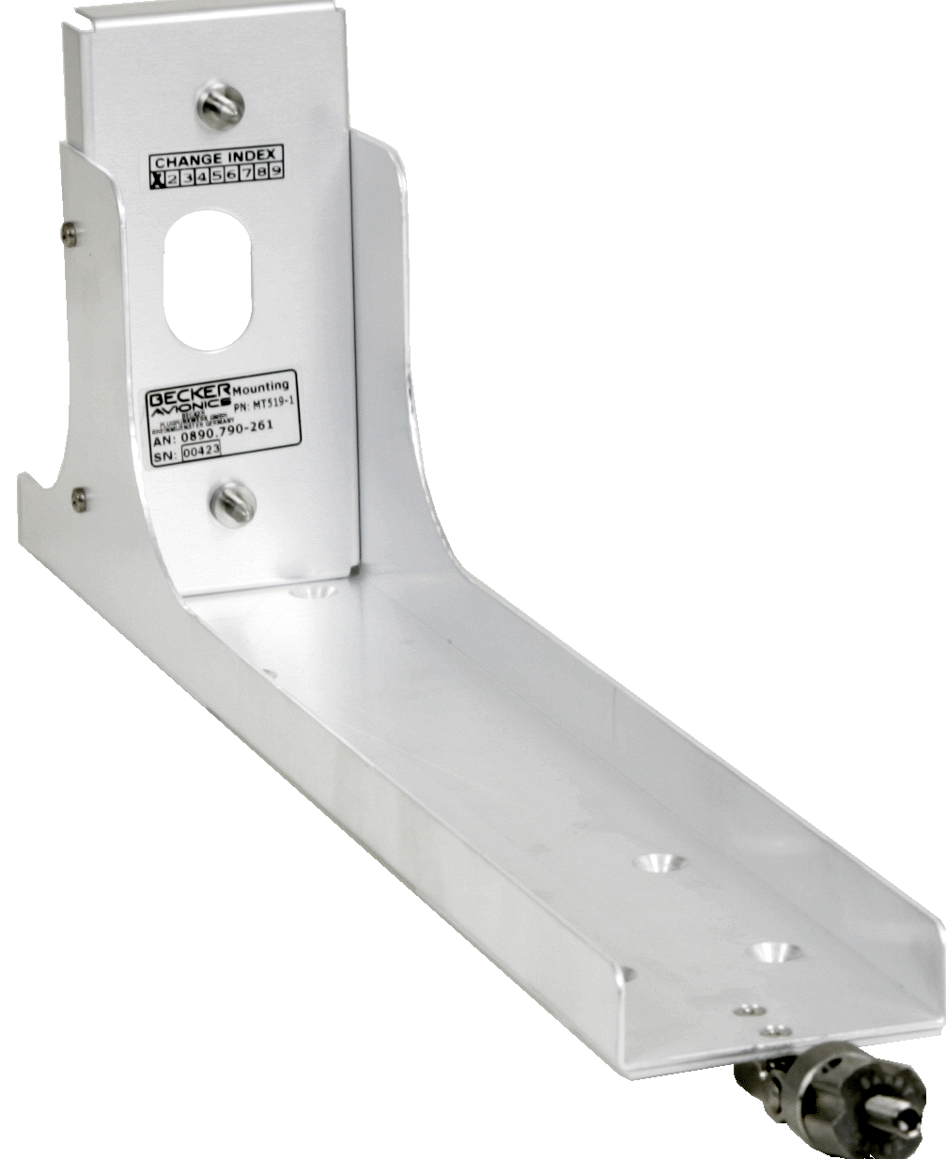
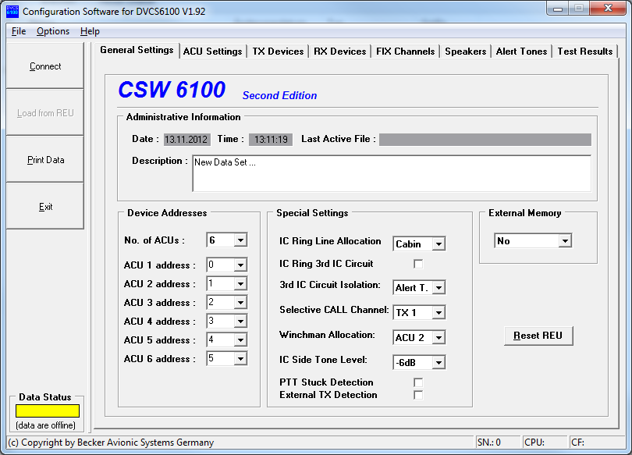
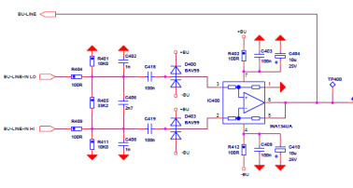
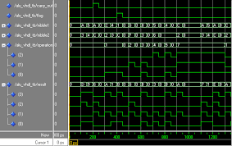
Technologies & Expertise
EXAMPLE
Technologies & Expertise
HMI / Panels
RF
Embedded Software
DO-178
Mechanical Design
Digital Hardware
Env. Qualification
DO-160
Configuration Software
DO-178
Analog Hardware
DO-254
System Engineering

Slide 14
Technologies & Expertise
EXAMPLE
System Engineering
  Requirements Engineering: Requirements based design, test and validation
  Understanding of mission specific CONOPS (=Concepts of Operations)
  Product Architecture & Enabling Systems
  STTE
  Reliability Engineering & MTBF prediction acc. MIL HDBK 217f / 217plus
  Model Driven Design: Matlab / Simulink
Hardware Engineering
  Analog / Digital Audio Hardware
  Power Supplies
  Backup-Circuitry
  Bus-Systems / Interfaces: CAN, Ethernet, ARINC 429, MIL 1533, Bluetooth,
  RS422/485, Optical Link

Slide 15
Technologies & Expertise
Digital Hardware / Complex Hardware DO-254 (up to DAL B)
  Xilinx, Altera, VHDL
  FPGA, PLD
RF Engineering
  MF-UHF (~300kHz – 1,5GHz)
  Transmitter output power 0.1W up to 500Watt peak power
  Modulation Schemes: AM, FM, DPSK, Pulse,…
  Antenna design: for example 3 band VHF/UHF antenna
  Simulation
HMI
  Keypads, Rotary Encoders, Displays, Switches, NVIS, Human Factors ..
Environmental Qualification DO-160 and MIL-Standards
  In-house activities: temperature, humidity, vibration, ESD, power input, cond. susceptibility
  External: for example HIRF, Sand and Dust, Fungus, Magnetic, indirect lightning and other
EXAMPLE

Slide 16
Technologies & Expertise
EXAMPLE
Mechanical Design
  Housings, Mountings: 160mm, DZUS, ARINC 600, 2,5”, 3,25”, Custom
  Panels (also NVIS compatible)
  Creation & Maintaining Part Lists, Build Standards
  Rapid Prototyping with additive Manufacturing technology (w. external supplier)
  Design of aluminum injection molding components
  Design of plastic injection molding components
Project Management
  V-Model + some agile elements

Slide 17
Technologies & Expertise
EXAMPLE
Embedded Realtime Software DO-178 (up to DAL B)
  µP: TI OMAP, ARM9, PIC, Fujitsu MB90F54, HCS08, 8-32 bit
  DSP 16/32 bit, TI 5xxx, 6xxx, OMAP
  Language C
Digital Signal Processing
  Algorithms: Mixing, Scaling, AGC, NR, 3D Audio and more
Configuration Software
  Windows, C++, C#, Delphi
Test Automation
  Windows, C++, C#, Labview

Slide 18

















Development Tools
EXAMPLE
Mechanical Engineering
  PTC Creo
  Windchill
Software Engineering
  MS Visual Studio
  Code Composer Studio
  IBM Rational RT
  Vector Cast Hardware Engineering
  OrCAD
  Xilinx, Altera FPGA Tool-Chains
  Model Sim
  Pspice, LTspice,WinSmith,
Config Management
  Source Gear Vault
Issue Tracking
  Bugzilla
Simulation / System Engineering
  Matlab / Simulink
  Polarion
Document Management / Archive
Part Lists, Industrialization
  IFAX (ERP)
Project Planning
  MS Project
Test Automation
  LabView
Obsolescence Mgmt
  Silicon Expert BOM Manager

Slide 19
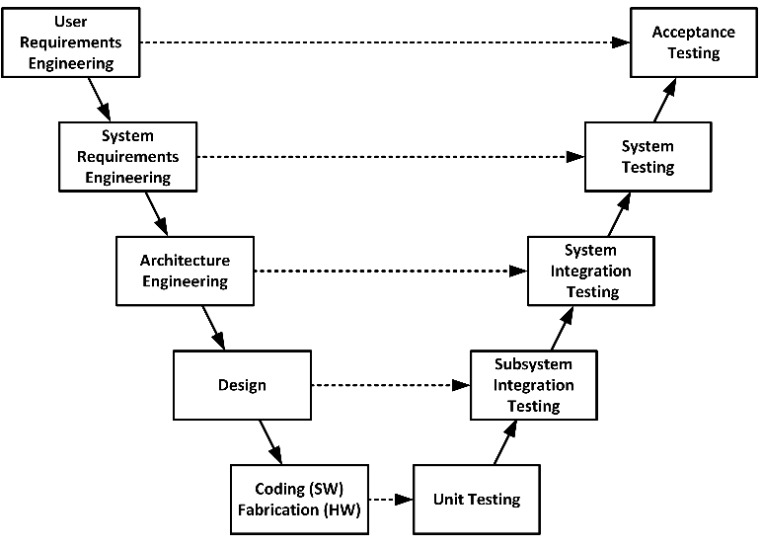
Development Process
EXAMPLE
DO-178 DO-254 DO-160
PR
PDR
B-Mod
CDR
FAI
QR
SOP
A-, B-, C-Model
Need
Product
MRS
SYRD, PHAC, PSAC, ICD
HRS, SRS
HDD, SDD
MDD, EDD
ATR, ATP, QTR, QTP,
DDP
SWAS, HAS
TP, TR, SWCI, HWCI, MCI
SWVD, HWVD
Support
Processes
Proj.M
Config.M
Change.M
Dev.Stds

