Slide 1
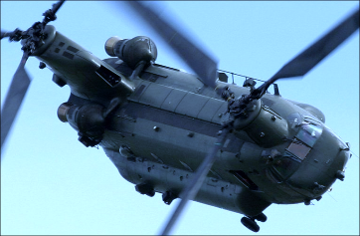
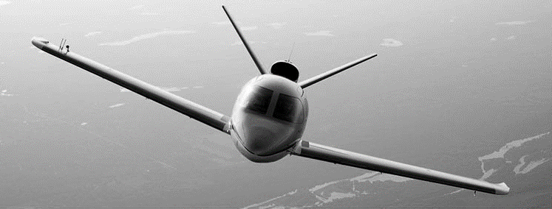
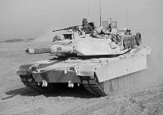
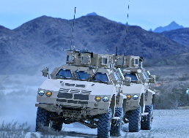

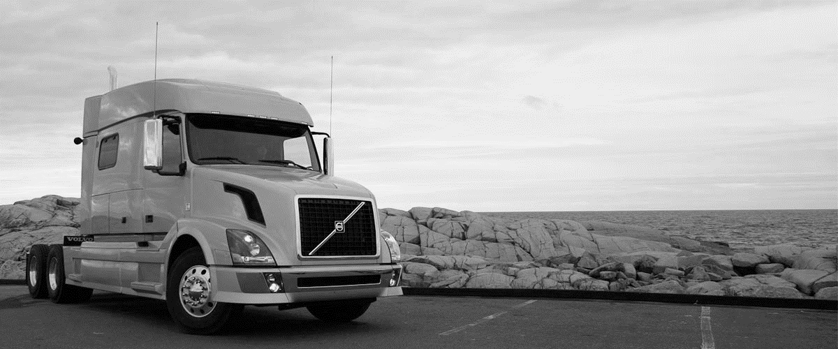


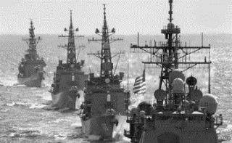
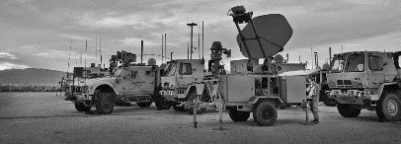
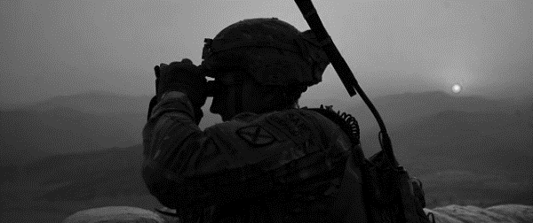

Slide 2
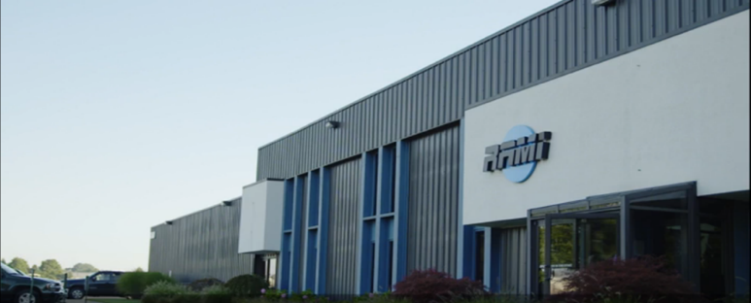
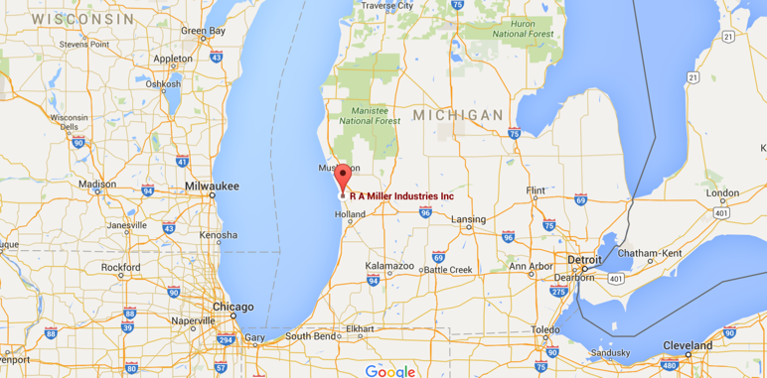
Company Overview
Founded 1954
Leading supplier of advanced antenna systems and RF components
  US Military
  Aviation
  Heavy Truck
Privately held, 100% woman owned, small business
Headquarters: Grand Haven, Michigan USA

Slide 3
Company History
1954
Robert Miller founded R.A. Miller Industries
1987
Robert M. Lynas Purchases RAMI
1992
RAMI acquires general aviation product line from Antenna Specialists
Military
Aviation
1956
RAMI begins manufacturing military antennas
Heavy Truck
1993
RAMI enters heavy truck antenna market (Volvo)

Slide 4


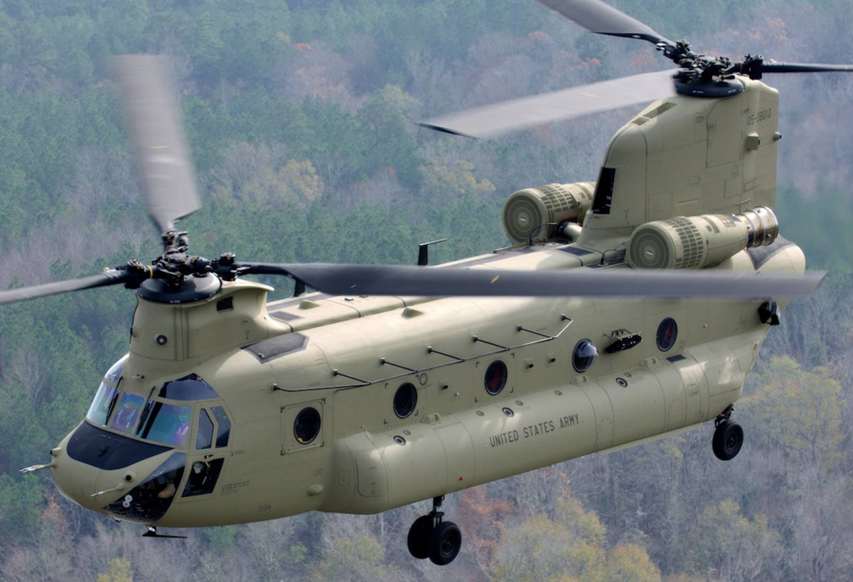




Markets
Military Land, Sea, and Air
Aviation
Heavy Truck

Slide 5




























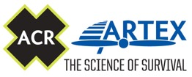


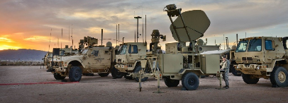


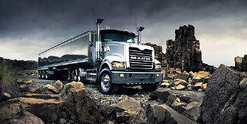
Customers
US Government
Defense and Aerospace
Aviation
Heavy Truck

Slide 6
Key Programs - Military
SINCGARS – Single Channel Ground and Airborne Radio System
1977
Present
EPLRS – Enhanced Position Location and Reporting System
1992
Present
FCS – Future Combat Systems
2003
2009
HMS – Handheld Manpack & Small Form Fit
2006
2040

Slide 7

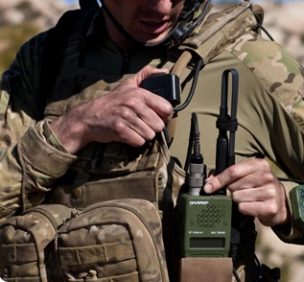

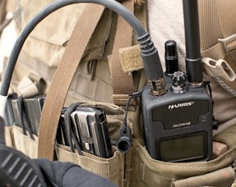
Military Handheld Examples
Long blade VHF
Short blade wide band UHF/VHF
ISR & GPS
Rubber Duckie wide band UHF/VHF

Slide 8
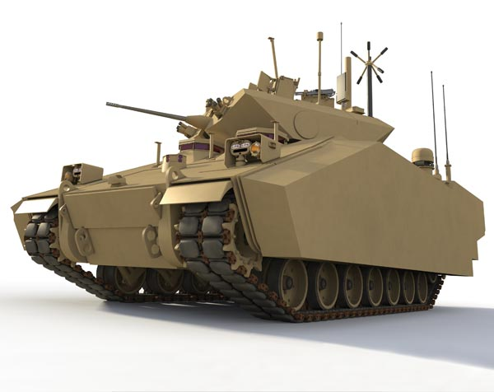
Military Vehicular Examples
Broadband communications
VHF Communications
GPS L1/L2
Diplexers/Triplexers
Antennas Risers

Slide 9


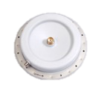
Military Airborne Examples
Glide slope
Radar interrogation
Communications
Marker beacon
Identification beacon
IFF

Slide 10

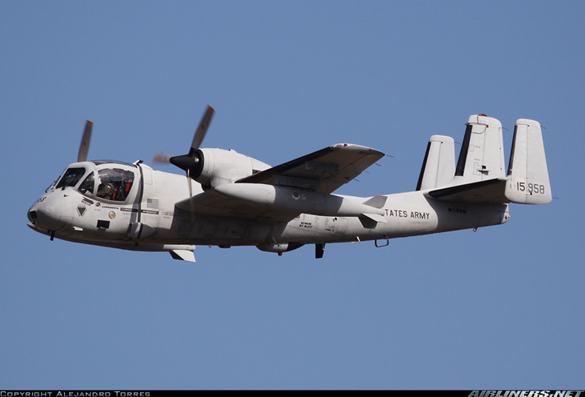
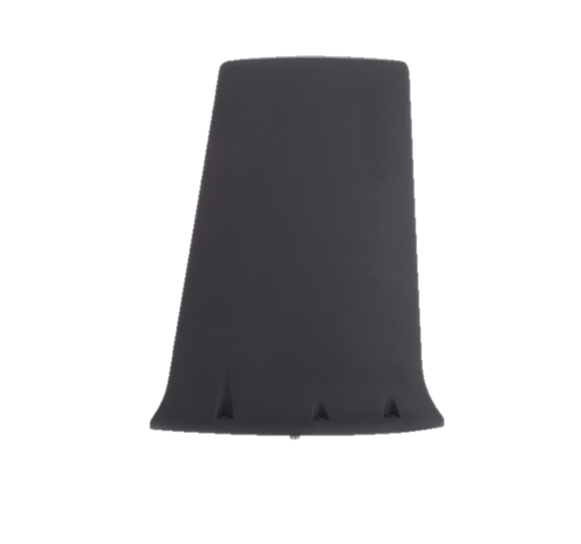
Military Airborne Examples
E-4B Airborne strategic command control post
High power
UHF communications
OV-1D Light attack and observation aircraft
VHF/UHF Communications

Slide 11
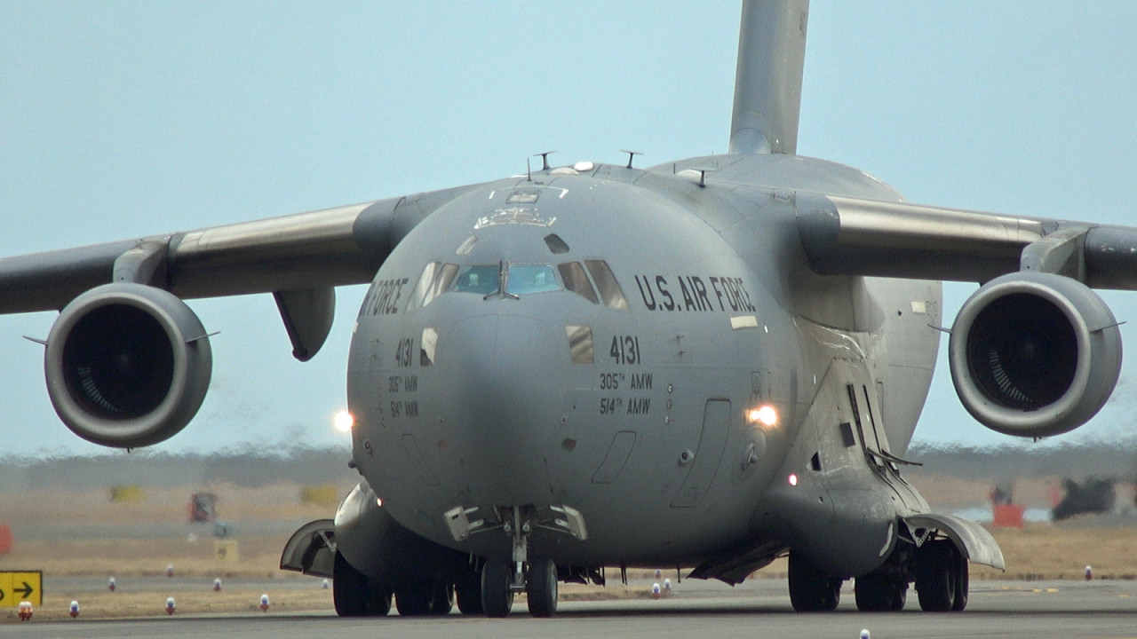
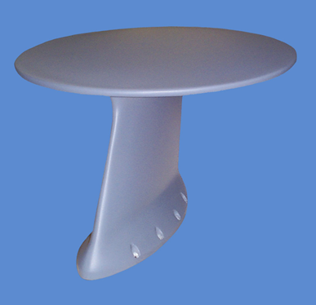
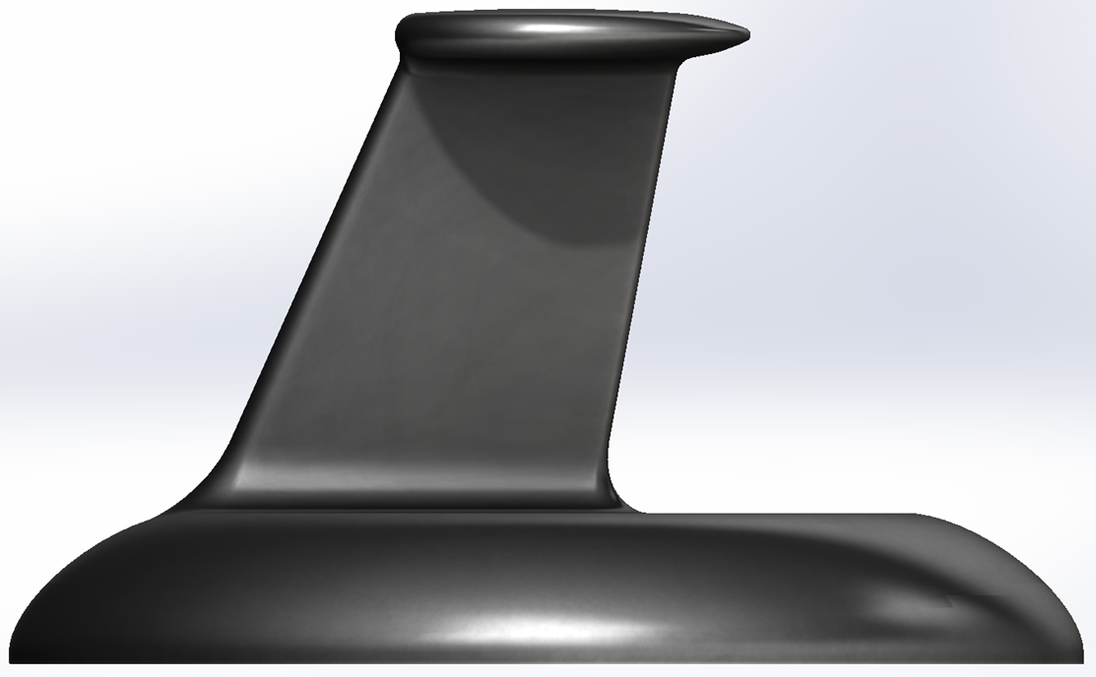
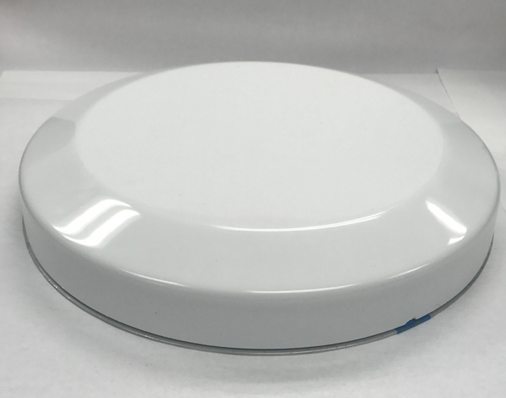
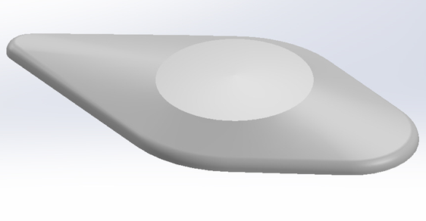
Conformal Antenna Development

Slide 12
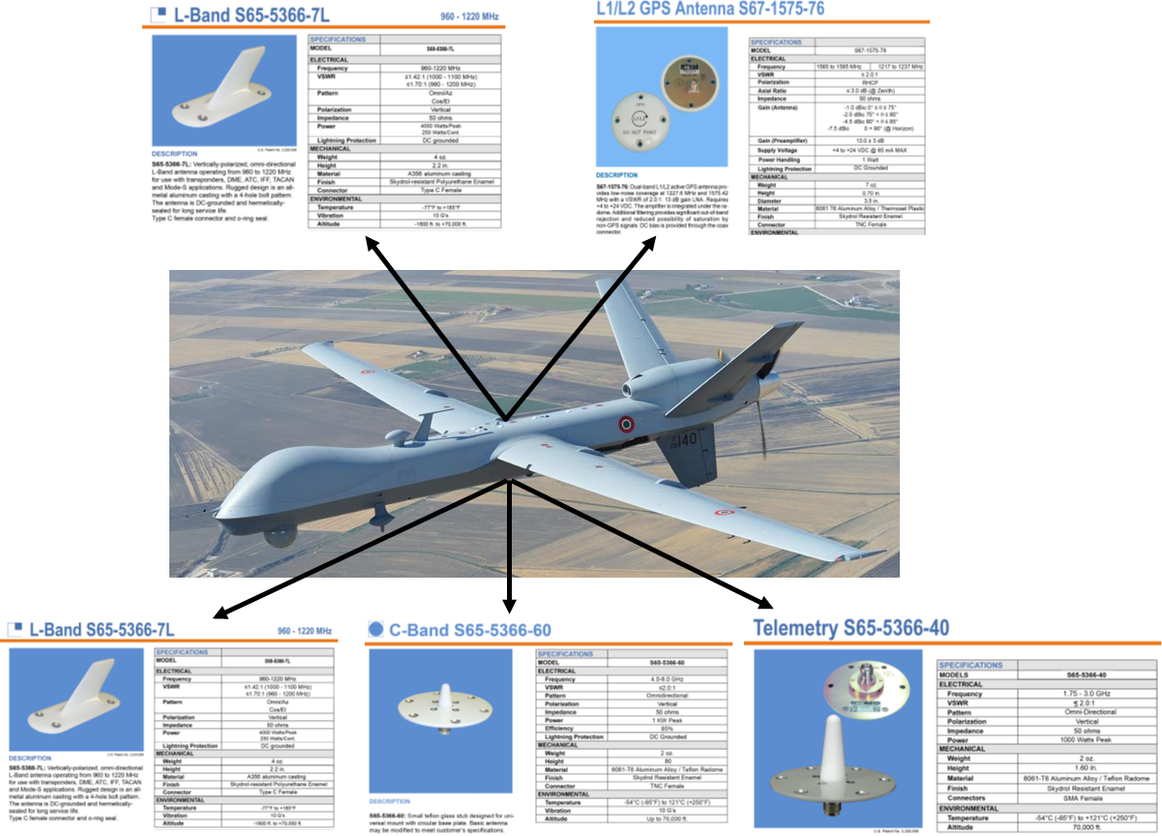
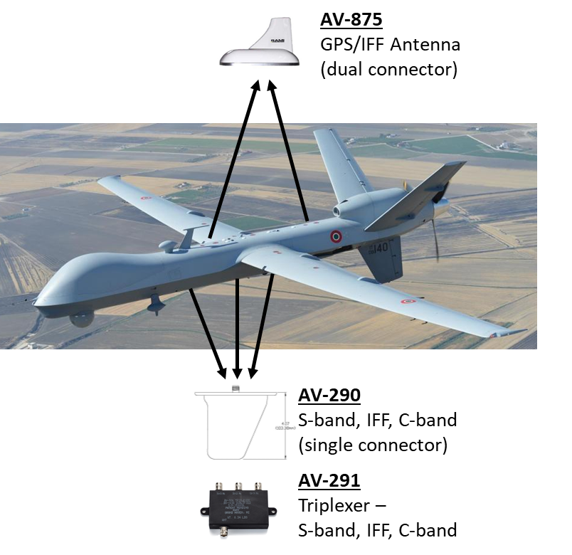
Antenna Consolidation

Slide 13
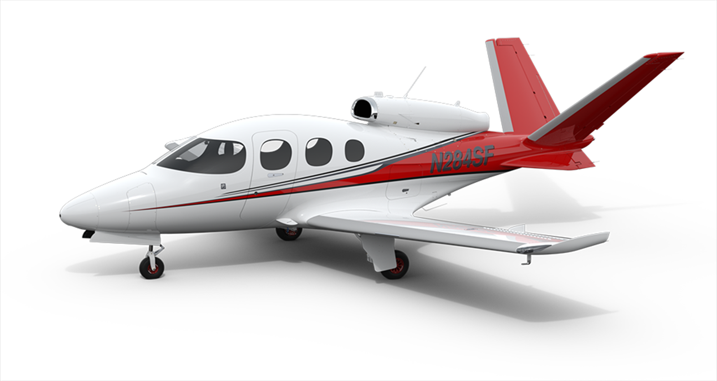
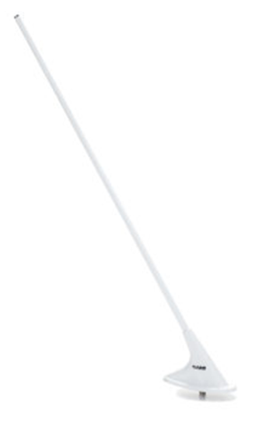

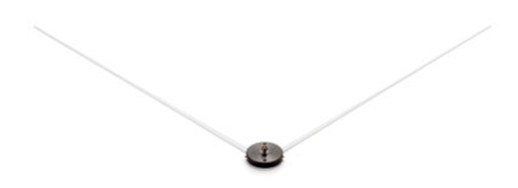
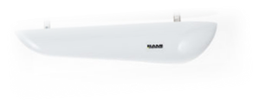
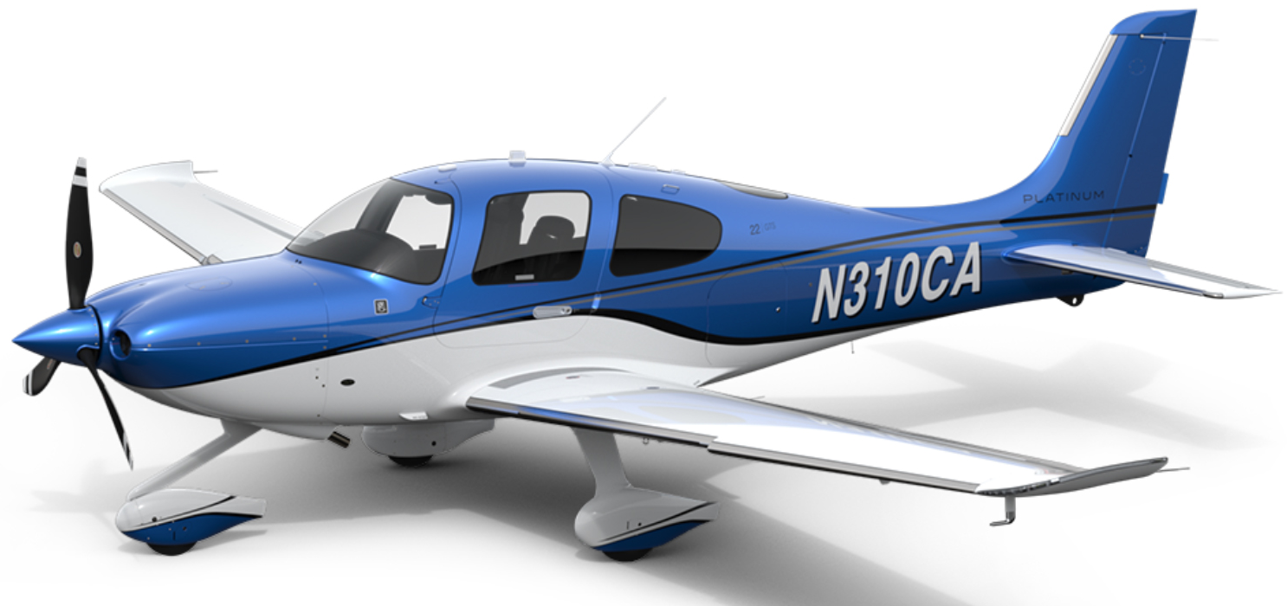
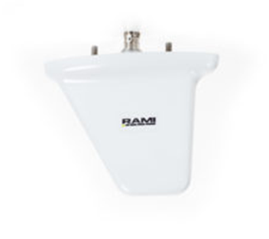
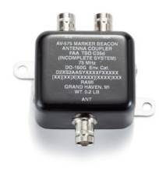
General Aviation Examples
Communications
GPS
VOR
Localizer
Glide Slope
Marker Beacon
Transponder
DME
ADS-B
Diplexers
Triplexers
Combiners

Slide 14
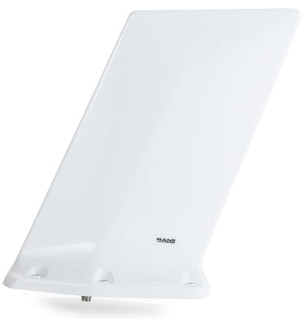

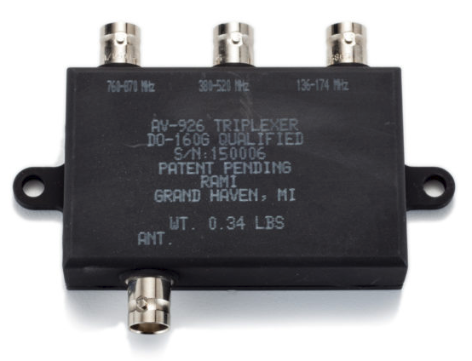
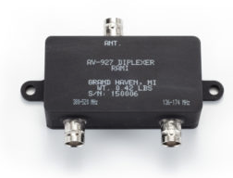
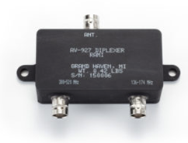
AV-925
AV-926
AV-927
AV-928
AV-929
AV-930
AV-931
AV-932
AV-933

Slide 17


Slide 18
Heavy Truck Example

Slide 20
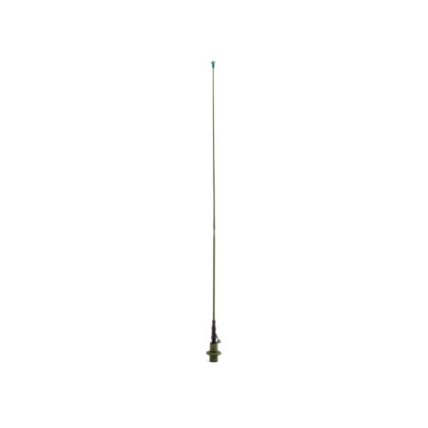
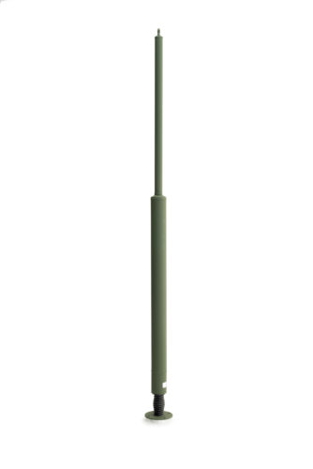
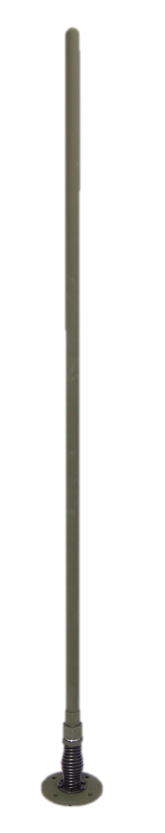
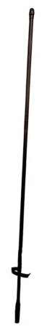
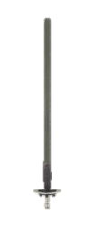
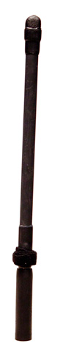
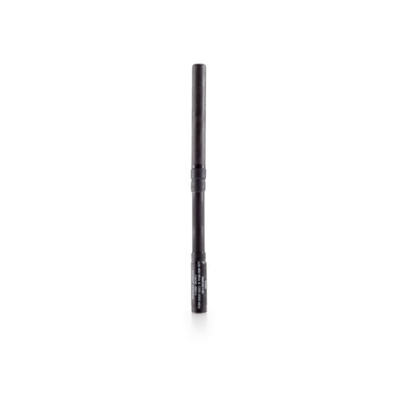
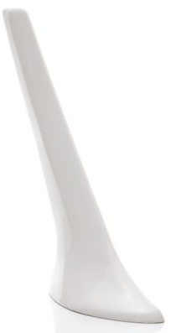
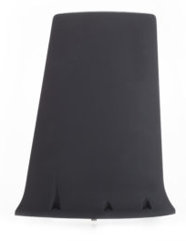
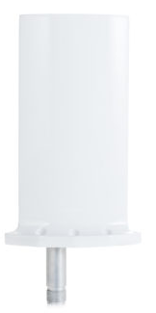
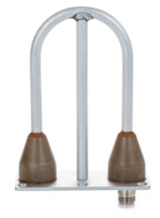
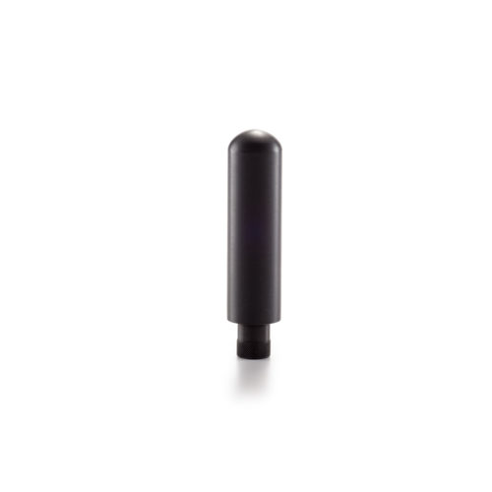








RF Competencies
Antennas
  HF-20 GHz
Filters & couplers
  LF to 20 GHz
System design
  Power
  Propagation
  Protocols
  Link reliability
Co-site mitigation

Slide 21



RF Design Capabilities
Software
  CST Microwave
  Filter Solutions
  Orbit FR 959 Spectrum & DataPro
  SOLIDWORKS 3D + PCB
Precision 2 and 4 port network analyzers
Anechoic chamber 16’x’16’x32’
  500 MHz – 20 GHz
  Dual axis positioner
25’ diameter RVTP (Rotating Vehicular Test Platform)
Outdoor ground reflection test range with AZ over EL positioner
(2) 26’ diameter test domes

Slide 22
Anechoic Chamber
16’x16’x32’ rectangular anechoic chamber
500 MHz through 20 GHz
Dual-axis antenna positions (roll over Azimuth)
Orbit FR 959 spectrum software (with circular polarization)
Orbit FR AL-4806-3A positioner controller

Slide 23

Outdoor Test Ranges
25’ Rotating Vehicular Platform
30,000 LB limit
26 MHz to 6 GHz
Azimuth positioners only in linear or circular polarization
Orbit FR 959 spectrum software with AL-4806-3C positioner controller
Rooftop Ground Reflection Range
Dual axis (AZ over EL) on roof of 10’x10’x10’ range building
26 MHz to 6 GHz
Azimuth and elevation patterns in linear or circular polarization
Orbit FR 959 spectrum software with AL-4806-3C positioner controller

Slide 24

Environmental and Mechanical Test Capabilities
Altitude chambers – 100,000 ft.
Salt fog chamber
Wind & rain
High - low temp chambers
Humidity & temperature chambers
Water immersion
Bounce loose cargo
Ballistic shock and vibration
Side load
Spring flex
Impact test track
FAA TSO

Slide 25

Assembly Capabilities
Mycronic SMT Line (pwb assembly)
Multiple Schlueniger cable processing machines
Multiple Schlueniger crimping machines
Pull test equipment
Multiple Spirig precision soldering/welding equipment
Multiple metered epoxy/foaming equipment
Multiple marking machines
10,000 sq. ft. of fiberglass tube processing facility which includes precision cloth cutting, ovens, tape roll, grinders and sanders
Multiple soldering equipment stations – including scopes and cameras
Resistive soldering equipment - custom
Multiple general assembly areas with custom fixtures, autofeed screwdrivers, in-line testing, etc.

Slide 26

Vertically Integrated Design,
Manufacturing & Testing
110,000 SQ/FT facility
Latest CNC equipment
  Multi-axis
  CNC lathes and mills
Flexible lean manufacturing centers
Proprietary machine design and installation
Maximize control for superior quality, schedule, and cost

Slide 27

Machining Capabilities
1 Okuma MacTurn – Multifunction/multi-axis
1 Okuma Multus – Multifunction/multi-axis
2 Okuma LT200 – Multifunction/multi-axis
6 Various Okuma and Miyano – STD CNC lathes
4 Miyano – STD CNC mills
Utilize GibbsCAM for programming
RAMI invests in the latest machining technologies and competencies

Slide 28

Rapid Prototyping Capabilities
Dedicated Engineering Design Center
Dedicated CNC equipment and personnel
Circuit board prototype capability
3D printing
3D design analysis
RAMI thrives on rapid response to customized requirements

Slide 29


Quality
ISO 9001:2015 certified
ISO 14001:2015 certified
AS9100 compliant
General aviation products are FAA TSO approved
MIL standards: STD-810, Q-9858
Corporate culture focuses on the mission critical nature of our products

Slide 30

Awards
DLA & Maritime Gold Awards
(100% delivery 100% quality)
Presented to only 0.5% of suppliers annually
RAMI received Gold every year back to 2009

