Slide 1
Flying & COVID-19 Covering The Exposure GAP
Aviation Clean Air Ionization System Solution
Peregrine & AviaGlobal Group Turnkey ACA Solution Provider
“Airliners, Continuously, Are As Clean As Medical Operating Rooms”

Slide 3
Support
Spares
Upfront inclusion of spares in initial agreement
Locations
Several regional locations to support airline local repair and service operations
Exchange locations
Route back to ACA

Slide 4
Financial
Outright sale
Turnkey install kit
Ions by the Hour
Need purchaser
Lease
Fixed term, lease to buy, 3 years

Slide 5
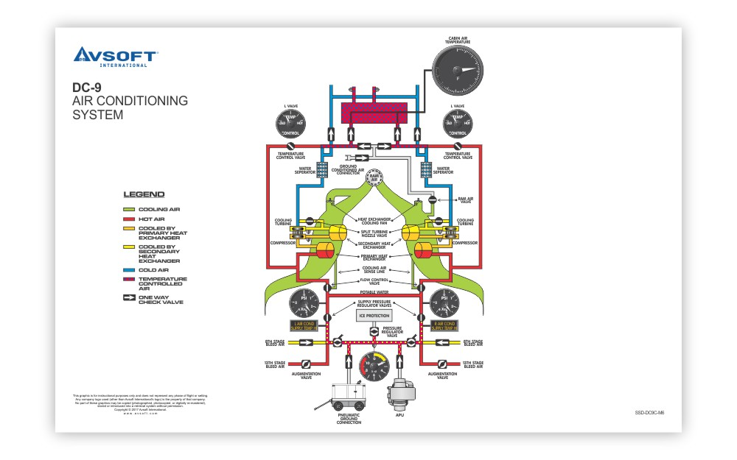

Slide 6
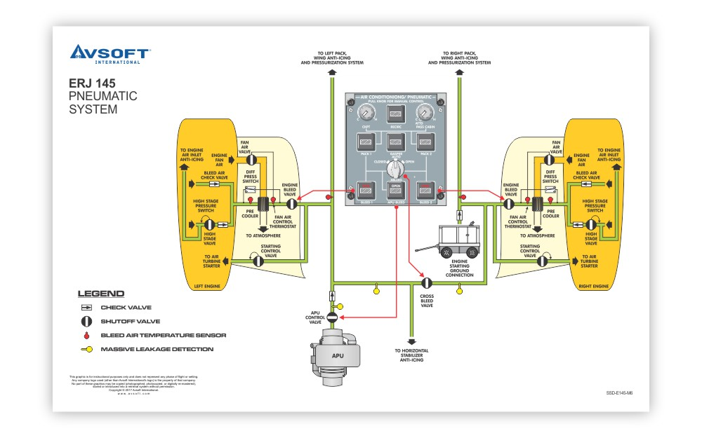

Slide 7
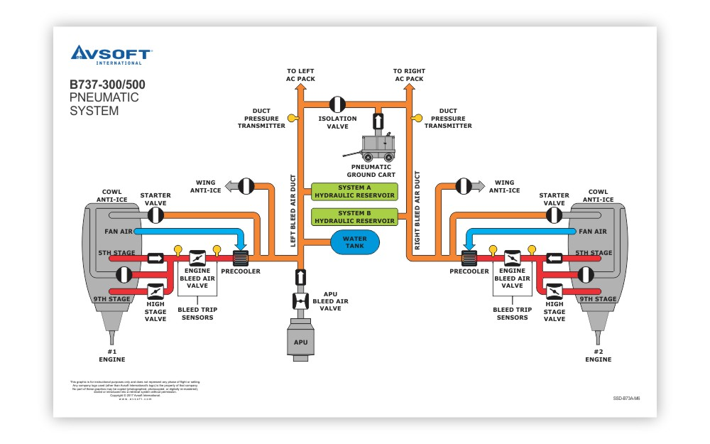
https://www.avsoft.com/product/boeing-b737-300-500-system-diagrams/

Slide 8
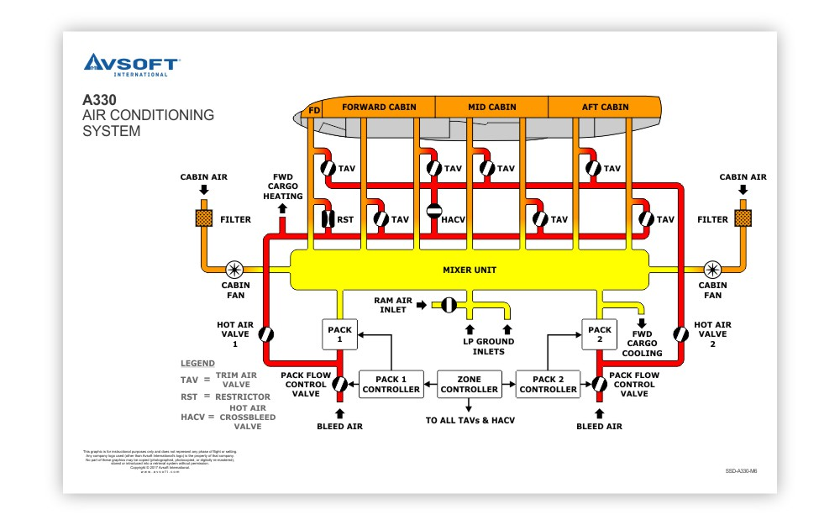
https://www.avsoft.com/product/airbus-a330-system-diagrams/

Slide 9
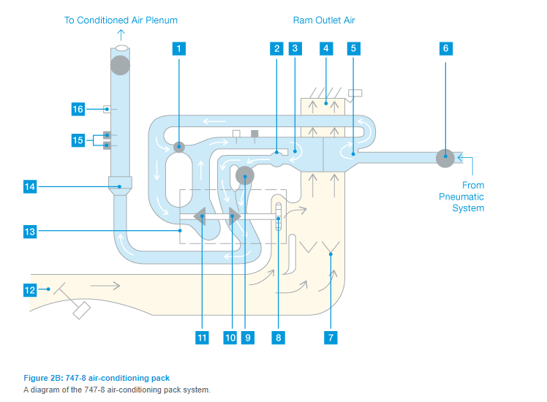
https://www.boeing.com/commercial/aeromagazine/articles/2012_q1/4/

Slide 10
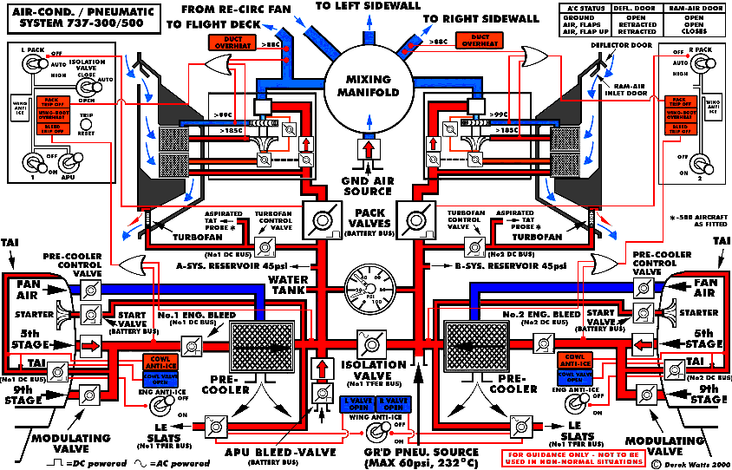
http://www.b737.org.uk/pneumatics.htm

Slide 11
https://www.ncbi.nlm.nih.gov/books/NBK219009/
https://www.duncanaviation.aero/news/duncan-aviation-offering-an-air-purification-upgrade
http://www.smartcockpit.com/docs/Dash8-200-300-Air_Cond_and_Press.pdf
https://imgur.com/gallery/GglKA

